Slide 1
Category 14 Agricultural Fertilizer Certification Training
Fred Whitford – Jim Camberato

Slide 2
Fertilizer and manure provide Essential crop nutrients
Macronutrients
  Nitrogen (N), phosphorus (P), potassium (K)
    Most likely to be deficient, most frequently added to soils
Secondary nutrients
  Calcium (Ca), magnesium (Mg), sulfur (S)
Micronutrients
  Iron (Fe), manganese (Mn), zinc (Zn), copper (Cu), chlorine (Cl), boron (B), molybdenum (Mo), nickel (Ni)

Slide 3
Environmental concerns related to crop nutrients
Nitrogen (N)
  ammonium and nitrate in surface waters cause eutrophication and increase the cost of water treatment
  ammonia is toxic to aquatic life
  nitrate in drinking water is toxic to infants and young animals
  ammonia and greenhouse gas emissions in the atmosphere cause breathing hazards and global warming

Slide 4
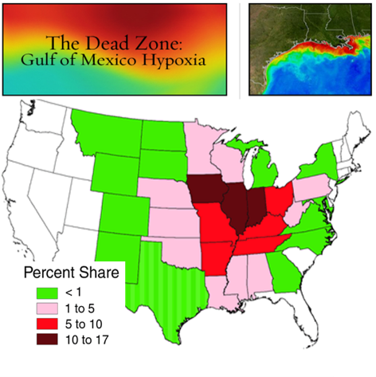
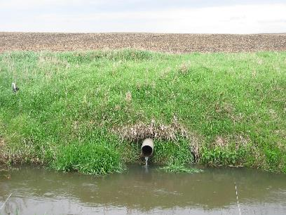
Nitrogen impacts water beyond Indiana
Tile drainage
Runoff
Seepage
Notes:
10% to Indiana, almost 40% IL, IA, and IN

Slide 5
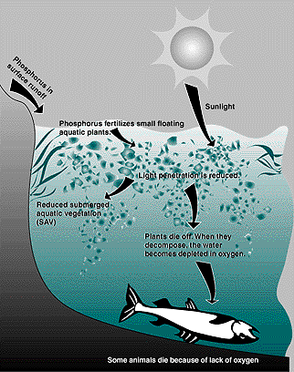
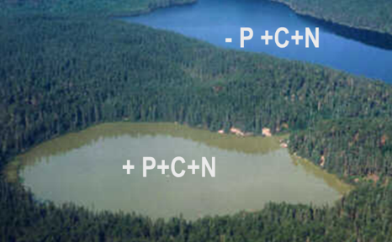
Environmental concerns related to Phosphorus
Bioavailable phosphorus (P) in surface fresh water may cause eutrophication
Image taken from the NSTA website: http://www.agnr.umd.edu/users/agron/nutrient/Factshee/Phosphorus/Eutrop.html

Slide 6
Eutrophication
Rapid eutrophication is the increased algal growth associated with N and/or P enrichment of surface water
Excess algal growth causes death of submerged vegetation resulting in low dissolved oxygen in the water
Low oxygen may result in fish kills, odor, reduced utility of the water for recreation and other uses
Image taken from the NSTA website: http://www.agnr.umd.edu/users/agron/nutrient/Factshee/Phosphorus/Eutrop.html

Slide 7
Pathways for Nutrient loss from farm fields
Erosion
  Loss of nutrients attached to soil particles or fertilizers (water or wind)
Runoff
  Loss of nutrients dissolved in water
Leaching
  Downward movement of nutrients through soil profile below the root zone and into tile drains or the water table

Slide 8
Soil properties affecting nutrient loss
Cation exchange capacity (CEC)
Soil organic matter
Soil texture

Slide 9
Cation Exchange Capacity
Cl⁻
CHLORIDE

Slide 10
Ammonium less likely to be lEACHED from the soil than nitrate
Ammonium (NH₄⁺)
Nitrate (NO₃⁻)
+
-
+
+
- - - - - - - - - - - -
Immobile
- - - - - - - - - - - -
Mobile
+
- - - - - - - - - - - -
- - - - - - - - - - - -
+
- - - - - - - - - - - -
- - - - - - - - - - - -
+
+
- - - - - - - -
- - - - - - - -
-
-
-
-
-
-
Ammonium is often referred to as the “stable” form of N because it is attracted to the cation exchange capacity

Slide 11
Soil Organic Matter
Concentrated in the topsoil improves a soil’s capacity for holding water and nutrients (increased cation exchange capacity)
Shallow topsoil and high water table increase potential for groundwater contamination

Slide 12
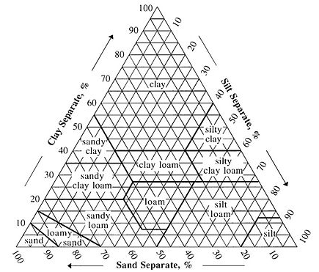
Soil texture
Relative proportion of soil size separates:
Sand
  (2.00 – 0.02 mm)
Silt
  (0.02 - 0.002 mm)
Clay
  (<0.002 mm)
http://en.wikipedia.org/wiki/File:SoilTextureTriangle.jpg
Some believe that the ideal soil contains equal portions of sand, silt, clay and organic matter

Slide 13

Soil Texture
Soils with more clay have higher cation exchange and moisture holding capacity than sandy soils
  losses by leaching are lower than in sandy soils but runoff and erosion losses are higher

Slide 14
Factors affecting runoff/Erosion
Soil type, slope of land, residue cover
Rainfall intensity and duration
  Increased rainfall intensity increases runoff and erosion while reducing leaching (less water moves through the soil profile
Soil moisture at the time of application
  Application to saturated soil increases potential for runoff

Slide 15
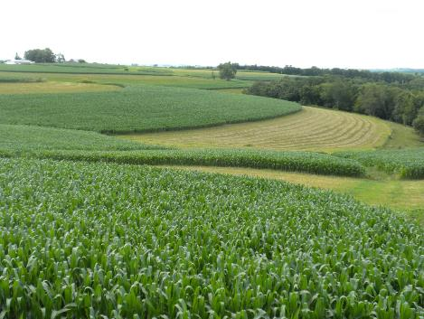
Factors affecting runoff/Erosion
Presence of conservation practices
  Contour plantings, grass waterways, filter strips, etc.
Distance to ditches or surface water

Slide 16
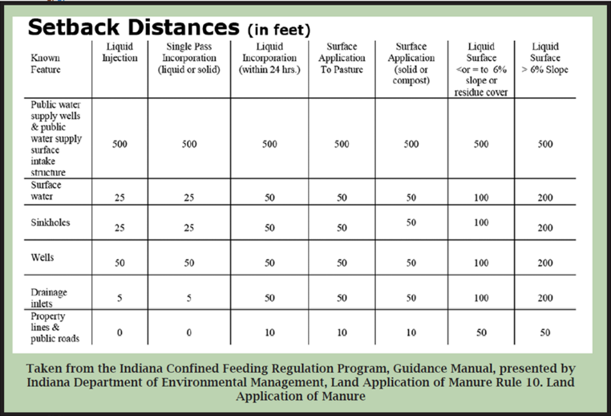
Setbacks are used to protect property and water

Slide 17
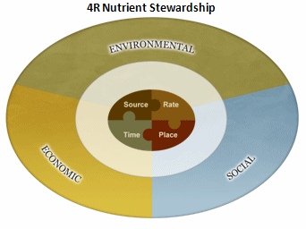
Components of an environmentally sound fertilizer material plan
Best Management Practices or 4R Nutrient Stewardship
Right rate, timing, placement and nutrient source for the crop to be grown

Slide 18
Right Rate
Consider the plant demand for nutrients and the soil nutrient supply
Account for all sources of nutrients (manure + fertilizer + previous legume crop)
Phillips et al., 2009, IPNI

Slide 19
Right Timing
Apply nutrients when they are needed by the crop and when soil and weather conditions are least like to cause loss
Stewart et al., 2009, IPNI

Slide 20
Consider Weather and soil conditions when making applications
Fertilizers should not be applied to:
  saturated soils
  immediately after heavy precipitation
  to frozen soils
Manure “must not be applied to frozen or snow-covered ground without residue protection, or cover crop, with slopes in excess of two percent (2%)”
Do not apply fertilizer or manure to the soil surface if heavy precipitation is imminent

Slide 21
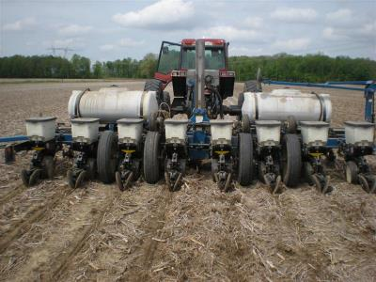
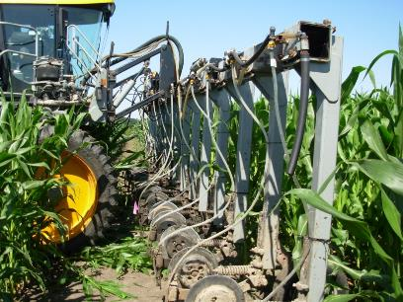
Right Placement
Apply nutrients where they are best utilized by the crop and where they are least subject to loss
Murrell et al., 2009, IPNI

Slide 22
Fertilizer applications - Injection
Injection:
  Allows fertilizer to be applied close to the young crop plant to increase root uptake
  Reduces P and K fixation by limiting exposure of these nutrients to the soil where they can be made unavailable by reaction with the soil
  Reduces NH₃ volatilization and odor

Slide 23
Fertilizer applications - broadcast
Goal of fertilizer application is to apply the intended rate uniformly to the field
Broadcast on soil surface with a spinner spreader (fertilizer at least 100 pounds per acre to allow equipment to operate accurately)
Incorporation of broadcast fertilizer and manure reduces potential runoff and NH₃ volatilization as well as odor

Slide 24
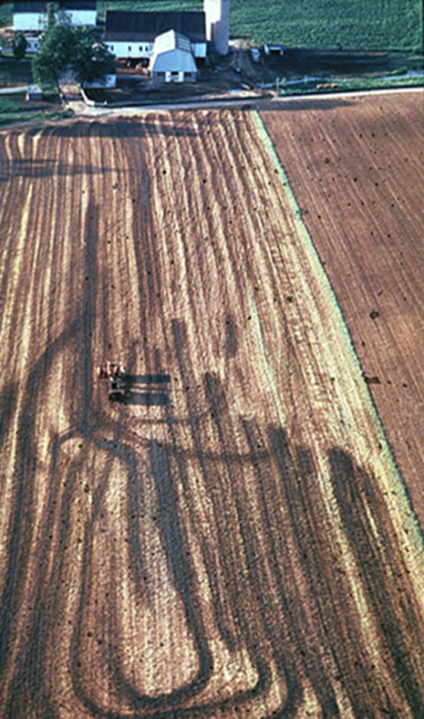
Manure is hard to spread uniformly
Keep your equipment in good working order
Calibrate the applicator and
spread uniformly

Slide 25
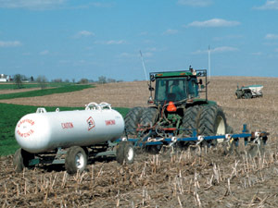
Right Source
Use the fertilizer material that results in the least loss given the rate, timing, and placement chosen
Mikkelsen et al., 2009, IPNI

Slide 26
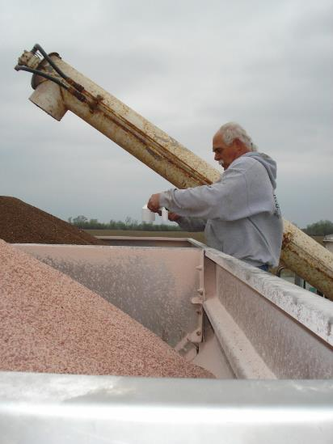
Calibration Math
10 out of 70 questions
Check calculator

Slide 27
Understanding Percentages
Multiplying by Percentage
150 x 50%, 20%, 5%
Divide percent by 100
150 x .50…. .20…… .05
Numbers get smaller or larger?
What Happens When You
Divide by the Number? 150 divided by .50

Slide 28
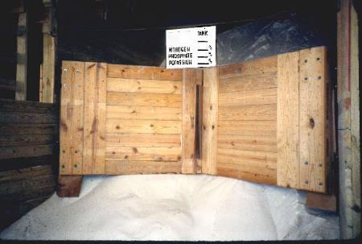
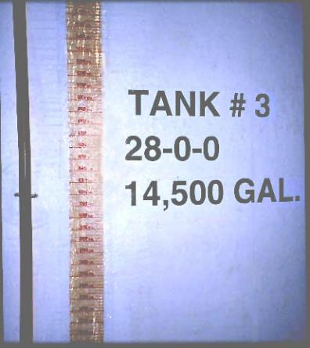
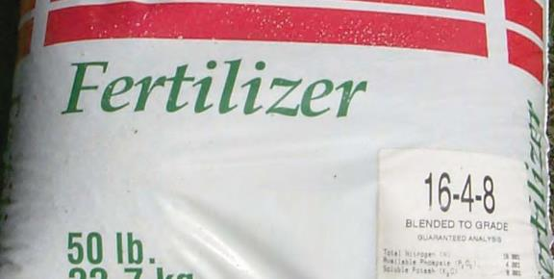
What do the numbers stand for?

Slide 29
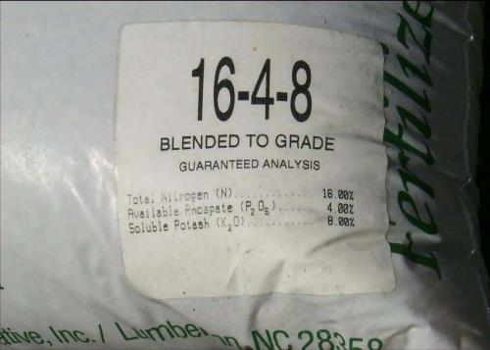
50 pound fertilizer bag
What is the percentage of nitrogen, phosphorus, and potassium in the bag?
How many pounds of N, P₂O₅, and K₂O are in the 50 pound bag?
.16 nitrogen per pound x 50 pounds = 8 pounds N
.04 phosphorus per pound x 50 pounds = 2 pounds P₂0₅
.08 potassium per pound x 50 pounds = 4 pounds K₂0

Slide 30
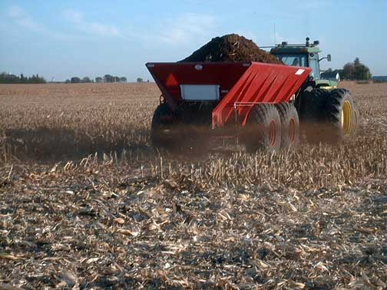
How many pounds of nitrogen are provided when solid fertilizer (30-46-0) are applied at 150 pounds per acre?
Is the number going to be smaller or bigger than the 150?
150 pounds of .30 pounds of nitrogen
product per acre x per pound of product =
45 pounds of nitrogen per acre when delivering 150 pounds of product

Slide 31
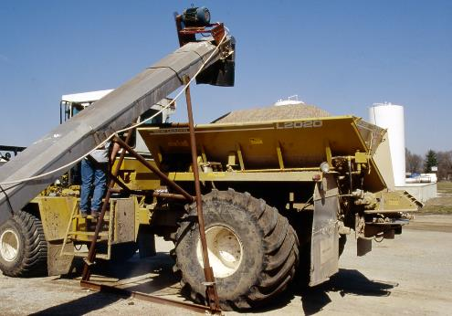
How many pounds of product are needed to provide 150 pounds of nitrogen per acre? The product is blended as 28-10-15.
Is the number going to be bigger or smaller than the 150?
150 pounds of nitrogen needed = 535.7 pounds of product
.28 is the blend of nitrogen to get me 150 pounds of
nitrogen

Slide 32
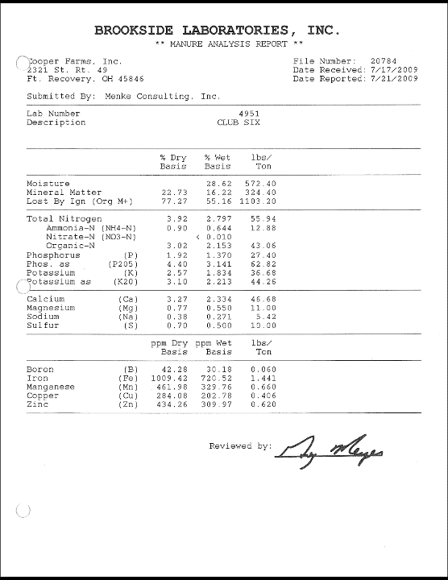

Slide 33

An agronomic producer obtains 60 tons of turkey litter with an analysis of 62.82 lbs./ton. If all of the material is applied to 40 acres, what is the application rate per acre for P205?
62.82 lbs./ton x 60 tons = 3769 pounds of P
3769 pounds of P = 94 pounds per acre
40 acres

Slide 34
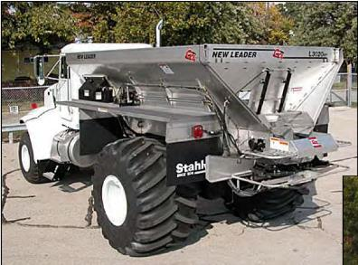
How many tons of granular fertilizer (28% nitrogen) are needed to treat a 150-acre field at a rate of 80 pounds of nitrogen per acre? 2,000 pounds = 1 ton
Is the number of pounds larger or smaller?
80 pounds of N = 285.7 pounds of product per acre
.28 N per pound
285.7 pounds x 150 acres to treat = 42,855 total pounds
42,855 pounds needed /2,000 pounds per ton = 21.4 tons

Slide 35
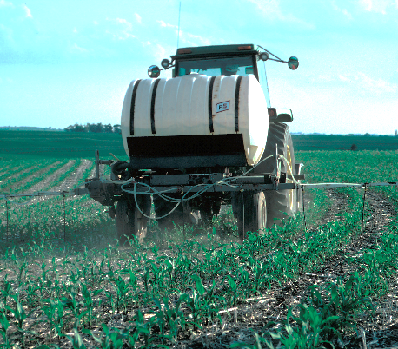
How many pounds of nitrogen (28-0-0) is in one gallon of liquid? One gallon weighs 11 pounds.
.28 pounds of N per gallon x 11 pounds per gallon
= 3.08 pounds of nitrogen

Slide 36
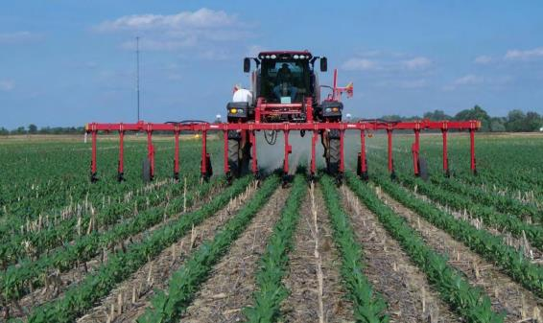
How many square feet in a piece of ground 2,000 x 3,000 feet? How many acres does this represent?
Square feet is L x W
2,000 x 3,000 = 6,000,000 square feet
1 acre = 43,560 square feet
6,000,000 divided by 43,560 = 137.7 acres

Slide 37
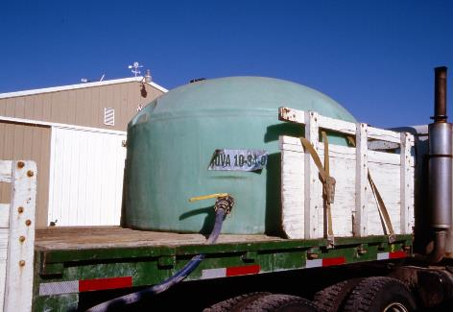
You put out 175 gallons to a field 80 long x 1,500 feet wide. What is the application rate in gallons per acre? 1 acre = 43,560 square feet.
80 x 1500 = 120,000 square feet
120,000 / 43,560 = 2.75 acres
175 gallons / 2.75 acres = 63.6 gallons per acre

Slide 38
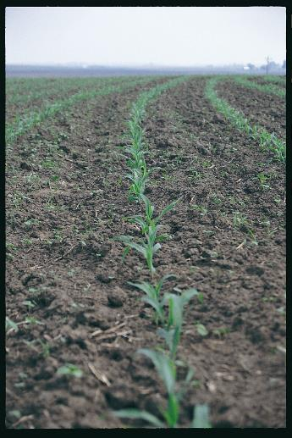
A 1200-gallon tank is calibrated to apply 20 gallons per acre. How many acres will a full tank cover?
1200 gallons / 20 gallons per acre = 60 acres

Slide 39
A spreader has a 5-ton hopper calibrated to apply 2000 pounds per acre. How many acres can be treated with a full load? 1 ton = 2,000 pounds
5 tons x 2,000 pounds = 10,000 total pounds in the hopper
10,000 pounds divided 2,000 pounds per acre = 5 acres or
1 ton does 1 acre so 5 tons does 5 acres

Slide 40
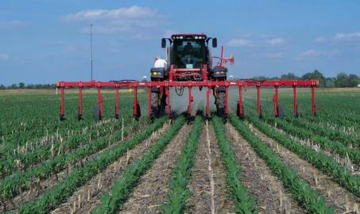
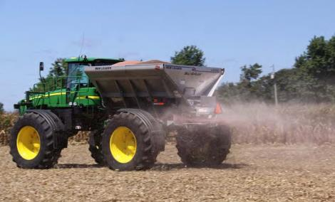
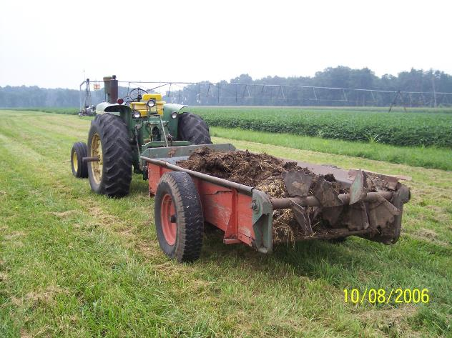
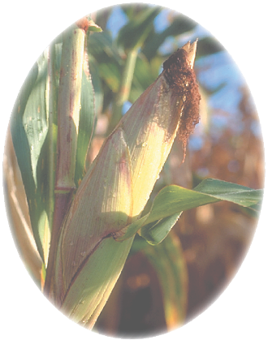

Slide 41
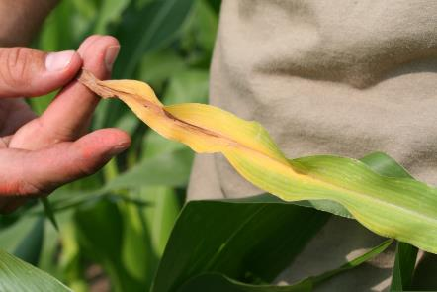
Nitrogen use by plants
Usually element of greatest amount taken up from the soil
  Amino acids assembled to form proteins, both structural and functional (enzymes)
  Component of chlorophyll
Speeds plant growth
Increases seed production
Improves quality of leaf and forage crops

Slide 42
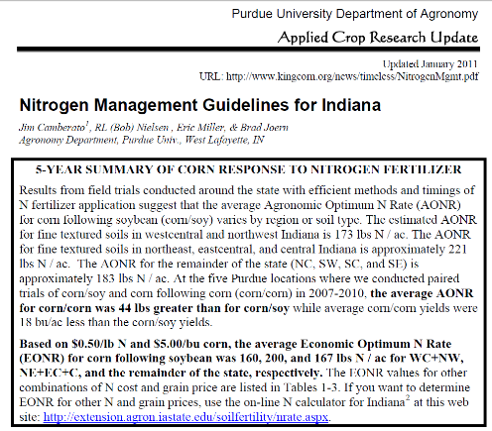
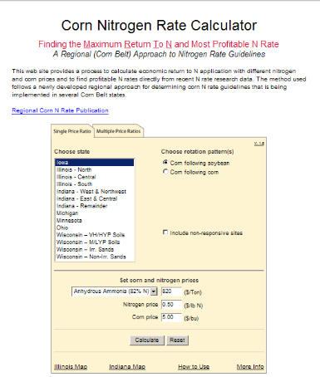
Nitrogen recommendations CAN BE obtained from Purdue univ.
http://extension.agron.iastate.edu/soilfertility/nrate.aspx
http://www.agry.purdue.edu/ext/corn/news/timeless/NitrogenMgmt.pdf

Slide 43
The Nitrogen Cycle
Component
Input to soil
Loss from soil
Atmospheric
nitrogen
Atmospheric
fixation
and deposition
Crop
harvest
Industrial fixation
(commercial fertilizers)
Animal
manures
and biosolids
Volatilization
Plant
residues
Runoff and
erosion
Biological
fixation by
legume plants
Plant
uptake
Denitrification
Organic
nitrogen
Nitrate
(NO₃)
Ammonium
(NH₄)
⁻
Immobilization
⁺
Leaching
Mineralization
Drawing from: Intl. Plant Nutr. Institute

Slide 44
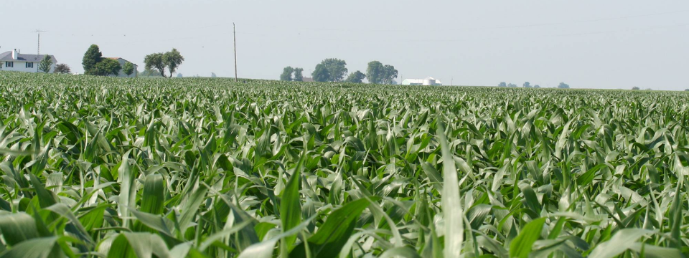
Nitrogen cycle
Under the best conditions only 60-70% of the N fertilizer added to the soil is used by the crop, much less when manure is the source of N

Slide 45
Common forms of nitrogen and their chemical symbols
Ammonium-N (NH₄⁺, NH₄-N)
Ammonia-N (NH₃-N)
Nitrate-N (NO₃⁻, NO₃-N)
Urea-N [CO(NH₂)₂]
Plants take up NH₄-N and NO₃-N through the roots
inorganic or mineral forms of N

Slide 46
Organic nitrogen
Organic-N refers to N bound to C as a result of biological activity
Organic-N must be ‘mineralized’ to NH₄-N to become plant available (microorganisms)

Slide 47
Organic Nitrogen reactions
Mineralization – conversion of organic-N to inorganic-N by microorganisms
  Soil, residue, manure, and biosolids organic-N become available to the crop because of this reaction
Immobilization – reverse of mineralization, inorganic-N becomes organic-N by microbial activity
  N deficiency because N unavailable to the crop

Slide 48
Ammonium Nitrogen reaction
Nitrification – conversion of NH₄-N to NO₃-N by bacteria
NH₄⁺
NO₂⁻
NO₃⁻
Nitrosomonas
Nitrobacter
Ammonium
Nitrite
Nitrate

Slide 49
Ammonium less likely to be lost from the soil than nitrate
Ammonium (NH₄⁺)
Nitrate (NO₃⁻)
+
-
+
+
- - - - - - - - - - - -
Immobile
- - - - - - - - - - - -
+
- - - - - - - - - - - -
- - - - - - - - - - - -
+
- - - - - - - - - - - -
- - - - - - - - - - - -
+
+
- - - - - - - -
- - - - - - - -
-
-
-
-
-
-
Leaching

Slide 50
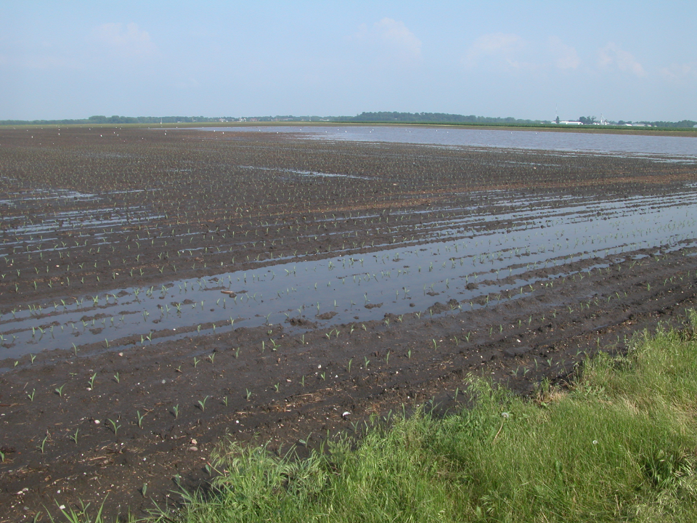
Denitrification
Bacterial conversion of nitrate N to gaseous forms of N that may be lost to the atmosphere
NO₃⁻ → NO₂⁻ → NO → N₂O → N₂
Occurs in waterlogged soils (low oxygen) and with an available source of carbon for the microbes

Slide 51
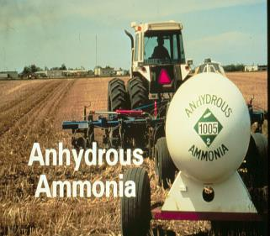
Anhydrous ammonia
82 – 0 – 0
Liquid under pressure that turns into a gas when applied to the soil
Slowest of common commercial N fertilizers to convert to nitrate-N, therefore least likely to be lost via leaching and denitrification
Fertilizer of choice for early winter application especially with a nitrification inhibitor (although N loss may still occur in the spring)

Slide 52
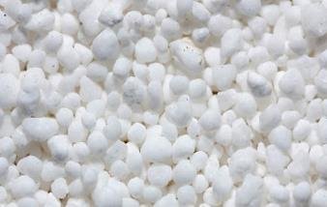
Urea
46 – 0 – 0
Often applied as a granular but also a component of liquid N (urea-ammonium nitrate) and foliar fertilizers
Ammonia volatilization is a concern with surface-applied urea especially in no-till
Rapid conversion to ammonium and then nitrate with warm conditions
Urea is leachable and significant losses can occur with high rainfall shortly after application

Slide 53
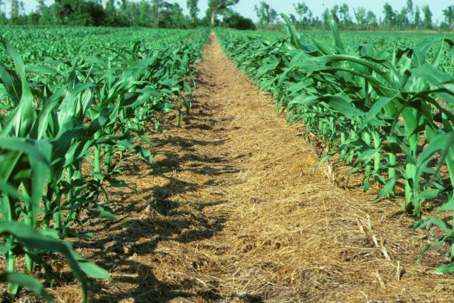
Urea hydrolysis
NH₃
Ammonia-N
NH₃
Ammonium-N
NH₄⁺
Urea-N
Urease
enzymes
Soil
solution
Urease inhibitor delays hydrolysis

Slide 54
Ammonium nitrate
34 – 0 – 0
Not widely available in granular form due to explosiveness
Component of liquid N (urea-ammonium nitrate)
50% NH₄-N and 50% NO₃-N
Rapid conversion of NH₄-N to NO₃-N with warm conditions and 50% NO₃-N at application result in high potential for leaching and denitrification

Slide 55
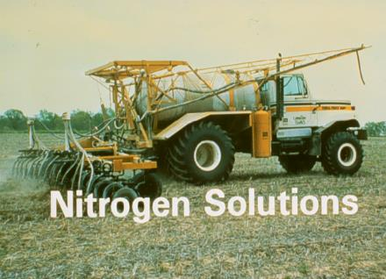
Nitrogen solutions
28 – 0 – 0 (up to 32 – 0 – 0)
Two components are urea and ammonium nitrate with ½ the N from each source (50% urea-N, 25% NH₄-N, and 25% NO₃-N)
Both NH₃ volatilization and NO₃-N leaching are concerns

Slide 56
Nitrification inhibitors
Nitrification inhibitors are chemicals that can be added to fertilizer or manure that delay and slow down conversion of NH₄-N to NO₃-N
  Nitrapyrin (N-Serve, Instinct)
  Dicyandiamide (SuperU, Agrotain Plus)
NH₄⁺
NO₂⁻
NO₃⁻
Nitrosomonas
Nitrobacter
Ammonium
Nitrite
Nitrate

Slide 57
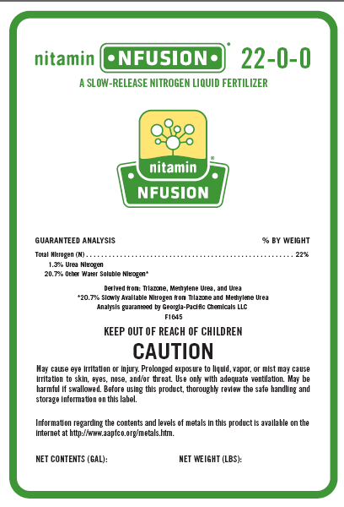
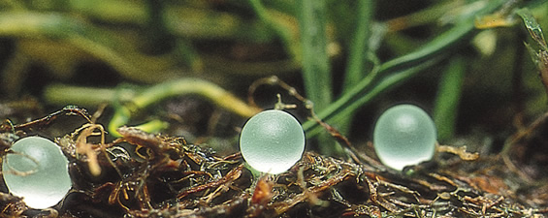
Control release N fertilizers
Polymer coated, or insoluble fertilizer sources that release N slowly over a period of time matching the crop N requirement

Slide 58
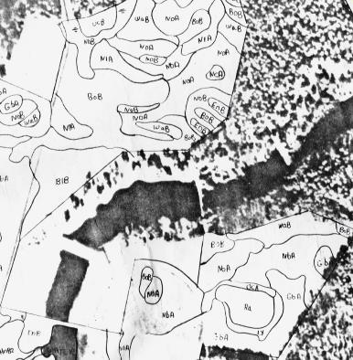
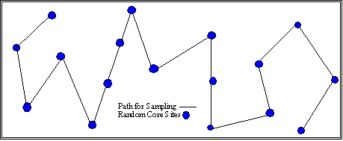
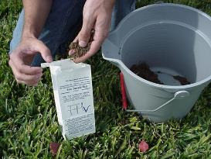
Phosphorus and potassium fertilizer rec. Soil Test Based

Slide 59
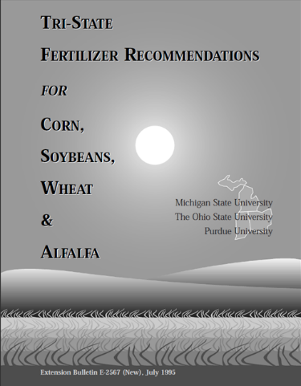
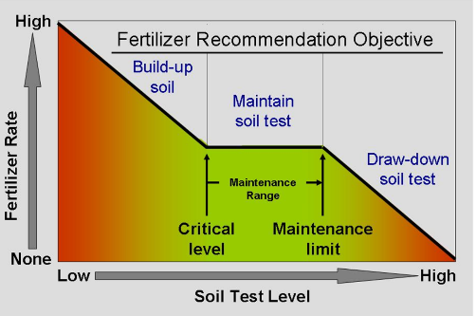
Phosphorus and Potassium recommendations
Rec’s can be obtained from Purdue Univ.
http://www.ces.purdue.edu/extmedia/AY/AY-9-32.pdf

Slide 60
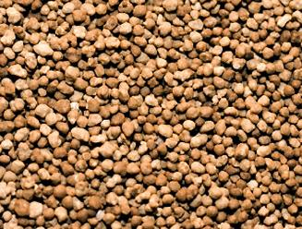
Phosphorus fertilizers
Multi-nutrient fertilizers (N and P)
  monoammonium phosphate (11-52-0)
  diammonium phosphate (18-46-0)
  ammonium polyphosphate (10-34-0)
These are water soluble P fertilizers that readily dissolve in soil and release P and NH₄-N
The NH₄-N rapidly converts to NO₃-N which is subject to leaching/denitrification
When these fertilizers are applied in the winter to frozen ground, both P and N can be lost in runoff
Photo: The Fertilizer Institute

Slide 61
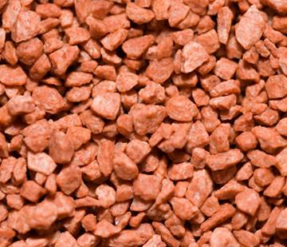
Potassium fertilizers
0-0-60 (up to 0-0-62) is the predominant source of K
referred to as potash, muriate of potash, K-C-L
  red, pink, or white dependent on ore processing and amount of contaminant iron
Photo: The Fertilizer Institute
Fertilizer and crop residue K are water soluble and easily available to crops

Slide 62
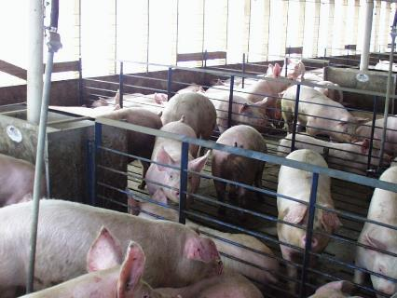
Manure nutrients
Manure contains N, P, and K as well as all other essential plant nutrients
Manure nutrient content is dependent on animal type, bedding, ration, housing, manure collection and handling, season, etc.
Manure nutrient availability is dependent on all these factors plus application method and timing, crop, and weather

Slide 63
Using Manure as a
Crop Nutrient Source
The requirements for using manure efficiently are no different than those of commercial fertilizer
  Know the nutrient content and availability of the manure
  Know the nutrient status of the soil and requirement of the crop to be grown
  Apply uniformly at the correct rate and in a timely fashion

Slide 64
Using Manure as a
Crop Nutrient Source
Eliminate, reduce, or supplement with other nutrient sources
Incorporate to reduce nutrient loss and nuisance factors
Utilize conservation practices to protect water and land resources

Slide 65
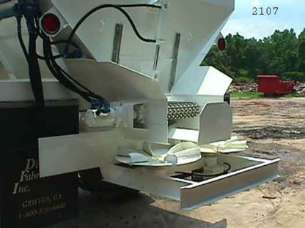
Know the Nutrient Content of the Manure
A representative sample and nutrient analysis is needed to plan applications
Request at least N, P, and K and an estimate of N availability

Slide 66
Manure nitrogen
Manures typically contain N in the uric acid/urea, NH₃-N, NH₄-N and organic-N forms
Manure composition may range from mostly NH₄-N (in liquid fraction) to mostly organic-N (in solid fraction)
The inorganic N forms in manure when applied to the soil react like the same forms in fertilizer

Slide 67
Available Nitrogen Content of Manure
Available N is determined from:
  Organic-N and NH₄-N content of the manure
Estimated mineralization of organic-N to NH₄-N
  type of manure (more bedding less N release), season
  some calculations estimate organic-N mineralization into the 2nd or more seasons after application

Slide 68
Plant Available Nitrogen Content of Manure
Estimated loss of NH₄-N to the air
  NH₄-N/ NH₃-N content, application method, time of year
Losses of N related to timing of application and time of the year

Slide 69
Indiana estimate of Nitrogen availability
Adjusts availability based on:
  Liquid, solid (poultry or other), or irrigated
  Ammonium and organic N
  Injected, incorporated or unicorporated
  Northern or southern Indiana, month of the year

Slide 70
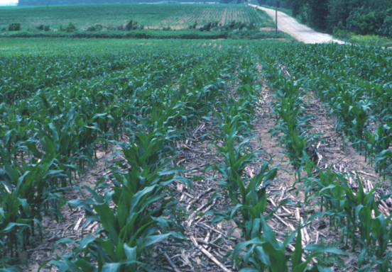


PreSidedress soil nitrate test can be used to improve N management
Use the PSNT when N availability is uncertain
http://www.agry.purdue.edu/ext/pubs/AY-314-W.pdf

Slide 71
Manure phosphorus
Manures contain both organic and inorganic P
Organic P must be mineralized to be plant available
Inorganic P sources must dissolve to become available
Availability of P in manure is usually estimated to be similar to commercial fertilizer sources of P

Slide 72
Manure phosphorus
Typically manures have more P than needed when manures are used to supply most of the crop requirement for N then 3 to 5 times more P than is needed may be added to the soil
To avoid overloading P on soils use manure at lower rates and supplement with N or apply manure every 2 or 3 years

Slide 73


CROP REMOVAL OF P₂O₅ IS OFTEN MUCH LESS THAN IS APPLIED IN MANURE

Slide 74
Factors affecting Phosphorus in Runoff and Erosion
Phosphorus Amount Subject to Loss
Soil P level of soil surface 1-2”
Amount of manure- or fertilizer-P on the soil surface
Likelihood of Transport from the Field to Water
Soil type, slope of land, residue cover
Rainfall intensity and duration
Distance to water
Presence of conservation practices

Slide 75
Manure Potassium
K in manures remains water soluble and is easily returned to the soil
Availability of manure K is considered equivalent to fertilizer K
Manure K is not known to cause any environmental issues

Slide 76
Rules and Regulating
Common Sense

Slide 77
Two Agencies to Know
Indiana Department of Environmental Management
  CFO/CAFO Plans
  All Spills
Office of Indiana State Chemist
  Certification
  Supervise up to 10 people with training
  Fertilizer and pesticide Bulk Storage

Slide 78

Notes:
Whether it’s livestock or poultry or other animals producers are concerned about pathogens.

Slide 79

Biosecurity, Pathogens, Infectious Diseases
Notes:
A pathogen in this case are organisms that can spread diseases. When animals are confined, disease can spread rapidly. If you are buying manure from a CFO you will likely be restricted to a specific area of the operation for pick-up. Most of the property will be off-limits.

Slide 80

Notes:
The Office of Indiana State Chemist regulates bulk storage of fertilizers. Bulk storage is defined by OISC as any quantity of fertilizer over 7500 gallons or a single tank larger than 2500 gallons. If these thresholds are exceeded, the fertilizer tanks require containment.
Would 3,250 gallons tanks require containment?

Slide 81

Notes:
Containment can be liners held in place with wooden berm.

Slide 82

Notes:
Liners surrounded by gravel.

Slide 83

Notes:
Or tanks within a concrete wall.

Slide 84

Notes:
All bulk fertilizer tanks need to be identified with its contents (e.g. 28-0-0)

Slide 85

Locked site gauge
Notes:
Site gauge needs to be locked.

Slide 86

Notes:
The number one enemy of poly tanks is sunlight.
Be sure to periodically check tanks for ultraviolet degradation.

Slide 87

12 tons undivided
Notes:
Bulk storage of dry fertilizers start at undivided quantities about 12 tons. Above this threshold a roof and walls are required.

Slide 88

72 hours without cover
Flat ground vs. slope
Runoff and fish kills
300 feet from surface water, drainage inlets (risers in field) or water wells
Cannot place in standing water, a waterway or floodway
Notes:
Manure can be piled uncovered in the field for up to 72 hours. Be sure to store the materials where they will not reach creeks or other waters.

Slide 89
72 hours without cover
After 3 days,
manure: cover or berm up to 90 days
fertilizer: cover up to 30 days or move to building
Notes:
After 72 hours the manure or fertilizer in the field needs to be covered.

Slide 90
Manure (Organic) Staging Restrictions
100 feet from property line or public road.
400 feet from residential buildings.
Manure cannot be staged on the side of a hill.
Applied within 90 days.
Notes:
Restrictions of Staging Manure.
Residential buildings where other people (not self) live.

Slide 91
Notes:
Do not store manure or commercial fertilizer in a waterway. Not only are most of these grass strips close to water, but storing there will circumvent the grass from filtering water as it runs across and through the fertilizer.

Slide 92

Notes:
Whether it’s a commercial blend . . .

Slide 93

Application Conditions
Site Awareness
Being a Good Neighbor
Notes:
. . . or manure, the applicator needs to think about the site. You might have to adjust the application to keep the materials out of water.

Slide 94

Notes:
How can you explain applying manure on frozen ground from an agronomic perspective?
You cant.
When the top layer thaws and you get some rain the material will flow with the water.

Slide 95

In field or collect
Level ground
Stable ground
Notes:
The best place to wash equipment is in the field.

Slide 96

Notes:
Anhydrous ammonia has an affinity for water. Make sure skin is protected. Goggles should be unvented to prevent anhydrous ammonia from interacting with the eyes.

Slide 97

Notes:
A seemingly harmless tractor-spreader combination.

Slide 98

Notes:
Putting farm equipment on the road can be dangerous.

Slide 99

Notes:
Putting farm equipment on the road can be dangerous.

Slide 100

Notes:
What is wrong with this photograph?
There is no slow moving vehicle sign. The SMV triangle informs the pubic that you are moving slower than normal.

Slide 101

Notes:
Examples of SMV signs on equipment.

Slide 102

Notes:
Make sure that the SMV card can be seen.

Slide 103

Visible to traffic
Traffic patterns
Rush hours, bus routes
Know where you are going
Visibility
Notes:
It goes without saying that there are times that our slower tractors and pulled implements should not be on the road.

Slide 104
Notes:
Growers are required to follow the weight limits imposed by county-assigned frost laws.

Slide 105
Notes:
Growers are also required to follow posted weight limits on bridges.

Slide 106

Notes:
The oversize permit is obtained from the Motor Carrier Service, Division of Department of Revenue.

Slide 107

Plan for Spill
Stop the leak
Dike up the area
Clean up
Call IDEM

Slide 108
In case of release:
Remove people from area
Call local authorities
Add water
PPE

Slide 109
In Review:
Which agency controls manure management plans and spills?
Which agency controls Cat. 14 certification?
Which agency controls nonmanure fertilizer bulk storage?
What is the number of uncertified employees a Cat. 14 can supervise?
Who is the agency that provides heavy load permits?
Describe OISC’s diking requirements?
How long can manure and fertilizer stay in a pile unprotected?
What is the best place to stage manure or fertilizer?

Slide 110
In Review:
What are areas to be concerned with when making fertilizer applications?
What is the best place to apply fertilizer equipment wash water?
What are some of the on the road concerns?
What do you do in the event of a spill with fertilizer, manure, and anhydrous ammonia?

Slide 111



