Slide 1
Understanding the Revised Worker Protection Standard
What Ag employers and others need to know

Slide 2
Overview only
This presentation is an overview only and does not fully address all the requirements of the Worker Protection Standard (WPS).
Details on total compliance can be found in US EPA’s How to Comply Manual which can be downloaded free from the EPA website and the Pesticide Education Resources Website:
https://pesticideresources.org/

Slide 3
The WPS applies to…
Farms
Production forestry
Sod farms
Orchards
Christmas trees
Nurseries/greenhouses
Rangeland where forage is harvested (growing plants)
Organic pesticides
Restricted-use pesticides
General-use pesticides
Herbicides
Fungicides
Insecticides
etc.

Slide 4
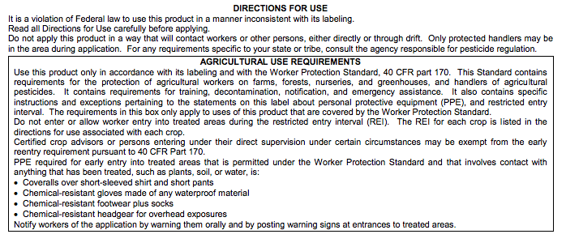
When Does the WPS Apply?
Agricultural establishments where ag pesticides are used

Slide 5
Does NOT apply to:
Ag-use pesticides used on non-agricultural plants
Ag-use pesticides that are attractants or repellents in traps
Ag-use pesticides that are used post-harvest
Pasture/rangeland where forage will not be harvested
Ag-use pesticides that are used to protect structures, livestock, or weeds in non-crop areas.
Notes:
Some pesticides are labeled for Ag uses as well as non-ag uses. Such as, a herbicide that is for weed control in crops, might also be labeled for use on residential turf.
The residential turf use does not require WPS compliance.
Pesticides that are used post harvest, such a grain bin insecticides are also exempt from the WPS requirements.

Slide 6
Who does the WPS protect?
Workers (in treated area within 30 days of app)
Weeding
Harvesting
Watering
Handlers – mixing, loading or applying

Slide 7
Who is responsible for compliance?
The agricultural employer
Not the certified applicator

Slide 8
Who is a ‘worker’?
Any person, including a self-employed person, who is employed and performs activities directly relating to the production of agricultural plants on an agricultural establishment.
A person is a “worker” under the WPS if they work in areas that were treated with a WPS-labeled pesticide within the last 30 days, or where a restricted-entry interval was in effect in the last 30 days
Notes:
Someone who has been in a treated area and generally performing a hand labor task.

Slide 9
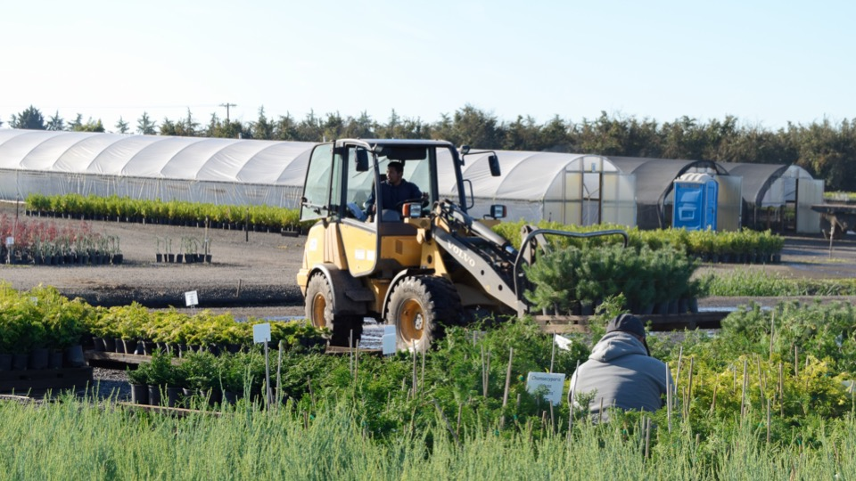
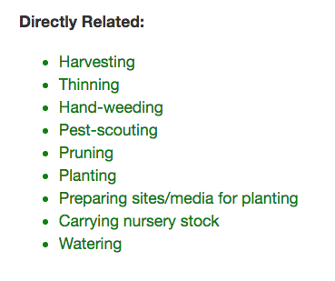

Slide 10
Who is a ‘handler’?
Mixing, loading, helping to apply, or applying pesticides
Disposing of pesticides
Handling open containers of pesticides
Cleaning, adjusting, handling, or repairing equipment that may have pesticide residues

Slide 11
Who is a ‘handler’?
Anyone who enters an enclosed space after it was treated and before ventilation criteria have been met
Entering a treated area outdoors after application of a soil fumigant before aeration
Performing tasks as a crop advisor during a pesticide application or REI

Slide 12
Does the WPS apply to workers in your farm stand?
Notes:
No. The produce has been harvested.

Slide 13
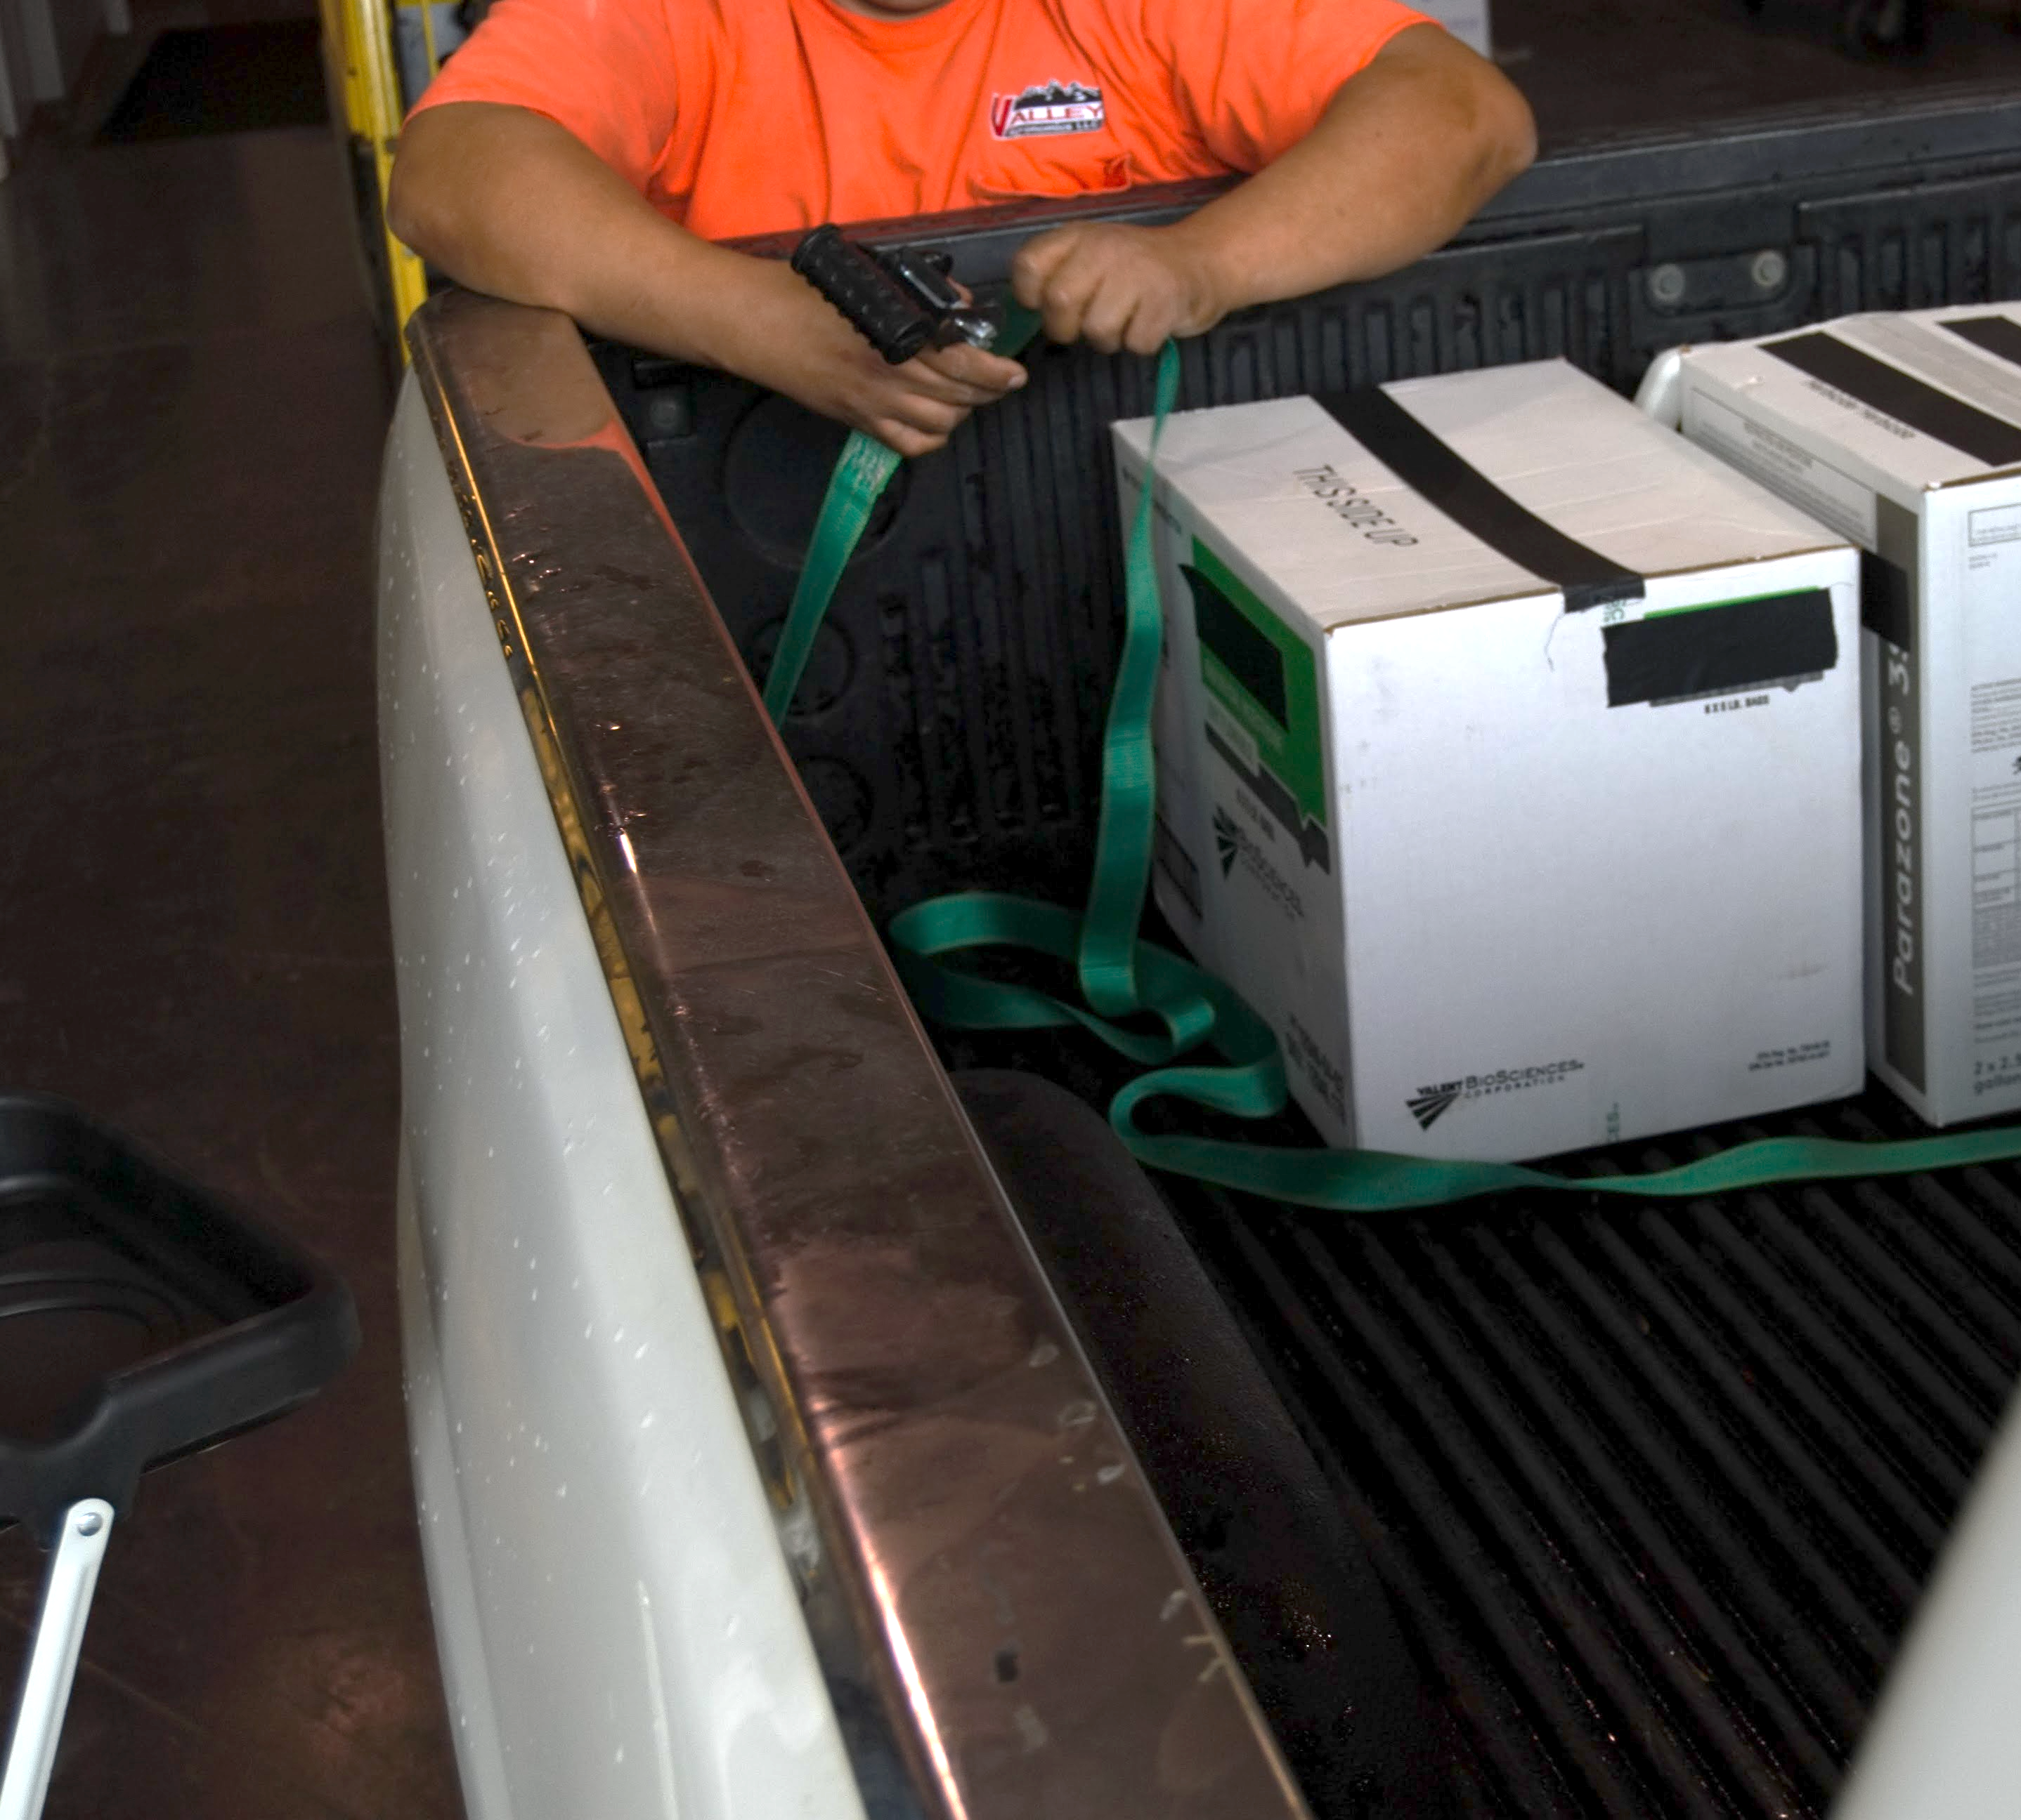
Does WPS apply to employees who transport pesticides?
Notes:
No. If they are merely transporting, WPS does not apply.

Slide 14
Who is responsible for compliance?
The agricultural employer
Not the certified applicator

Slide 15
Exempt from some portions
Owners and members of immediate family
Spouse
Children
Stepchildren
Foster children
Grandparents
Grandchildren
In-laws
Notes:
If more than 50 % of an LLC or other corporation type is owned by immediate family members, they are eligible for the exemption.
The exemption allowed in the WPS applies only to the owners and their immediate family members on any agricultural establishment where a majority of the establishment is owned by one or more members of the same immediate family. A “majority of the establishment” means that more than 50% of the equity in the establishment is owned by one or more members of the same immediate family as defined above.

Slide 16
Exempt from which portions?
Pesticide safety training
Notice of applications
Posting and SDS
Emergency assistance
Minimum age* (must be 18, a Private Applicator or Fully Certified to use Restricted Use Pesticides)
Still must follow ALL label requirements

Slide 17
WPS in a nutshell
Pesticide safety training for employees
Pesticide safety, application, hazard info
Notice about applications
Respirator fit testing
Decontamination supplies
Emergency assistance
Notes:
Required to get a medical evaluation prior to use of respirator.

Slide 18
Pesticide safety training
Workers must be trained before entering treated area
Handlers must be trained before performing any handling task
Trained yearly
Employer must keep record of training
Two years

Slide 19
Who can conduct training?
Certified pesticide applicators
Commercial or private applicators
Graduates of Train the Trainer courses
Designated trainers (extension educators)

Slide 20
What does training involve?
Present with EPA approved materials
Trainer present entire time
No distractions
New content (2018)

Slide 21
Safety, application & hazard info
Must be displayed if app within 30 days and workers or handlers are present
Information about applications
Emergency information
SDS (was MSDS)
Pesticide safety poster
New content required 2018

Slide 22
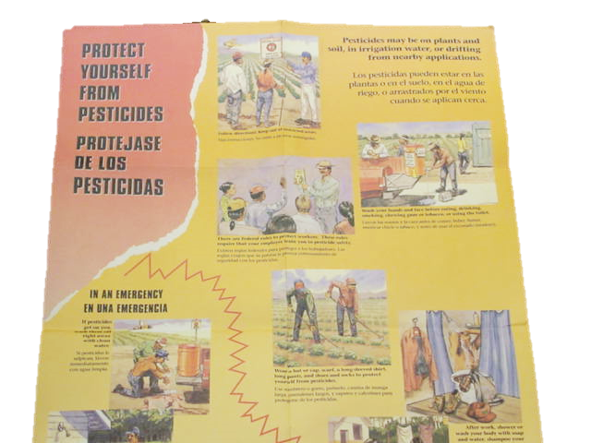

Slide 24
Application info
Location and description of treated area
Product name, EPA Reg.#, active ingredient(s)
Restricted Entry Interval (REI)
Description of treated area
Time and date of application
Start and end times
Keep records for two years

Slide 25
Notice about applications
Verbally warn workers and post warning signs if required by the label
All danger poison products
Otherwise post warning signs if the REI is >
4 hours for enclosed space (greenhouse)
48 hours for outdoor production

Slide 26
Respirator requirements
When a respirator is required by the label employers must provide prior to use
Medical evaluation
Respirator training
Fit testing
Keep records of above for two years

Slide 27
Decontamination supplies
Within ¼ mile of worksite
Water – 1 gallon per worker, 3 per handler
If protective eyewear required for handlers
1 pint immediately available
Extra 3 gallons for eye flush
Plenty of soap and single use paper towels
Change of clothes for handlers

Slide 28
Emergency assistance
Transport promptly to medical facility
Promptly provide to medical personnel
Product name, EPA Reg.#, active ingredients
How pesticide was being used
Circumstances of exposure
SDS

Slide 29
Help is available
Joe Becovitz – (765)494-1589—regulator
becovitz@purdue.edu
Fred Whitford – (765)494-1284—extension
fwhitford@purdue.edu
Resources:
https://pesticideresources.org/

