Slide 1
Reducing pollinator exposure to pesticides
INTEGRATED PEST AND POLLINATOR MANAGEMENT IN CUCURBITS
Notes:
How many of you grow watermelon? Pumpkins? Pickling cucumbers? Corn? Soybean?

Slide 2
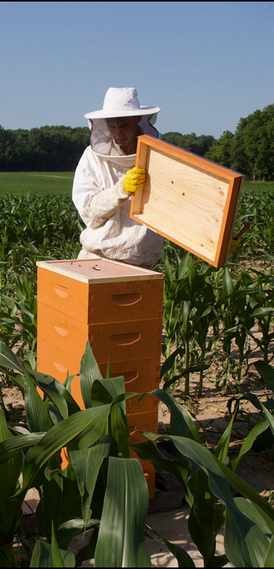
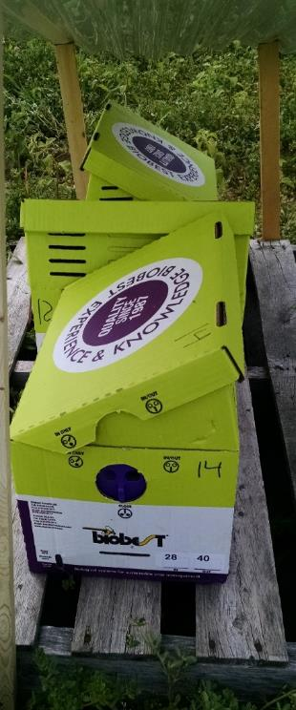
Pollination
Crucial for fruit set in many agricultural crops
500-1000 grains of pollen for effective fertilization of watermelon
10-20+ visits by pollinators for fruit set
Increased visitation of pollinators leads to better fertilization and fruit set
INTEGRATED PEST AND POLLINATOR MANAGEMENT IN CUCURBITS

Slide 3
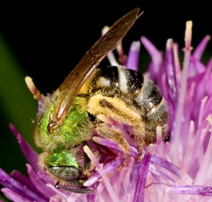
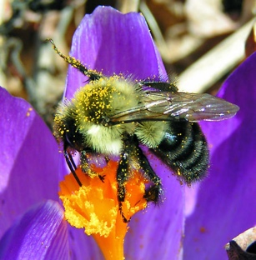
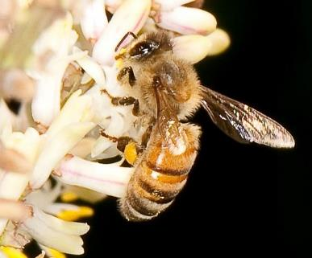
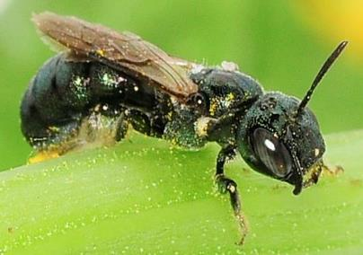
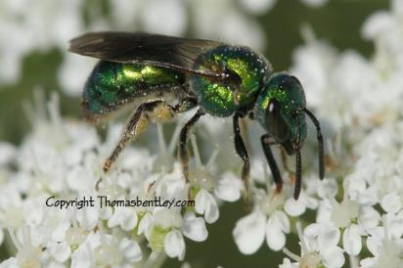
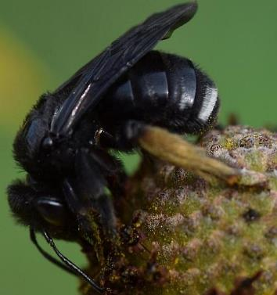
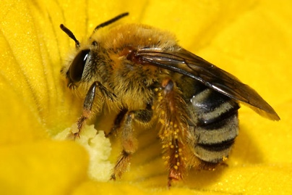
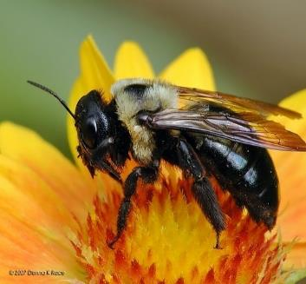
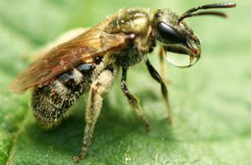
Pollination
INTEGRATED PEST AND POLLINATOR MANAGEMENT IN CUCURBITS

Slide 4
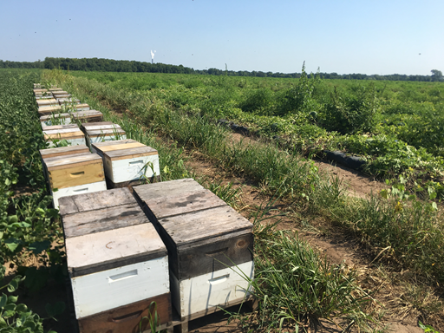
Pollination
Pollinators experiencing global declines
Beekeepers suffer from overwintering losses far greater than historically seen
Native bees at risk of extinction
Rusty patched bumble bee (Bombus affinis)
first endangered bee species in the U.S.
INTEGRATED PEST AND POLLINATOR MANAGEMENT IN CUCURBITS

Slide 5
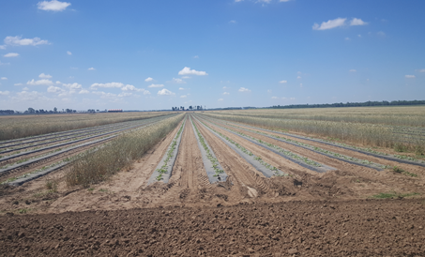
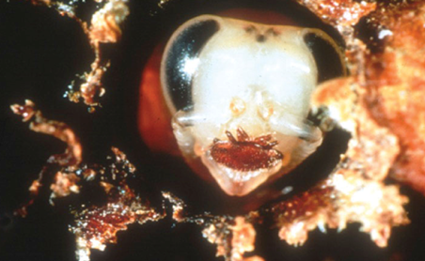
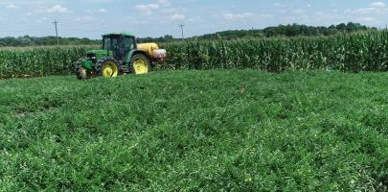
Pollinator Declines
Contributing Factors
Loss of habitat and land use change
Climate change
Pathogen spread
Varroa mites
Increasing risk from insecticide use
INTEGRATED PEST AND POLLINATOR MANAGEMENT IN CUCURBITS
Notes:
There are synergies between these factors, acting together and in different ways, sometimes at the same time, leading to bee declines. There is no ONE ANSWER to what is killing the bees.

Slide 6
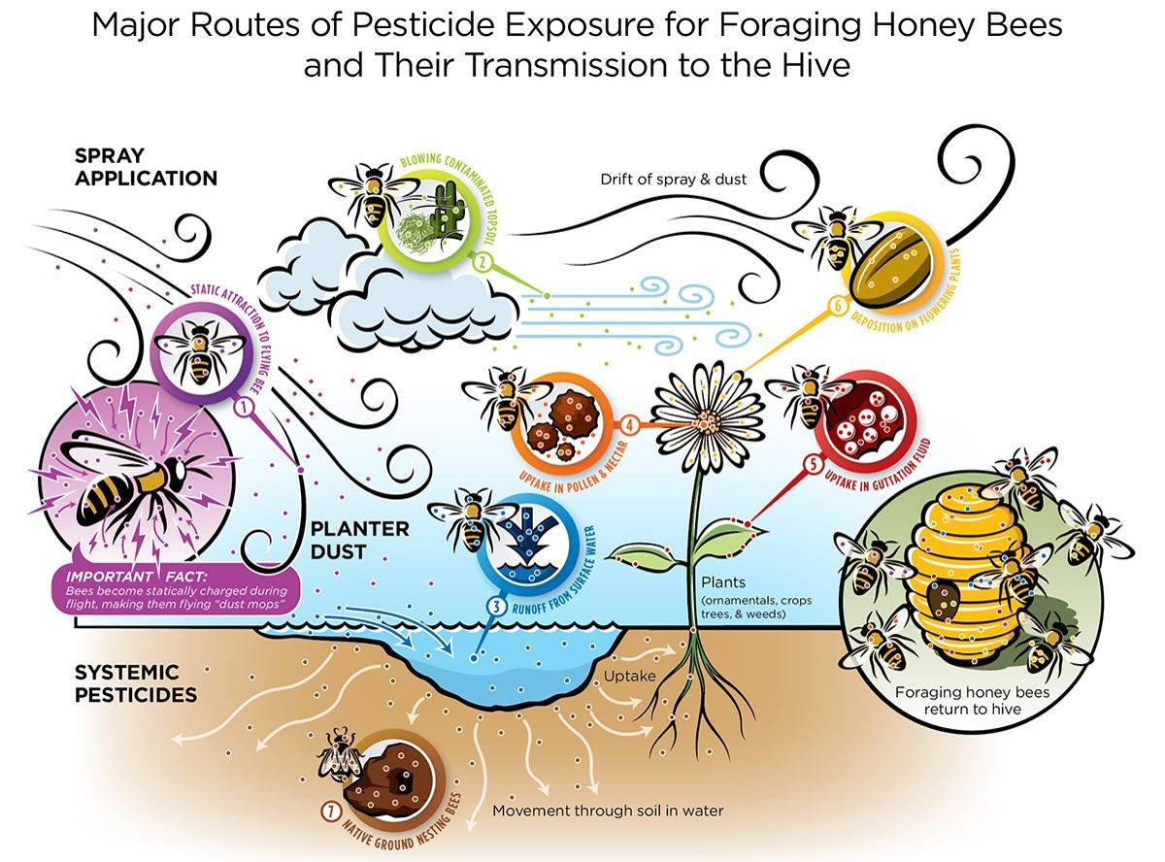

Slide 7
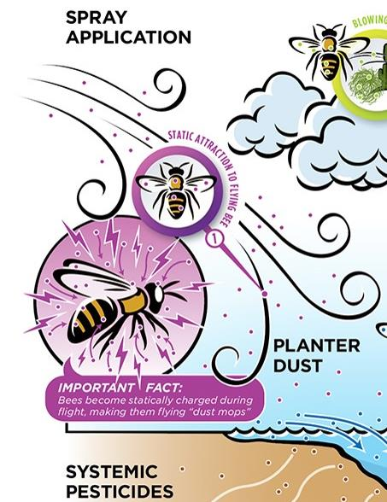
1. Static Attraction

Slide 8
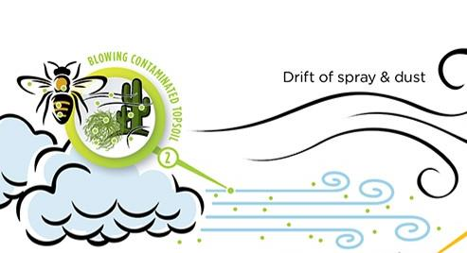
2. Blowing contaminated topsoil

Slide 9
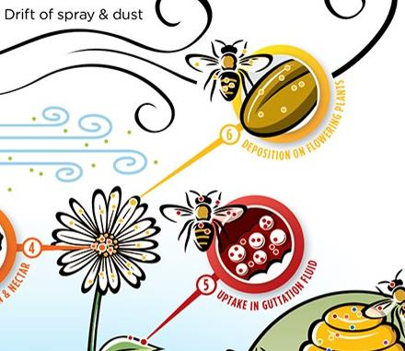
6. Deposition on flowering plants

Slide 10
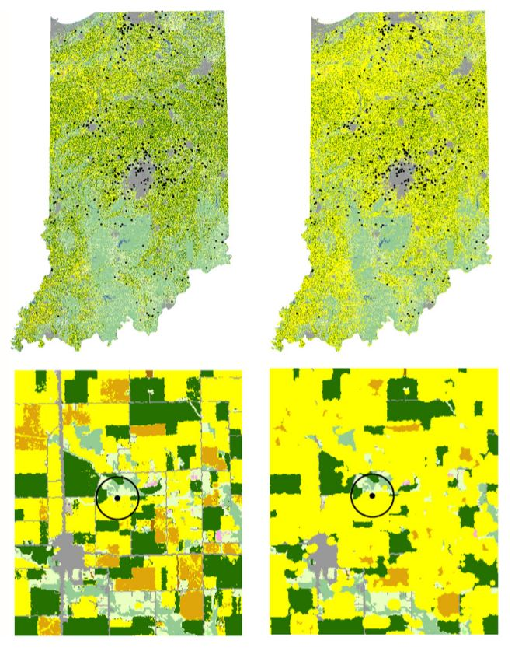
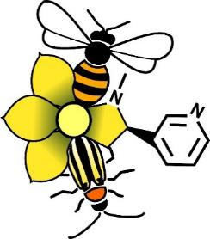
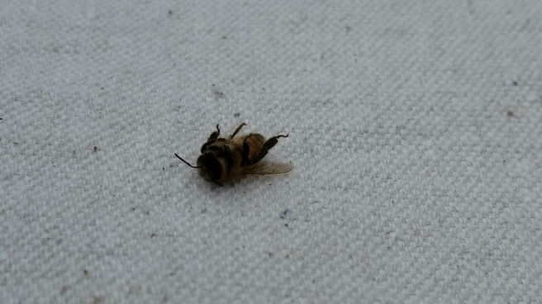
Pollination
Risks in Indiana
Krupke et al. 2017 J. Appl. Ecol.
Notes:
Exposure from planter dust of seed-treated corn. On the left, planter dust not drifting outside the field, right illustrates dust drifting up to 90m

Slide 11
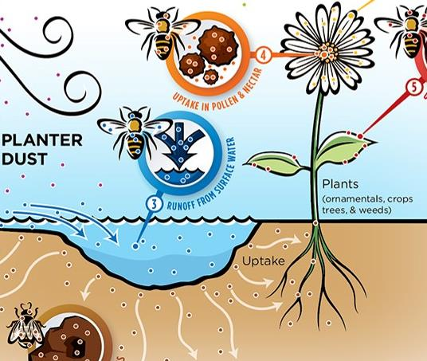
3. Runoff from surface water

Slide 12
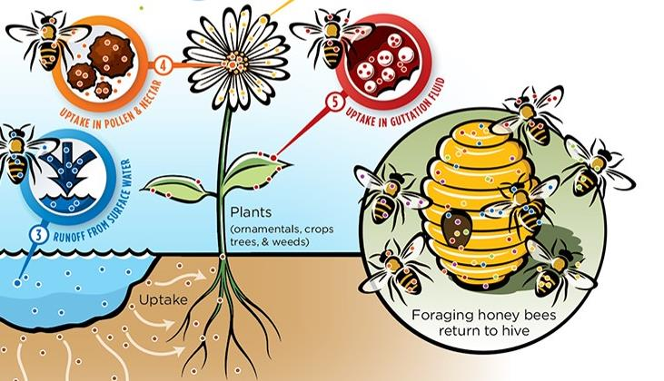
4. Uptake in pollen & nectar
5. Uptake in guttation fluid (drinking water)

Slide 13
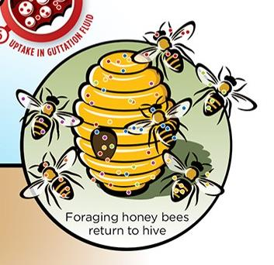
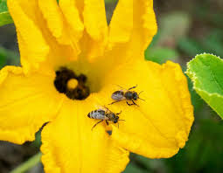
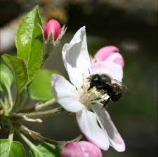
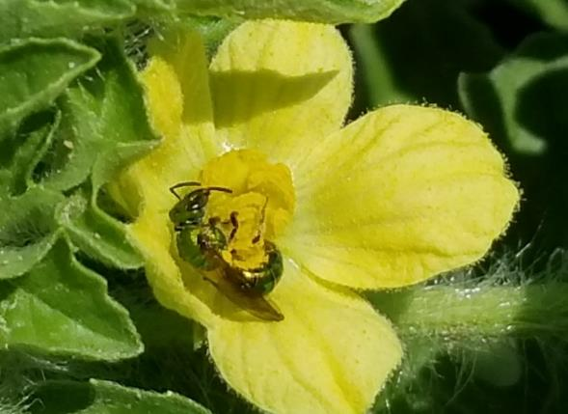
Social Bees
Solitary Bees

Slide 14
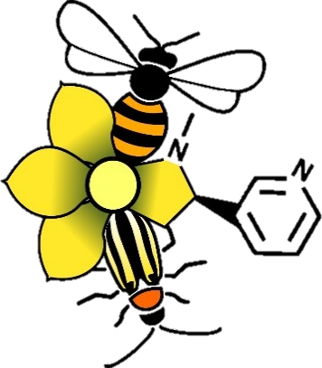
Conserving pollinators in specialty crops requires a systems approach; foraging radius beyond the crop

Slide 15
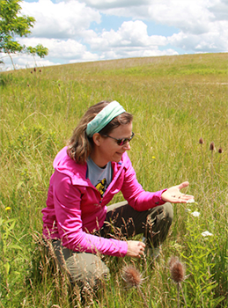
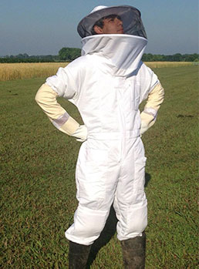
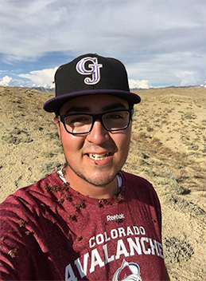
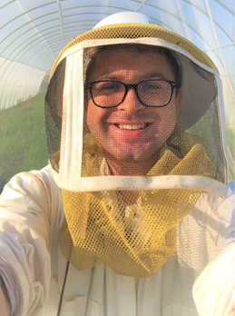
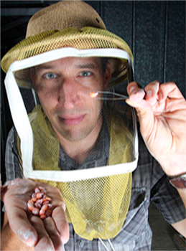
INTEGRATED PEST AND POLLINATOR MANAGEMENT IN CUCURBITS

Slide 16
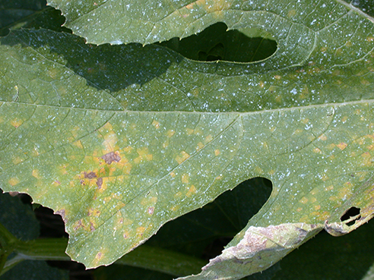
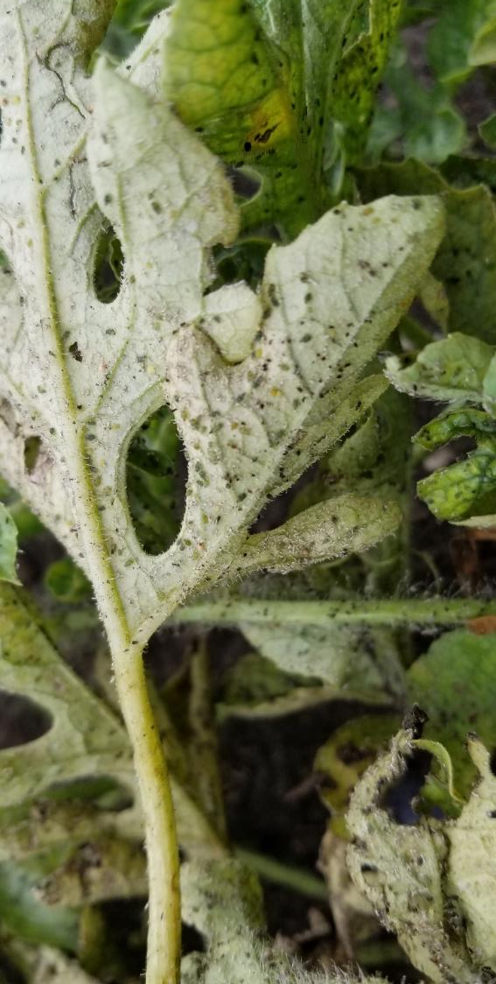
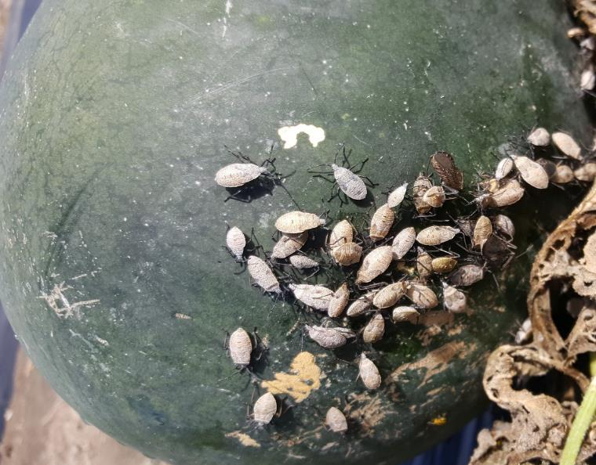
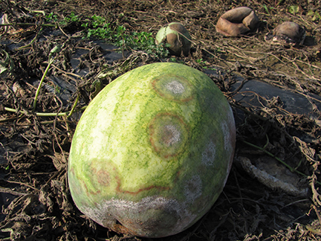
Notes:
Aphids and sooty mold, cucumber beetles, squash bugs, downy mildew, phytophthora fruit rot

Slide 17
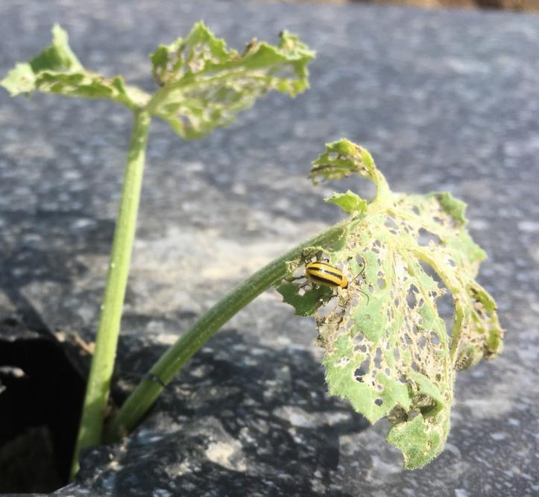
Pest Management
Focus our efforts on cucumber beetles
5 beetles per plant, threshold in watermelon
Reduce inputs, secondary pest outbreaks
Minimize exposure of pollinators to insecticides in cucurbit crops
INTEGRATED PEST AND POLLINATOR MANAGEMENT IN CUCURBITS

Slide 18
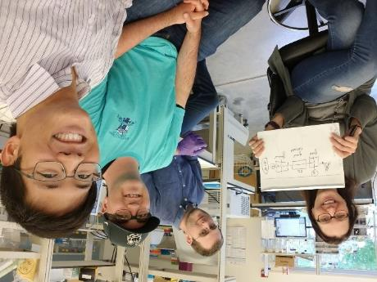
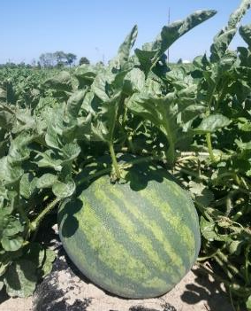
Approach: Observational & Experimental
Observational (On-Farm)
In-field observations and measurements
Variation in management practices
Experimental (Research Farm)
In-field observations and measurements
Control over inputs and management practices
INTEGRATED PEST AND POLLINATOR MANAGEMENT IN CUCURBITS

Slide 19
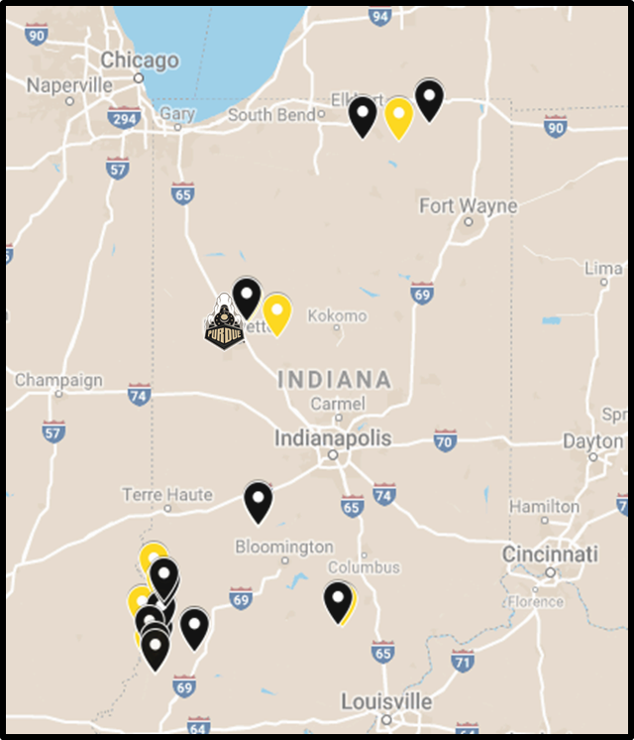
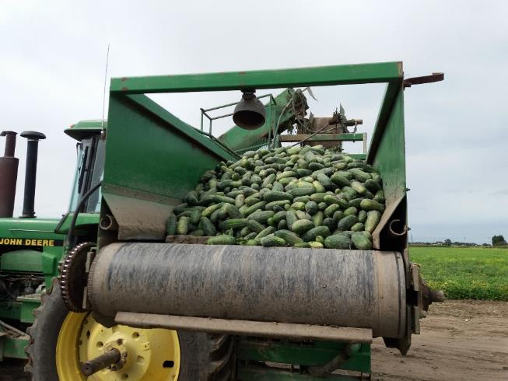
On-Farm
Michigan
31 commercial pickling cucumber fields
Ohio
30 commercial pumpkin fields
Indiana
30 commercial watermelon fields
INTEGRATED PEST AND POLLINATOR MANAGEMENT IN CUCURBITS

Slide 20
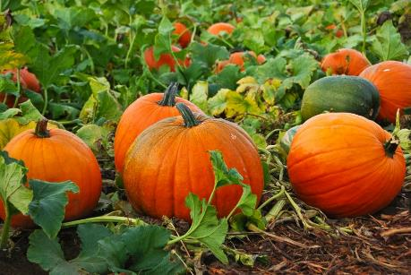
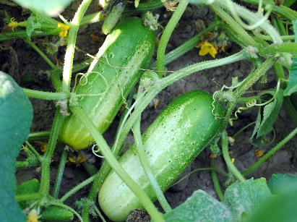
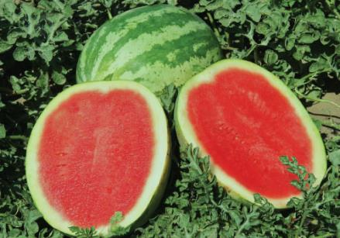
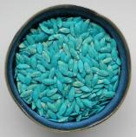
acetamiprid
imidacloprid
thiamethoxam
thiamethoxam
thiamethoxam
+ foliar insecticides
+ foliar miticides
+ foliar fungicides
+ foliar insecticides
+ foliar fungicides
+ foliar fungicides
INTEGRATED PEST AND POLLINATOR MANAGEMENT IN CUCURBITS
Notes:
Amongst our collaborators, no one using treated seeds in watermelon. Some of you apply a neonic at transplant, some of you avoid neonics all together and rely on pyrethroids. One of our participants is an organic grower.

Slide 21
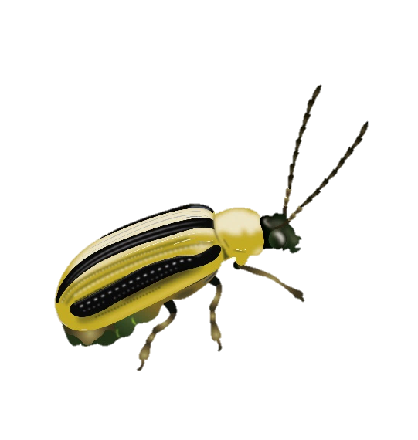
Protection from seed treatment ~35 days
1-4 additional foliar applications, no difference in beetle counts
Only 4 beetles found across 2 years
Beetle counts never exceeded threshold (5/plant avg.)
Includes organic production
INTEGRATED PEST AND POLLINATOR MANAGEMENT IN CUCURBITS

Slide 22
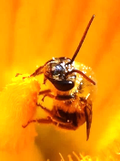
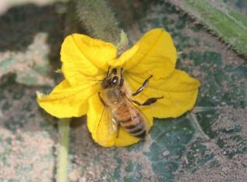
Honey bees make up 98% of all visits
Bumble bees (1%) and other wild bees (1%) make up the rest
INTEGRATED PEST AND POLLINATOR MANAGEMENT IN CUCURBITS

Slide 24
Lowest measured residue in cucumber pollen = 0.048 µg per gram of pollen. Consuming 0.10 grams of pollen would expose them to a lethal dose.
Hopwood et al. 2016. How Neonicotinoids Can Kill Bees

Slide 25
Honey bee pollen collection
Sumac
Goldenrod
Corn
Cucumber pollen is only 1-2% of the diet
INTEGRATED PEST AND POLLINATOR MANAGEMENT IN CUCURBITS

Slide 26
Seasonal effect on exposure
No link to cucumber bloom!
Spike when foraging on corn and goldenrod.
Consuming 1 gram of pollen is lethal dose.
INTEGRATED PEST AND POLLINATOR MANAGEMENT IN CUCURBITS

Slide 27
On-Farm Results
Seed treatment in direct-seeded specialty crops effective, may not be necessary
Thiamethoxam residues in pollen/flowers about 25% of leaf tissue
Pollinator communities vary depending on crop type
Surrounding landscape important for community composition AND exposure risks to insecticides
INTEGRATED PEST AND POLLINATOR MANAGEMENT IN CUCURBITS

Slide 28
Research Farms
Controlled Experiments
2017-2020
Matrix of corn (15 acres)
Watermelon focal crop (0.5 acres)
We regulate ALL inputs

Slide 31
INTEGRATED PEST AND POLLINATOR MANAGEMENT IN CUCURBITS

Slide 34
Where and when do we use NST?
Vegetable + fruit + orchards + grapes
Soybean
Maize (corn)
Published in: Margaret R. Douglas; John F. Tooker; Environ. Sci. Technol. 2015, 49, 5088-5097.
DOI: 10.1021/es506141g
Copyright © 2015 American Chemical Society

Slide 35
Where and when do we use NST?
69 studies
Indiana
15 years (2000-2015)
NSTs are no better than other chemistries, should be an elective choice used in rotation.
INTEGRATED PEST AND POLLINATOR MANAGEMENT IN CUCURBITS

Slide 36
Yields (bu/acre) do not differ
2012
2013
2014
Notes:
Evaluate the effectiveness of seed treatment in field corn, across three different years at various locations in Indiana. Compared naked seed to clothianidin low and high rate.

Slide 37
Where and when do we use NST?
194 studies
14 states
11 years (2006-2017)
INTEGRATED PEST AND POLLINATOR MANAGEMENT IN CUCURBITS

Slide 38
Holistic Approach to Mgmt
Pollinators forage across the landscape, need a landscape approach to their management
Promoting pollinator health and diversity provides economic benefit
Increases in yield
Less reliance on managed pollinators
INTEGRATED PEST AND POLLINATOR MANAGEMENT IN CUCURBITS

Slide 39
Pollinator Declines
Contributing Factors
Loss of habitat and land use change
Climate change
Pathogen spread
Varroa mites
Increasing risk from insecticide use
INTEGRATED PEST AND POLLINATOR MANAGEMENT IN CUCURBITS
Notes:
There are synergies between these factors, acting together and in different ways, sometimes at the same time, leading to bee declines. There is no ONE ANSWER to what is killing the bees.

Slide 40
Best Management Practices
Implement scouting and threshold-based interventions
Choose pesticides carefully
Apply late in the day
Avoid open flowers
INTEGRATED PEST AND POLLINATOR MANAGEMENT IN CUCURBITS

Slide 41
Best Management Practices
Share the responsibility of bee care
INTEGRATED PEST AND POLLINATOR MANAGEMENT IN CUCURBITS
Notes:
There is an established threshold for over winter survival, if hives are below that weight they are not likely to survive.

Slide 42
Best Management Practices
Bees forage outside of the target crop
Habitat for nesting influences species present in the crop (woody landscape)
Pesticide applications in neighboring fields impact pollinators in your specialty crops
INTEGRATED PEST AND POLLINATOR MANAGEMENT IN CUCURBITS

Slide 43
Thank you!
lingwell@purdue.edu
765-494-6167
@Ingwell_VegIPM
Purdue Fruit & Veg IPM

Slide 44
On-Farm
Residue Analysis (30 pesticides, including neonicotinoids)
Soil
Leaf tissue
Pollen/nectar
Pollinator Sampling
Pollinator collection and observation
Abundance, richness, pollination events
Pollen traps
Pest Sampling
Weekly sampling, visual counts along transects
INTEGRATED PEST AND POLLINATOR MANAGEMENT IN CUCURBITS

Slide 45
Fungicide impacts
Interact with insecticides to cause damage
Harmful directly by decreasing nutritional quality of bee bread
Increase prevalence of parasite Nosema ceranae
Implicated in range contractions for bumble bee species
INTEGRATED PEST AND POLLINATOR MANAGEMENT IN CUCURBITS

Slide 46
Holistic Approach to Mgmt
Seed treatments are a tool for pest management
Target use where economically important
Employ scouting to manage pests, worth the investment!
INTEGRATED PEST AND POLLINATOR MANAGEMENT IN CUCURBITS

