Slide 1
Post-Harvest Sanitizers for Fruits and Vegetables
Amanda Deering, Ph.D. Department of Food Science

Slide 2
Pesticides
A pesticide is any substance or mixture of substances intended for:
preventing
destroying
repelling or
mitigating any pest.
Often misunderstood to refer to insecticides, but also refers to herbicides, fungicides, and various other substances used to control pests.
Under United States law, a pesticide is also any substance or mixture of substances intended for use as a plant regulator, defoliant, or desiccant.
www.epa.gov

Slide 3
What is a Pest?
Pests are living organisms that occur where they are not wanted or that cause damage to crops, humans or other animals. Examples include:
insects,
mice and other animals,
unwanted plants (weeds),
fungi,
microorganisms such as bacteria and viruses
www.epa.gov

Slide 4
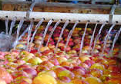
Post-Harvest Processing
Performed to reduce bacteria, yeasts, and molds that may cause spoilage to reduce shelf-life of a product
Also, pathogenic bacteria that can cause disease to humans
Cleaning post-harvest water is important to prevent cross-contamination

Slide 5
What Sanitizers Can I Use for Post-Harvest Processing of Fruits and Vegetables?

Slide 6
EPA Registration Number
All products must have an EPA registration number on the label
This means the product should perform as stated on the label and not pose unreasonable hazards to your health IF used according to the label on the instructions.
This should be the first thing you look for when checking to see if a particular product can be used

Slide 7
Minimum Risk Pesticides
List of approximately 30 compounds that do not have to be registered with the EPA
However:
The product must not bear claims either to control or mitigate microorganisms that pose a threat to human health
The product must contain ONLY active ingredients that are listed in the table (next slide) and inert ingredients that have been classified by EPA as “Inert Ingredients of Minimal Concern”
The product still needs to be registered for use in Indiana

Slide 8
Minimum Risk Pesticides
Castor Oil | Linseed Oil
Cedar Oil | Malic Acid
Cinnamon and Cinnamon Oil | Mint and Mint Oil
Citric Acid | Peppermint and Peppermint oil
Citronella and Citronella Oil | 2-Phenethyl Propionate
Cloves and Clove Oil | Potassium Sorbate
Corn Gluten Meal | Putrescent Whole Egg Solids
Corn Oil | Rosemary and Rosemary Oil
Cottonseed Oil | Sesame and Sesame Oil
Dried Blood | Sodium Chloride
Eugenol | Sodium Lauryl Sulfate
Garlic and Garlic Oil | Soybean Oil
Geraniol | Thyme and Thyme Oil
Geranium Oil | White Pepper
Lauryl Sulfate | Zinc Metal Strips
Lemongrass Oil

Slide 9
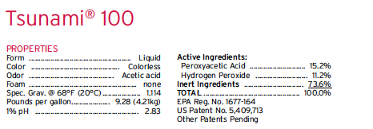
EPA Registration Number

Slide 10
EPA Registration Numbers
Examples: EPA Reg. #xxxxxx-yyyy
xxxxxx = Company I.D. yyyy = Product I.D.
EPA Reg. #xxxxxx-yyyy-zzzzz
zzzzz = Distributor Suffix
The 3rd field designates that the product is likely a private label and that the true manufacturer’s name has been replaced with the private label

Slide 11
EPA Registration Numbers
EPA numbers and information about products can be found on the Pesticide Product Label System (PPLS) website
Product name
Company name
EPA registration number
http://iaspub.epa.gov/apex/pesticides/f?p=PPLS:1

Slide 12
EPA Registration Number
Products that have the same EPA registration number should have the same ingredients
The third field may vary as that field are supplemental registrations or private label products derived from the same federal registration

Slide 13
Examples
EPA No. 63838-1
PERCENT ACTIVE INGREDIENT
26.5% Hydrogen Peroxide
5.6% Peroxyacetic Acid (also called peracetic acid)
20 products registered in Indiana with same EPA number and different companies
Perasan A
Arkema PAA 6
Peroxysan RS
WC-237
SB-Peracetic Acid

Slide 14
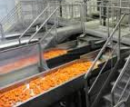
Products with the Same EPA Number
Even though they are the same chemical they may not have a label that states use for fruits and vegetables
Label must give use rates for post-harvest processing of fruits and vegetables and the label must be followed exactly

Slide 15
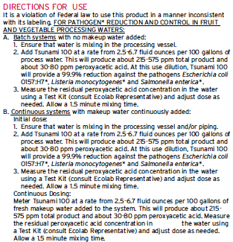
Example – Tsunami®100

Slide 16
Product Labels
The label should tell you:
Concentration for use and how to dilute it
Contact time
Possibly what types of organisms the product can kill (Listeria monocytogenes, spoilage organisms, etc.)
If a final rinse of the produce with potable water is needed following contact with the sanitizer
Disposal of product and containers
First aid procedures

Slide 17
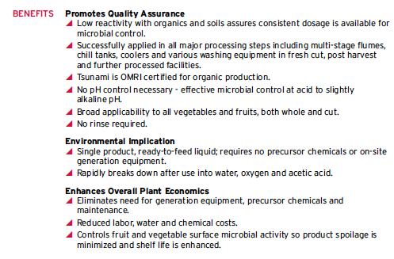
Example – Tsunami®100

Slide 18
Example – Tsunami®100

Slide 19
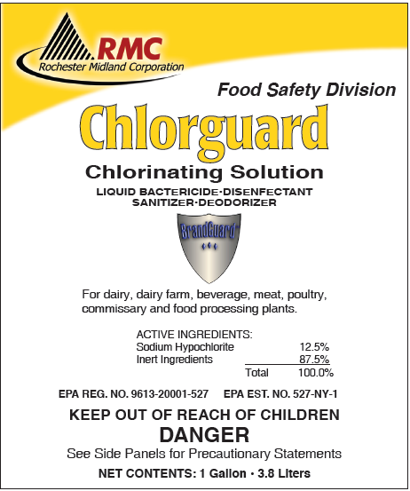
Example – Chlorguard

Slide 20
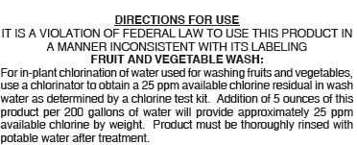
Example – Chlorguard

Slide 21
Example – Chlorguard

Slide 22
Example – Chlorguard

Slide 23
Example – Chlorguard

Slide 24
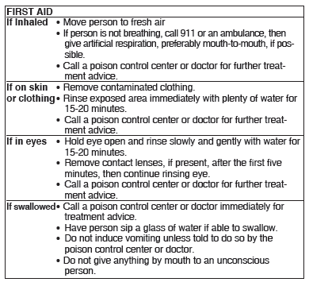
Example – Chlorguard

Slide 25
What Products Can Be Used?
Once a product is registered with the EPA it must also be registered in the state that it is used
The product is registered through the Office of the Indiana State Chemist (OISC) and has to be renewed each year
Product registration data is maintained on the National Pesticide Information Retrieval System (NPIRS)

Slide 26
What Products Can Be Used?
Indiana specific registrations can be searched at: http://npirspublic.ceris.purdue.edu/state/state_menu.aspx?state=IN
Contact for questions:
Ed White, OISC
765-494-1587
ewhite@purdue.edu

Slide 27
Approved Sanitizers for Fruits and Vegetables
Every approved sanitizer in Indiana has a hard copy of the label on file at the OISC
Searched all labels to determine which ones were approved for post-harvest processing of fruits and vegetables
Scanned the label of approved sanitizers so an electronic version is available

Slide 28
Approved Sanitizers for Fruits and Vegetables
Searched the Pesticide Product Registration database that is through the Illinois Department of Agriculture to determine if products approved in Indiana were approved in Illinois
http://www.agr.state.il.us/Environment/Pesticide/ productsearch.php

Slide 29
Approved Sanitizers for Fruits and Vegetables
Handout of approved sanitizers for post-harvest processing of fruits and vegetables was developed
However, there may be other products approved in Illinois that aren’t in Indiana
Contact:
http://www.agr.state.il.us/pesticides

Slide 30
Thank You!
Acknowledgements:
Ed White, OISC
Jennifer Coleman, ISDH
Yoojung Heo
Shiyu Cai
Questions?
Contact Info:
Amanda Deering
Department of Food Science
Phone: 765-494-0512
Email: adeering@purude.edu

