Slide 1
Personal Protective Equipment and Work Clothing for Pesticide Application
Adapted from: Janis Stone, extension professor,
Textiles & Clothing Department
Joyce Hornstein, extension program specialist, Department of Entomology

Slide 2
Use work clothing and personal protective equipment (PPE) to protect yourself from
The risk of acute pesticide poisoning
Health effects from long-term exposures
Labels on agricultural pesticides that refer to EPA’s Worker Protection Standard require that certain items of PPE must be worn.

Slide 3
Exposure to pesticides can occur through…
Eyes
Nose
Mouth
Skin
All formulations—liquid, powder, or granular—can be absorbed in clothing, thereby becoming a path to skin exposure.

Slide 4
Look on the pesticide label for...
PRECAUTIONARY STATEMENTS
Explains the type of personal protective equipment (PPE) and work clothing needed.

Slide 5
Work clothing includes...
Long-sleeved shirt and long pants
Underwear—briefs and t-shirt
Socks and shoes
Hat with brim

Slide 6
The more toxic a pesticide, the more PPE that is required
CAUTION
Regular work
clothes—long-
sleeved shirt,
long pants,
shoes & socks,
waterproof
gloves
WARNING
Coveralls over
work clothing,
shoes & socks,
chemical-
resistant gloves,
eyewear
DANGER
Coveralls over
work clothing,
chemical-
resistant gloves
and footwear,
respiratory and
eye protection

Slide 7
“Rubber” gloves are not all alike...
Nitrile
Neoprene
Disposable
nitrile
Disposable
barrier laminate

Slide 8
Glove materials differ in resistance to pesticides
The pesticide label shows a letter A-H that corresponds to the right glove materials for that pesticide
EPA chemical resistance category selection chart can be found on the EPA web site

Slide 9
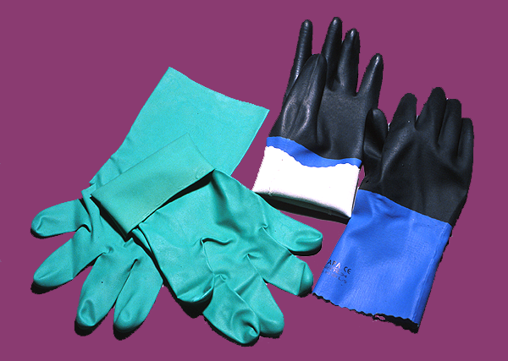
Gloves without linings preferred
Unlined nitrile
AVOID
Lined neoprene
Notes:
Gloves without cloth lining are preferred. If spilled pesticide runs inside the glove, the absorbent cloth would hold the pesticide against skin, prolonging the contact.
Most important is that chemical resistant neoprene gloves provide protection while handling, mixing, pesticides.

Slide 10
Measure your hand to find glove size
Inches
7–8 small
8–9 medium
9–10 large
10–12 x-large

Slide 11
Use disposables for short tasks
Disposables are thinner, can’t be adequately cleaned, and can’t be reused
Two types are barrier laminate and nitrile
Nitrile
Barrier laminate

Slide 12
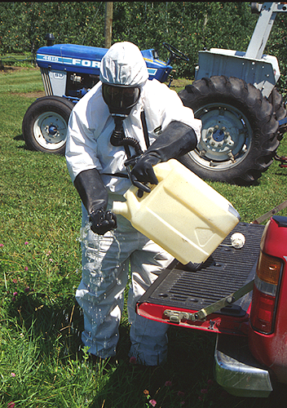
Wash reusable gloves with soap and rinse before you take them off your hands

Slide 13
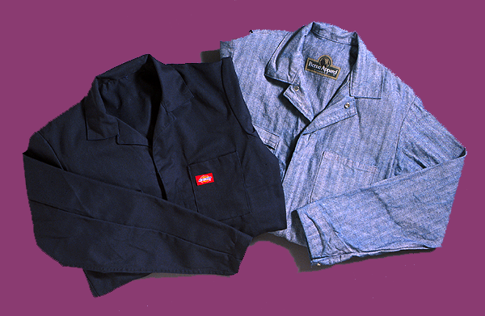
Use coveralls when required by label
Reusable—cotton twill

Slide 14
Disposable coveralls—some options
Disposable or limited use coveralls are sold under brand names such as
Tyvek®
Pro/Shield®
Kleenguard®

Slide 15
For limited-use or disposable coveralls it is your job to...
Keep track of time; avoid wearing more than 8 hours
Not wash to clean
Decide when to quit wearing them and discard
Discard using rules for containers

Slide 16
Aprons are a good idea when mixing or loading pesticides. They...
Protect coveralls, work clothing
Are available in the same materials as gloves and coveralls
Should be material that can be rinsed

Slide 17
Eye protection is important
Check the label! Find a good fit
Can wear over glasses
Goggles or glasses
should have brow
and side-shield
protection

Slide 18
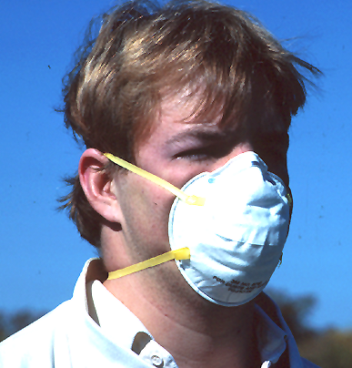
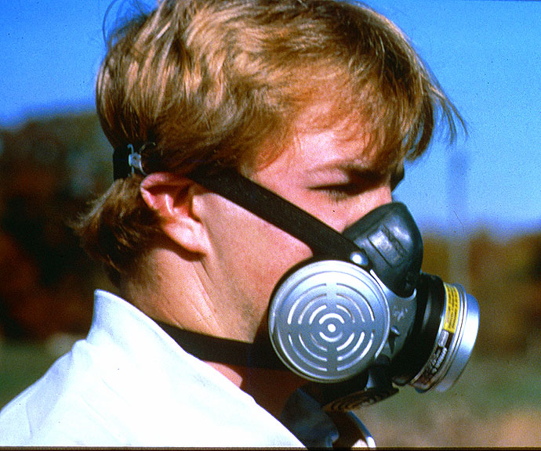
Respirators required for some pesticides
Look at the label for the specific type of respirator required.
Dust/mist single use
Cartridge

Slide 19
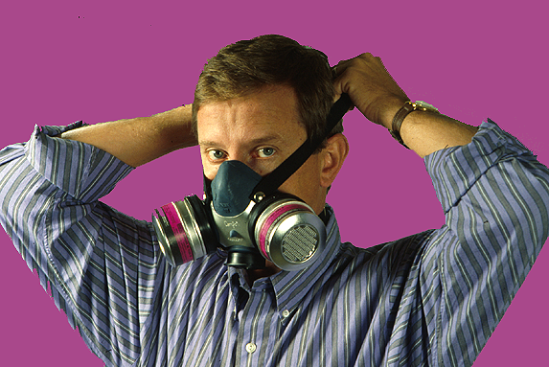
If cartridge respirators are required
They must be professionally fitted and cannot be worn over a beard
Half-face
Full-face with goggles

Slide 20
Headgear protects from exposure to pesticides and the sun
Few pesticide labels require headgear; if needed choose:
Hoods that are attached to disposable coveralls
Hats with a brim
Chemical-resistant hoods

Slide 21
An Iowa field study compared headgear. Workers said...
Baseball caps were best in fit, keeping on the head, and in appearance
Booney style gave good sun protection
Brims of Solarweave® Booney, and Tyvek® cover, flopped in the wind and were hard to keep on the head
Tyvek®
Baseball
Booney

Slide 22
Alternatives to baseball caps are
Headgear with stiff, sturdy brims that fit securely
Tightly woven straw hats with Solarweave® lined brim or cowboy style
Full brim hard hat
NO

Slide 23
Follow safety guidelines for cleanup and disposal of personal protective equipment
Have a cleanup station with water, soap, towels, and clean PPE nearby
Dispose of worn out or leaky gloves and pesticide-contaminated PPE
should be cut up, so they can’t be recycled
discarded as you would pesticide containers

Slide 24
Store pesticide contaminated work clothing carefully before cleanup…
Store soiled PPE separately from other family items
Use trash bags, zip-close bags, or containers; label contents

Slide 25
To launder work clothing and reusable PPE ...
Wear rubber gloves
Keep separate from family clothing
Wash daily and as soon as possible after soiling
Prerinse or presoak and drain away this water before washing

Slide 26
For maximum pesticide removal…
Don’t stuff washer with too many items
Use hot water
Use high-water level
Use regular wash cycle, not shorter knit cycle
Use heavy-duty liquid detergent

Slide 27
Laundering additives are optional...
Bleach, ammonia, and fabric softeners neither help nor hinder pesticide removal.
Starch added to the final rinse may stiffen the clothes when dry, but assist with pesticide removal in the next wash.

Slide 28
Finishing up safely...
Run washer through complete cycle with detergent and no clothes to remove pesticide residue before another wash
Line dry if possible or use the high heat setting on your dryer

Slide 29
Two things not to do...
Never put chemical-resistant gloves in your washer or dryer.
Never wash headgear or caps worn for pesticide work in the dishwasher.

Slide 30
Reduce your exposure to pesticides and be ready for emergencies!
Call 911 for poison emergencies
Post Poison Control Center numbers beside the phone
Choose and use the appropriate PPE specified on pesticide labels
Follow good cleanup procedures

Slide 31
Sponsoring Agencies
U.S. Environmental Protection Agency, Region VII
Iowa Department of Agriculture and Land Stewardship
Iowa State University
This project has been funded by the Iowa Department of Agriculture and Land Stewardship through a grant from the U.S. Environmental Protection Agency

