Slide 1


Cover Crops and Weeds
Don Robison
Seed Administrator
Office of Indiana State Chemist
and Seed Commissioner
@IndianaChemist

Slide 2
Cover Crops
@IndianaChemist

Slide 3
Is “Cover Crop” Seed Subject to Regulation by State and Federal Seed Laws?
YES *

Slide 4
Exceptions From Labeling Requirements
Grain not intended for seeding and sowing purposes
Seed that satisfies all the following:
  Seed is grown on the property owned by the seller of the seed
  Seed is sold and delivered to the purchaser on the property on which the seed is grown
  Seed does not contain weed seeds classified as noxious or exceed the maximum of 2.5% of all weed seeds****
This has always been known as the “farmer exemption”

Slide 5
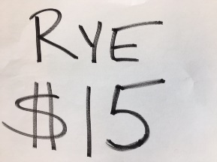
Conditions That Void the “Farmer Exemption”
Seed that is advertised
Higher than current market prices
If a farmer sells seed not produced by him

Slide 6
Weeds
@IndianaChemist

Slide 7
Weed Seeds in Cover Crops
The vast majority of cover crop seed in Indiana is clean and has a good germination level.
Rye, on the other hand has some issues.
  Many issues are due to locally grown seed that is not managed as a seed crop
  Some local growers, but those are in the minority
  Professionally grown rye is typically much cleaner
    Only issues with this seed is sometimes germ claims are too high compared to actual. Should have claimed 85%

Slide 8
Weeds?
One species as an example
Rye As An Example
  One Local Sample
  95% Germ
  But…
  93.59% Pure = to 6.41% something other than seed
  2 Noxious Weeds – 176/lb
  21 Weed Species besides noxious

Slide 9
Seed Sample Terminology
Official Samples – Pulled by an OISC Inspector from a place of business. Statistically significant due to methodology of sampling, lot size, dividing procedures, etc.
Service Samples – sent by farmer or seed company. Can be or cannot be statistically significant due to lack of methodology in sampling

Slide 10
Rye Seed Quality? Official Samples
  Total Rye Official Sample Failure Rate in 2018? *32%
    Mostly due to lower germ than claims, about 10% due to weeds
    ** samples with weeds, insects
Samples | 2016 | 2017 | 2018
Avg Germ** | 83.27 | 76.23 | 79.13
Weed Species** | 4.81 | 3.89 | 2.13
Failure Rate % | 6.5 | 9.8 | 32*
High Quality % | - | 59 | 57.9%

Slide 11
Rye Seed Quality – Service Samples
(Locally grown in most cases)
2018 Weed Species List
  Amaranth, Poison Hemlock, Quackgrass, Wild Garlic, Johnsongrass, and others
  ** samples with weeds, insects
Samples | 2016 | 2017 | 2018
Avg Germ** | 85.04 | 76.94 | 74.28
Weed Species* | 4.8 | 3.1 | 3.14
High Quality % | 29.8 | 29.6 | 11

Slide 12
Does it matter where seed is grown?
2017 Study
Yes! Out of 112 2017 samples
  Southern Indiana Grown Rye
    75% Germ
  Northern Indiana Grown Rye
    82% Germ
  Professionally Grown and Seedsman Sold Rye
    90% Germ
  23% of all locally grown rye had below 50% germ

Slide 13
Is professionally grown seed always great?
No, but normally pretty good.
Sample with highest number of weed species?
  Had 10 species

Slide 14
Weed Seeds of the year…
2016 Corncockle
2017 Quackgrass
2018 Wild Garlic, Curled Dock, Amaranth

Slide 15
How To Get a Seed Test?
Pull representative sample – sample 10% plus 5 bags
  20 bag lot? Pull 2 bags plus 5 bags for 7 bag total.
  Bulk pile? X pattern with 3-5 probes per location
Full, Quart size zippered bag
www.oisc.purdue.edu/seed/forms.html
Don’t wait until the last minute!
  Average sample was in testing for over three weeks
  February to April and August-October?
    Add a week to ten days

Slide 16
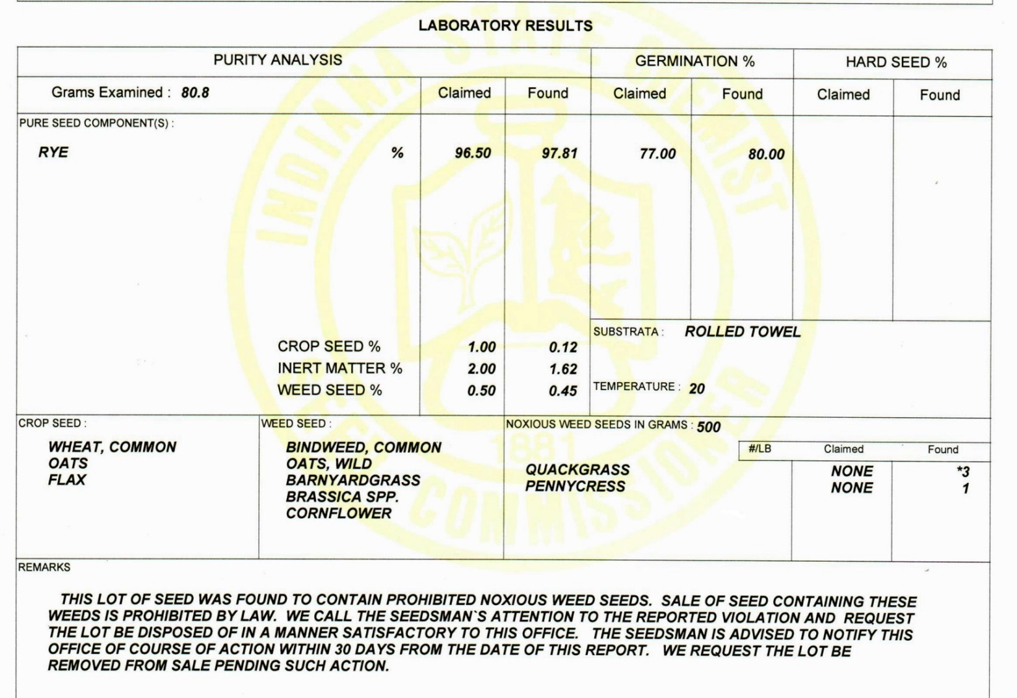
Understanding the Report

Slide 17
Organic Seed ‘16 vs ‘17
  Organic Seed Professionally Grown
    Looks pretty good
    Similar to other Corn/Beans from professional growers
  Locally Grown Organic Seed? – Disclaimer: small sample size
    High Noxious Weed Seed Rate – Two years running…
    FOURTEEN weed species/sample average! Up from 11 in ’16
    Small Seeds are harder to clean
      In many cases we suspect it hasn’t been cleaned

