Slide 1
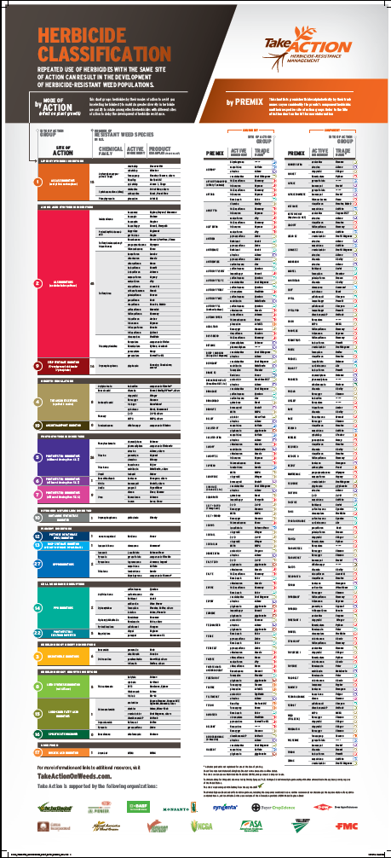
Using The Herbicide Classification Chart
Travis Legleiter
Weed Science Program Specialist
Purdue University

Slide 2
Classification Chart is a redesign of former Herbicide MOA chart
Part of the “Take Action” effort
Access to chart and other resources:
http://takeactiononweeds.com/

Slide 3
What Causes Herbicide Resistance?
Selection Pressure
The repetitive use of a single mode of action over time under non-ideal conditions.
Notes:
Chart is designed with a focus on increasing awareness of herbicide modes of action and reducing selection pressure through the use of multiple sites of action in a herbicide program.

Slide 4
Mode of Action vs. Site of Action
Terms often interchanged or confused
Mode of Action: The effect of the herbicide on plant growth and eventual death at effective doses.
Site of Action: The enzyme site or pathway that the herbicide binds or inhibits to create the plant growth effects.
Sites of action are subsets of modes of action
Notes:
One issue is the confusion of what the difference in “Mode of Action” and “Site of Action”

Slide 5
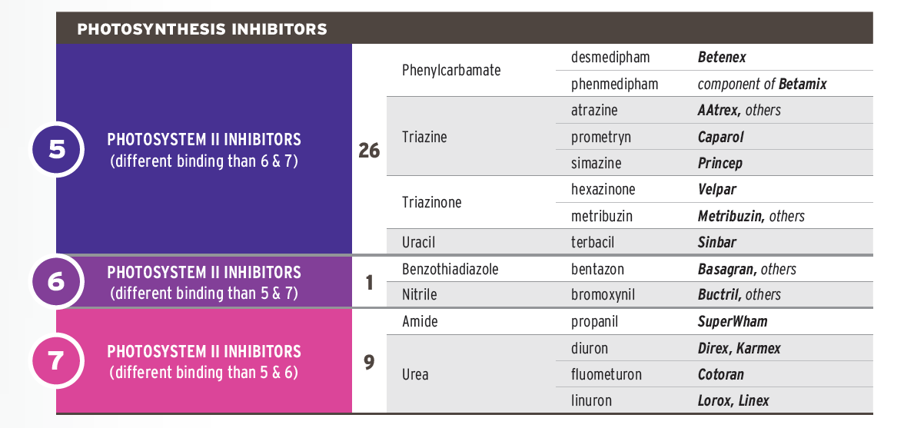
Some Modes of Action have one site of action
Other Modes of Action have multiple sites of action
Notes:
There are some Modes of Action that only contain one Site of Action, while other Modes of Action have multiple sites of action.

Slide 6
Site of Action Group #’s
Each unique site of action given a unique number
Group #’s are easier to use and recognize than scientific site of action names
These group #’s are included on many herbicide labels as well.
Notes:
Each site of action has been assigned and unique numerical value or “Group number”. This assignment of numbers for each site of action makes recognition of unique site of action easier as numerical numbers are easier to memorize and recognize than scientific site of action names. For example a group 9 is easier to recognize and retain than EPSP synthase inhibitor.

Slide 7
Chart Layout:
Publication is split down the middle into two Charts:
Notes:
This publication actually contains two different charts on each half. The two charts are used separately, but are connected by the color coding scheme and group numbers.
On the left side is the By “Mode of Action” chart that classifies herbicides by their “Mode of action” and “Sites of Action” within those modes of action. This chart contains the trade names of herbicide that contain only one active ingredient and therefore are within one herbicide group.
On the right side is the By “Premix” chart that is an alphabetical list of herbicides with multiple active ingredients. The listing identifies the site of action group numbers included in each herbicide with corresponding color coding that can be used to refer back to the left side of the chart.

Slide 8
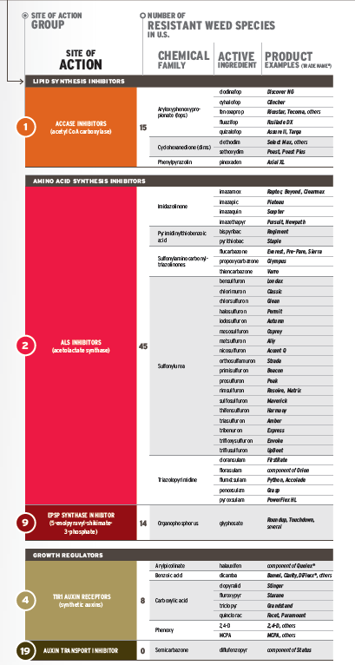
Notes:
Lets start by focusing on the “By Mode of Action” half of the chart and how it is laid out.

Slide 9
By Mode of Action:
Trade name products and their respective active ingredients
Notes:
The trade name products and their respective active ingredients are listed on the far right of the “By Mode of Action” Chart

Slide 10
By Mode of Action:
Trade name products and their respective active ingredients
Grouped By
Chemical Family
Notes:
The trade name products and their respective active ingredients are grouped by chemical Family

Slide 11
By Mode of Action:
Trade name products and their respective active ingredients
Grouped By
Chemical Family
Grouped By
Site of Action
Notes:
The chemical families are grouped by site of action, which are differentiated by different colors.

Slide 12
By Mode of Action:
Trade name products and their respective active ingredients
Grouped By
Chemical Family
Grouped By
Site of Action
Grouped By
Mode of Action
Notes:
And finally the sites of action are grouped by Mode of Action, separated by the black bars.

Slide 13
By Mode of Action:
Trade name products and their respective active ingredients
Grouped By
Chemical Family
Grouped By
Site of Action
Grouped By
Mode of Action
Chart includes: Number of resistant weed species for each site of action
Notes:
The chart also includes two sets of numbers, which need to be clarified to avoid confusion. The first set of numbers are between the sites of action and chemical family columns. As you can see if you go to the top of the chart, this is the number of weed species in the U.S. that have been confirmed resistant to each particular site of action. This gives an indication of how prone a site of action is to conferring resistance to a weed species. In example you can see that Group 2 or ALS inhibitors have “45” known resistant weed species in the U.S. indicating a high rate of conference of resistance as compared to the other sites of action which have a lower number of species.

Slide 14
By Mode of Action:
Trade name products and their respective active ingredients
Grouped By
Chemical Family
Grouped By
Site of Action
Grouped By
Mode of Action
Chart includes: Number of resistant weed species for each site of action
And Most Importantly
Group Number and an associated color for each Site of Action
Notes:
Lastly and the most important you will find a number on the left site of the site of action column which is the “Site of Action Group number”. This is the number that is most important and needs to be associated with each herbicide.

Slide 15
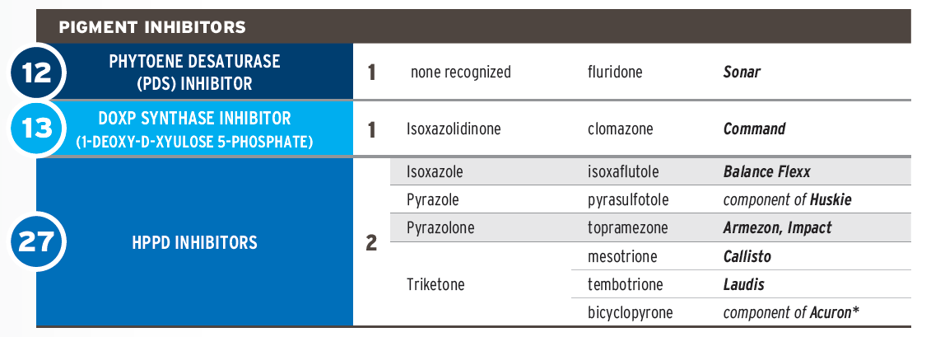
Example: Callisto
Notes:
For example lets look at Callisto. If you look in this blue section you should find the trade name product Callisto in the right hand column.

Slide 16
Example: Callisto
Active Ingredient: mesotrione
Notes:
As you move to the left you see that the active ingredient in Callisto is mesotrione.

Slide 17
Example: Callisto
Active Ingredient: mesotrione
Chemical Family: Triketone
Notes:
You will then observe that it is in the Triketone chemical family.

Slide 18
Example: Callisto
Active Ingredient: mesotrione
Chemical Family: Triketone
Site of Action: HPPD Inhibitor
Notes:
And that the Site of Action for Callisto is HPPD inhibitors.

Slide 19
Example: Callisto
Active Ingredient: mesotrione
Chemical Family: Triketone
Site of Action: HPPD Inhibitor
Mode of Action: Pigment Inhibitor
Notes:
Which fall under the mode of action: Pigment Inhibitor.

Slide 20
Example: Callisto
Active Ingredient: mesotrione
Chemical Family: Triketone
Site of Action: HPPD Inhibitor
Mode of Action: Pigment Inhibitor
Number of Resistant Weed Species: 2
Notes:
2 known weed species that are resistant to the site of action: HPPD Inhibitors.

Slide 21
Example: Callisto
Active Ingredient: mesotrione
Chemical Family: Triketone
Site of Action: HPPD Inhibitor
Mode of Action: Pigment Inhibitor
Number of Resistant Weed Species: 2
& Finally
Herbicide Group #: 27
Notes:
Lastly and most importantly is the site of action group number: 27. This is the number that should be marked down to represent Callisto.

Slide 22
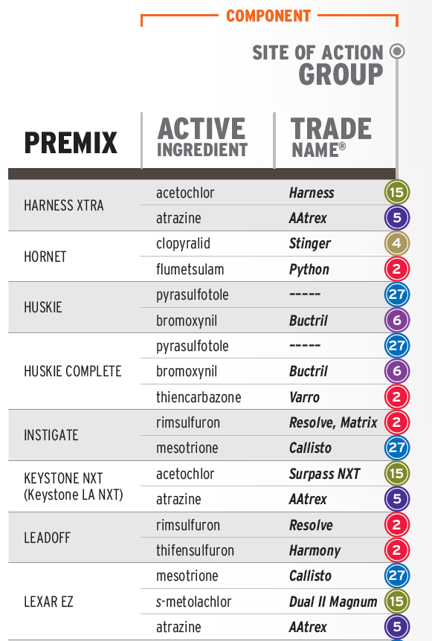
By Premix:
Notes:
Now Lets focus on the “By Premix” half of the chart

Slide 23
By Premix:
Premix names listed in alphabetical order
Notes:
The premix trade names are listed in alphabetical order, for ease of use in looking up trade name products.

Slide 24
By Premix:
Premixes listed in Alphabetical order
Includes:
-Active ingredients
Notes:
For each trade name premix there is a list of active ingredients in that premix.

Slide 25
By Premix:
Premixes listed in Alphabetical order
Includes:
-Active ingredients
-Trade names of products w/ single active
Notes:
There is also a list of trade names of products that contain those single active ingredients.

Slide 26
By Premix:
Premixes listed in Alphabetical order
Includes:
-Active ingredients
-Trade names of products w/ single active
-Site of Action Group Numbers and corresponding color coding.
Notes:
And lastly, and again most importantly there is a list of the site of action group numbers that are contained in each premix.

Slide 27
By Premix:
Premixes listed in Alphabetical order
Includes:
-Active ingredients
-Trade names of products w/ single active
-Site of Action Group Numbers and corresponding color coding.
Example:
Lexar EZ contains actives:
-mesotione (Callisto), s-metolachlor(Dual II Magnum), & atrazine(Aatrex)
Notes:
For example if you look at Lexar EZ you will see that it contains mesotrione, s-metolachlor, and atrazine. The representative trade names for each of those actives would be Callisto, Dual II Mangnum, and Aatrex.

Slide 28
By Premix:
Premixes listed in Alphabetical order
Includes:
-Active ingredients
-Trade names of products w/ single active
-Site of Action Group Numbers and corresponding color coding.
Example:
Lexar EZ contains actives:
-mesotione (Callisto), s-metolachlor(Dual II Magnum), & atrazine(Aatrex)
Those actives are in the site of action groups:
-27, 15, & 5
Notes:
Those active ingredients are in the site of action groups 27, 15 and 5. So there are three sites of action contained in the premix Lexar EZ.

Slide 29
By Premix:
Remember Callisto from the “By Mode of Action” Chart. You can link to that chart using the color coding (Blue) and group number (27).
Premixes listed in Alphabetical order
Includes:
-Active ingredients
-Trade names of products w/ single active
-Site of Action Group Numbers and corresponding color coding.
Example:
Lexar EZ contains actives:
-mesotione (Callisto), s-metolachlor(Dual II Magnum), & atrazine(Aatrex)
Those actives are in the site of action Groups:
-27, 15, & 5
Notes:
You may remember that earlier we looked at Callisto on the “By Mode of Action” side of the chart. We can connect these two halves of the chart by either looking at the color, Blue, or the site of action number, 27.

Slide 30
Outline Herbicide Programs
Use chart to outline site of action rotation
Find products on chart and write down site of action group #
What to look for:
-# of site of action used
-# of effective sites of action used
-Selection pressure placed on a site of action (used more than 2x)
Notes:
Here is an example of how to use the chart. We will look for each product on the chart and write down the site of action number for each product. We will then look at which sites of action are effective on the particular weed we are trying to control. If a single site of action is used more than 2x in a given season then it would be considered to have have significant selection pressure placed on it.

Slide 31
Herbicide Classification
Waterhemp (ALS + glyphosate resistant)
Timing | Herbicide | Active Ingredient(s) | SOA Group
Early Post | Extreme
Late Post | Flexstar GT
Notes:
Here is an example of how to use the chart. This is a program used to manage common waterhemp that has known resistance to ALS-inhibitors and glyphosate. Lets look at how many sites of action are used in this program of Extreme applied early post followed by a late post application of Flexstar GT.
First we will look up Extreme.

Slide 32
Herbicide Classification
Waterhemp (ALS + glyphosate resistant)
Timing | Herbicide | Active Ingredient(s) | SOA Group
Early Post | Extreme | imazethapyr | 2
 |  | glyphosate | 9
Late Post | Flexstar GT
Notes:
Extreme is on the “by Premix” half of the chart you find that it contains imazethapyr and glyphosate which are in the site of action groups 2 & 9.
Next we will look up Flexstar GT.

Slide 33
Herbicide Classification
Waterhemp (ALS + glyphosate resistant)
Timing | Herbicide | Active Ingredient(s) | SOA Group
Early Post | Extreme | imazethapyr | 2
 |  | glyphosate | 9
Late Post | Flexstar GT | fomesafen | 14
 |  | glyphosate | 9
Notes:
Flexstar GT contains fomesafen and glyphosate and the sites of action groups 14 and 9.
This program includes 3 different sites of action: Group 2, 9, and 14. We used group 9 twice.
What is wrong with this program?

Slide 34
Herbicide Classification
Waterhemp (ALS + glyphosate resistant)
Timing | Herbicide | Active Ingredient(s) | SOA Group
Early Post | Extreme | imazethapyr | 2
 |  | glyphosate | 9
Late Post | Flexstar GT | fomesafen | 14
 |  | glyphosate | 9
Effective Sites of Action!
Notes:
If we look at Effective Sites of action, we are actually only using one site of action: Group 14. This would be cause for concern as selection pressure is being placed on group 14. In this case an adjustment of the program would be needed to include additional effective sites of action and reduce the selection pressure on group 14.

Slide 35
Herbicide Classification
Palmer Amaranth (ALS + glyphosate resistant)
Timing | Herbicide | Active Ingredient(s) | SOA Group
Burndown | Roundup
 | 2,4-D
 | Envive
Early Post | Prefix
Late Post | Cobra
Notes:
Here is another example program used to manage Palmer amaranth with known resistance to ALS-inhibitors and Glyphosate.
We will first look up Roundup in the “By Mode of Action half of the chart”

Slide 36
Herbicide Classification
Palmer Amaranth (ALS + glyphosate resistant)
Timing | Herbicide | Active Ingredient(s) | SOA Group
Burndown | Roundup | glyphosate | 9
 | 2,4-D
 | Envive
Early Post | Prefix
Late Post | Cobra
Notes:
Roundup in in the SOA group number 9.
Next we will find 2,4-D.

Slide 37
Herbicide Classification
Palmer Amaranth (ALS + glyphosate resistant)
Timing | Herbicide | Active Ingredient(s) | SOA Group
Burndown | Roundup | glyphosate | 9
 | 2,4-D | 2,4-D | 4
 | Envive
Early Post | Prefix
Late Post | Cobra
Notes:
2,4-D which is not listed by a trade name due to several products containing this active can be found in the brown section and is a group number 4.
Next will be Envive which is a Premix.

Slide 38
Herbicide Classification
Palmer Amaranth (ALS + glyphosate resistant)
Timing | Herbicide | Active Ingredient(s) | SOA Group
Burndown | Roundup | glyphosate | 9
 | 2,4-D | 2,4-D | 4
 | Envive | chlorimuron | 2
 |  | thifensulfuron | 2
 |  | flumioxazin | 14
Early Post | Prefix
Late Post | Cobra
Notes:
Envive contains three active ingredients: chlorimuron and thifensulfuron that are both SOA action group 2 and flumioxazin that is a SOA group 14.
Next will be Prefix, which is also a premix.

Slide 39
Herbicide Classification
Palmer Amaranth (ALS + glyphosate resistant)
Timing | Herbicide | Active Ingredient(s) | SOA Group
Burndown | Roundup | glyphosate | 9
 | 2,4-D | 2,4-D | 4
 | Envive | chlorimuron | 2
 |  | thifensulfuron | 2
 |  | flumioxazin | 14
Early Post | Prefix | s-metolachlor | 15
 |  | fomesafen | 14
Late Post | Cobra
Notes:
Prefix contains s-metolachlor, SOA group 15, and fomesafen, SOA 14.
Lastly we will look at Cobra, which contains a single active ingredient.

Slide 40
Herbicide Classification
Palmer Amaranth (ALS + glyphosate resistant)
Timing | Herbicide | Active Ingredient(s) | SOA Group
Burndown | Roundup | glyphosate | 9
 | 2,4-D | 2,4-D | 4
 | Envive | chlorimuron | 2
 |  | thifensulfuron | 2
 |  | flumioxazin | 14
Early Post | Prefix | s-metolachlor | 15
 |  | fomesafen | 14
Late Post | Cobra | lactofen | 14
Notes:
Cobra has a single active ingredient, lactofen, that is in the SOA group 14.
In this program we can see that there are five sites of action being used including groups: 9,4,2,14, and 15.

Slide 41
Herbicide Classification
Palmer Amaranth (ALS + glyphosate resistant)
Timing | Herbicide | Active Ingredient(s) | SOA Group
Burndown | Roundup | glyphosate | 9
 | 2,4-D | 2,4-D | 4
 | Envive | chlorimuron | 2
 |  | thifensulfuron | 2
 |  | flumioxazin | 14
Early Post | Prefix | s-metolachlor | 15
 |  | fomesafen | 14
Late Post | Cobra | lactofen | 14
Effective Sites of Action!
Notes:
When considering Effective sites of action, that number decreases to three sites of action including groups: 4, 14, and 15. This is a better program than the previous as it includes multiple sites of action, rather than just one. A concern with this program would be that group 14’s are used three times within the season.

Slide 42
Your Turn!
-Write out your soybean program and site of action group numbers
-How many Effective Sites of Action do you have?
-Write out your programs for a 2 year corn and soybean rotation
Notes:
Now it is the audiences turn to write down their programs and spend some time looking up the SOA groups for each product and assess the effectiveness of those SOA groups. We can then assess the number of effective sites of action being used as well as analyze any selection pressure that is placed on the weeds.

Slide 43
Tools For The Battle Against Weeds
Purdue Weed Science Webpage:
Purdue Weed Science Facebook:
https://ag.purdue.edu/btny/weedscience
http://www.facebook.com/purdue.weedscience
Travis Legleiter: tlegleit@purdue.edu (765) 496-2121
Dr. Bill Johnson wgj@purdue.edu (765) 494-4656

