Slide 1
2018 Indiana Required Training for Users of Engenia, FeXapan and Xtendimax dicamba products “Threading the Needle”
Presenter:

Slide 2
The purpose of this presentation is three-fold:
To help you meet the label-mandated* training requirements for 2018.
To inform you of your responsibilities in complying with specific label use directions and requirements.
To help you appreciate the risks of off-target movement associated with the use of these products & the weed control and increased yields they may bring.
*this refers to federal label requirements for users, negotiated by U.S. EPA and the manufacturers of these three new dicamba products
Notes:
Is quality weed control and increased yields worth the heavy regulatory burden and potential liability of off-target movement? Meeting the responsibilities of regulations and risk of off-target movement for having quality weed control an increased yields.

Slide 3
Federal labels require applicators to attend dicamba-specific training approved by the State (OISC) before applying Engenia, FeXapan, or Xtendimax in 2018.
Training is required for ALL applicators using these products:
Category 1 commercial applicators
Registered technicians working under direct supervision
Certified private applicators (farmers)
Non-certified applicators working under private applicator supervision
This program has been approved by OISC and meets your label-required training obligations under state and federal regulations
Notes:
This required dicamba specific training is a label requirement, regardless of where you plan to use these products in the U.S. This training reIn 2017 registrants were responsible for training. In 2018 state-approved training is mandated. Registrant training not accepted in 2018.

Slide 4
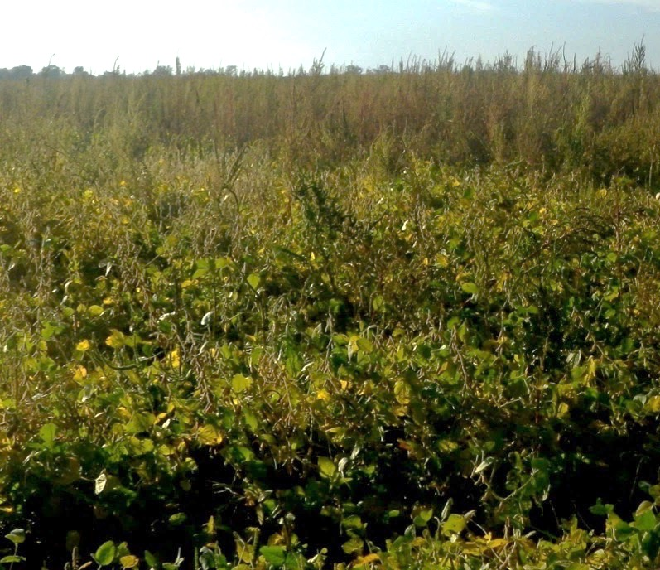
The Emergence of Resistant Weeds
What Can We Say About This That You Don’t Already Know
Notes:
This is reason why dicamba-tolerant beans are needed.

Slide 5
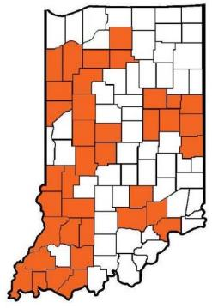
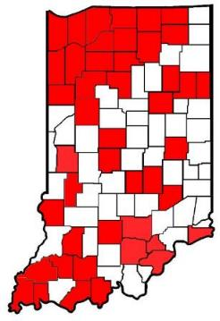
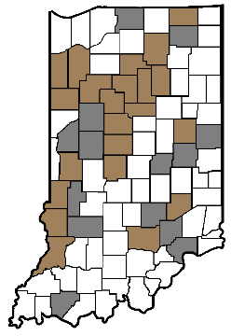
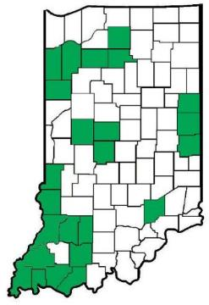
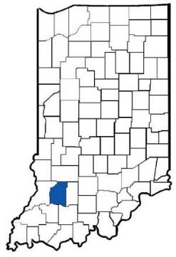
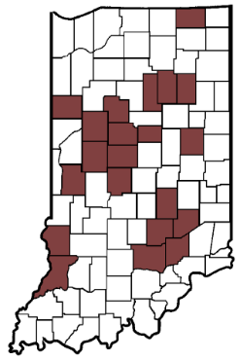
Glyphosate-Resistant Giant Ragweed
Glyphosate-Resistant Waterhemp
Palmer Confirmed (assumed glyphosate + ALS-resistant)
PPO-Resistant Palmer
ALS-Resistant Giant Ragweed
PPO-Resistant Waterhemp

Slide 6
The Need
Many herbicide-resistant weeds are already here, more to come
Resistance of multiple weeds to multiple herbicide modes of action is a game changer
Marestail - $20/A and Giant Ragweed - $30/A
Waterhemp and Palmer - $50/A
No new sites of action (unique active ingredients) coming to market any time soon
Reluctance to return to intensive tillage programs
Notes:
These are rounded estimates. But dicamba and 2,4-D good post emergent control of Marestail.

Slide 7
Control Options
Cover crops can help with Marestail, but results are very erratic with Palmer and Giant Ragweed.
Growers will migrate to the best perceived short-term solutions through their GMO seed purchases:
Liberty Link
Xtend
Enlist
Bleacher beans (Balance GT and MGI) ) – 2019???
Notes:
We refer to these as short-term solutions because over-reliance and over-use of these weed control technologies will most certainly result in additional instances of weed resistance.

Slide 8
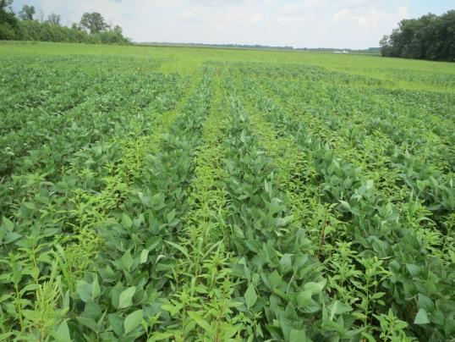
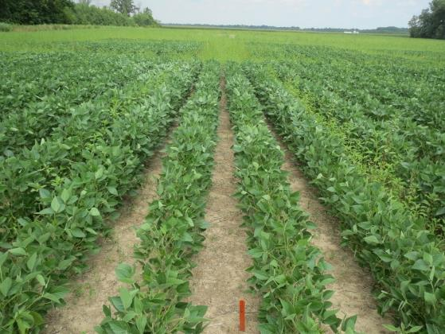
Dicamba products registered for dicamba-tolerant (DT) soybeans appear to be an effective option.
Notes:
Dicamba is a group 4 herbicide, giving alternative to break resistance cycle. Year after year use of dicamba, like any herbicide class, is not a long term solution.

Slide 9
Notes:
Research shows that herbicides volatilize more from plant surface than soils surface. So not only are smaller weeds easier to control, making applications when plants are smaller – less surface area – reduces chance of product volatilizing.

Slide 10
Notes:
Be mindful of weed growth stage when balancing optimal control and legal use application restrictions.

Slide 11
Dicamba – What Happened in 2017?
Notes:
In other words, why are we here for training today?
What went wrong in 2017 in both Indiana and many other states?
And be advised, although we will focus on the 2017 spray season for most of the next several slides, the Indiana Pesticide Review Board has been studying and evaluating the introduction of dicamba-tolerant and 2,4-D- tolerant crops and the potential impacts to non-target plants and crops since 2007, almost 10 years.
And for any of you who are not familiar with the Indiana Pesticide Review Board, they are the Governor appointed pesticide policy board for the state of Indiana. They provide both guidance and oversight to the Office of the Indiana State Chemist, and they also coordinate pesticide rule making for Indiana.

Slide 12
Official Dicamba-related Injury Investigations as Reported by State Departments of Agriculture (*as of October 15, 2017)
40
250
2
114
4
93
107
28
0
245
129
0
125
310
2
18
132
15
19
986
3
78
7
0
2
*Total: 2,708
©Dr. Kevin Bradley, University of Missouri
Notes:
As stated, the large numbers of off-target injury complaints in 2017 were a problem in many states, not just Indiana. In fact, Indiana got off luckier than many states. Regardless, the excessive number of dicamba drift or off-target movement complaints filed in 2017 were unprecedented. Estimates from many states suggest that the number of off-target incidents that actually occurred may have been anywhere from 5 to 10 times the number of official complaints filed with pesticide state lead agencies. Low complaint numbers in Michigan and Wisconsin, as compared to Indiana and Illinois, may have been due to lower weed pressure or lower adoption of the DT soybean technology. When looking at these numbers, some folks will point to a state like Georgia and the zero official complaints. While Georgia has had a very active and high quality auxin herbicide training program in place for a couple of years, it is probably worth noting that their average annual soybean acreage and cropping systems may be significantly different than many Midwestern states. They may not plant as many soybeans in close proximity to one another as we do. Regardless, we are hopeful that additional training might significantly reduce our complaint numbers in 2018.

Slide 13
OISC received record-setting numbers of drift complaints in 2017 for ALL types of applications
Notes:
Looking at Indiana-specific drift data for 2017 we see that the number & complexity of 2017 drift complaints were unprecedented. Average total drift complaints filed with OISC annually have rarely exceeded 100. The 257 total drift complaints filed was obviously a record. With the wet and windy spring and the compressed spray season, 2017 would have been a record drift complaint year with or without the contribution of dicamba. It is probably important to note that this level of drift complaint response by OISC is not sustainable unless all other regulatory priorities are permanently realigned. In 2017 OISC was forced to ignore many other compliance activities such as WPS implementation and many types of non-ag pesticide inspections just to address this onslaught.

Slide 14
Recent Drift & Dicamba Data for Indiana
Year Total Drift Dicamba Percent
2013 92 3 3%
2014 83 5 6%
2015 81 8 10%
2016 74 3 4%
2017 287 132 46%
Notes:
2017 weather made it bad year for drift. It was a record year for drift cases without dicamba applications. It was a record year for drift, considering ONLY dicamba cases.
Drilling down on dicamba specifically over the last 5 years, we can see dicamba was never involved in over 10% of our drift complaint investigations. In 2017, dicamba accounted for about 46% of all of our record number (287) of complaints.

Slide 15
Details of 132 dicamba investigations for 2017
Applicators involved:
23% Commercial applicator
62% Private applicator
15% Noncertified applicator
Target crop/site:
92% Soybean
6% Corn
1% R.O.W.
1% Pasture
Products applied:
45% Engenia
7% FeXapan
40% Xtendimax
8% Other
Notes:
We can see that for the cases processed to date, most of the applicators were certified. So, the concept of following label directions should not have been a foreign concept to most of them. That may or may not speak to the challenges of complying with ALL of the drift management restrictions on these labels. We may literally be asking applicators to “thread the needle” with their applications. We can see that although dicamba can now be legally applied to a variety of different crops, the overwhelming majority of the complaints resulted from application to soybeans.
For the 3% other cases originally filed as dicamba complaints, it was determined through investigation that other non-dicamba products were actually applied.

Slide 16
Details of 132 dicamba investigations for 2017
Off-Target Exposure Crop/Site
92% Non-DT Soybeans
1% Melons
1% Tomatoes
3% Ornamentals
1% Blackberries
2% Garden
1% Person
Route of Off-Target Exposure
23% Particle drift
3% Tank contamination
0% Inversion
0% Volatilization
0% Dust particles
0% Runoff
74% Undeterminable
Notes:
Likewise, most of our first season complaints to date involved exposure to non-DT beans. As part of the investigation process, OISC attempted, somewhat unsuccessfully, to determine with scientific or evidence-based certainty the cause of the off-target movement. That has been extremely challenging. Perhaps most notable and disturbing about these results to date is that in well over half of the off-target incidents, OISC has been unable to determine why dicamba exposure occurred. This seems to be in contrast to what some recent industry media interviews have suggested. Historically OISC has looked for things like herbicide residue or exposure symptomology drift gradients moving away from suspected sources. In 2017 we observed a drift gradient damage pattern only 17% of the time. More often we found many instances of uniform exposure across entire fields, with or without the failure to follow all label restrictions.

Slide 17
2017 Dicamba Complaint Violations
Total violative cases… 93%
Drift… 23%
Wind blowing toward adjacent sensitive crops…46%
Wind (or gusts) greater than 15 mph …4%
Wind less than 3 mph… 8%
Did not maintain a 110 ft. buffer ...2%
Did not visit website (registrant or DriftWatch)… 71%
Did not survey site… 7%
Exceeded 24” boom height …1%
Complaint withdrawn… 1%
Notes:
You can see that completely legal use of these products in 2017 has been challenging. 95% of the investigations involved at least one or more label violations. That doesn’t mean that the documented violation was the specific reason for off-target movement, but it may have contributed. . It should be noted that failure to visit a website does not by itself cause off-target movement, but it can result in lack of site awareness and the likelihood of a complaint being filed. If the only documented violation was failure to visit a web site, usually only a warning would be issued.
Regarding visiting a sensitive crop website on the 2017 labels, they state:
“Before making the application, the applicator must survey the application site for neighboring sensitive areas. The applicator must also consult sensitive crop registries to locate nearby sensitive areas where available.”….ENGENIA
“ Before making an application, the applicator must survey the application site for neighboring non-target susceptible crops. The applicator must also consult sensitive crop registries to identify any commercial specialty or certified organic crops that may be located near the application site.” …XTENDIMAX & FEXAPAN

Slide 18
EPA and Manufacturers Agreed to Make Xtendimax, Engenia, and FeXapan Federally RUPs and to Add More Label Restrictions
Notes:
The resulting 2018 labels and all the restrictions were a negotiation between EPA & the product registrants to address off-target movement. It is important to note that some states are regulating these products above and beyond the federal label because they believe that the labels may not go far enough to address the risks associated with use of these products.

Slide 19
Engenia, FeXapan, and Xtendimax Federally Registered Until November 2018 EPA will decide whether the products should continue to be registered. It appears this will depend partially on the number of off-target incidents in 2018.
This is our chance to get it right for 2018 or growers may lose these new-use dicamba products. Dicamba-tolerant seed may be available, but these herbicides may not.
Notes:
The level of acceptable or unacceptable off-target movement incidents for 2018 has not been specified, but it is presumed it would be significantly less than what has occurred in 2017. Again, part of our mission here today is to see if we can improve label compliance and hopefully reduce off-target movement so that we can preserve the technology for future use as a weed control option.

Slide 20
RUP by Indiana Pesticide Review Board (IPRB)
Classified agricultural herbicides containing at least 6.5% dicamba as State Restricted-Use Pesticide (RUP). This does not include many of the products used in turf and right-of-way.
Examples of newly state-restricted dicamba products include:
Status
Clarity
Banvel
Sterling Blue
WeedMaster
DiFlexx
The RUP Box will not be on the label of these state-restricted use pesticides.
Notes:
The IPRB (Indiana Pesticide Review Board) has studied the new dicamba and 2,4-D herbicide uses for over 10 years and determined that the potential for misuse of older more volatile dicamba formulations on new DT soybeans was too great to just ignore. Therefore, the Board determined RUP classification for all ag dicamba products was a necessary safeguard. It is important to note that although Engenia, FeXapan, and Xtendimax will all bear the RUP legend on their labels in 2018, the other state-restricted dicamba products will not. EPA does not permit the RUP legend on labels unless it is federal RUP. In addition, this training requirement does not apply to use of state-restricted products, but it is highly recommended because the older formulation products can be equally or more challenging to apply without off-target incidents.

Slide 21
RUP classification:
Restricts sale & distribution to registered RUP dealers only;
Requires dealers to keep sales records for two years;
Restricts purchase and use only to certified applicators or registered technicians or non-certified applicators working under their supervision;
Requires users to keep application records for two years.
Notes:
Just like all other RUPs currently in use. Use and record keeping by certified applicators and sale and record keeping by registered dealers will be a requirement for all dicamba products in Indiana in 2018.

Slide 22
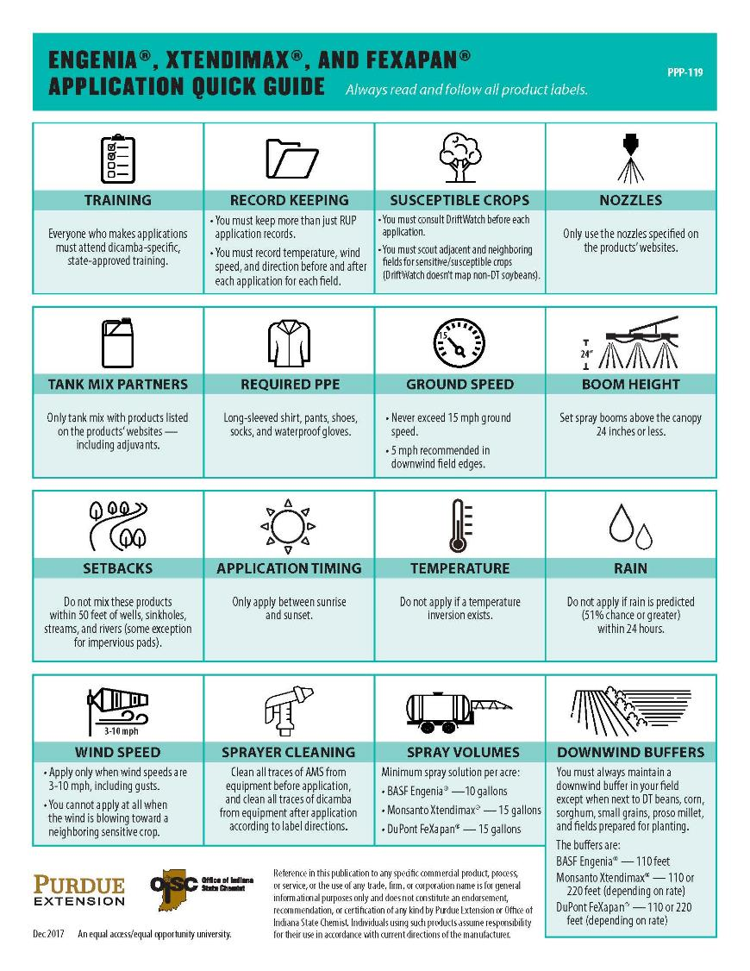
Pay attention to the labels. Many requirements among the three products are similar, but a few differences. The Quick Guide you received will help.
Notes:
This is a quick reference to help you become familiar with many of the new generation label restrictions and requirements at a glance, but should not be a substitute for studying the labels.

Slide 23
This handout includes experience-based recommendations from University Extension Weed Specialists to assist with safe & effective dicamba applications.
ALWAYS follow required, legal use restrictions…
“The label is the law”
Notes:
Stress that this handout is BMPs, NOT the Legal Restrictions. The LABEL requirements from Handout in previous slide must always be met. This handout provides recommendations that the area weed specialists have developed based on their experience.

Slide 24
Let’s walk through what a work day would look like when applying Engenia, Xtendimax, or FeXapan products.
Notes:
Expectation is the required records on the form are completed in a timely, accurate fashion. If OISC investigates the more documentation the applicator has recorded, then there is more confidence in its validity.

Slide 25
Purchasing Product at the RUP Dealer (Ag Retailer/Distributor)
Provide evidence of a private applicator permit (for personal use) or Category 1 license (for commercial use) to purchase restricted-use dicamba products.
Keep your receipt for all purchases of Engenia, Xtendimax, and FeXapan. Receipts will become part of your application record.
RUP dealer is not required to ask whether you have completed dicamba training, but they might.
Notes:
If an applicator both farms and sprays for him/herself and also works as an applicator for a commercial ag dealer, he or she should hold both a private permit and a commercial Ca.t. 1 license. The credential used to purchase the product should reflect the intended use of that product, i.e. personal or business. This requirement applies to all RUP purchases, not just dicamba.
Cat 1 business keeps shipping records from the registrant/distributor, just like any other RUP distribution.

Slide 26
Pre-Application Records
Record proof of OISC-approved dicamba-specific training.
Training is required for all applicators, including those who do not hold a permit or a registered technician credential.
Proof of training will include date, location & CCH or PARP number.
Record review date of DriftWatch for nearby sensitive crops & sites.
Record review date of registrant’s website for tank-mix partners & nozzles.
Determine who farms neighboring/adjacent fields & what sensitive non-DT crops may be planted there (non-DT soybeans not on DriftWatch).
Notes:
DriftWatch is a voluntary registry, so not all sensitive crops are registered but good place to start. Visit site no more than 7 days prior to application.

Slide 27
Neighboring/Adjacent Fields & Areas Include:
Touching or abutting
Separated by:
Vegetative strip
Fence row
Tree row
Farm lane
Driveway
Street
County, state, or interstate road
Railway corridor
Separated by:
Drainage ditch (not CRP lands)
Residential area
Body of water
Known threatened or endangered species habitat
Natural area
Wooded lot
Other similar field boundaries
Notes:
Failure to comply with the prohibition against spraying when wind is blowing toward sensitive neighboring crops was a major point of violation in 2017. So a clear understanding of what neighboring or adjacent means is important for applicators to understand for 2018 compliance.

Slide 28
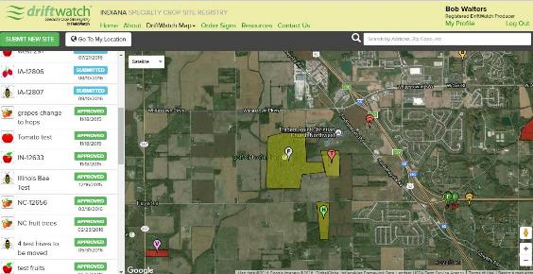
Specialty Crop Site Registry Producer View
www.driftwatch.org/
Notes:
Applicators are required to check DriftWatch for nearby sensitive crops, but not all sensitive crops, i.e. non-DT beans will not be posted on DriftWatch.

Slide 29
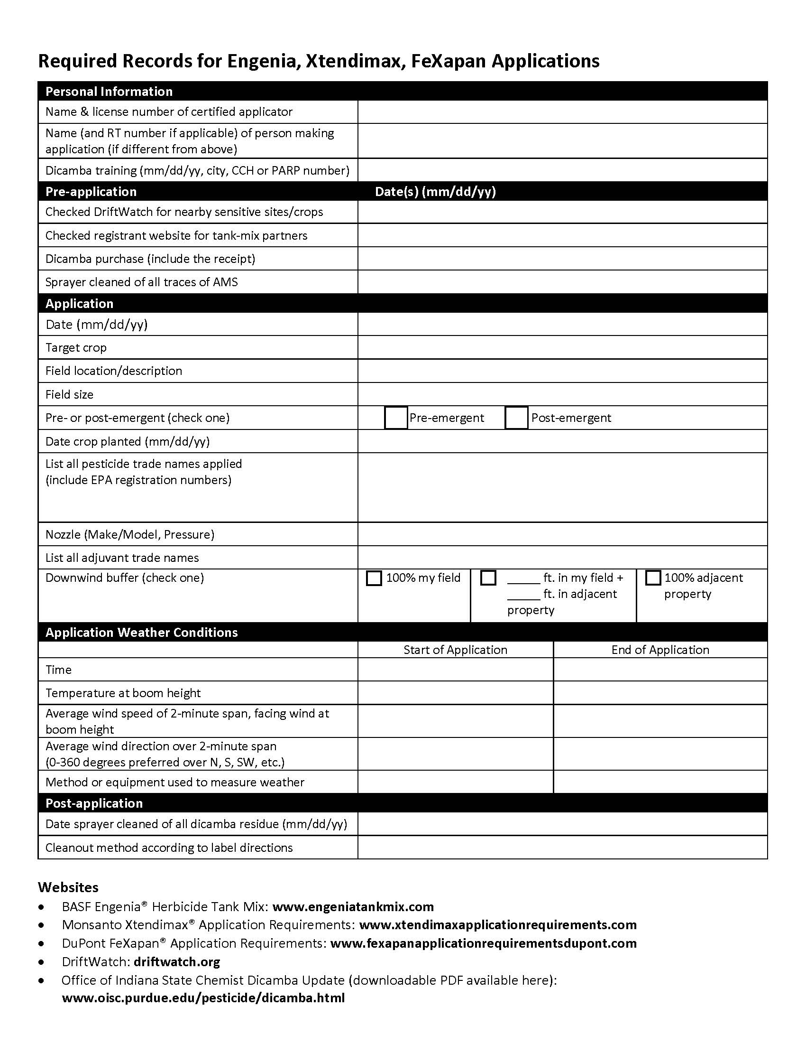
Required Record Keeping for each application
of these new Dicamba Products.
While record keeping is an applicator requirement, OISC recognizes that some tasks on the list may be jointly performed & shared by various commercial applicator business staff.
Notes:
This record keeping form is also among your handouts. A form that can be filled out on your computer will also be made available to you through the OISC dicamba herbicide web page and other sources. If you make split (different day, different time) applications to a single field, separate records will be required for each application.

Slide 30
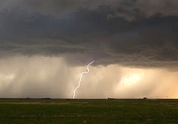
At the Farm or Custom Ag Shop
Plan application date and time:
Look at weather forecast
No application if rain expected within 24 hrs. (OISC policy forecast 51% or greater).
No application if wind speeds less than 3 mph or greater than 10 mph (including gusts).
No application before sunrise after sunset.
No application if wind blowing toward neighboring/adjacent sensitive crops.
Notes:
Finding reliable weather forecasting sources is going to be critically important for safe and legal application of these products.

Slide 31
At the Farm or Custom Ag Shop
Mixing:
Carrier rate will be minimum of 10 or 15 gallons depending on product. Product rates vary.
Tank mix ONLY with other pesticides and adjuvants listed on the manufacturer’s designated dicamba website.
Do not tank mix with ammonium sulfate (AMS) or urea ammonium nitrate (UAN).
Use ONLY nozzles listed on the website.
Do not mix dicamba within 50 feet of well, sink hole, streams, rivers, lakes, reservoirs. Some exceptions with impermeable mixing and load pads.
Notes:
Mixing with prohibited or unauthorized chemicals, either adjuvants or other herbicides, can increase the volatility of these new formulations.

Slide 32
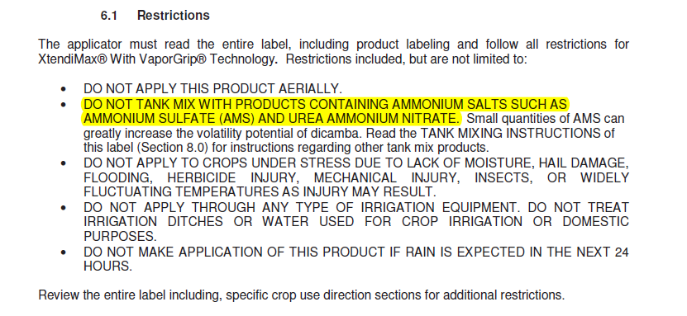
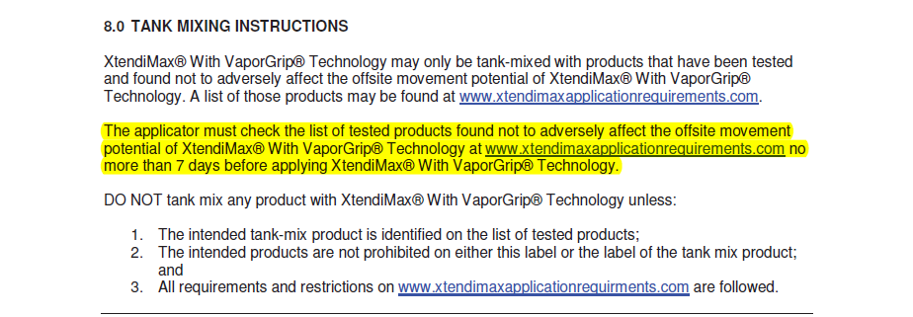
Notes:
Again, the issue of mixing with AMS or UAN and increased volatility is referenced directly on the labels, albeit in small print.

Slide 33
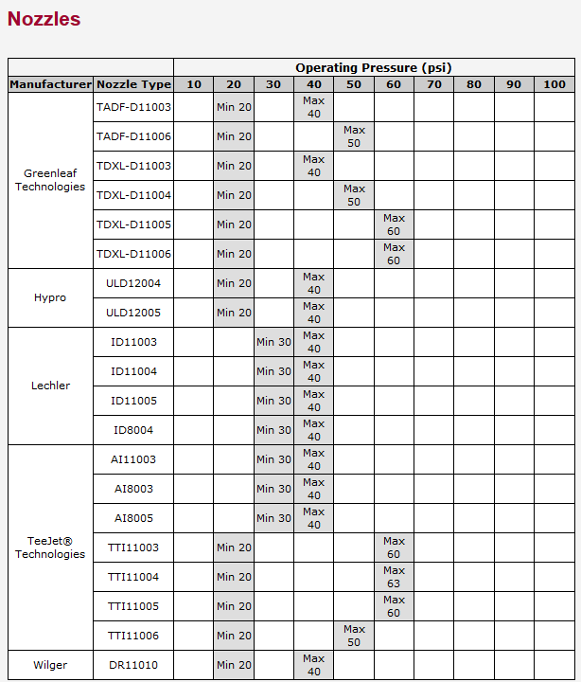
Notes:
Label directed spray nozzles have never been more closely scrutinized. The right nozzles are no longer a drift reduction recommendation, it is a legal requirement.

Slide 34
At the Application Site/Field
Scout the nearby fields for sensitive crops.
Confirm neighbor’s downwind soybeans are dicamba-tolerant.
Confirm the wind is not blowing toward adjacent susceptible/sensitive crops.
Confirm a temperature inversion does not exist at boom height.
Maintain 110- to 220-foot downwind buffer for all applications.
Buffers can include fields readied for planting, and select dicamba tolerant crops (see list on label).
Notes:
Buffers, sensitive crops, and dicamba tolerant crops will be discussed in greater detail in later slides.
Record on record how wind and temperature measured.

Slide 35
Sensitive and susceptible crops Include but not limited to:
Non-DT soybeans and cotton
Cucumber & melons
Flowers
Fruit trees
Grapes
Ornamentals (including greenhouse-grown and shade-house grown broadleaf plants)
Peanuts
Peas and beans
Peppers
Tomatoes
Other fruiting vegetables
Potatoes & sweet potatoes
Tobacco
Nurseries
Other broadleaf plants
Notes:
Do not spray when wind blowing in the direction of sensitive crops.
“Certified Organic’ crops are not listed specifically on the label, however they are a category of sensitive crops mapped on Drift Watch. Therefore in Indiana, certified organic crops would be considered sensitive or susceptible crops.

Slide 36
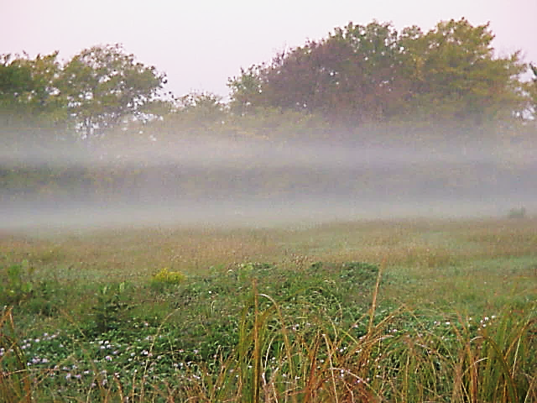
At the field of application What is this called?
WCR, LLC

Slide 37
Recognizing Inversions
Under clear to partly cloudy skies with low winds, a surface inversion is often present from late afternoon until mid-morning
Be especially careful near sunset and an hour or so after sunrise, unless…
There is low heavy cloud cover
The wind speed is greater than 5-6 mph at ground level
There has been at least a 5 degree temperature rise since sunrise
Notes:
Around bodies of water, bottom ground, in valleys, and in protected areas. The lower picture actually shows a double inversion layer. Low to the ground inversion layers will trap light weight droplets. They can not fall and will not rise. They are just waiting for some wind to blow them somewhere. Pilots have to be aware of similar situations because if they spray above the inversion the spray will not all reach the target.

Slide 38
Smoke Bomb Test (Univ. of Missouri Weed Science)
4 PM – No Inversion Present
7:30 PM – Inversion Present
Mandy Bish, University of Missouri

Slide 39
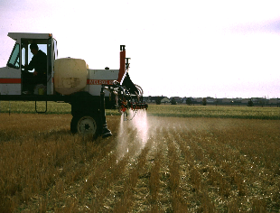
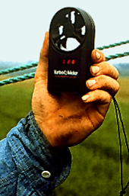
At the Application Field/Site:
Sprayers must not travel more than 15 mph
Spray boom must not exceed 24 in. above the crop canopy
Wind speeds must be between 3 and 10 mph, including gusts
Only apply between sunrise and sunset.
At start & end of each application measure & record the following at boom height:
Date
Times
Temperatures
Wind directions
Wind speeds and gusts
Measuring equipment & method (ex. Pocket Spray Smart)
Notes:
Wind direction/speed, temperature measurements must be made with a reliable, defendable source. In records describe method used to measure.
If possible with sprayer, drive 5 mph around the field border.

Slide 40
184 Legal Spray Hours At Agronomy Center (ACRE) with 2017 Label
The no spray red boxes from June 13-20, 8 days, 2” weeds can quickly grow past 4”. What’s your backup plan?
Green = > 8 spray hours in a day (3-15 mph winds including gusts)
Yellow = < 8 spray hours in a day (3-15 mph winds, including gusts)
Red = No spray; rain forecast or fields too wet
Notes:
ACRE= Agronomy Center, West Lafayette, Tippecanoe Co.

Slide 41
Agronomy Center (ACRE) – 44 Legal Spray Hours With 2018 Revised Label
Green = > 8 spray hours in a day (3-10 mph winds including gusts)
Yellow = < 8 spray hours in a day (3-10 mph winds, including gusts)
Red = No spray; rain forecast or fields too wet
Notes:
Look at number of no spray days based solely on weather conditions. This does not even include what sensitive crops you may have bordering your fields. 2018 could be better or it could be worse.

Slide 42
NE Purdue Ag Center 50 legal spray hours in June with 2018 label
Green = > 8 spray hours in a day (3-10 mph winds including gusts)
Yellow = < 8 spray hours in a day (3-10 mph winds, including gusts)
Red = No spray; rain forecast or fields too wet
Notes:
Speaker Note; Can choose one the PAC located nearby.
NEPAC = Northeast Purdue Ag Center, Columbia City, Whitley Co.

Slide 43
SE Purdue Ag Center – 64 legal spray hours in June with the 2018 label
Green = > 8 spray hours in a day (3-10 mph winds including gusts)
Yellow = < 8 spray hours in a day (3-10 mph winds, including gusts)
Red = No spray; rain forecast or fields too wet
Notes:
Speaker note: Can choose the PAC located nearby to discuss.
SEPAC = Southeast Purdue Ag Center, Butlerville, Jennings Co.

Slide 44
Wind Speeds in June at ACRE
Year | Total Hours Gusts > 10 MPH | Total Hours Wind < 3 MPH
2013 | 417 (58%) | 93 (13%)
2014 | 366 (51%) | 150 (21%)
2015 | 378 (53%) | 121 (17%)
2016 | 334 (46%) | 149 (21%)
2017 | 428 (59%) | 91 (13%)
5-year Average | 385 (53%) | 121 (17%)
Notes:
Based on wind speed alone, the 5-year average shows that only 30% of all the hours in June have winds for legal application.

Slide 45
Spray hours in June at ACRE with 2018 label
Year | Spray Hours | Sunrise to Sunset Hours Wind Gust > 10 MPH | Sunrise to Sunset Hours Wind < 3 MPH
2013 | 67 | 344 (72%) | 33 (7%)
2014 | 72 | 295 (61%) | 60 (13%)
2015 | 35 | 311 (65%) | 45 (9%)
2016 | 59 | 287 (60%) | 53 (11%)
2017 | 44 | 346 (72%) | 41 (9%)
5-year Average | 55 | 317 (66%) | 46 (10%)
Notes:
Weather Data at ACRE shows that the 5-year average for spray hours with the 2018 label is 55 hours in June. This includes rainfall forecast (an estimate that 0.1” is enough to have triggered a likely forecast rainfall), and accounting for soil conditions.
Of all of the potential 480 hours between sunrise and sunset in June, 76% have wind speeds that are off-label.
The 5-year average shows that 117 hours are available in June based on wind speed alone. This does not include wind direction, rainfall forecast, or if a field is dry enough to carry a sprayer.

Slide 46
Working Through the Label Required Buffers Is CHALLENGING!
Helpful definitions:
A buffer is the area NOT sprayed.
A buffer is always perpendicular to the wind direction.
Neighboring/adjacent=The field or area immediately next to (touching) the target field.
Also means field or area separated from the target field by only a fence row, vegetative strip, tree row, lane, driveway, road, drainage ditch, residential area, creek, river, etc. …See OISC handout for a more complete list.
Notes:
Road can be county, state, interstate.
Review the OISC Handout terms & phrases. Remember, even though the labels focus on neighboring sensitive crops and plants, Extension Weed Specialists recommend protection of any downwind sensitive plants within ½ mile of the target field.

Slide 47
Working Through the Label Required Buffers Is CHALLENGING!
Questions to Ask BEFORE Spraying
1) Is wind between 3-10 mph & not gusting over 10 mph?
If yes, proceed to next question. If no, STOP, can’t spray.
2) Is wind blowing completely away from any adjacent downwind sensitive crop (opposite direction)?
If yes, proceed to next question. If no, STOP, can’t spray.
3) If wind is between 3-10 mph & there are no adjacent sensitive crops, do I need a downwind buffer?
Yes, downwind buffers required for every application (buffer not required for CRP areas).

Slide 48
Working Through the Label Required Buffers Is CHALLENGING!
4) How much of the required 110 ft. or 220 ft. downwind buffer must come from within my field?
Depending on what is downwind of your DT soybeans, the buffer might be calculated:
all from within your field (100%);
partially from your field & partially from the neighboring property; or
all from the neighboring property (100%).
Notes:
Again, what you are allowed to use as part of your buffer past the last downwind row will be limited by the label.
The 220 ft buffer is for burndown/preplant only for Xtendimax and FeXapan – Not Engenia

Slide 49
Required Downwind Buffers
The labels specify the entire buffer will always be in your field, except when the following are immediately adjacent to the downwind side of your field.
Agricultural fields prepared for planting.(NOT certified organic ground)
Planted agricultural fields containing asparagus, corn, DT soybeans, sorghum, proso millet, or small grains. (NOT certified organic ground)
Manmade structures with walls and a roof (limited usefulness).
Paved or gravel road surfaces
Warning: vegetative shoulders alongside a road prevent most roads from being used as part of the buffer. Most of the time this exception serves no practical purpose & roads can not be used as part of the buffer calculation.
Notes:
This relatively short list of acceptable buffer areas may seem overly restrictive, but that is one of the safeguards the product registrant and EPA negotiated to get the product on the market.
New dicamba labels do not specifically address protection of organic crops/fields. However the labels do state, “Do Not apply under circumstances where spray drift may offur to food, forage or other plantings that might be damaged or the crops thereof rendered unfit for sale, use or consumption. “

Slide 50
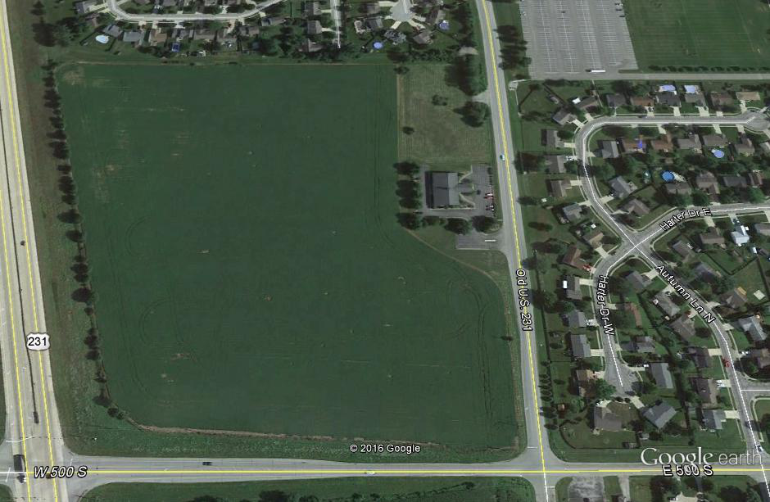
RESIDENTIAL AREA
I intend to spray 22 fluid oz. of Xtendimax. If the wind is blowing 5 MPH from this direction, and
Hwy 231 Measures 110 ft across,
DO I NEED A DOWNWIND BUFFER?
STATE ROAD VEGETATION SHOULDER
110-foot Xtend Soybean Out of Your Field
YES, Highway 231 is not immediately adjacent to field.
The 110 ft buffer will come out of your field.
COUNTY ROAD VEGETATION SHOULDER
Notes:
Downwind Buffer is perpendicular to wind direction. This map, a North and South Buffer is not needed.
Only downwind. Remember vegetative road shoulders can not be used as part of the buffer, only the paved or gravel surface.

Slide 51
RESIDENTIAL AREA
I intend to spray Engenia. The wind is blowing 5 MPH in this direction, Will I NEED A DOWNWIND BUFFER?
80-foot Xtend Soybean Out of Your Field
30-foot wide sweet corn patch
STATE HWY ROADSIDE VEGETATION
YES, 30 feet of sweet corn plus 80 feet of your Xtend soybeans.
COUNTY ROADSIDE VEGETATION
Notes:
Roadside vegetation is a considered along roads is a sensitive area because of protection of endangered species.

Slide 52
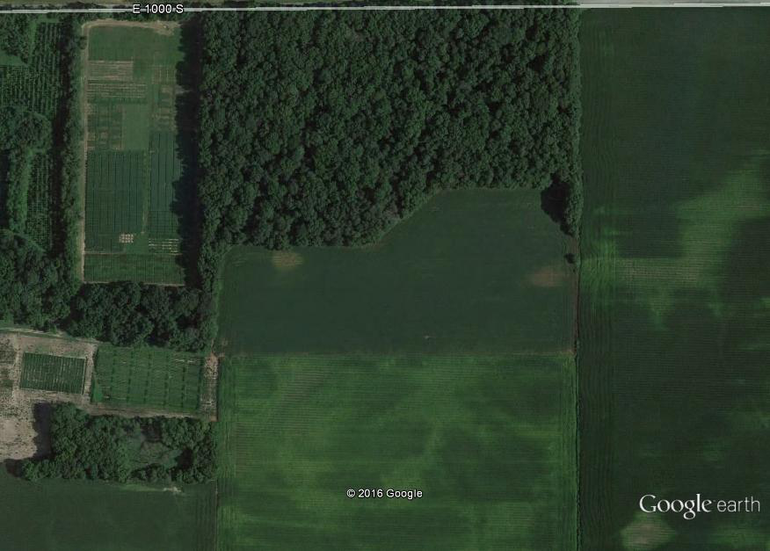
WOODED AREA (400 ft)
110-foot Xtend Soybean
Neighbor’s ROUNDUP XTEND SOYBEANS
The wind is blowing 7 MPH this
direction? DO I NEED A DOWNWIND BUFFER?
WOODED & ORCHARD AREA
Yes, all 110 ft. from your field
Notes:
You need to ask neighbor what type of bean is planted. You cannot identify difference between DT beans and Non Tolerant (normal) beans. Non DT beans are a sensitive crop, but not listed as a sensitive crop on Drift Watch.

Slide 53
Neighbors ROUNDUP XTEND SOYBEANS
WOODED LOT
If the wind is blowing 8 MPH this direction?
DO I NEED A DOWNWIND BUFFER?
110-foot Xtend Soybean
YES – All 110 feet of buffer from your neighbor’s Xtend soybeans
110-foot Xtend Soybean
Notes:
Finally, an example of where you actually get to legally spray your entire soybean field. The buffer or no-spray zone comes out of your neighbors DT beans.

Slide 54
If the wind is blowing 4 MPH this direction?
DO I NEED A DOWNWIND BUFFER
Commercial
Tomatoes
Buffer is a moot point. Application NOT ALLOWED when wind is blowing toward sensitive crop.
Notes:
Happy to report that we did not have any Indiana complaints of off-target movement to commercial tomatoes in 2017, but we do know that RedGold was very proactive prior to the 2017 season and that most, if not all, of their fields have been posted on DriftWatch for a number of years. May be cause and effect or may be a coincidence, but we do anticipate that more dicamba could be applied in 2018 as compared to 2017.

Slide 55
If the wind is blowing 9 MPH this direction?
Can I spray now?
No! It’s not just limited to commercial tomatoes this year. Wind blowing toward neighboring sensitive crop you cannot spray!
Grandpa’s Grape Arbor
Could apply to part of the field on this side of dashed line
Notes:
Could apply to part of the field south of the dashed line. You would have to wait until the wind blows in a different direction to spray the rest of the field north of the blue line. This would be a separate application with a separate record.

Slide 56
Grapes & Beehives
Wooded Lot
Neighbor’s Corn &
Wheat
If the wind is blowing 13 MPH this direction?
Can I spray FeXapan now?
Neighbor’s personal vegetable garden
No. Cannot spray when wind is above 10 MPH.
Notes:
This would have been a legal application (<15 mph) in 2017, but is off-label in 2018. The presence of a sensitive crop somewhere downwind, not just adjacent, was probably a factor in some of the 2017 off-target complaints, but where do you draw the line?

Slide 57
Wooded Lot
Watermelons
Neighbor’s DT Soybeans
There is no wind - dead calm - can I spray now?
Commercial
Tomatoes
No, Application Not Allowed when wind under 3 MPH (inversion potential).
Notes:
Again, measured temperature differentials above and below boom height or smoke bombs in the field are probably more reliable ways to identify a temperature inversion, but the 0-3 mph wind is sort of a default. One of the biggest challenges with applying into a temperature inversion is the unpredictability of the wind direction once the wind does pick up again hours later. In this example, calm winds during application that shift to winds from the East tomorrow morning could be devastating.

Slide 58
County road with vegetative shoulder
Wooded Lot
110-foot Xtend Soybean
If the wind is blowing 9 MPH this direction?
DO I NEED A DOWNWIND BUFFER?
Neighbors ROUNDUP XTEND SOYBEANS
110-foot Xtend Soybean
Yes, all 110 ft. from your field
Notes:
Because winds don’t always blow completely perpendicular to field edges or neighboring fields, a 2-sided buffer may often be required, based on wind direction. Again, in this example, because acceptable buffer areas do not butt directly up to the downwind edges of this field, all 110’ no-spray buffers must come out of your field.

Slide 59
Nature Preserve
Well, when the heck can I spray???
Melons
When winds are 3-10 MPH not blowing toward sensitive crops.
It’s between sunrise and sunset.
No rain forecast (51%) for next 24 hours.
Non-DT Soybeans
Grapes
Still need a downwind buffer!
Commercial
Tomatoes
AND, volatility can occur for several days after application and move with any wind at that time.
Consider BMP of any sensitive plant within ½ mile or more.!
Plant Nursery
Notes:
* BMP recommendation is ½ mile from sensitive crop.

Slide 60
Clean
the
Spray Tank
Notes:
Is it easy for 1 gallon of material to hide in a spray rig somewhere?
Read label for recommended tank cleaner to use.

Slide 61
Post Application
Confirm and record that the spray system has been rinsed according to the label.

Slide 62
Post Application
Create the records within 14 days of application.
Keep records for at least 2 years.
Remember, if split treatment is made in a field, two separate records will be required since application time, temperature, & winds may be different.
Required application recordkeeping consists of two parts:
Standard RUP records (all dicamba products); plus
Label-required records (Xtendimax, Engenia, & FeXapan.)

Slide 63
RUP application information (all RUP Dicamba Products)
Location
Applicator name and permit number
Date of application
Crop
Pest
Acres treated
Rate
Total amount used
Brand name & formulation
Manufacturer
EPA registration number
Notes:
11 required items for RUP record. You can designate the RUP records from other pesticide records with a *, asterisk; or ‘RUP’, etc. It’s to your benefit to record all pesticide applications you make.
If a non-certified person applies pesticides under your supervision, your name and permit number are recorded. The private applicator is accountable for that application. And if you allow someone else to use your name and permit number to make a RUP application, it’s your name that is on the line.
These are the 11 items of required information for RUP records and you have 30 days following an application to record it.

Slide 64
Additional records for Xtendimax, Engenia, and FeXapan include:
Proof the applicator was trained
Receipts for product purchase
Product label
Date you visited DriftWatch for nearby sensitive crops & documentation that you surveyed nearby fields for sensitive crops prior to application (BMP within ½ mile).
Pre-emergence or Post-emergence (if post, also include number of days after planting).
List of all products in the tank mix
Type of nozzle & pressure used
Date & start & finish times of application
Air temperature at the start & end of application, measured at boom height
Wind direction & speed at start & end of application, measured at boom height
Date the sprayer was cleaned & method used to clean it
Notes:
2 sets of records needed for Xtendimax, Engenia, FeXapan.
This set– record sheet PPP119 and RUP records.

Slide 65
You were given this recordkeeping form to use as a guide. The form is available at OISC website as a pdf you can print or fill in and save electronically.

Slide 66
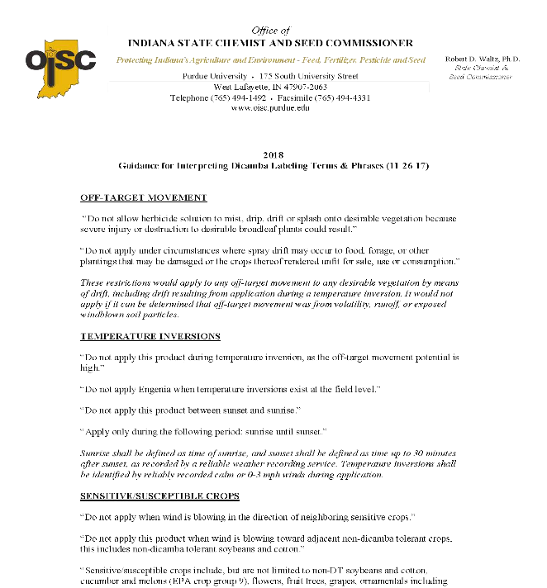
The label is complex, requiring much from the user of these products.
Observe OISC’s guidance for “Interpreting Dicamba Label Terms And Phrases.”
Guidance was developed thru consultation & input with EPA & registrants.
Notes:
This guidance was developed by OISC after consultation with both registrants and the EPA staff that negotiated these labels. OISC will use this compliance guidance in responding off-target incidents in 2018. This guidance has been included with your take home handouts and is also available, along with all other training materials from today on the OISC Dicamba Herbicide Update website.

Slide 67
Keep in mind
Q: We’ve been spraying dicamba on corn since the 1960’s and there hasn’t been any resistance issues, so why can’t I just spray Engenia, FeXapan, or Xtendimax 3 times a season?
A: We’ve been down this road, it was called “Roundup Ready”. HISTORY will repeat itself if we do the same thing − RESISTANCE!
Bill Johnson, Purdue weed scientist
Rotate herbicide classes when possible as a way of reducing resistance. Dicamba is a Group 4.
Do your part to preserve the technology!
Notes:
Over-use + No rotation of groups = Resistance.

Slide 68
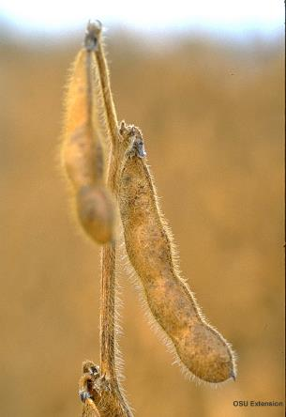
Conclusion
Weed resistance is a real and ever-growing issue.
Rotate herbicide classes when possible as a way of reducing resistance.
Dicamba products are important tools in managing resistant weeds such as marestail, Palmer, and water hemp in dicamba-tolerant crops such as soybeans.
The label is written to put all of the liability (both regulatory and civil) on the applicator. Follow the label.
There are alternatives to dicamba products in soybeans in many cases.
Notes:
OISC Handout

Slide 69
“Threading The Needle”
To prevent spray technology from falling apart in 2018
Notes:
These products are going to be very challenging to use legally, but we hope you now have an idea of potential pitfalls before you plan your 2018 weed control options.

Slide 70
Contributors:
Joe Ikley, Weed Science Professional Assistant, Purdue University
Bill Johnson, Professor of Weed Science, Purdue University
Dave Scott, Pesticide Program Administrator, Office of Indiana State Chemist
Fred Whitford, Clinical Engagement Professor, Purdue Pesticide Programs

Slide 71
Best Management Practices
Do not apply if sensitive crops are within ½ mile
Pay attention to wind forecast 2-3 days after application
Use an app like Spray Smart to check for inversions
Avoid applications when temperatures exceed 80 degrees
Higher temps = higher risk for volatility
Consider Preplant, Preemergence, or very early Postemergence only
TALK TO YOUR NEIGHBORS
Notes:
OPTIONAL: Weed Specialists put together this slide on BMP of dicamba applications. The points have been addressed throughout the presentation. But if you prefer to talk from this slide, add it where you see fit.

