Slide 1
Fertilizer
Application
Regulations
Presenter
Revised by: Ramona Briggeman
Fertilizer Control Specialist, Office of Indiana State Chemist
11-2022

Slide 2

OISC regulations do not replace any of the Indiana Department of Environmental Management manure regulations, permitting, spill reporting, or other
water quality standards
Notes:
The Office of Indiana State Chemist (OISC) and the Indiana Department of Environmental Management (IDEM) play complementary roles in protecting waters of the State.
IDEM regulated the Confined Feeding Operations (CFO) and the manure they store and apply.
OISC regulates the manure distributed from a CFO and all other manure.

Slide 3
Why are we
regulating nutrients?

Slide 4
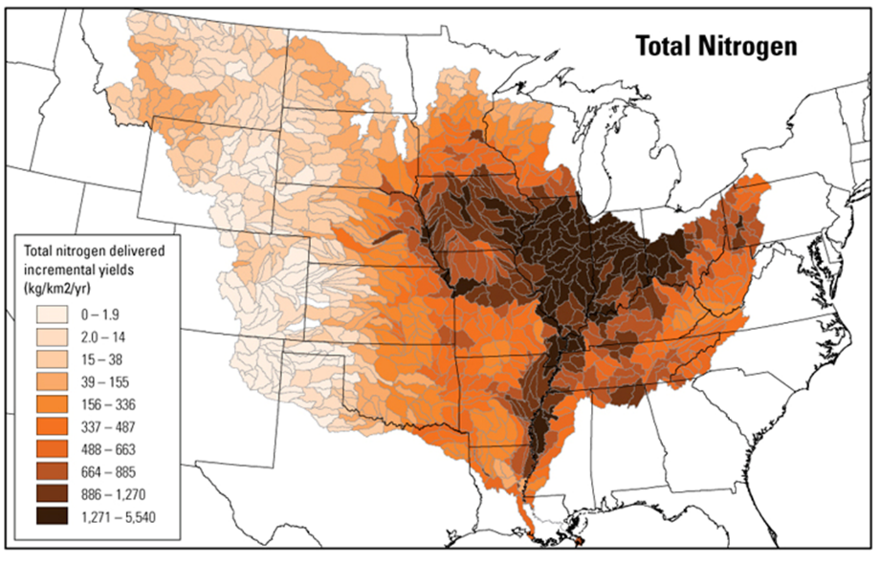
USGS SPARROW model
Notes:
You can discuss the hypoxia zone in the Gulf of Mexico, issues with Lake Erie, and Chesapeake Bay.
The Two Sparrow Models indicate an estimate of the amount of a contaminant (nitrogen and Phosphorus) transported from inland watersheds to larger water bodies by linking monitoring data with information on watershed characteristics and contaminant sources.
Fertilizer applications can affect not only the field they are applied on and areas close to the application site but can also make their way to the Great Lakes and even the Gulf of Mexico. This migration of nutrients causes detrimental affects to the ecology of these systems. This can impact the wildlife and people in those regions. Commercial fisheries are impacted by hypoxic zones (dead zones) in the gulf of Mexico. The fertilizer regulations are meant to minimize the amount of nutrients lost during fertilizer applications. Following setback rules and applying at an appropriate agronomic rate ensures your fertilizer is staying where you want it. This helps keep nitrogen and phosphorus in the field to help the crops grow and out of our waterways.

Slide 5
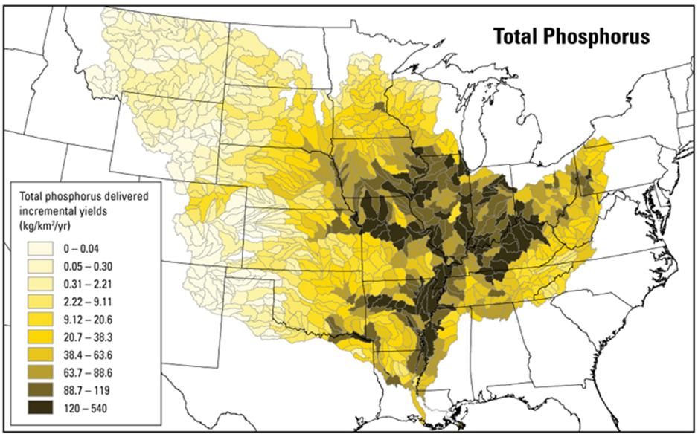
USGS SPARROW model

Slide 6
What is a Fertilizer Material?
It is any substance containing nitrogen, phosphate, potash or any recognized plant nutrient that: (1) is used for the plant nutrient content; and (2) has nutrient value in promoting plant growth.
Two Types:
Inorganic: 28%, potash, anhydrous ammonia
Organic: manure, compost, dry distiller grains, spent silage
Exemptions:
Lime, gypsum, biosolids
Notes:
Presenter note: First some definitions to get started –
Inorganic does not include Lime or gypsum
Organic does not include Biosolids, Biosolids are regulated by the Indiana Department of Environmental Management
"Fertilizer material", means any substance containing nitrogen, phosphate, potash, or any recognized plant nutrient that: (1) is used for the plant nutrient content; and (2) has nutrient value in promoting plant growth. The term includes unmanipulated animal and vegetable manures

Slide 7
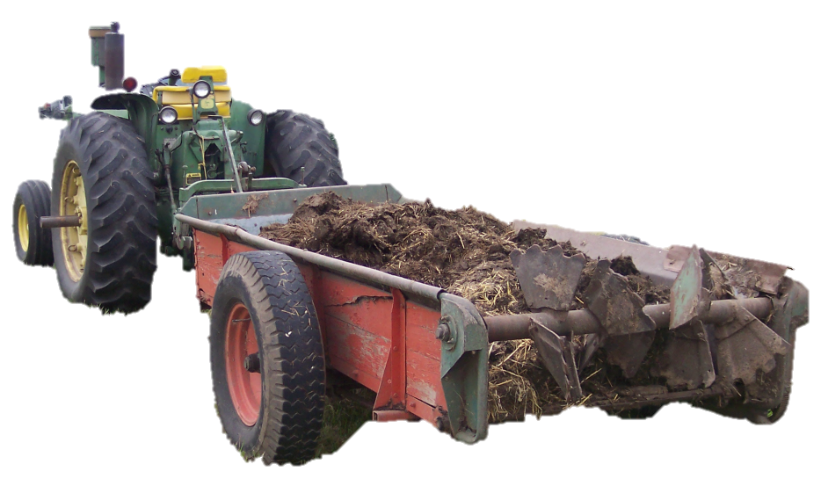
Who is exempt from standards?
Any person distributing or using less than 10 cubic yards or 4000 gallons of any type of fertilizer material* in a calendar year.
Notes:
Know it’s not much of an exemption
*This is the same exemption as with certification but now applies to Inorganic as well as Organic

Slide 8
What creates 10 yrd³ per year?
10 yrd³ is produced by:
  Sow = 2
  Finishing Hogs =10
  Steer = 1
  Dairy Cow = 1
  Ewe = 7
  Horses = 1
  Layers = 239
  Broilers = 212
  Turkeys = 82
  Ducks = 118
                Source: IDEM numbers
Notes:
Anybody who cleans out a barn/stall with one horse will produce 10 cubic yards in a year….the farmer/grower is required to have an application plan and follow application setbacks. However not everyone is required to be licensed.

Slide 9
Who needs an Applicator License and
Category 14 Certification?
Persons who apply or transport commercial fertilizer material including manure FOR HIRE. Business License + Applicator License
Persons who APPLY or TRANSPORT MANURE, from the following:
  Indiana regulated confined feeding operations.
  Operations outside Indiana that would be permitted confined feeding operations if they were located in Indiana.
  Private applicator if applying manure (from an IDEM permitted facility) for their own crop
Notes:
Quick review of who needs to be certified. Who needs a license to apply manure? Anyone who does business for hire: if they aren’t applying or transporting for themselves then its likely for hire. Think of IDEM Permitted CFO manure as Restricted Use Poo (RUP) or manure. Just like with restricted use pesticides. You must be certified or supervised by someone who is certified to haul, transport, or apply.
OISC Licensing for IDEM Permitted Facilities handout available

Slide 10
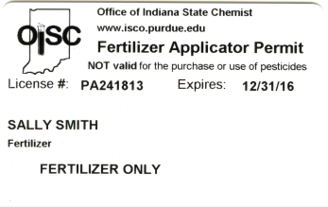
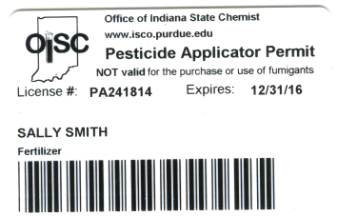
Category 14 Certification
Who does it apply to?
For Hire Ag & Transporters (commercial)
Users of manure from a Permitted CFO (private)
Manure that is custom-applied doesn’t require the grower to be certified, just like RUP and private pesticide applicators.
Notes:
USE = apply, handle & transport Third-party delivery to “co-op” is exempt. Delivery to end user isn’t exempt from certification
Card on left is Private Applicator Category 14 (Fertilizer-Only) cannot purchase Restricted use pesticides
Card on right is a Private Pesticide Applicator permit w/ Category 14.
Custom-applied manure just like custom applied pesticide, grower doesn’t need to be certified but applicator does.

Slide 11
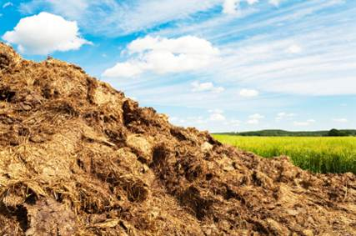
Fertilizer Material Use,
Distribution
and Record Keeping

Slide 12
CFO Manure Required Records for Distributor/Seller
Distributor (seller) must have a Distributor License.
Applicator must have Category 14 Certification to obtain manure from IDEM Permitted CFO.
Record: Name, certification number, amount sold (Tons, gallons), manure analysis (NPK), date.
Records kept for 2 years.
Notes:
Only manure from an Indiana Department of Environmental Management (IDEM) permitted CFO requires recordkeeping by the seller or distributor.
Distributors (seller) must have a Distributor license to sell, barter, and/or give away manure from an IDEM permitted CFO.
Applicator must have Category 14 certification and Application License (can be For Hire or Private). If “for hire” they must be working for a Licensed Fertilizer Application Business. (A non licensed individual may buy the manure, but they must have a licensed applicator do the application. The CFO will need the licensed applicators name and License # for their records.
IDEM already requires record of this information, just adding certification number of buyer. IDEM requires records to be kept for 5 years
Records must be made available upon request of OISC investigator.

Slide 13
Fertilizer Plan
Fertilizer Plan required by ALL growers.
  Required for both Manure (organic) and Inorganic Fertilizer applications
The Fertilizer Plan, at a minimum, is a written plan that ties the application of fertilizer to agronomic rates.
Must include how fertilizer rates are determined.
The purpose is that you have thought about rates to meet the crop’s needs.
Notes:
Plan required by everyone who applies fertilizer materials – inorganic/commercial and manure/organic. Certified and not certified.
Certified/ licensed applicators must keep application records for 2 years
Both Manure (Organic) and Inorganic Fertilizer [what you buy from your ag retailer or distributor]. Liquid or solid fertilizer included as well as anhydrous ammonia)
Rule does not really specify what is in the plan except to mention how fertilizer rates are determined. Nutrient application at agronomic rates for producing an agricultural crop.
Agronomic rate is defined in the rule (on the next slide)
Think paragraphs, not plan.
Maybe manure sample, or standard replacement value of 1.2 pounds per bushel of corn removed, soil sampling, tri-state fertilizer recommendations, yield records
IDEM permitted CFO is required to have manure analysis, non permitted CFO does not. Highly recommend having analysis
A fertilizer plan is the grower’s defense against unpreventable acts of nature (storms, floods, etc).

Slide 14
Agronomic Rates
The nutrient content of the fertilizer material to be applied (ie manure analysis).
The fertility level of the soil (soil analysis).
The nutrient needs of the current or planned crops (crop rotation and yield goals) .
The nutrient holding capacity of the soil.
Additional sources of nutrients, including legume credits, process wastewater, or biosolids.
Reasonable nitrogen losses.
Reasonable phosphorus levels
Keep records for 2 years.
Notes:
How do you determine if you are applying at an appropriate agronomic rate? Appropriate agronomic rate based on Nutrient content of manure, crop rotation, yield goals, soil analysis.
Manure analysis- (NPK) Nitrogen, Phosphorus, Potassium (or other sources)
Soil analysis- Phosphorus levels
Crop rotation – i.e. beans into corn with a yield goal of 200 bushels/acre
Recommendations from a licensed Certified Crop Advisor (CCA)
Recommendations from your Ag dealer
Using Tri State recommendations
Online/Computer based fertilizer applicator calculator Purdue’s Manure Management Planner
A fertilizer plan is the grower’s defense against unpreventable acts of nature (storms, floods, etc).
Keep records for 2 years- 5 years for IDEM permitted farms

Slide 15
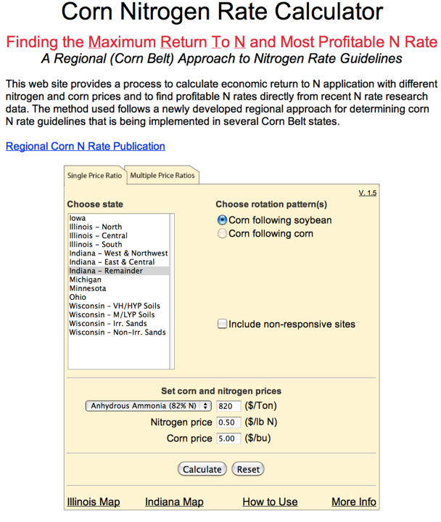
Fertilizer Plan Resources:
Tri-State Fertilizer Recommendations,
https://extensionpubs.osu.edu/tri-state-fertilizer-recommendations-for-corn-soybean-wheat-and-alfalfa-pdf/
Agronomist recommendations
The following websites:
http://cnrc.agron.iastate.edu/
https://www.purdue.edu/agsoftware/mmp/
Notes:
Plan resources

Slide 16



Staging rules

Slide 17

Staging
Staging is the temporary placement of product in a pile in preparation of field application. The fertilizer material is meant to be used now, rather than later.
Fertilizer materials behind the barn are not defined as ‘staging’ and are exempt from setback restrictions.
Notes:
Staging is IN the field for application purposes. Piles behind barns at the CFO facility do not meet the definition for staging. These storage piles are not regulated by the Office of Indiana State Chemist.
Storage piles behind the barn may be subject to IDEM Regulation and WILL BE if runoff contaminates water. Even though these piles are not regulated by OISC it is recommended as best management practices to follow the setbacks r

Slide 18
Inorganic Fertilizer Staging
Restrictions
Cannot place within 300 feet of surface water, drainage inlets (risers in field) or water wells.
Cannot place in standing water, a waterway,
or floodway.
After 72 hours, the pile needs to be
covered.
Can be staged along property line
      Applied within 30 days.
Notes:
More common sense approaches for inorganic fertilizers
Floodway as defined by Department of Natural Resources (DNR)
Staging is temporary = cover after 72 hours; applied within 30 days. Example is potash in the fall.
Floodway determination: If grower unsure if location in field is floodway/plain, DNR has website of digital maps that can help identify area in question.
DNR Floodplain Information page www.floodmaps.in.gov. Select “Indiana Floodplain Information Portal”

Slide 19
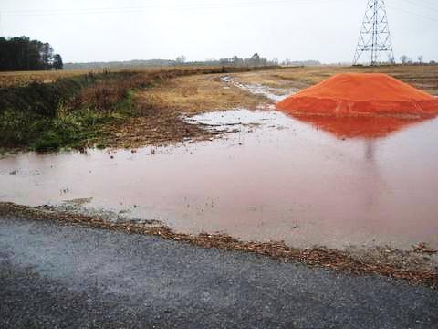
Potash Staging
Notes:
They “had” to take delivery (because their early price was delivery by a date xxx) They get 5” of rain that week. Red Arrow shows there is a ditch

Slide 20
Manure (Organic) Staging Restrictions
Do not place within 300 feet of surface water, drainage inlets or water wells.
Cannot place in standing water, a waterway or floodway.
After 72 hours, the pile needs to be covered or bermed.
Notes:
These points are the similar to inorganic staging.

Slide 21
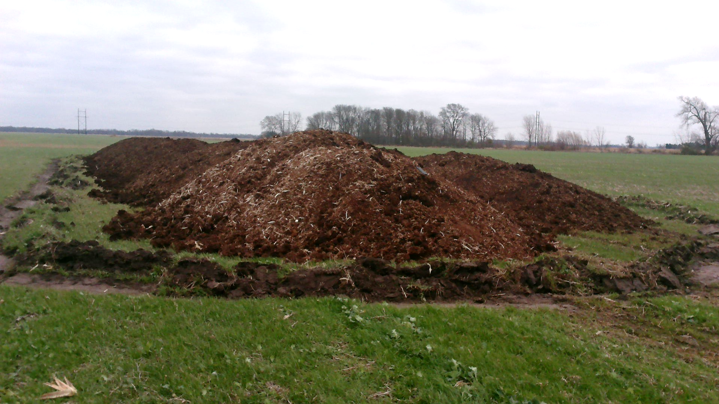
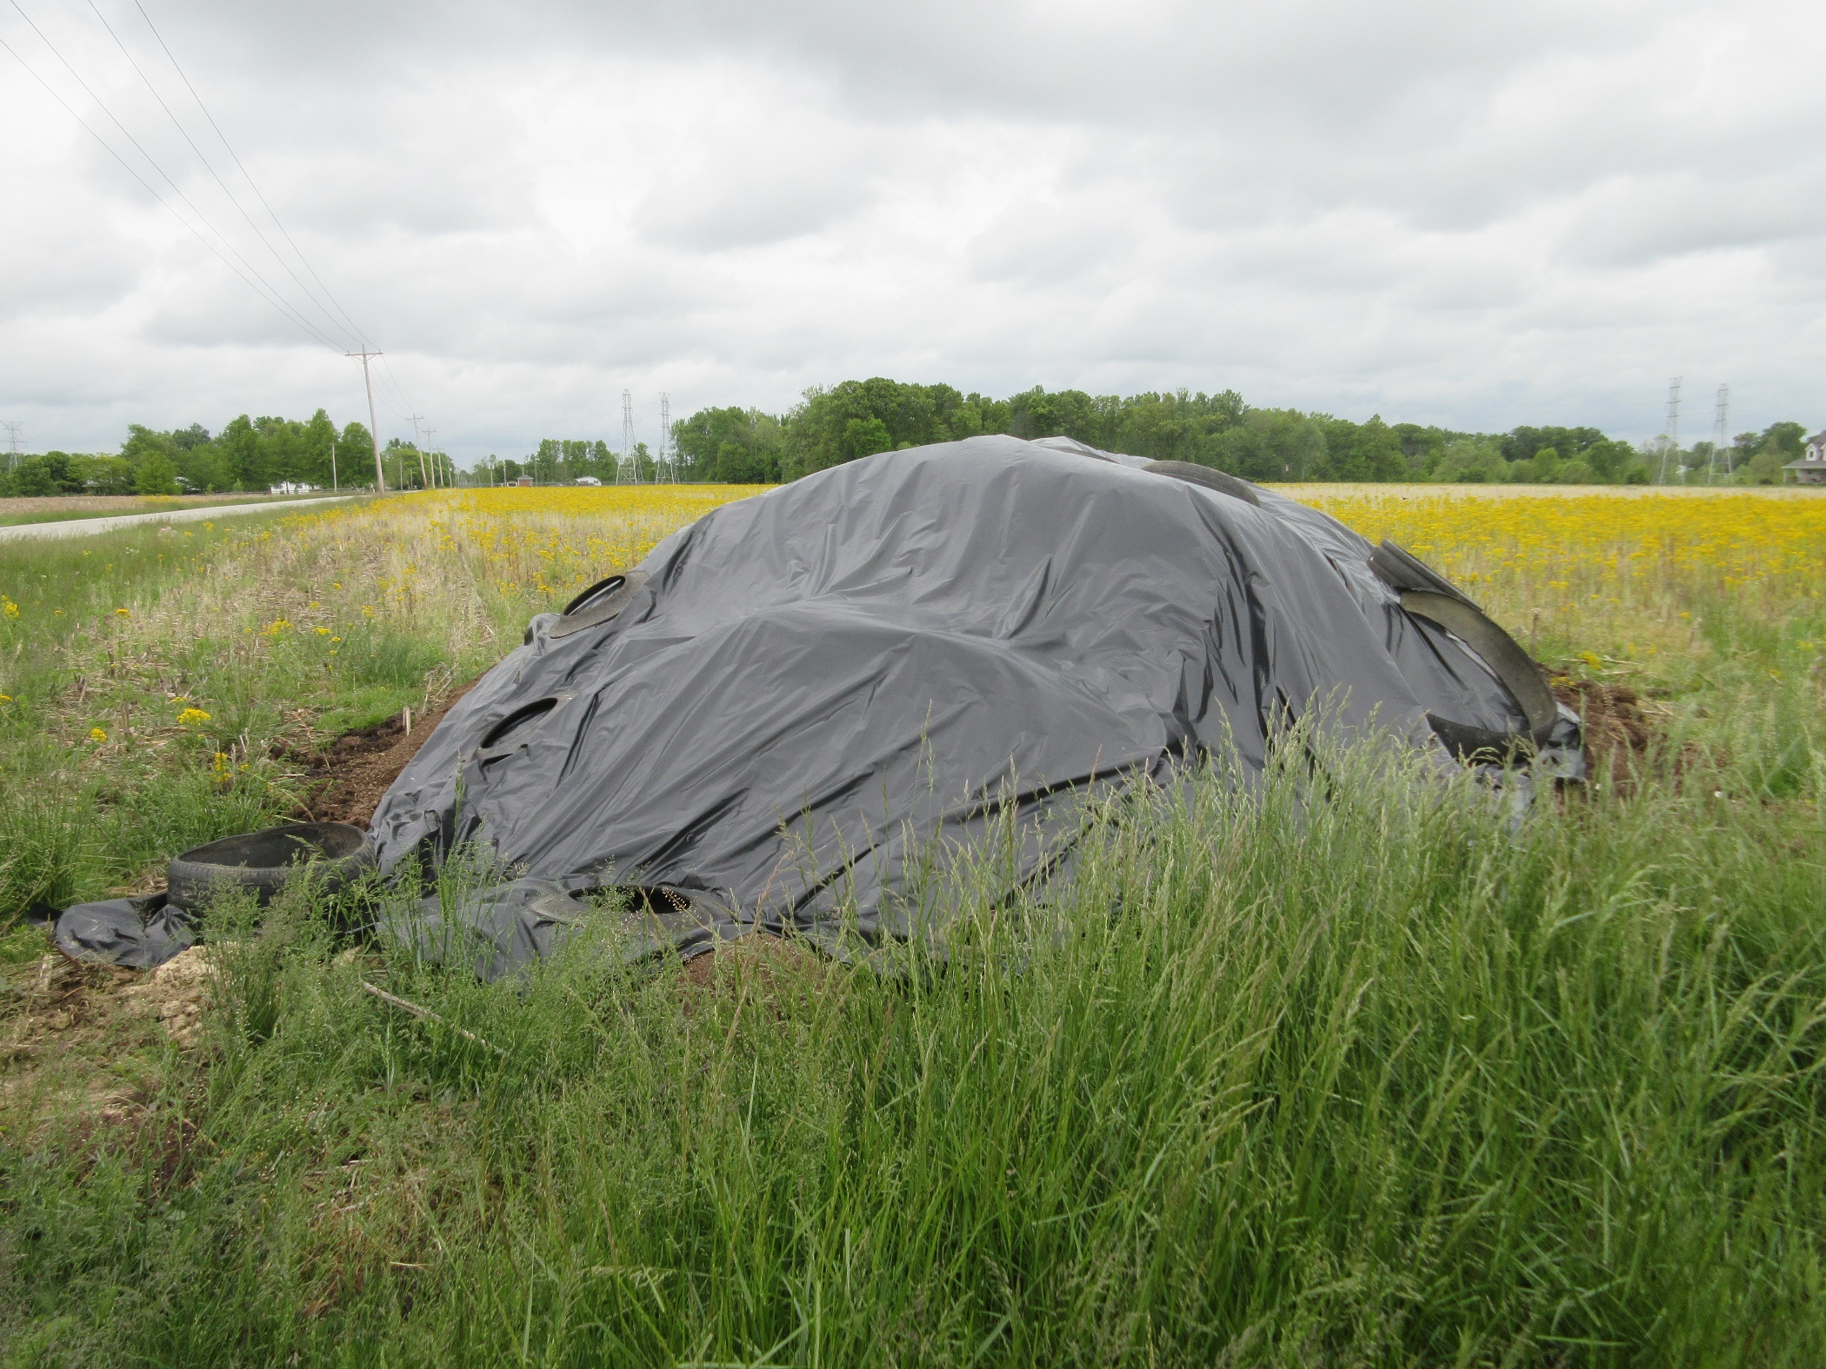
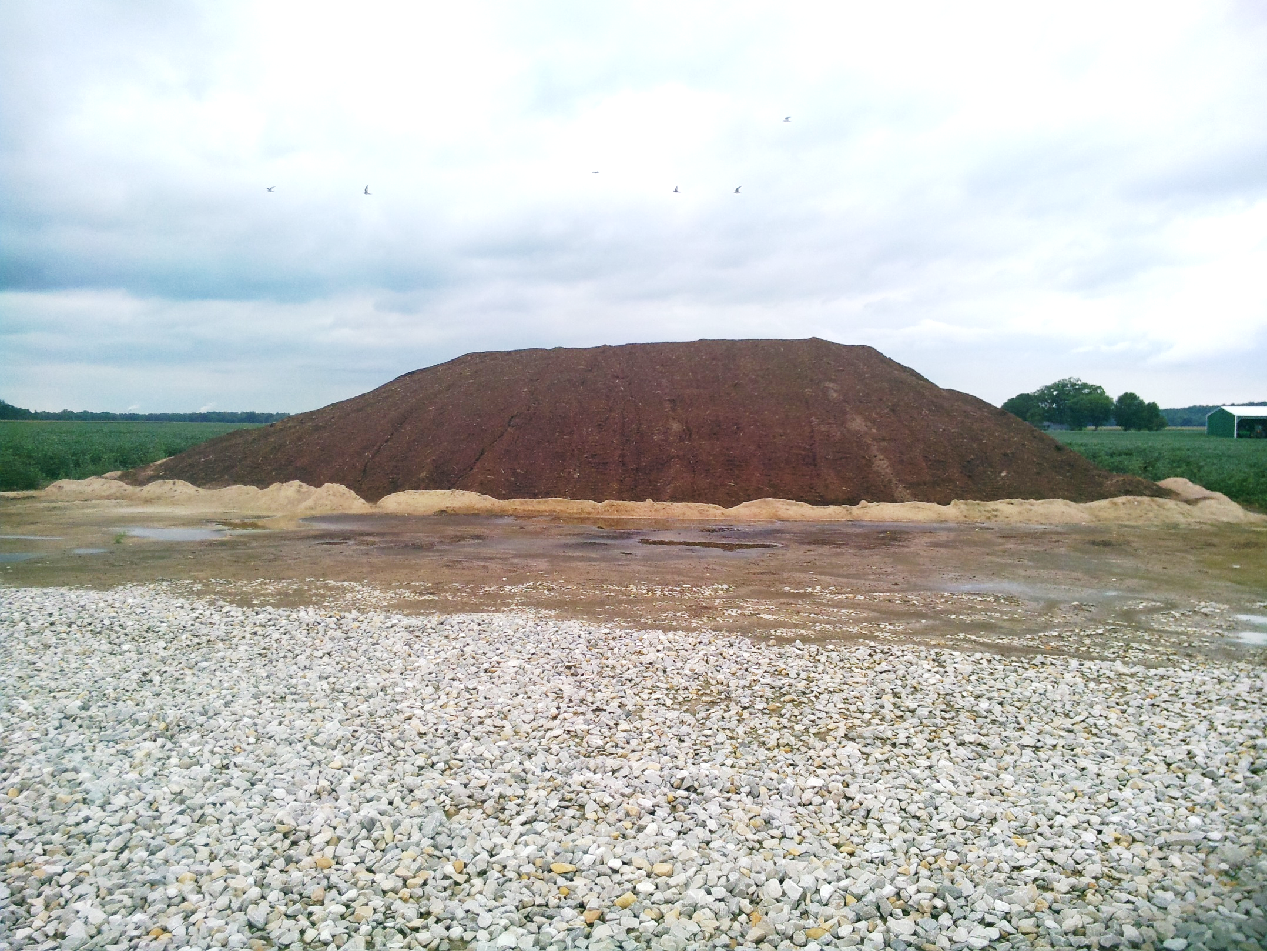
Berming and Tarping
Notes:
Examples of berming and tarping: Berm/gradient barrier with soil, Berm with Lime, Tarp Silt fencing is not acceptable. "Gradient barrier" means a structure or feature that prevents runoff from entering surface water.

Slide 22
Manure (Organic) Staging Restrictions
100 feet from property line or public road.
400 feet from residential buildings.
Manure cannot be staged on the side of a hill.
Applied within 90 days.
Notes:
Restrictions of Staging Manure. The restrictions in Italics are the differences between staging of Inorganic and Manure.
Residential buildings where other people (not self) live.

Slide 23
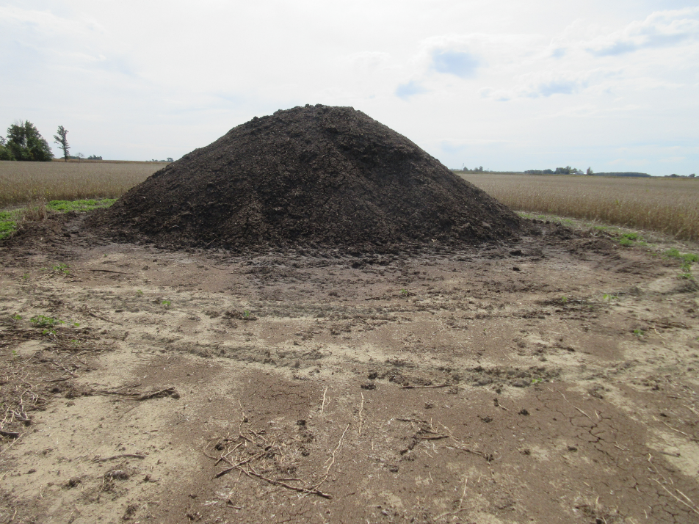
Manure (Organic) Staging Restrictions
Note:
These setback standards will be used by OISC to handle complaints.
This applies to all manure staging.
Notes:
Civil penalty fine. This civil penalty can be as much as $250/day for each day in violation of the staging setback/berming rule.

Slide 24
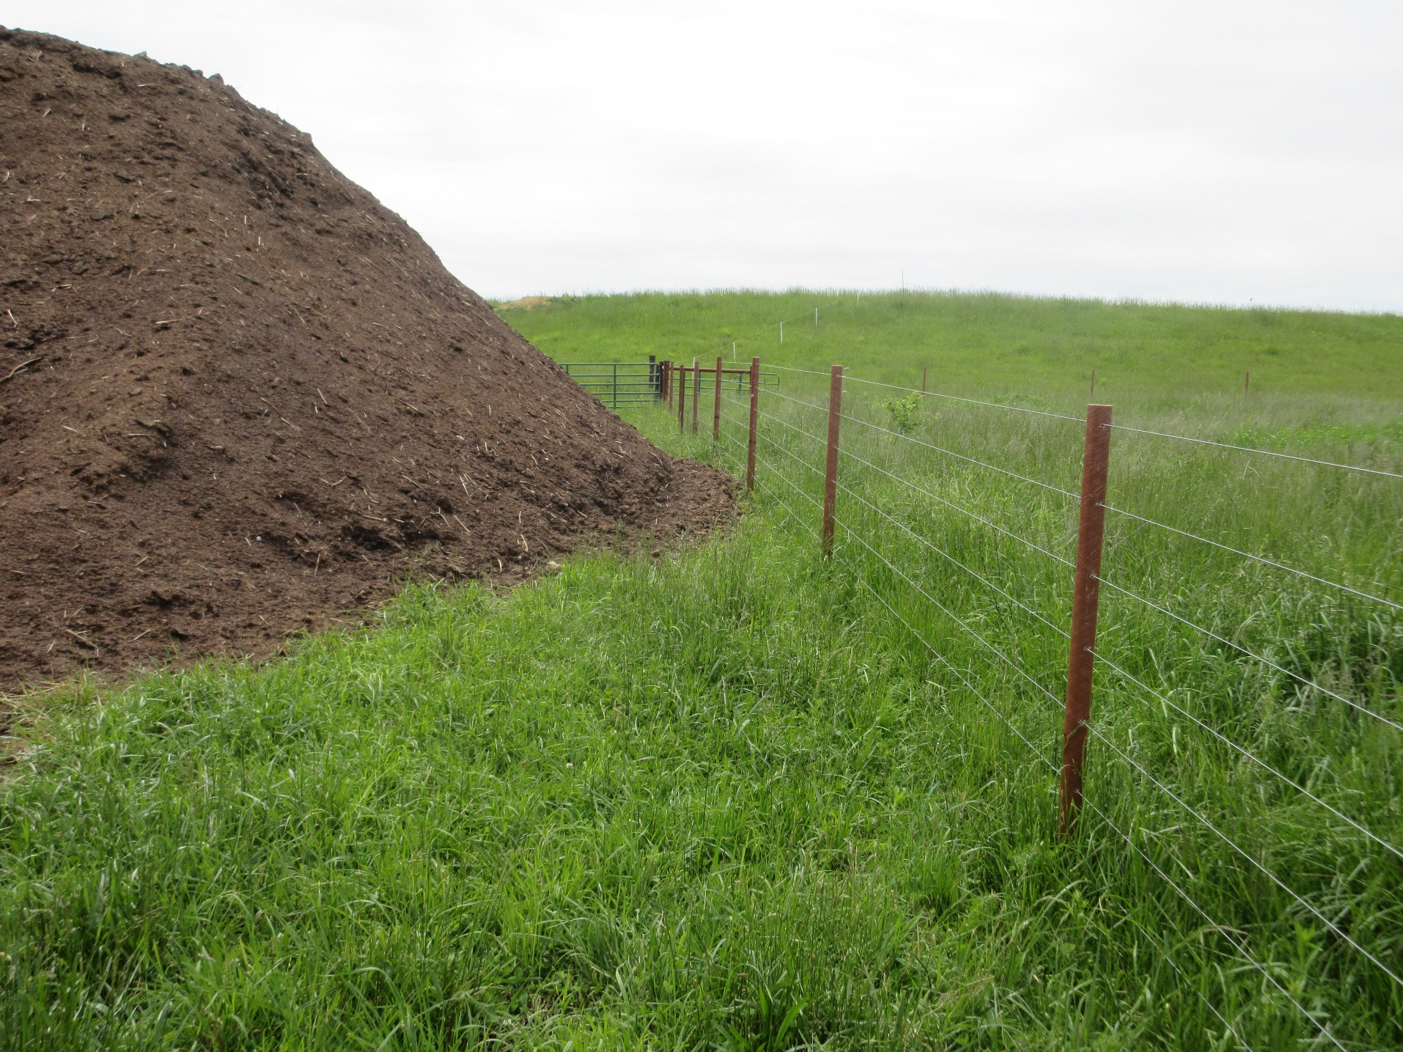
Violations
No gradient barrier
Less then 100 feet from property line

Slide 25
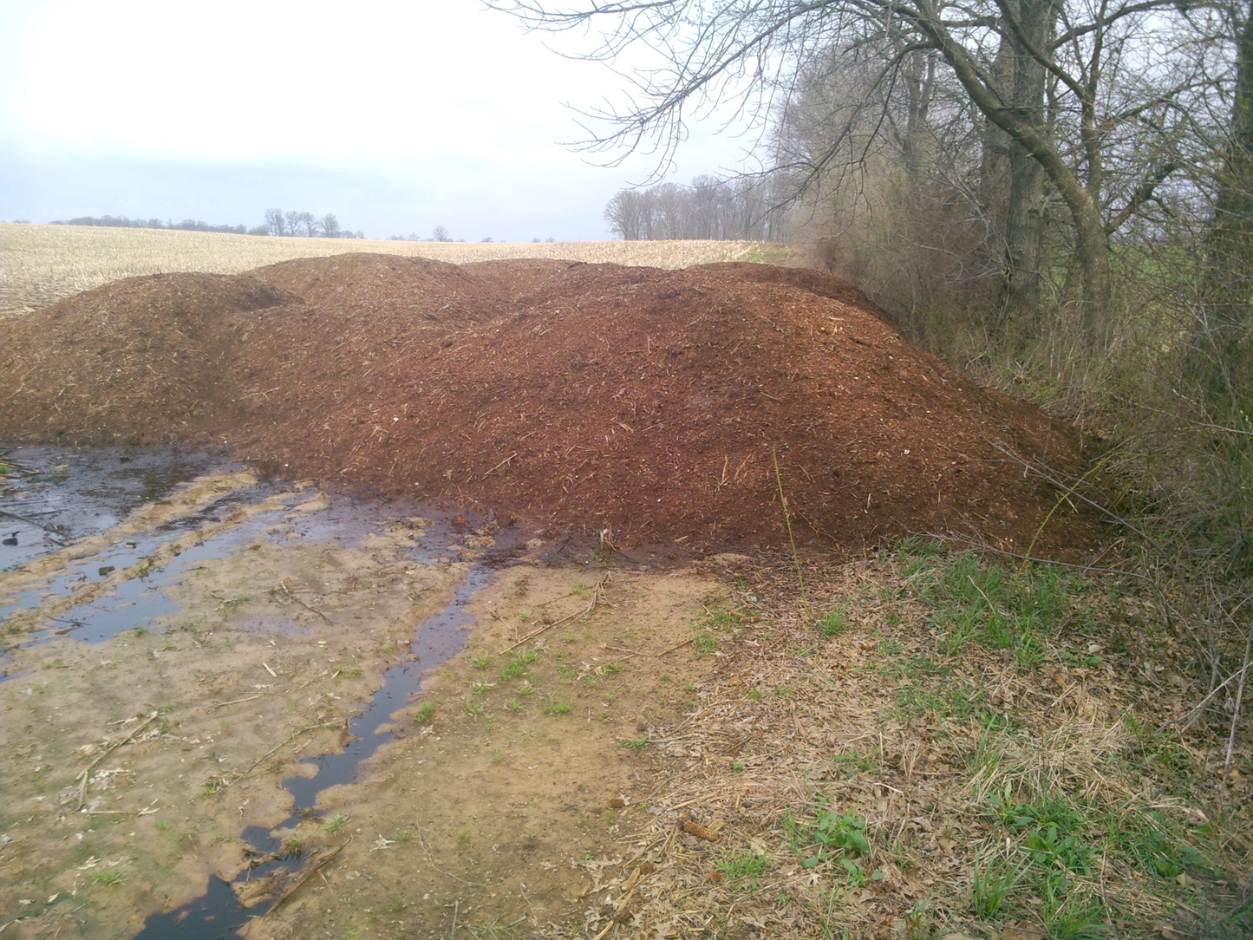
Violations
No Gradient Barrier
Staged next to small waterway
Notes:
You can see the runoff from the staged manure. There is a small waterway in the tree line.

Slide 26
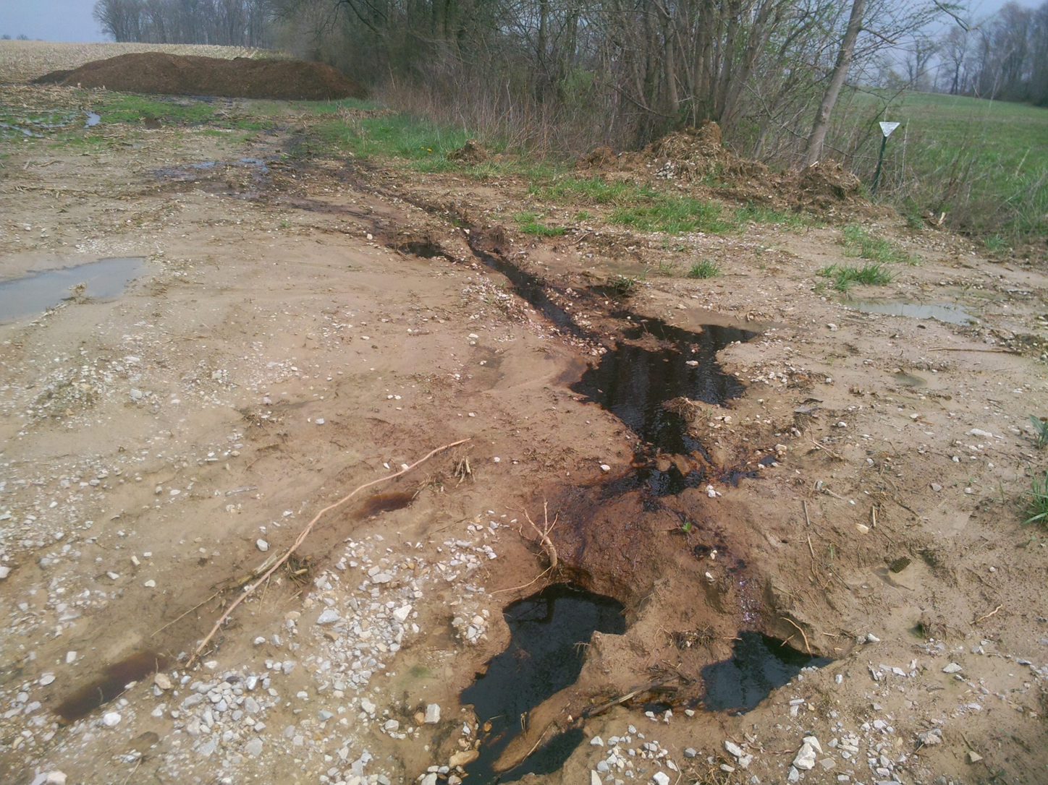
Violations
Notes:
Violation- No berm/ gradient barrier. To close to a property line. To close to water (small drainageway in tree line). A berm would have prevented this runoff that goes to a road ditch and nearby creek.

Slide 27
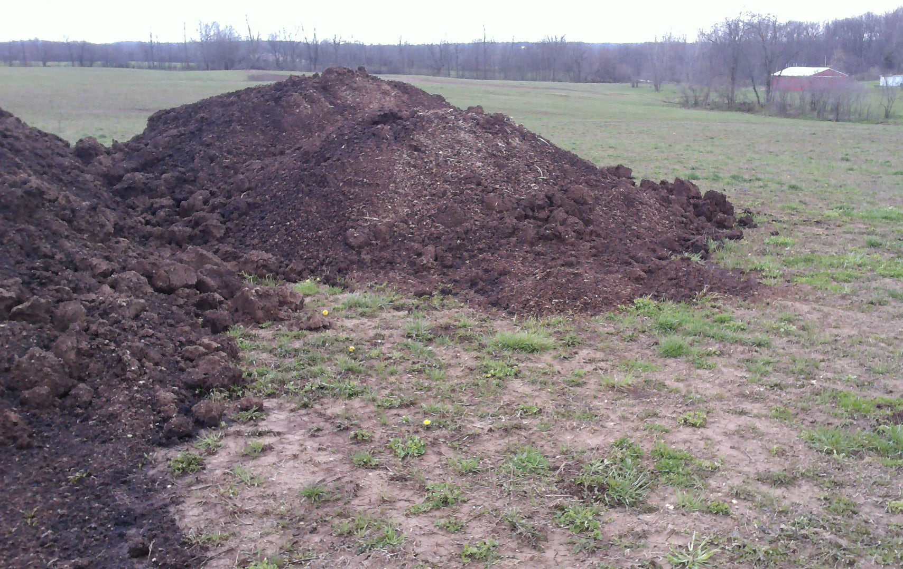
Violations
No Gradient Barrier
Notes:
No berm/gradient barrier. Also notice the small line of trees , that is a waterway they must be 300 feet from.

Slide 28
Application Rules

Slide 29
Application of Fertilizer Material
Develop a fertilizer application plan prior to application;
Apply fertilizer material in accordance with the fertilizer application plan for the target application site;
Not apply fertilizer material directly to surface water;
Not apply fertilizer material to saturated ground; and
Not apply fertilizer material from a public road.
Notes:
A person applying fertilizer material for the purposes of producing an agricultural crop shall:

Slide 30
Fertilizer Material (Inorganic)
Application Restrictions
Cannot be applied directly to water
Cannot be applied from a public road
Cannot be applied to saturated ground
If you can get in the field, then it’s not saturated
Can apply to frozen ground
No other application restrictions for Inorganic.
Notes:
Fertilizer Materials = Inorganic/commercial AND Manure/organic
Really Not Much of an Affect to Production Practices
Public Right-of-way is not Public Road
Saturated means soil soaked with moisture that it cannot absorb any more liquid e.g., standing water. Puddle in the field that can be driven through or around is exempt from saturation requirements.

Slide 31
Manure (Organic) Application Restrictions
Affects ANYONE applying manure.
 | Liquid Injection or Single-pass Incorporation of Liquid or Solid | Liquid Incorporation (within 24 hr) or Surface-applied Solid
Public Water Supply | 500 feet | 500 feet
Surface Waters | 25 feet | 50 feet
Sinkholes | 25 feet | 50 feet
Water Wells | 50 feet | 50 feet
Drainage Inlets | 5 feet | 50 feet
Property Lines | 0 feet | 10 feet
Public Roads | 0 feet | 10 feet
Notes:
Applies to ALL manure applications – not just Category 14 certified applicators.
Injection and incorporation application methods have less restrictive requirements because the Fertilizer material is less likely to run off. No injection or no incorporation application methods have higher setback restrictions because of higher run off potential
Liquid Injection: Liquid manure injected below ground.
Single Pass Incorporation: Is liquid or solid manure applicator and incorporation tool, pulled behind each other by same equipment. This is not a commonly used method. Most incorporation methods are within 24 hours due to equipment limitations
Public Road NOT same as Public Right-of-way.
Watch for neighbors' water Well heads.
There is a handout that summarizes the staging and application setbacks.

Slide 32
Manure (Organic) Application Restrictions
Watch out for property lines and wells
 | Surface-applied Liquid⎯ no incorporation or injection of manure
 | Less than 6% Slope or Residue Cover | Greater than 6% Slope
Public Water Wells | 500 feet | 500 feet
Surface Waters | 100 feet | 200 feet
Sink Holes | 100 feet | 200 feet
Water Wells | 100 feet | 200 feet
Drainage Inlets | 100 feet | 200 feet
Property Lines | 50 feet | 50 feet
Public Roads | 50 feet | 50 feet
Notes:
Penalties for applying it right on the surface and leaving it exposed to rain

Slide 33
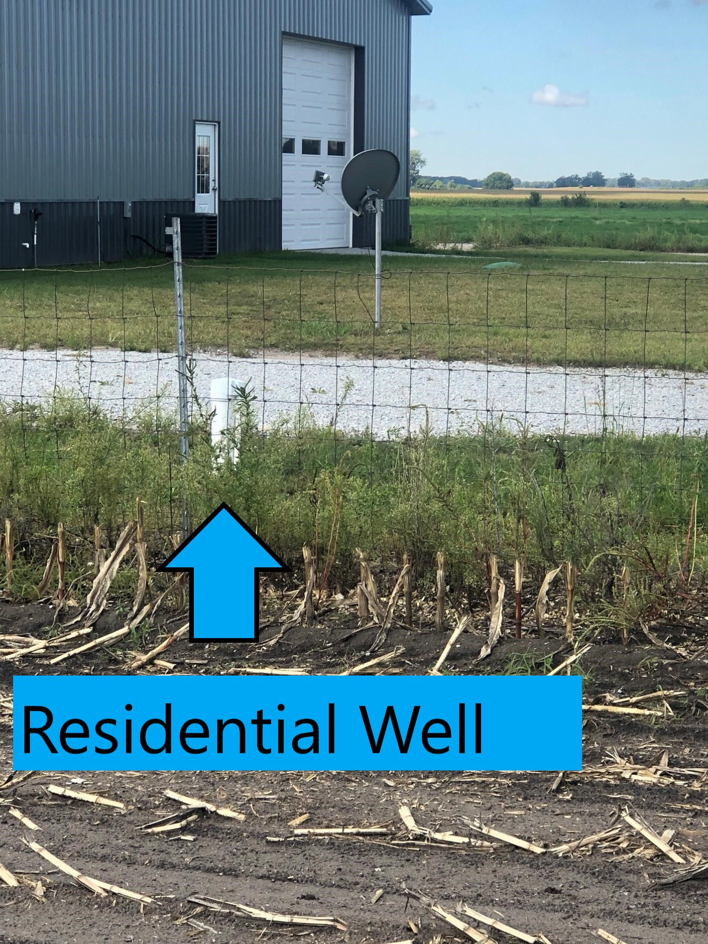
Be Aware
Residential Wells
Property Lines
Notes:
PVC pipe is the wellhead for the neighbor to this crop field. You must be aware of these when making your applications. The fence is the property line.

Slide 34
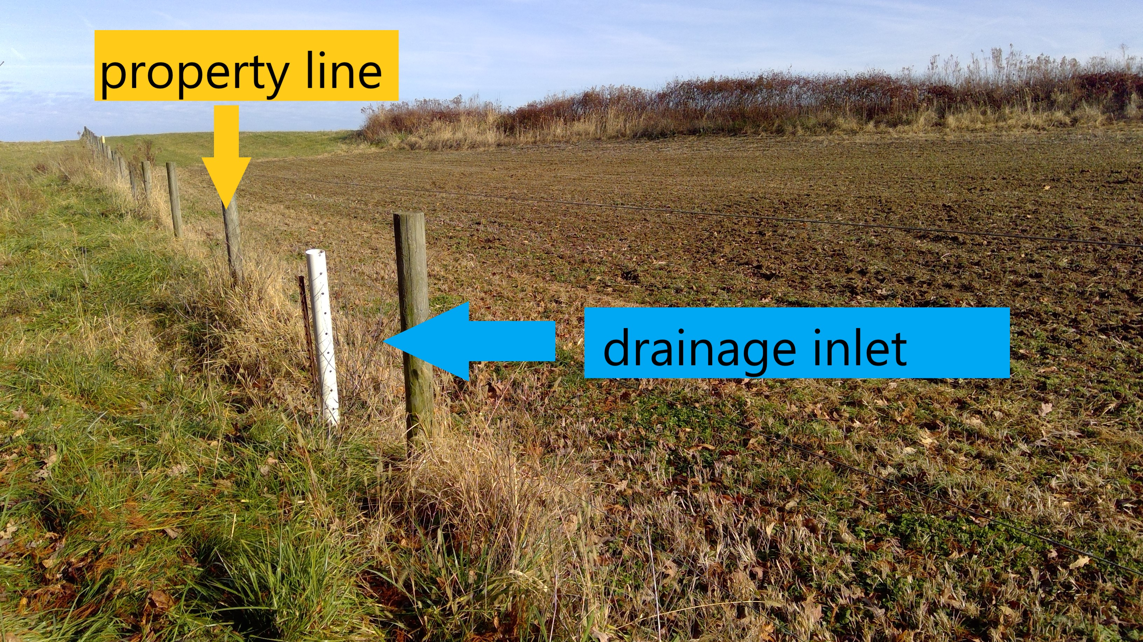
Be Aware
Drainage Inlets
Property Lines
Notes:
Greater than 6% slope Do you know what setbacks to use here? Liquid surface application- 200 ft from drainage inlet solid surface

Slide 35
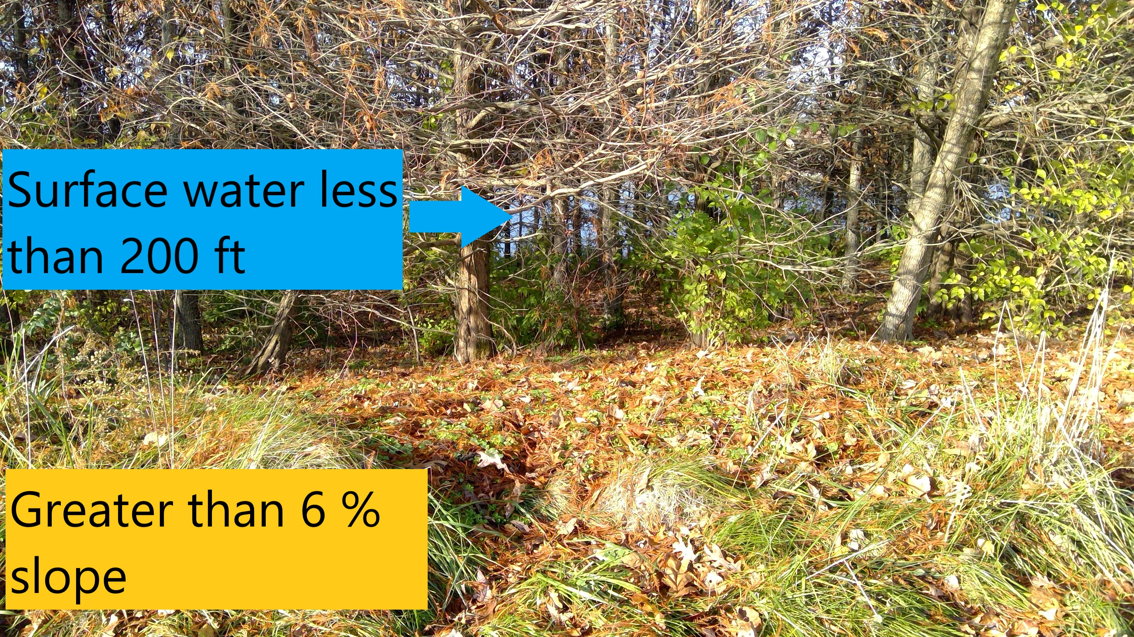
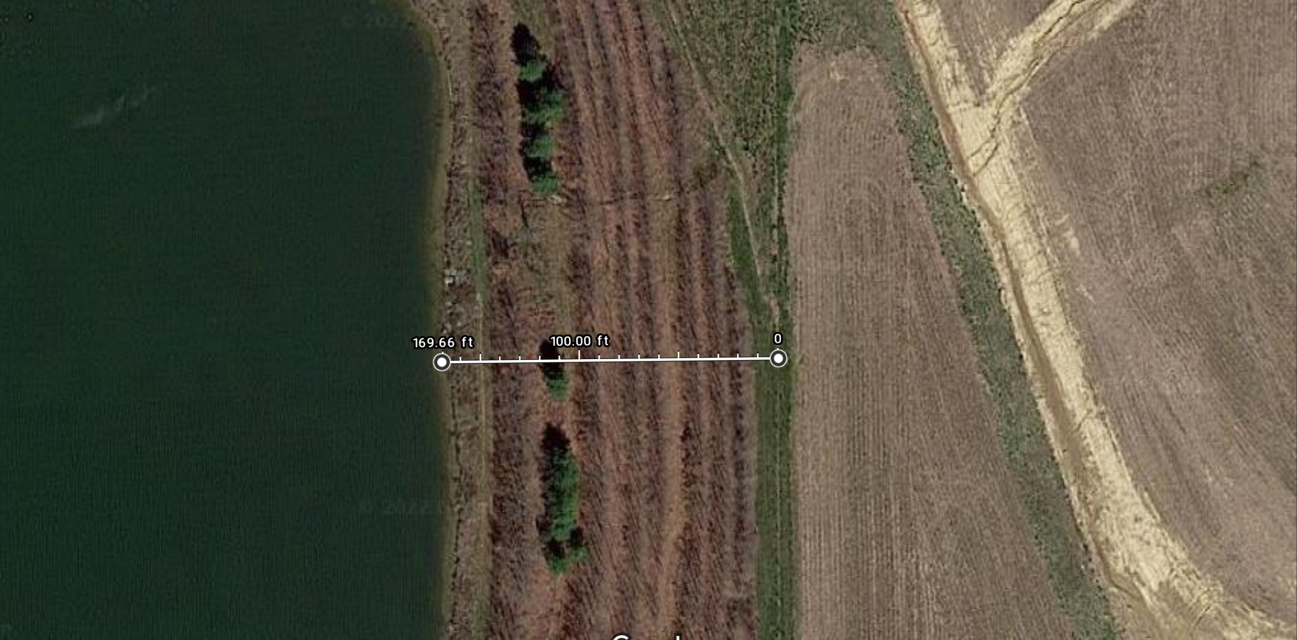
Be aware
Steep slopes
Surface water
Crop field greater than 6% slope
Steep slope
lake
Notes:
Increase setbacks on steep slopes. Aerial view showing Liquid surface application less than 200 feet from water (170 ft). In this case the landowners also got their drinking water from the lake. It is hard to see the lake through the trees if the applicator is unfamiliar with the field.

Slide 36
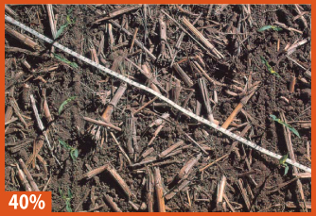
Manure (Organic) Applications
to Highly Erodible Land
Manure cannot be applied to HEL unless the land has:
  At least 40% crop residue; or
  A vegetative cover crop.
IL NRCS
Notes:
This is what 40% crop residue looks like. The idea is that crop residue or a cover crop help control run off from the field. It is all about keeping the nutrients where you want them and not letting it run off.

Slide 37
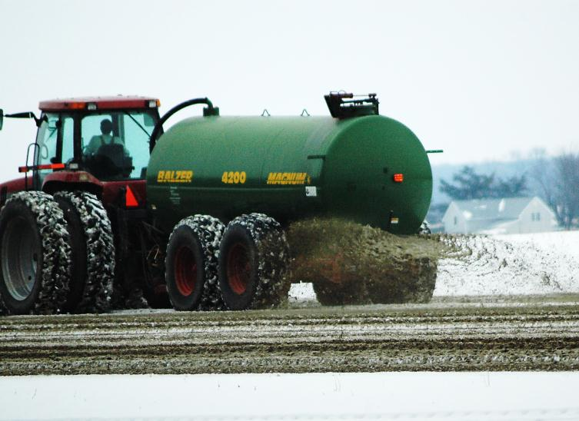
Manure (Organic) Applications
to Frozen or Snow Covered Ground
A CFO (IDEM-permitted) facility CANNOT apply manure to frozen ground, unless special permission granted by IDEM.
Notes:
Rule of thumb: for IDEM permitted facilities snow covered = manure doesn’t come in contact with ground
If the manure is under the jurisdiction of IDEM- It has Not been marketed and distributed. Then the applicator must ask for special permission from IDEM. See your IDEM CFO staff for information on this.

Slide 38
Manure (Organic) Applications
to Frozen or Snow Covered Ground
Manure obtained from all sources (including CFO) CAN apply manure to frozen ground in the following circumstances.
If equipment can inject or incorporate the same day application is allowed when the crop is not in the field. Application can be at full recommended rate.
Notes:
BUT– a CFO cannot apply manure from their facility to frozen ground. CFO-IDEM rules; Manure Marketed and distributed form a CFO and all others sources = OISC regulations
In addition – the general application setbacks apply. The rational is if you can inject or incorporate on the same day then the ground is not actually frozen.

Slide 39
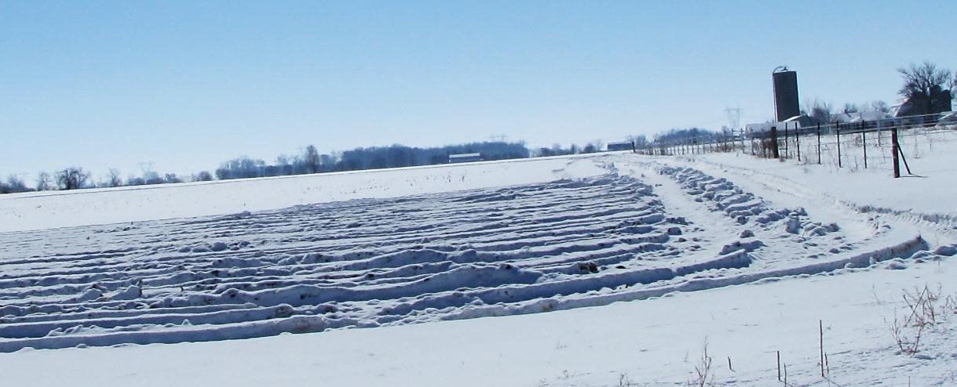
If the equipment can only apply the manure to the surface without incorporation, then the following rules cover those surface-only applications.
Notes:
Surface-only compared to injection or incorporated
In addition – the general application setbacks apply

Slide 40
Manure (Organic) Applications to
Frozen Ground or Snow Covered Ground
Cannot apply within 200 feet of surface water
Cannot apply within floodway
Can only represent up to 50% of the next crop
Cannot apply when slope is greater than 2% unless 40% crop residue or cover crop
Inorganic fertilizer
CAN be applied to
frozen ground
Notes:
We prefer no applications on frozen or snow covered ground however the OISC rule does allow for it but with special conditions. This is manure that has been marketed and distributed from a permitted CFO or manure from Non Permitted facilities.
50% Example: if N recommendation is 250 lb of N; then the maximum single application to snow/frozen ground is 125 lb.
In addition – the general application setbacks apply

Slide 41
Manure (Organic) Applications
Monitoring Requirements
Prior to application:
Monitor soil conditions and 24-hour weather forecast to ensure that predictable runoff does not occur.
During and After:
  Monitor site effluent from field tile outlets and surface water channels for a change of color, flow or volume.
If there is a change:
        Stop the application, stop the effluent and apply it later or elsewhere.

Slide 42
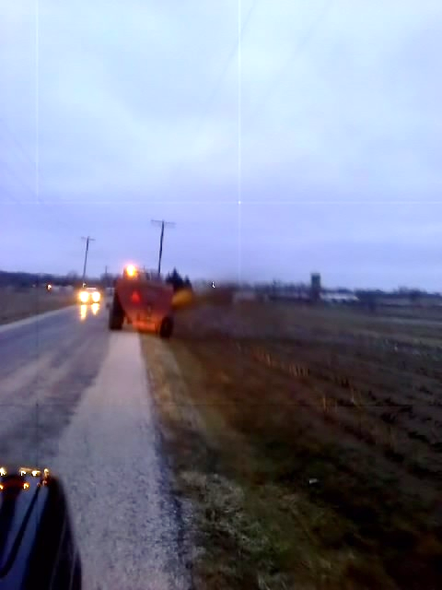
Violation: Application from the road
Notes:
Examples of application violations

Slide 43
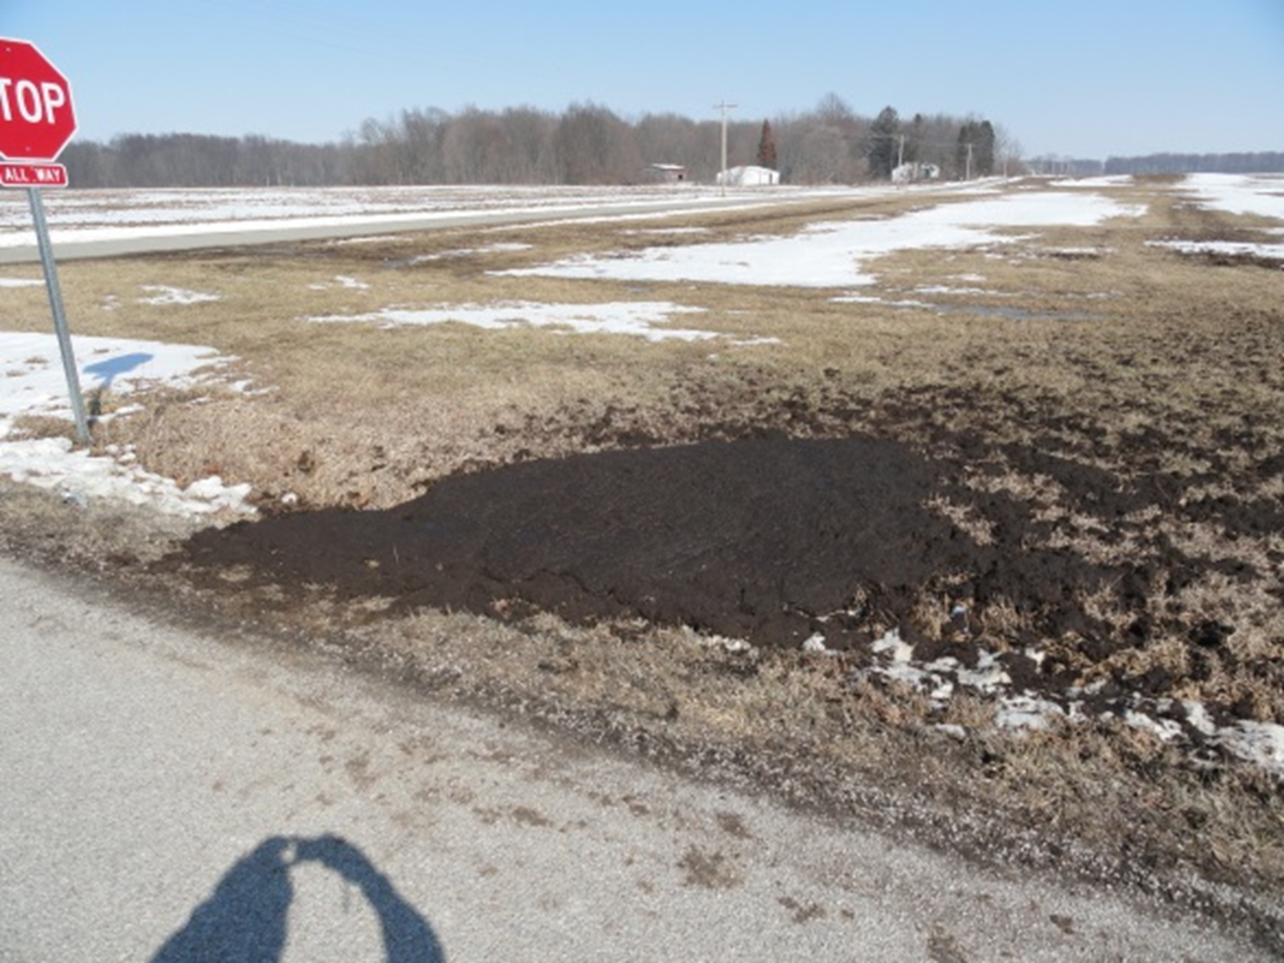
Violation: application from the road and setbacks

Slide 44
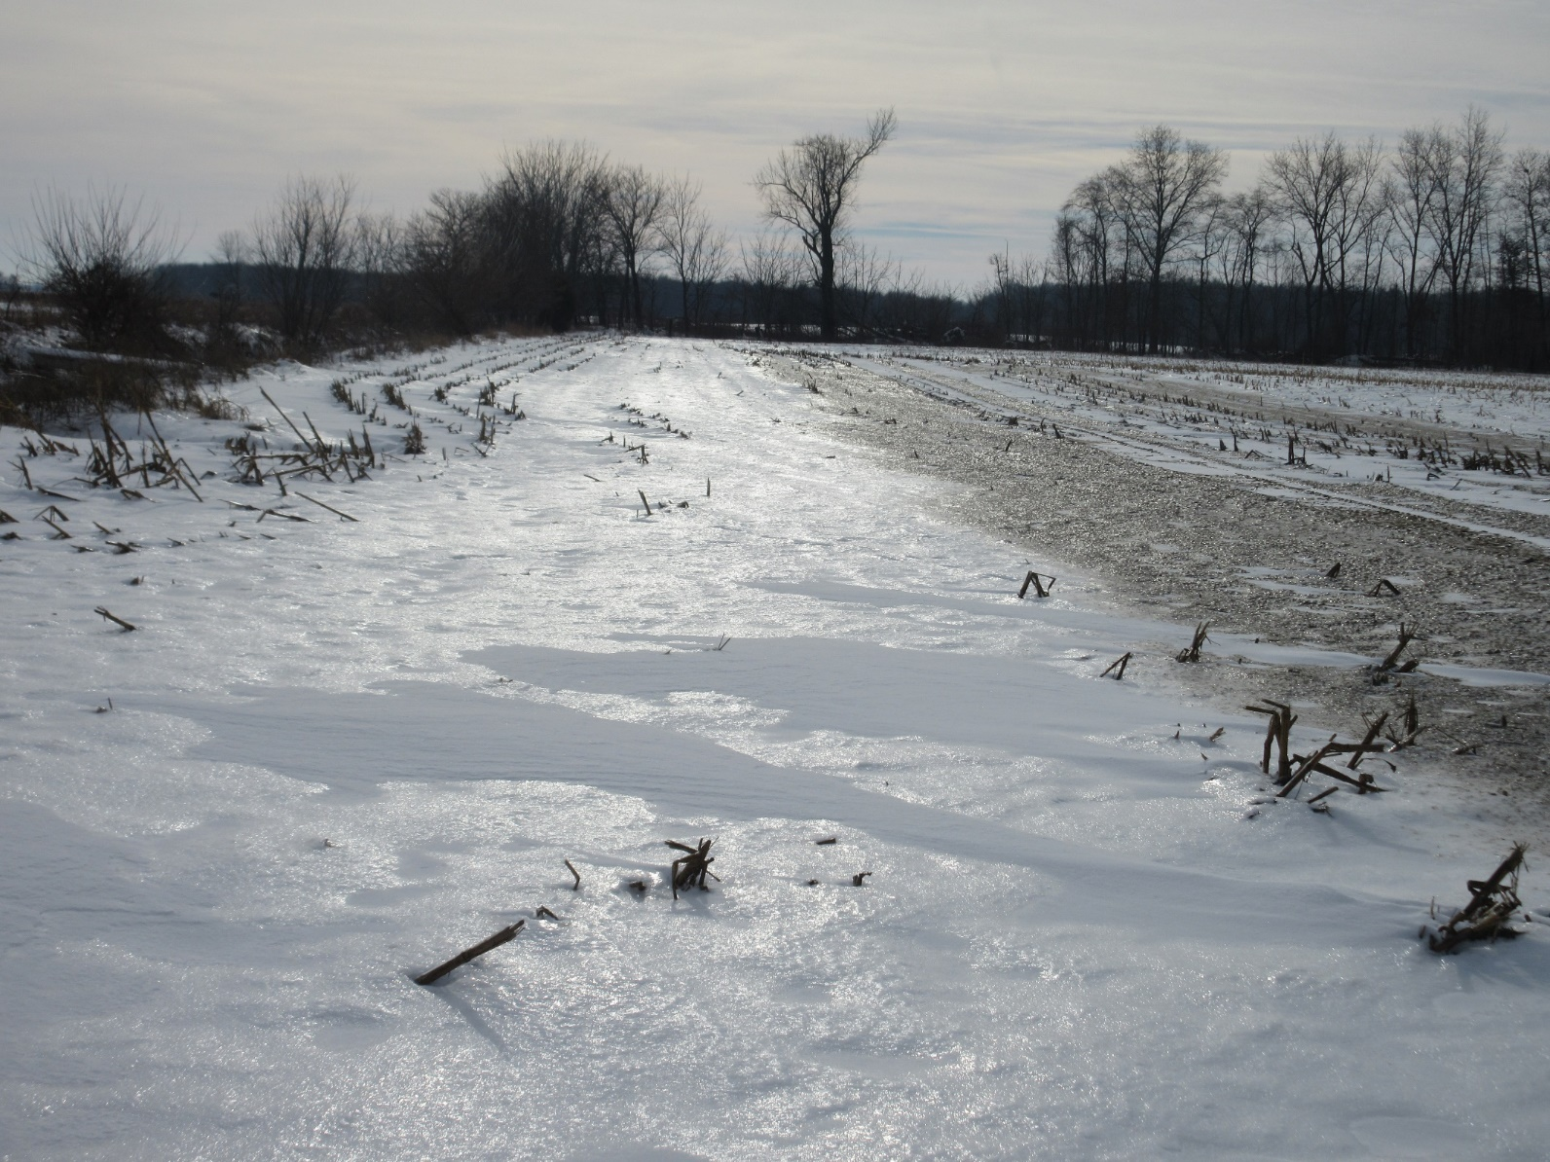
Violation: within 200 feet of surface water
Notes:
Snow covered ground, no incorporation. If the application had been 200 feet from water at 50% rate it would have been in compliance with the rule.

Slide 45
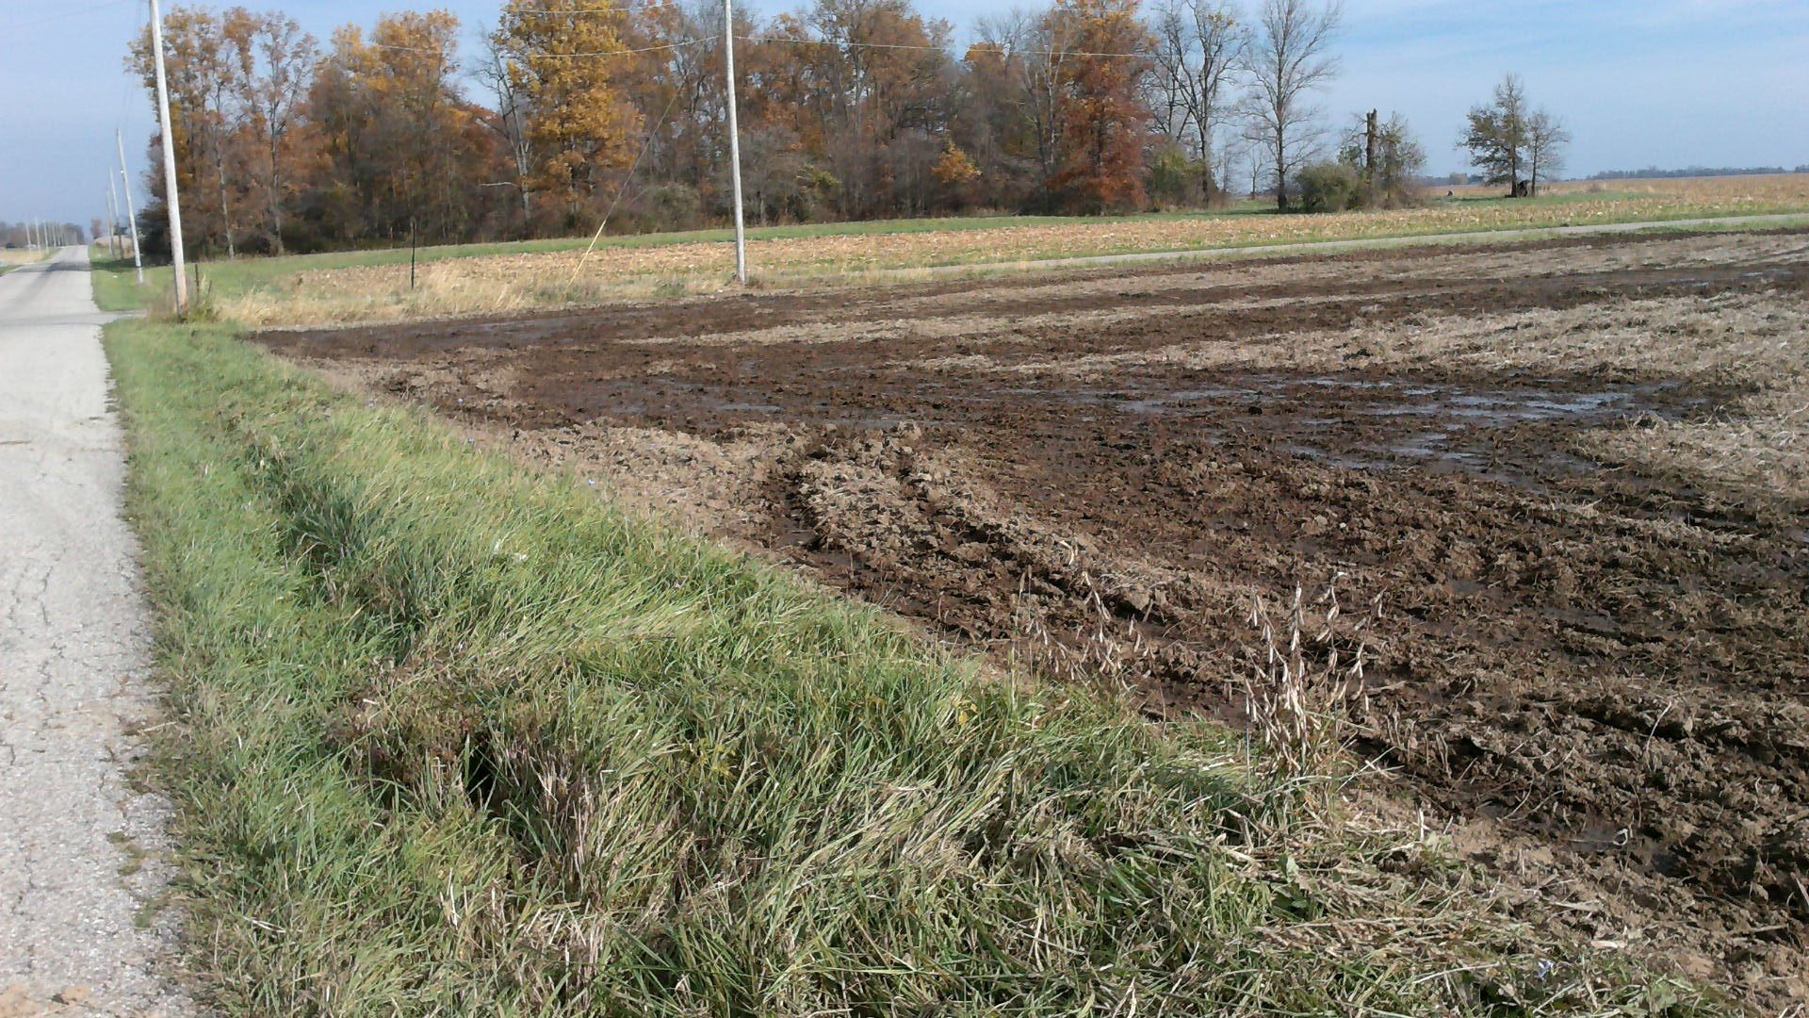
Violation: liquid surface application with no incorporation must be 50 feet from road
Notes:
The rest of the field was injected. This surface application occurred when the applicator was turning and lifted the equipment letting manure run onto the surface. The application then became a surface application and no longer met the more restrictive surface application setback required.

Slide 46
Fertilizer Materials
Application Records
Category 14 private applicators only keep records of manure (organic) applications
Category 14 commercial applicators keep records of Inorganic fertilizer and Manure (organic) applications
Records kept for 2 years
Commercial company can maintain records for their
customers
Notes:
Recordkeeping required only for licensed and certified Category 14 applicators.
Compare RUP required records vs glyphosate applications
Good management to keep record of all, but only certified Cat 14 required.
If an investigation-- records will be requested.
IDEM CFO requires records to be kept for 5 years.

Slide 47
Required Records
Location:
Applicator+ Cert. no. | Date (m-d-yr) | Fertilizer Type | Nutrient value | Rate/acre | Application Method
Notes:
Information required. Additional information can be kept. No specific form.
Fertilizer type can include liquid, dry, solid
Nutrient value is the N-P-K formula; X lbs P₂O₅/Ton
Application method is surface, injected, or incorporated
Can use PPP-18 or PPP-19 to meet recordkeeping
IDEM has different required records.

Slide 48
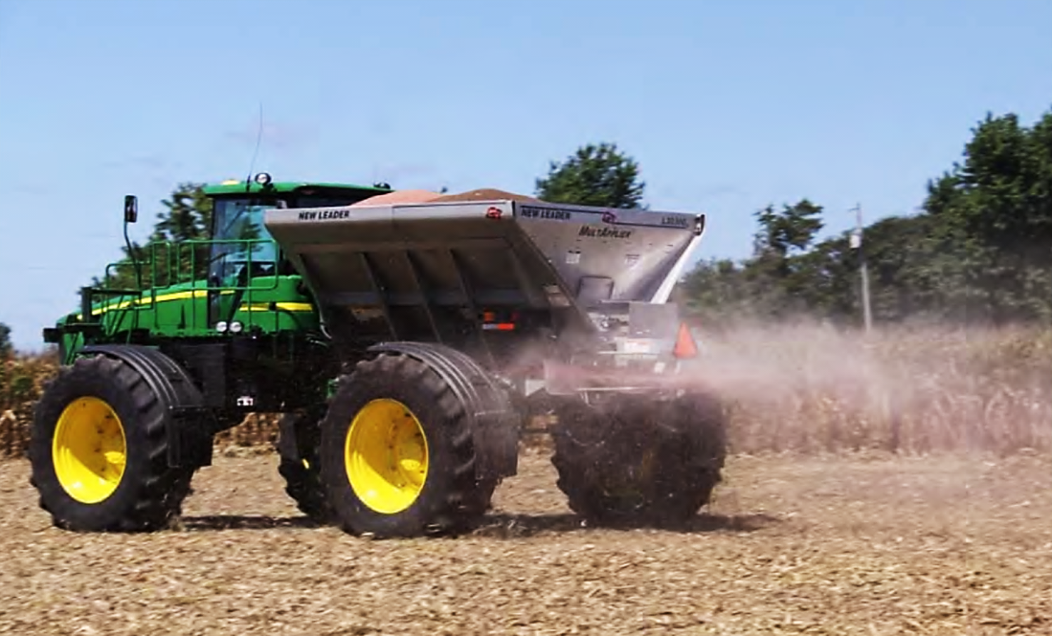
For the following examples, you will use the tables and information found in the handout.
Notes:
Presenter : Select from the following slides examples most appropriate to your audience and time schedule.

Slide 49
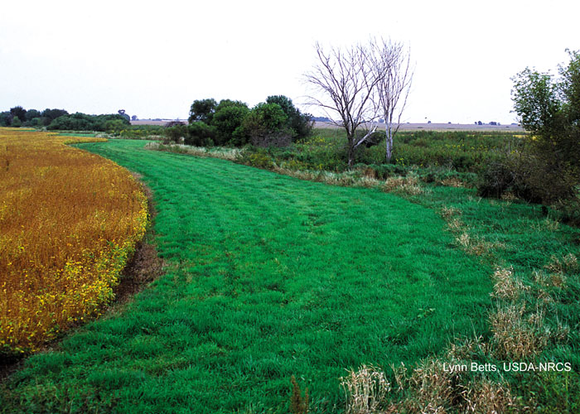
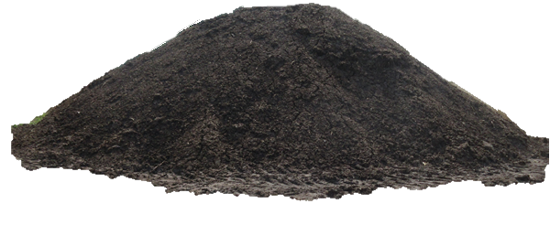
What regulations must be followed if staging fertilizer in this location?
Notes:
What’s the problem. Can’t stage in a waterway also near creek.

Slide 50
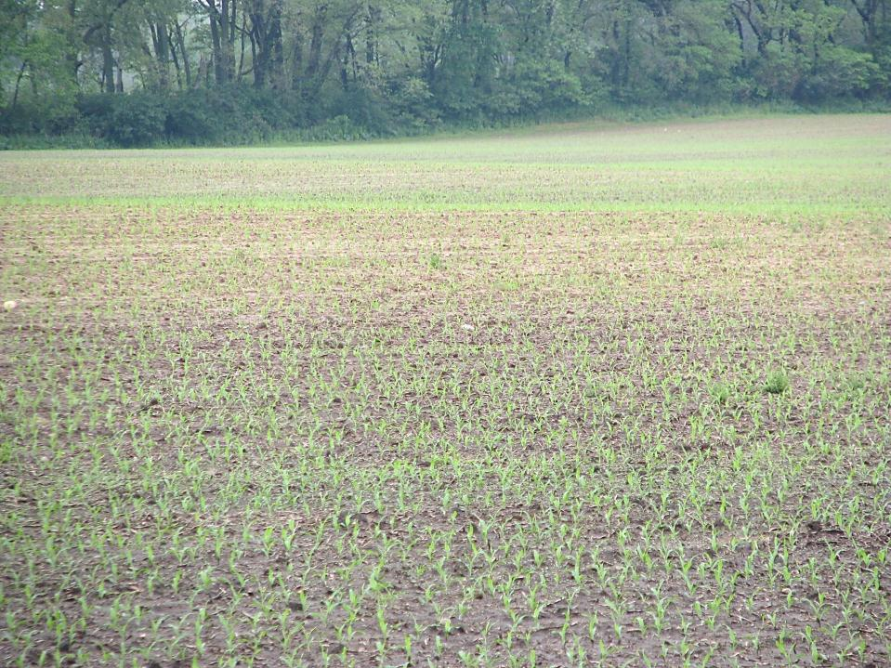
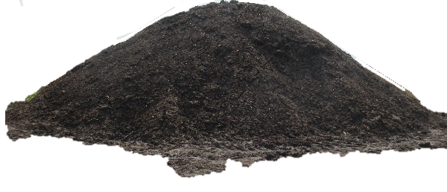
Blue lines indicate a creek in the trees.
What is the setback distance to stage in this field?
Notes:
The blue marks indicate that at the edge of the field there is water. The pile needs to be more than 300 feet unless it is covered and land around the pile slopes away from water.

Slide 51
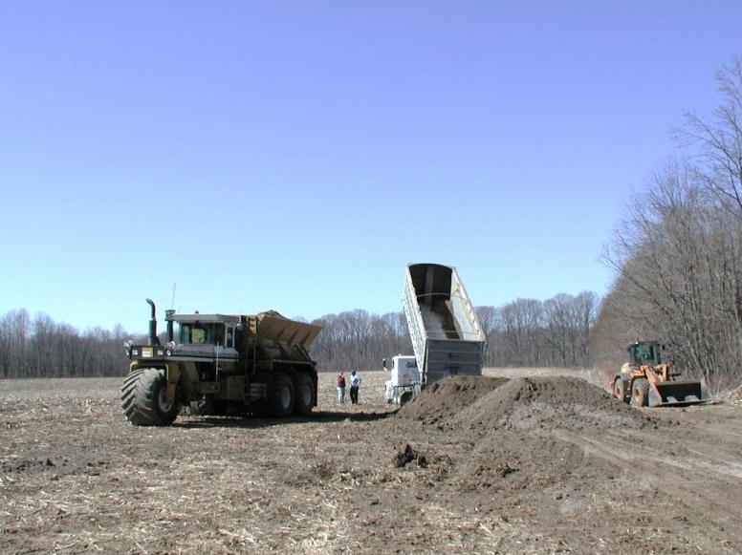
How long can a pile of inorganic or organic fertilizer remain in the field?
Notes:
What is maximum time this Fertilizer can sit in field? If covered in 72: Inorganic can stay for 30 days and manure for 90 days.
The grower is responsible where pile is placed.

Slide 52
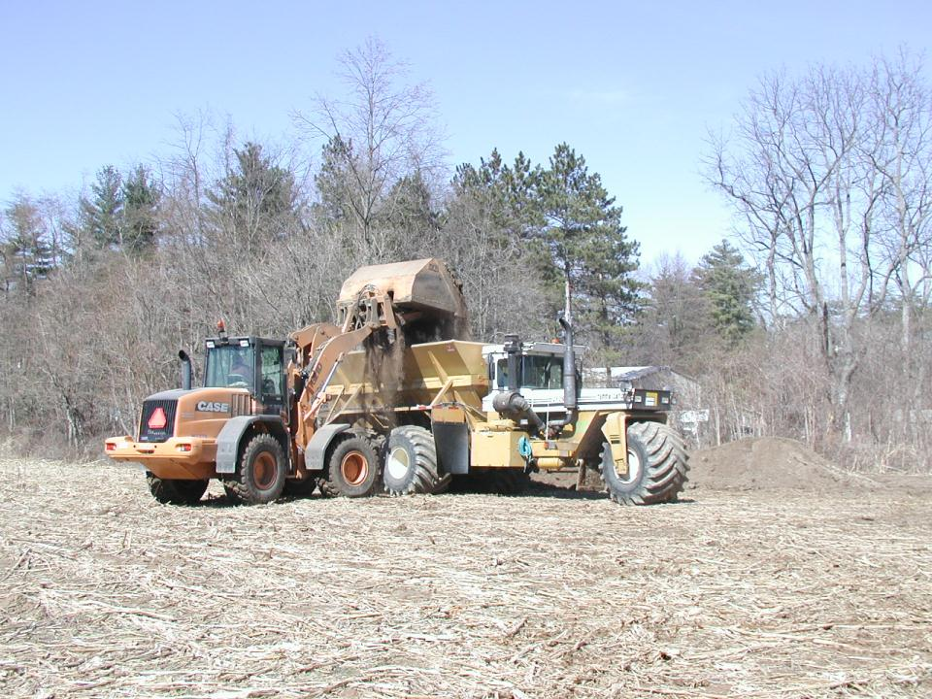
What is the minimum distance that is required between a house and the staging of inorganic and organic?
Notes:
Yellow outline is a Neighbor’s house in woods. Fertilizer outlined in green. What is set back distance for staging inorganic fertilizer?
Staging: inorganic right up to property line and manure is 100 feet.

Slide 53
How close to the property line can an application of inorganic and organic be made?
Notes:
Same Scenario Application Setbacks: Yellow outline is neighbor’s house in woods. Fertilizer outlined in green.
Application: inorganic up to line. Organic - Look at tables. In this example, dry material is being applied to the surface without any follow-up incorporation. The table with the heading of Liquid incorporation; Surface Application solid. Look for property lines 10 ft surface application.

Slide 54
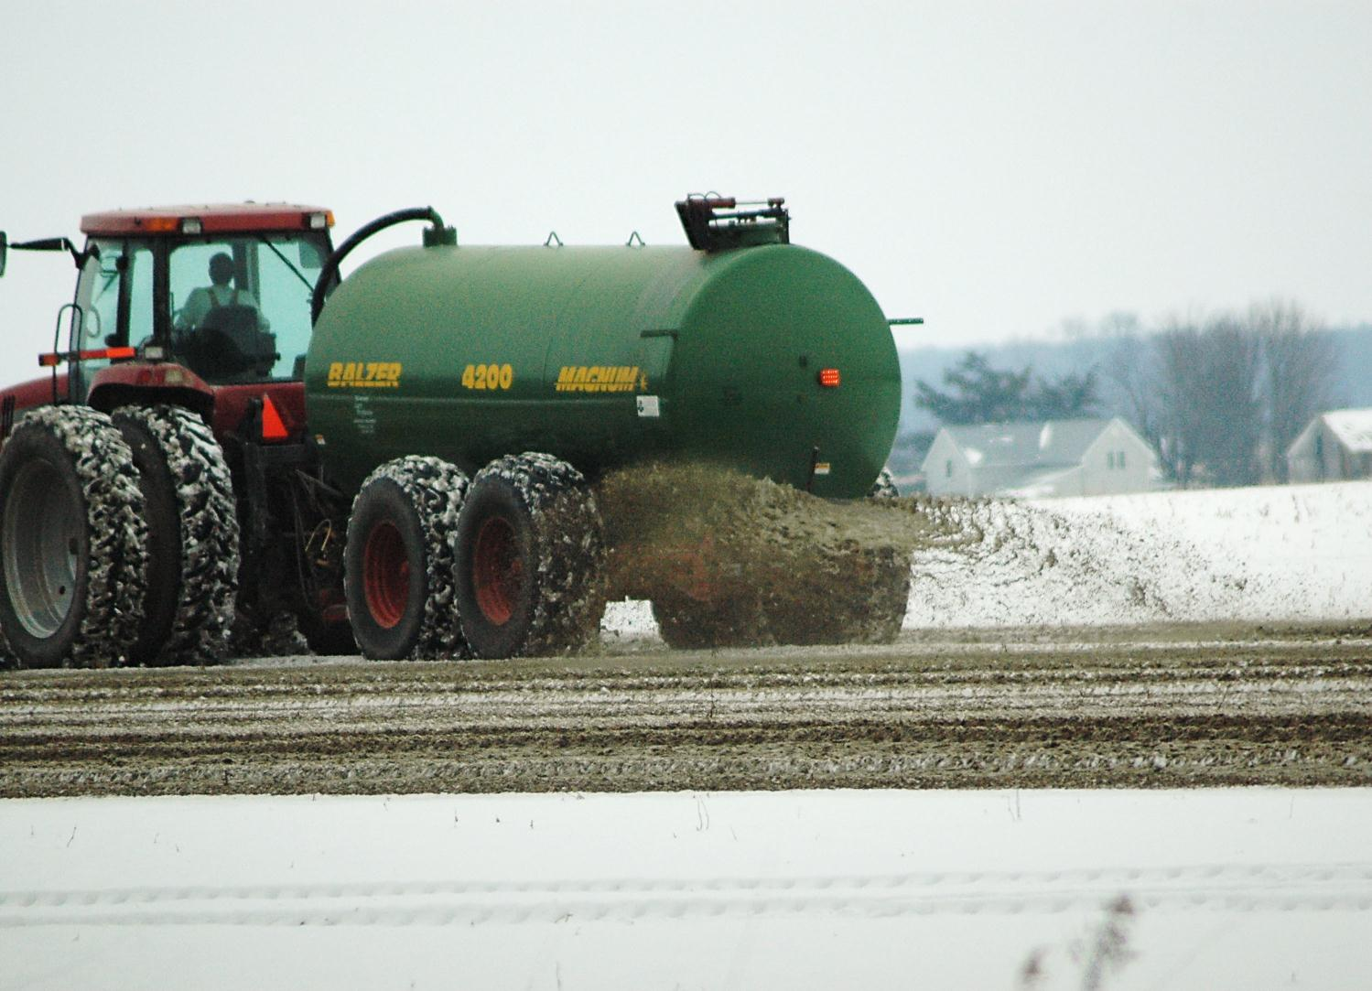
Under what conditions can manure be applied?
Can you apply inorganic fertilizer on frozen ground?
Notes:
If it is incorporated or injected then manure applications allowed at normal rates in chart. If not, then must stay 200 feet away from surface water and not applied to floodway, 50% agronomic rate. A IDEM permitted CFO cannot apply unless incompliance with IDEM rules.
Inorganic fertilizers can be applied to frozen ground.

Slide 55
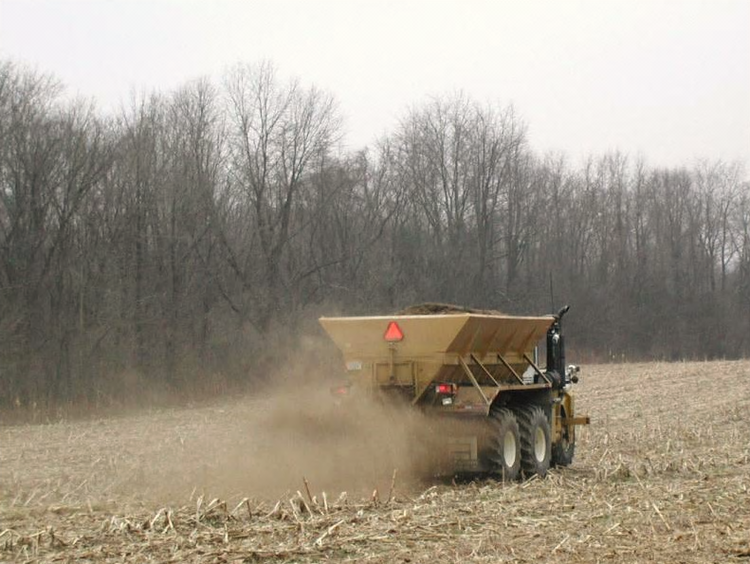
Under what conditions can you apply this inorganic fertilizer?
Notes:
Ground is not saturated. Good residue cover. The only thing to consider is if the tree line was someone else’s property or there is water on the other side of the trees.
10ft form public road, 10 ft from property line; 50 ft surface water, sinkholes and water wells.

Slide 56
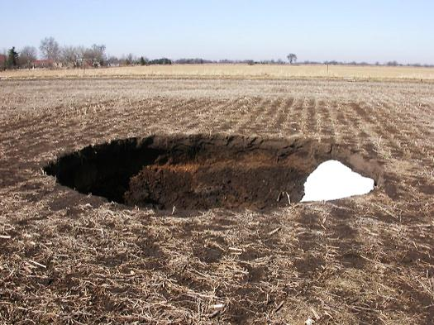
Under what conditions can fertilizer be applied to this field?
Wisconsin Geological survey
Notes:
Inorganic does not specify distance from sinkholes, only not to apply to surface water. Be a good steward and follow same setback distances as for manure (organic) fertilizer.
It depends on how the manure is applied. Look at sinkhole category to come up with setback restrictions. It will go from 25 feet, to 50, to 100 to 200 feet.

Slide 57
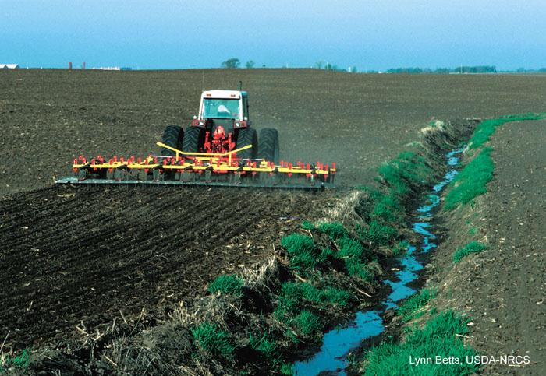
Surface liquid manure application was made in past 24 hours, incorporation follows, is this an acceptable application?
Notes:
No must be 50 ft from surface water.

Slide 58
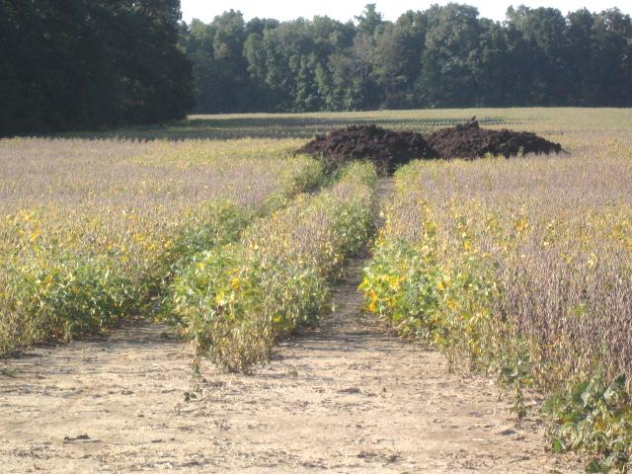
Will application of this pile meet deadline?
Notes:
After 72 hours must be covered or bermed. Applied to field within 90 days. But note stage of beans --- how likely is that application going to happen?
– you can see where the truck backed in and dumped it – look how big the beans are… 90 days could be a problem depending on first truckload. Growers must plan ahead

Slide 59
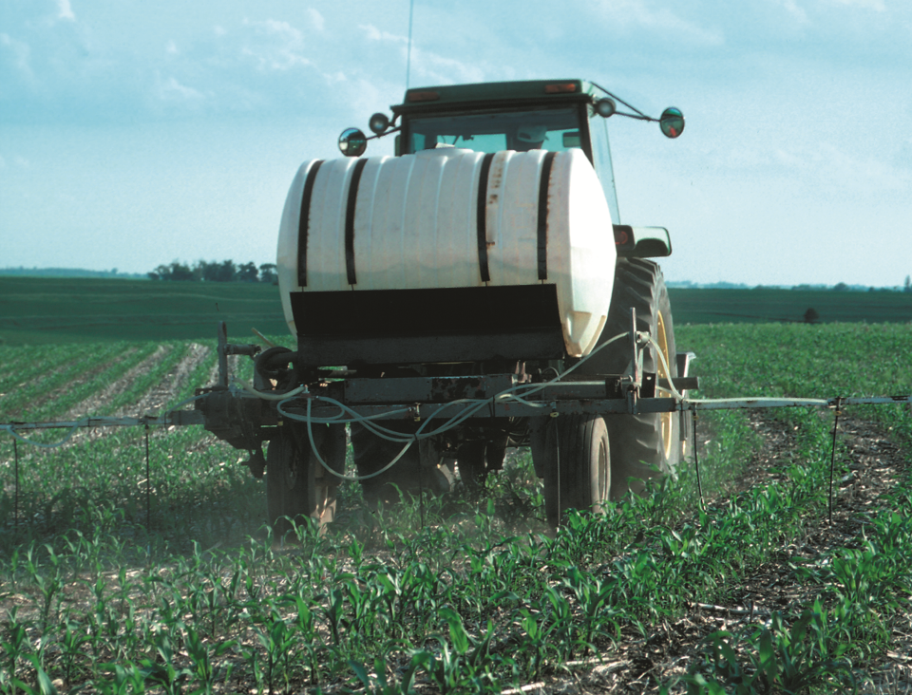
What are the conditions of this application?
What rules need to be met?
Notes:
Surface applied inorganic.
No surface water.
Follow agronomic plan, not on saturated ground, not from road.

Slide 60
Conclusions
Category 14 certification and license required for the applicator if manure obtained from CFO or “For Hire”.
Licensed distributors (sellers) and applicators of manure must keep records for 2 years.
Fertilizer Plan required by ALL growers.
  Both Manure (organic) and Inorganic Fertilizer.
Staging of Inorganic Fertilizers: use within 30 days in the field.
Manure (organic): Many setback and application
restrictions. Stage, berm and use within 90 days.
Application restrictions when surface applied on frozen ground.

Slide 61
For more information
OISC
765 494 1492
www.oisc.purdue.edu

