Slide 1
Purdue On The Farm:
Summary of 2022 Crop Scouting Results
Dan Quinn, Purdue Extension Corn Specialist, djquinn@purdue.edu
Shaun Casteel, Purdue Extension Soybean Specialist, scasteel@purdue.edu

Slide 2
Operations Team
Dr. Dan Quinn – Extension Corn Agronomist
Dr. Shaun Casteel – Extension Soybean Agronomist
Dr. Michael Langemeier – Ag Economist
John Scott – Purdue Extension and WHIN
Joe Rorick – Indiana Soybean Alliance and Purdue Extension
Hans Schmitz – CCSI Agronomist
Scott Gabbard – Shelby County ANR Extension

Slide 3
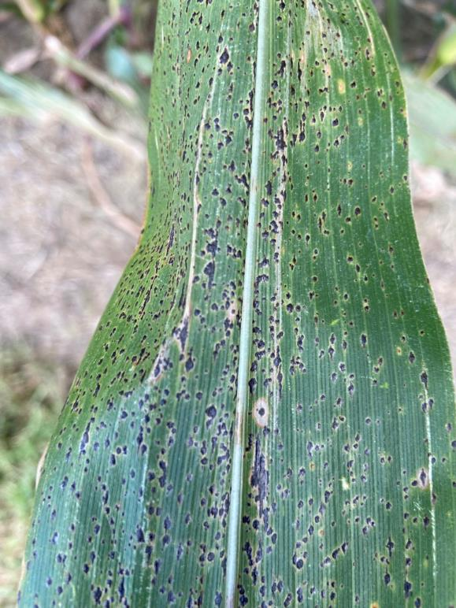
Crop Scouting Survey and Field Monitoring
Corn and Soybean Scouting Surveys
Early, Mid, and Late-Season
Give Purdue Extension Educators the opportunity to:
Scout (Disease, Weeds, Insects, Nutrient Deficiencies, etc.)
Soil and Tissue Sample
Growth Stage
Estimate Yield, etc.
Enhance Agronomic Knowledge
Build relationships with farmers
Data used to help inform Purdue Extension Specialists on, management practices used, crop conditions, and issues observed around the state

Slide 5
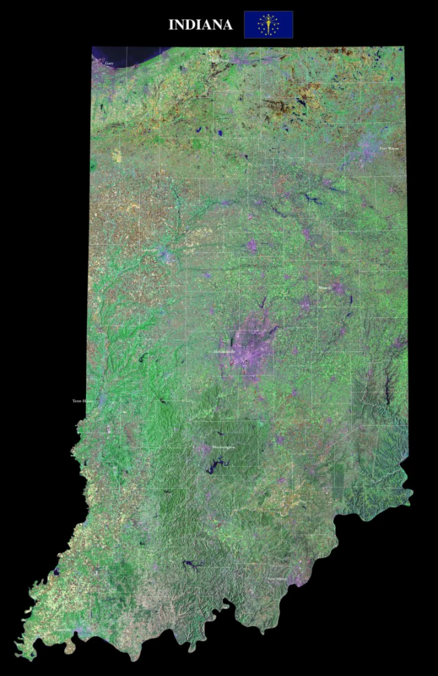
2022 Crop Scouting Overview
Corn Scouting
27 total fields scouted
21 different farmers
15 different counties
14 different educator participation
800 acres scouted

Slide 6
Corn Early Season Lessons Learned - 2022
Planting date range – April 20th – June 2nd
Farmer seeding rate – 29,000 – 34,000 seeds/acre
Plant population – 25,000 – 38,000 plants/acre
Farmer total nitrogen rate applied – 150 – 210 lbs/acre
Most prevalent nutrient deficiency – sulfur
23% of fields scouted
Average weed height – 2 in
Minimal weed pressure in all fields scouted
No seedling disease or insect pressure
Both wet and dry conditions depending on planting date
Overall crop condition score
Excellent – 48%
Good – 30%
Fair – 8%
Poor – 0%
N/A – 14%

Slide 7
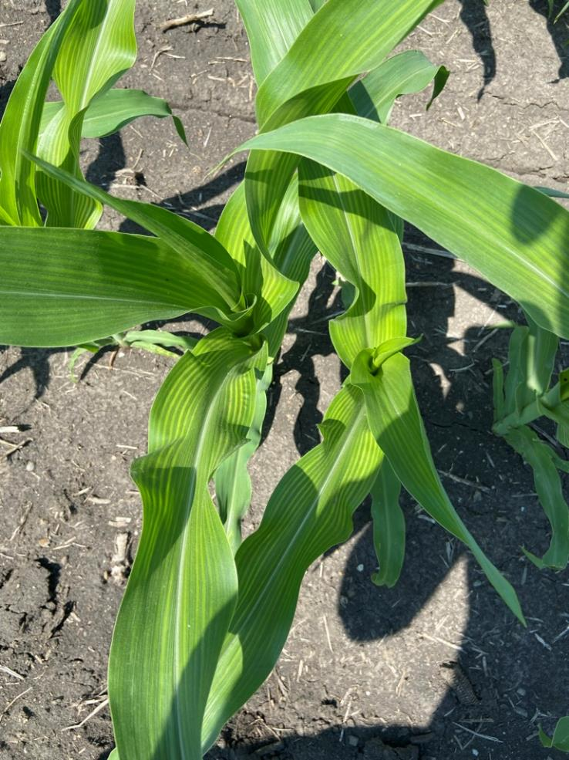
Sulfur Deficiency - Corn
Cool and wet springs, lack of S mineralization early.
Most predominant nutrient deficiency observed in early scouting trips
Did not translate to R1 tissue results
Only 1/31 samples was below 0.17% S

Slide 8
Corn Soil Fertility - 2022
Soil pH < 6.0
7 out of 24 fields (30%), 3 of which also had low P and/or K
Phosphorus < 20 mg M3P/kg
2 out of 24 fields (27%)
Potassium < 120 mg M3K/kg
6 out of 24 fields (25%)
CEC ranged from 8 to 19 cmolc/kg
SOM ranged from 1.8 to 3.8%

Slide 9
Corn Mid Season Lessons Learned - 2022
Most common nutrient deficiency – nitrogen
35% of fields scouted
Hot and dry conditions
Leaf rolling upwards of 100% in fields
Minimal disease pressure
1 – 5% of scouted plants
Minimal insect pressure
1 – 4% of scouted plants
Overall weed pressure
Clean – 70%
Weeds found in other 30% – waterhemp, johnsongrass, ragweed, barnyardgrass, velvetleaf, thistle, lambsquarter
Overall crop condition score
Excellent – 30%
Good – 40%
Fair – 10%
Poor – 0%
N/A – 20%

Slide 10
Corn Plant Tissue Analysis (R1 ear leaf) - 2022
Sulfur deficiency <0.17% S
1 out of 31 samples
Boron deficiency <4 ppm
3 out of 31 samples
Zinc deficiency <20 ppm
1 out of 31 samples
Manganese deficiency <20 ppm
0 out of 31 samples
Minimal macro and micronutrient deficiencies observed from R1 plant tissues analysis

Slide 11
Corn Late Season Lessons Learned - 2022
Final plant population – 28,000 – 33,000 plants/acre
Tar spot – 60% of scouted fields
10 – 100% incidence on scouted plants
Gray leaf spot – 60% of scouted fields
92 – 100% incidence on scouted plants
Southern rust – 0% of scouted fields
Lodging potential – 0 – 4% of scouted plants
Yield estimates
Factor 65 – 202 – 310 bushels/acre
Factor 75 – 175 – 268 bushels/acre
Factor 85 – 154 – 242 bushels/acre
Ear abnormalities – jumbled kernels, ear rot (diplodia), tip back, smut, tassel ears

Slide 12
2022 Crop Scouting Overview
Corn Scouting
27 total fields scouted
21 different farmers
15 different counties
14 different educator participation
800 acres scouted
Soybean Scouting
21 total fields scouted
17 different farmers
14 different counties
10 different educator participation
1450 acres scouted

Slide 13
SOYBEAN Early Season Lessons Learned - 2022
Planting date range: April 23 to June 7
3 fields in April, 12 fields in May, 6 fields in June
Farmer seeding rate: 120,000 to 160,000 seeds/acre
Exception: 225,000 seeds/acre
Plant population: 86667 – 142222 plants/acre (Average: 115,908 ppa)
Up to 9% seedling death
Herbicide trait:
Enlist 11 of 21 fields (52%)
Extend Flex: 7 of 21 fields (33%)
Other: 3 of 21 fields (14%)
Bean Leaf Beetle pressure 4 out of 21 fields had (19%)
Notes:
Herbicide trait:
Plant Population: kinda hard to generate plant population unless the area of the stand count is known.
Weed photos are cumbersome to work through for canopy and pressure.
Canopeo: 3 out 21 fields were imaged. 23% weed canopy cover, ~3% weed canopy cover
Weed pressure and ranking very difficult to distinguish on excel
Farmer conversations or notes:
Evaluate cereal rye cover, stringy or leggy soybeans and interesting for a normally full till producer
Sidedressed 28% as a demo
Low plant stands on several with discussion to the farmer. Then, replanted and/or understood why
Headlands tilled vs. no-till rest of the field, so planter improperly setup
Seedling disease
Herbicide carryover

Slide 14
SOYBEAN Soil Fertility - 2022
Soil pH < 6.0
5 out of 15 fields (33%), 3 of which also had low P and/or K
Phosphorus < 20 mg M3P/kg
4 out of 15 fields (27%)
CEC ranged from 7 to 19 cmolc/kg
Potassium < 120 mg M3K/kg
9 out of 15 fields (60%)
Notes:
0-8” soil depth
15 of the 21 fields
Herbicide trait:
Plant Population: kinda hard to generate plant population unless the area of the stand count is known.
Weed photos are cumbersome to work through for canopy and pressure.
Canopeo: 3 out 21 fields were imaged. 23% weed canopy cover, ~3% weed canopy cover
Weed pressure and ranking very difficult to distinguish on excel
Farmer conversations or notes:
Evaluate cereal rye cover, stringy or leggy soybeans and interesting for a normally full till producer
Sidedressed 28% as a demo
Low plant stands on several with discussion to the farmer. Then, replanted and/or understood why
Headlands tilled vs. no-till rest of the field, so planter improperly setup
Seedling disease
Herbicide carryover

Slide 15
SOYBEAN Early Season: Discussions/Demos
Evaluate cereal rye cover, stringy or leggy soybeans and interesting for a normally full till producer
Sidedressed 28% as a demo
AMS vs. No AMS
Fungicide vs. No Fungicide
Low plant stands on several with discussion to the farmer. Then, replanted and/or understood why
Headlands tilled vs. no-till rest of the field, so planter improperly setup
Seedling disease
Herbicide carryover

Slide 16
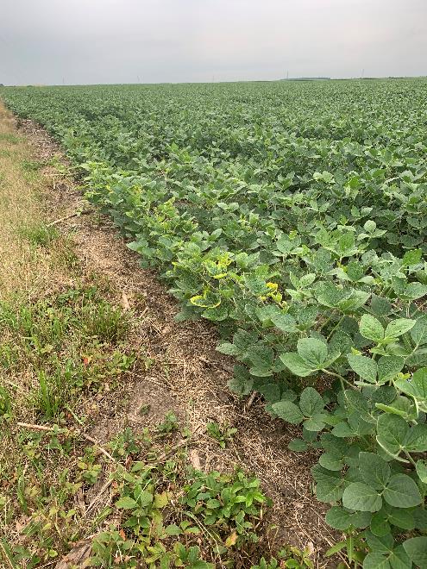
SOYBEAN Mid Season Lessons Learned - 2022
Growth Stage primarily: R2 (full bloom) to R3 (first pod)
Imbalance of N:S ratio of 18:1 or higher
5 of 11 fields (45%), but S deficiency was not observed. A few fields were close to S deficient levels.
Leaf Potassium
5 of 11 fields were low (Same as low soil K)
4 more fields that were low in soil K that were not leaf sampled.
Dry field conditions also limited mass flow and K uptake.
Interestingly, no leaf symptomology to note.
No nutrient differences among 3 demo fields (AMS, Fungicide)
Small pocket of Mn deficiency reported to farmer
Notes:
23 fields in mid season report
11 fields in AL tissue plus 3 more samples that were part of a demo
* Only 15 fields sampled for soil
Pictures taken and uploaded, but have they been connected with sample results? Specialist review?
Were the pictures beneficial to you and your clientele?
Frogeye Leaf Spot
Pictures taken and uploaded (to box). Did they make it to PPDL? Pictures and the samples?
Other observations and notes:
Small pocket of Mn deficiency reported to farmer

Slide 17
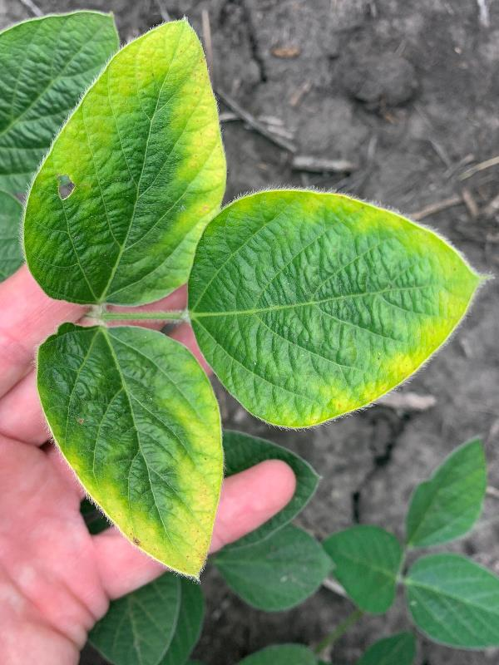
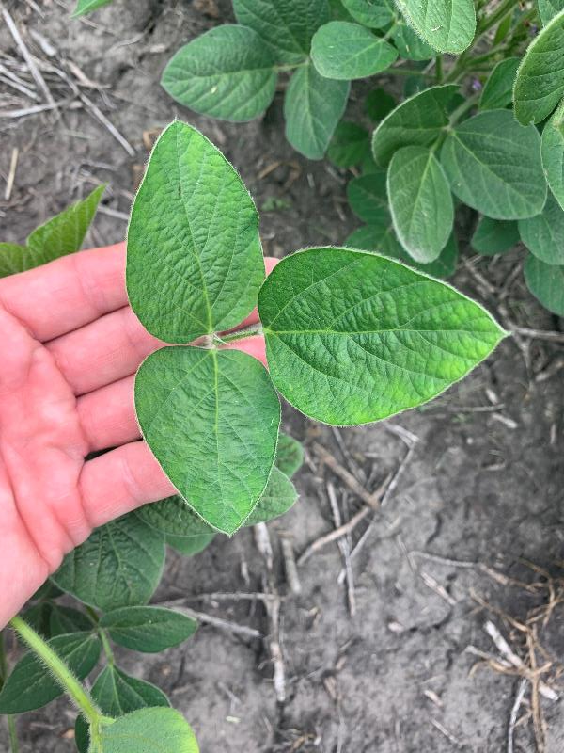
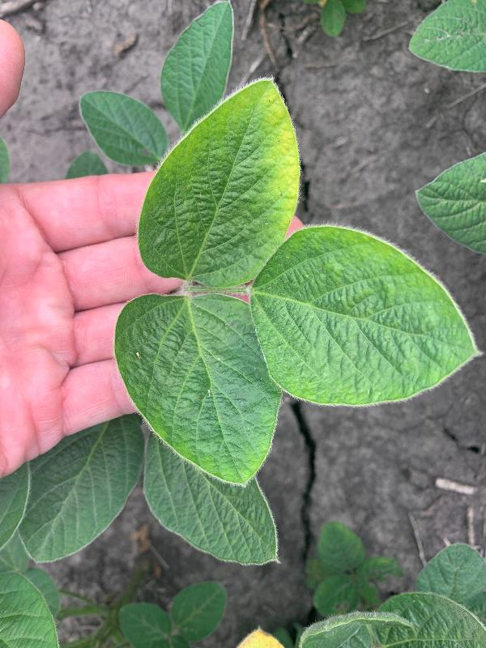
Potassium Deficiency: Progression

Slide 18
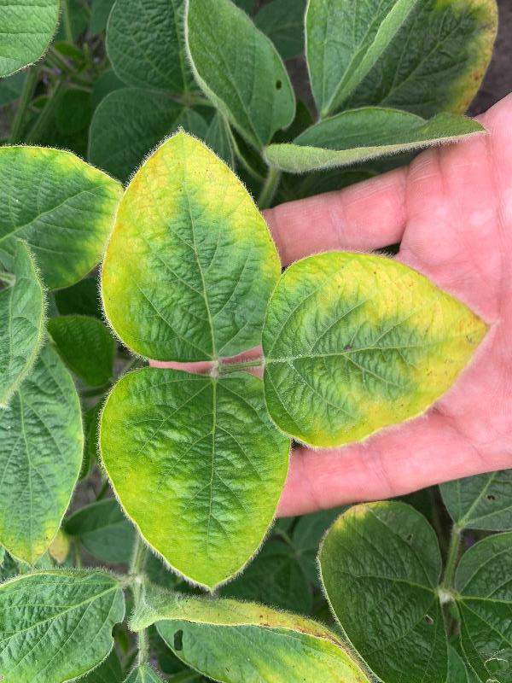
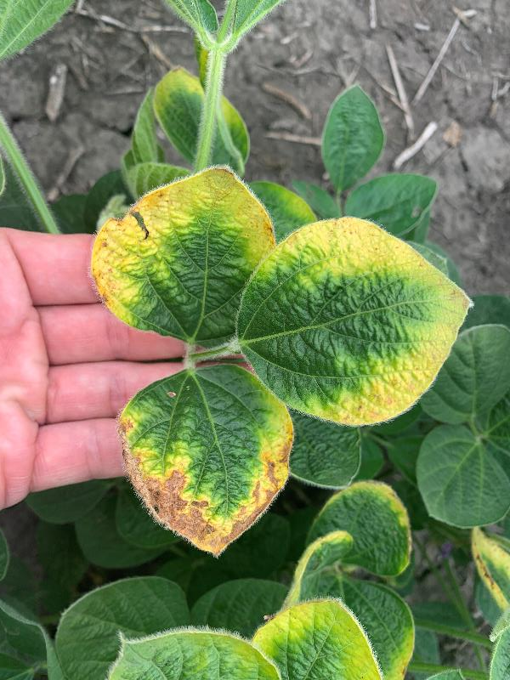
Potassium Deficiency: Progression

Slide 19
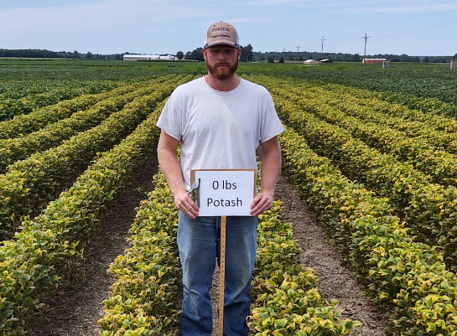
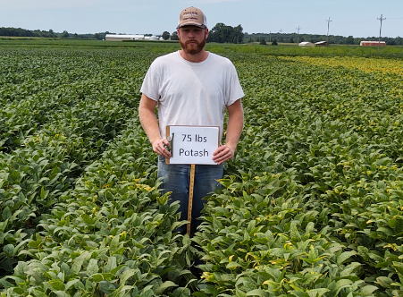
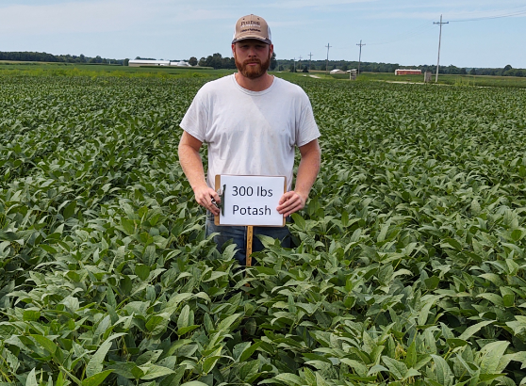
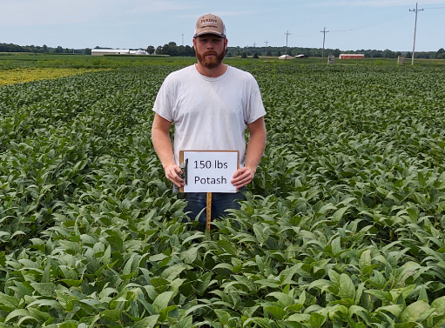
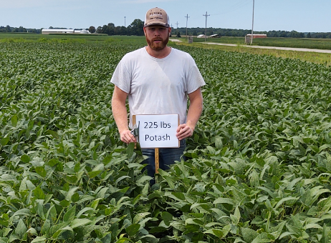
Hidden hunger – yield loss without symptoms
51
24 bu/acre
74
64
69
Camberato and Helms, 2020
2020 SEPAC

Slide 20
SOYBEAN Mid Season Lessons Learned - 2022
Bean Leaf Beetle presence was minimal and feeding was 10% leaf defoliation at the highest. Most fields did not have BLB present nor leaf feeding.
Green stink bugs were not found.
Field conditions:
Dry in 17 of 23 fields
Wet in 2 of 23 fields
Minimal disease pressure
Septoria Brown Spot: 0 – 5% of canopy severity, 0 to 2 trifoliates infected per plants
Frogeye Leaf Spot and Downy Mildew: very little
Notes:
23 fields in mid season report
11 fields in AL tissue plus 3 more samples that were part of a demo
* Only 15 fields sampled for soil
Pictures taken and uploaded, but have they been connected with sample results? Specialist review?
Were the pictures beneficial to you and your clientele?
Frogeye Leaf Spot
Pictures taken and uploaded (to box). Did they make it to PPDL? Pictures and the samples?
Other observations and notes:
Small pocket of Mn deficiency reported to farmer

Slide 21
SOYBEAN Late Season Lessons Learned - 2022
Growth Stage: R6 (Full pod)
Final plant population
84,000 to 150,000 plants/ac, AVG: 118,000 plants/ac
Foliar fungicide and insecticide applied in 7 of 13 fields (53%)
Bean Leaf Beetle
Presence: 6 out 13 fields with nearly 100% plant presence
Pod feeding: 4 out 13 fields with 10 to 40% pod presence*
Green Stink Bug
Plants: 3 out 13 fields with 30 to 40% plant presence
Pod feeding: 2 out 13 fields with ~10% pod presence*
Pod Counts and Yield Estimates
360 to 684 pods per 10,000th of acre
A few were over 1000, which were counting pods that wouldn’t make a seed
Normal Seed Size → 50 to 95 bu/ac
Small Seed → 43 to 81 bu/ac
Notes:
Normal Seed Size (2.5 seeds/pod, 18 seed size factor which is 3000 seeds/lb) → 50 to 95 bu/ac
Small Seed ((2.5 seeds/pod, 21 seed size factor which is 3300 seeds/lb) → 43 to 81 bu/ac

