Slide 1
Notes:
Can use this slide as a title page

Slide 2

Paraquat
(Paraquat Dichloride)
One Sip Can Kill !
Elizabeth Evans, Modifications by Nancy Fitz; Bob Bellinger
Notes:
Permission given by Robert G. (Bob) Bellinger, Ph.D.
Professor of Entomology & Extension Pesticide Coordinator;
Director, Pesticide Information Program;
Extension Pesticide Safety Education Program Coordinator;
Pest Management Information Program Coordinator;
Dept. of Agriculture & Environmental Sciences e-mail: bbllngr@clemson.edu
130 McGinty Court Voice: 864-656-5042, 3111
Rm 258 Poole Agriculture Center Fax: 864-656-
340310, Clemson University
Clemson, SC 29634-0310

Slide 3
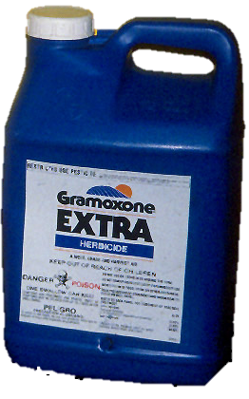
Paraquat
Paraquat is a Restricted Use herbicide.
Remember that all herbicides are pesticides!

Slide 4
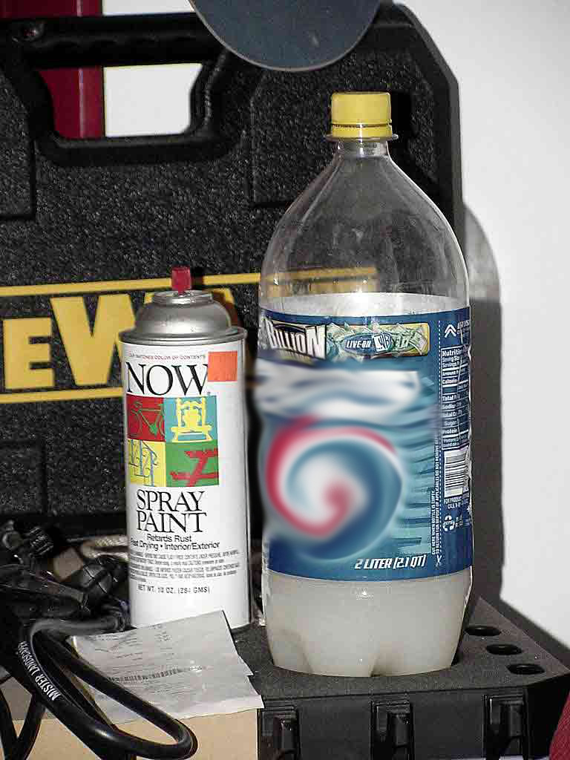
Deaths from Accidental Ingestion of Paraquat
Paraquat is highly toxic to humans; one small
accidental sip is often fatal and there is no antidote.
Several accidental paraquat ingestion deaths have occurred in recent years.
EPA looked into these deaths and found that such cases often occur as a result of the pesticide being transferred into a beverage container.
This is a major concern to EPA because paraquat is a Restricted Use Pesticide and, like all pesticides, should never be placed into a beverage container.

Slide 5
Deaths from Accidental Ingestion of Paraquat
The product labels clearly prohibit pouring paraquat into food or beverage containers with the prominently-placed statements:
“NEVER PUT INTO FOOD, DRINK OR OTHER CONTAINERS.”
“DO NOT REMOVE CONTENTS EXCEPT FOR IMMEDIATE USE.”

Slide 6
Paraquat Toxicity
Paraquat poisoning can result in initial poisoning symptoms, a period of (false) recovery, and a miserable relapse as it destroys the lungs. The relapse usually leads to death (due to suffocation).¹
Pulmonary effects represent the most lethal and least treatable manifestation of toxicity; however, pulmonary toxicity occurs later in paraquat poisoning than other manifestations.²
The delayed toxic damage of the pulmonary fibrosis, the usual cause of death, most commonly occurs 7-14 days after the ingestion.²
¹ Mike Weaver, VA Tech University
^{2 “}Recognition and Management of Pesticide Poisonings.” http://www2.epa.gov/sites/production/files/documents/rmpp_6thed_ch12_paraquatdiquat.pdf

Slide 7

True Stories
About June 3, 2014 an individual stole some Gramoxone (a.i. paraquat). A second individual put the herbicide into plastic soft drink bottles labelled “Pepsi”. He then sold the bottles to two people. One buyer mistook the herbicide for a soda and drank some. This individual died June 15, 2014.
*The two alleged offenders, in addition to being charged with multiple counts of violation of the South Carolina Pesticide Control Act, are, in sum, charged with Involuntary Manslaughter, receiving stolen goods, petty (petite) larceny.
* Note: As of March 10, 2015 this case is under criminal investigation and no other details are available or should be presumed.

Slide 8
True Stories
In 2008, an 8-year old boy drank paraquat that had been put in a Dr. Pepper bottle, which he found on a window sill in the garage. He died in the hospital 16 days later.
His older brother had used the product on weeds around the house and put it in the bottle in the garage. The older brother obtained the product from a family friend who is a certified Restricted Use Pesticide applicator.
Notes:
There are 4 true stories, pick and choose which one, how many you would like to present.

Slide 9
True Stories
In 2003, a 49-year old male took a sip from his coffee cup in which he had poured paraquat herbicide because the product’s bottle was deteriorating. He realized his mistake and went to the Emergency Department. At that time, he was vomiting, cold and sweating profusely.
Doses of activated charcoal were administered and his stomach was pumped; morphine was provided for esophageal pain; and he was intubated to support breathing function on the fourth day. Aggressive supportive care continued until he died on the tenth day.

Slide 10
True Stories
In 2000, a 15-month old boy ingested paraquat product that had been transferred into a Gatorade container and stored inappropriately.
The boy survived in the hospital for 13 days after the ingestion and received aggressive treatment, but died after suffering acute kidney and liver failure.

Slide 11
True Stories
In 2000, an 18-month old boy ingested an unknown amount of paraquat solution from a bottle found in his father’s landscaping truck.
He received multiple-dose activated charcoal treatment two hours after the ingestion. He suffered from lack of oxygen during the first 24 hours followed by progressive liver, kidney, and cardio-pulmonary dysfunction. The boy died 11 days after the ingestion.

Slide 12
Applicators: You are the solution!
To prevent the severe injury and/or death from paraquat ingestion, a paraquat product must:
Only be used by a certified applicator or under the direct supervision of a certified applicator.
Never be transferred to a food or drink container.
Securely stored to prevent access to children and/or other unauthorized persons.
Never stored in or around residential dwellings.
Never used around home gardens, schools, recreational parks, golf courses or playgrounds.

Slide 13
Applicators: You are the solution!
Some paraquat products
Bonfire
Firestorm
Gramoxone
Helmquat
Para-Shot
Parazone
Quik-Quat

Slide 14

Emergency treatment for paraquat poisoning
If paraquat or diquat has been ingested in any amount, immediately administer an adsorbent. This is the one therapeutic measure most likely to affect the outcome of paraquat (or diquat) ingestion favorably. ²
Bentonite (7.5% suspension) and Fuller’s Earth (15% suspension) are highly effective but sometimes not available. ²
Activated charcoal may be most available.
Crush pellets if in
pellet form.
^{2 “}Recognition and Management of Pesticide Poisonings.” http://www2.epa.gov/sites/production/files/documents/rmpp_6thed_ch12_paraquatdiquat.pdf

Slide 15
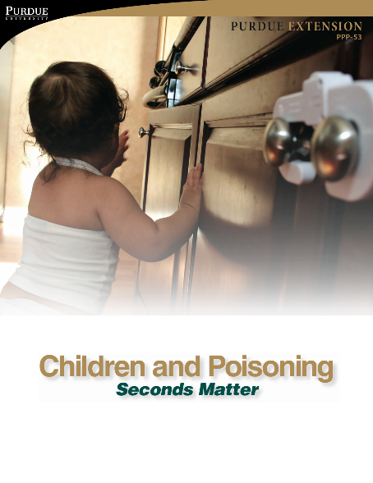
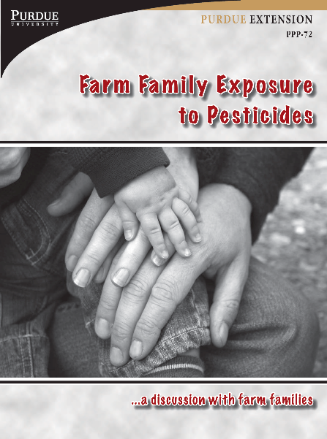
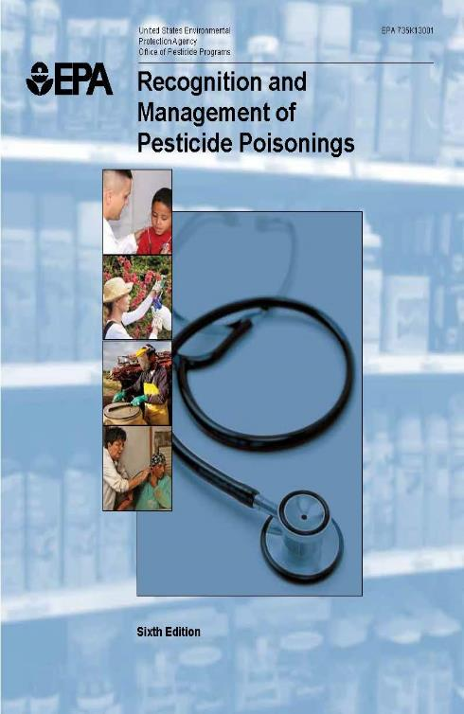
Useful references on pesticide poisonings
^{2 “}Recognition and Management of Pesticide Poisonings.” http://www2.epa.gov/sites/production/files/documents/rmpp_6thed_ch12_paraquatdiquat.pdf
Notes:
In addition to the EPA publication the following publications from Purdue Pesticide Programs would be helpful: PPP 50, 53 and 72
Available from The Education Store or print from https://ag.purdue.edu/Extension/PPP/Pages/Publications.aspx

Slide 16
Remember:
Paraquat
One Sip Can Kill !
Elizabeth Evans, Modifications by Nancy Fitz; Bob Bellinger

