Slide 1
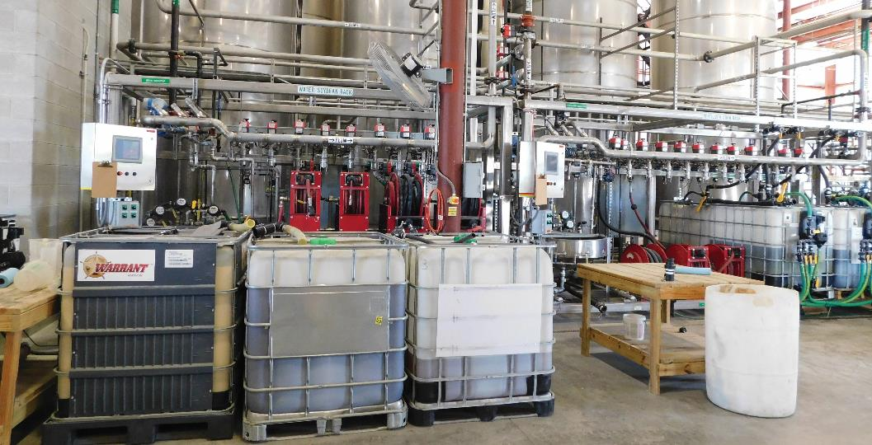
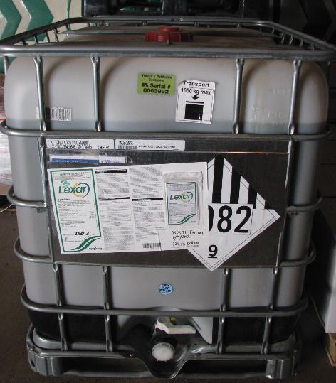
PESTICIDE MINIBULKS
Educator Name, County/Title
Purdue University is an equal access / equal opportunity institution.
Notes:
Read PPP-136, Pesticide Minibulks, prior to giving this presentation.
This is a longer PARP regulatory topic than most and can serve as both a regulatory and educational topic.
Around 45 minutes should be allotted for this full presentation.

Slide 2
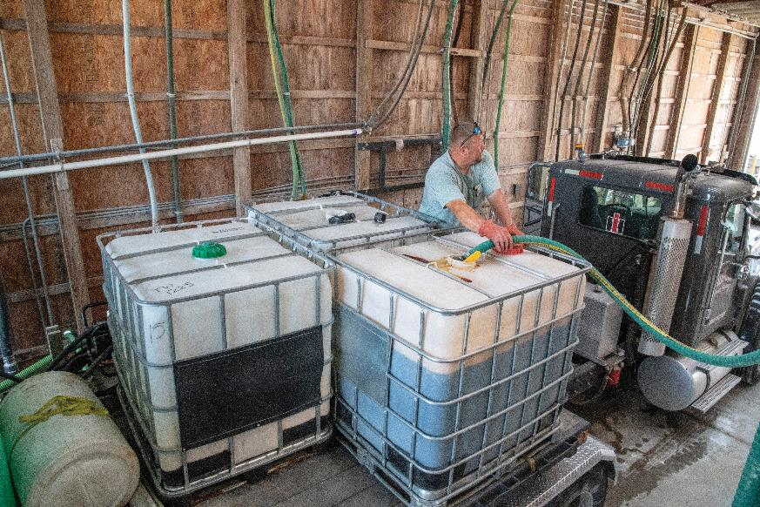
Agenda
Introduction
Bulks vs. Minibulks
Secondary Containment
Filling Minibulks
Pressure Testing
Farm-Owned Minibulks
Summary
Purdue University is an equal access / equal opportunity institution.

Slide 3
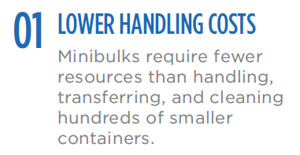
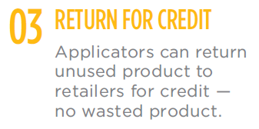
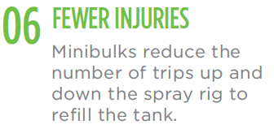
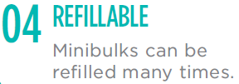
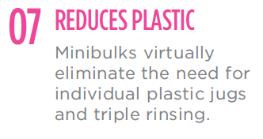
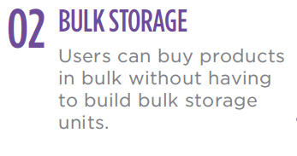
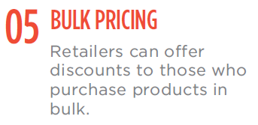
Why Minibulks?
Notes:
Minibulks – aka - shuttles, totes, and intermediate bulk containers (IBC)
Remind audience this presentation is for pesticide minibulks, not fertilizers.
There are many reasons minibulks are used (review slide).
There are also disadvantages:
Transport Concerns
Storage limitations and use
Spills
most spills occur during loading /unloading and transporting)
A minibulk spill means 100s of gallons on the ground which can lead to chemical going to environmentally sensitive sites

Slide 4
Bulks vs. Minibulks
Purdue University is an equal access / equal opportunity institution.

Slide 5
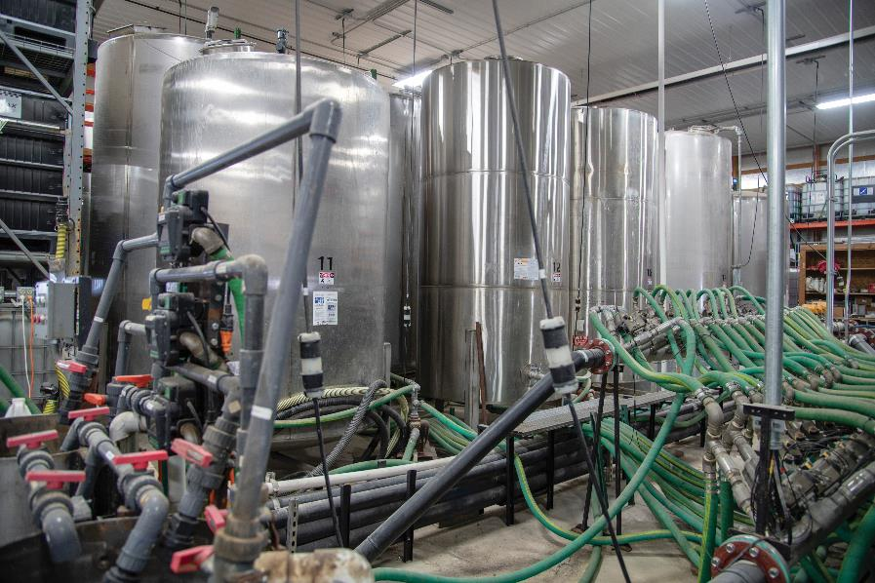
Liquid BULK
Bulk:
undivided quantity more than 55 gallons
Notes:
EPA and OISC define bulk as undivided quantity of more than 55 gallons
DOT is different – 119 gallons for hazardous materials
If you have bulk amounts of pesticide or fertilizer (in permanent storage OR if minibulks stored for >30-day, you must register your facility with OISC.
No cost
Annual renewal (OISC sends notice once you’ve registered)
Form (Pesticide or Fertilizer): https://www.oisc.purdue.edu/fertilizer/pdf/registration_bulk_storage_facilities_fert_pest.pdf

Slide 6
Mini BULK
Minibulk:
holds 56 to 400 gallons
Notes:
Minibulks are a type of bulk storage.
(Remember, EPA and OISC define bulk as undivided quantity >55 gallon)
Rules governing the Minibulk and bulk differ a little.

Slide 7
BULK
(>55 gal)
Stationary Storage
(>400 gal)
Minibulks
(56-400 gal)
Notes:
Two main types of bulk storage: stationary and minibulks
Stationary Storage:
Often stainless steel
400 - 5,000 gallon capacity
Require secondary containment
Dedicated plumbing
Minibulks:
Often caged plastic tanks with support
56-400 gallons capacity
Pre-filled or refilled
Mobile

Slide 8
A storage room has ten 2.5 gallon plastic containers and a 35-gallon container. Would any be considered bulk?
No, because no single container holds more than 55 gallons.
Notes:
Recall - OISC and EPA define liquid bulk pesticide as an undivided quantity >55 gallons.

Slide 9
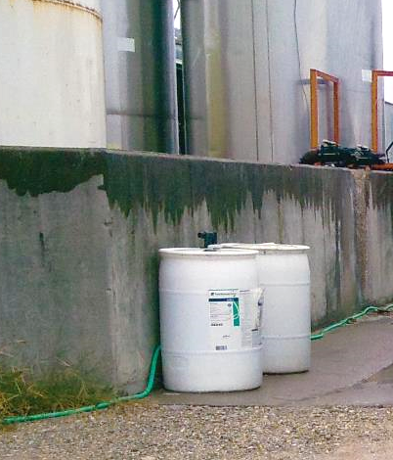
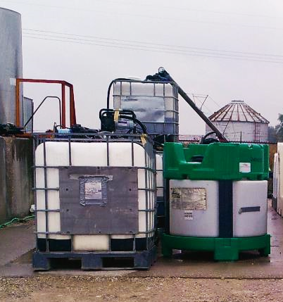
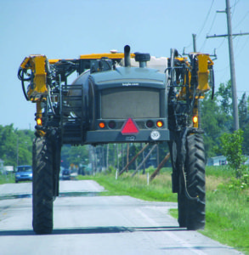
Are these liquid bulk pesticides?
55 Gallon Drum
265 Gallon "Minibulk"
Sprayer Tank
Sprayer photo from Purdue Pesticide Programs website
Notes:
A 55 gallon drum is not GREATER than 55 gallons, therefore it is NOT a liquid bulk pesticide.
A 265 gallon minibulk is a bulk tank because it holds more than 55 gallons.
A sprayer tank is application equipment, not storage equipment, and therefore does not fall under bulk containment regulations.

Slide 10
SECONDARY CONTAINMENT
Purdue University is an equal access / equal opportunity institution.
Notes:
If the primary containment system fails, it prevents uncontrolled spread of a hazardous substance.
It provides a second enclosure which blocks or traps leaks and spills of hazardous substances. It’s your back-up plan!

Slide 11
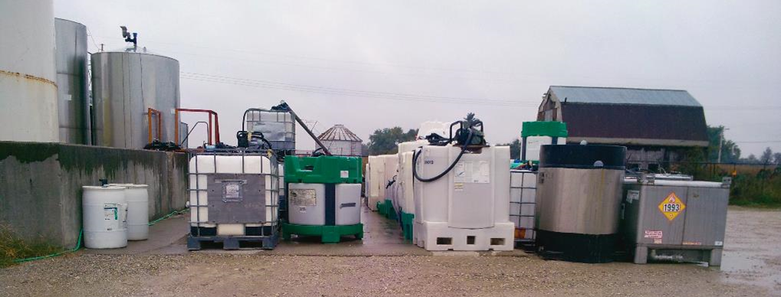
Applicators may order minibulks in fall. Do minibulks fall under secondary containment regulations?
After 30 days, minibulks must have secondary containment.
Notes:
If applicators buy material early, they can ask retailers to hold them until spring.
Regulations take effect when a minibulk touches the property.
Mini bulks are sometimes used for semi-permanent storage, however, they are designed to be filled, emptied and refilled quickly.
If used as intended, regulations state minibulks stored/used at retailers or farms for 30 days or less do not require secondary containment.
For prefilled minibulks delivered to retailers or farms, 30 days start on the day of delivery.
This picture is of an operational/load pad which does not appear to offer secondary containment.
Different Rules for Fertilizers:
Regulations apply for bulk fertilizer storage with quantities over 7,500 gal or a single tank of over 2,500 gal
See PPP-63

Slide 12
Does putting minibulks on a trailer exempt them from the 30 days?
No. A minibulk stored on a truck, trailer, or on the ground for over 30 days must have secondary containment.
Notes:
For prefilled minibulks delivered to retailers or farms, 30 days start the day of delivery.
There has been a misconception that trailers or other methods were allowed to extend the 30 days – Per Joe Becovitz (OISC), this was never allowed!

Slide 13
Farmers may have large (3,000 - 5,000 gal) on-farm storage tanks. Do secondary containment regulations differ between farmers and ag retailers?
No. Stationary tanks held by farmers and retailers must follow Indiana secondary containment regulations.
Notes:
Note: pesticide storage, not fertilizer
Secondary containment is the same for farmers and retailers.

Slide 14
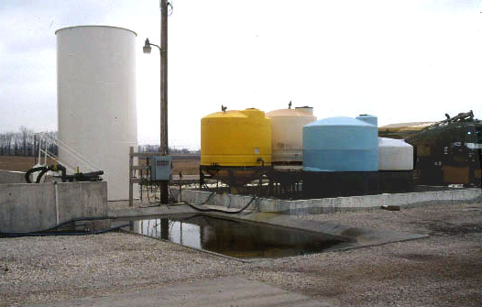
Secondary Containment
Primary containment (tanks)
Secondary containment (dike)
Notes:
Cite picture
See pages 11-12 of PPP-136.
There are a few secondary containment options for storing minibulks:
Store within an existing secondary containment structure (Note: minibulks cannot be stored in fertilizer containment unless separated by a wall)
Use an already existing 10-foot x 20-foot mix/load pad, which is sometimes referred to as operational area containment (more on this in later slide)
Building a separate 10-foot x 20-foot sloped pad that holds a minimum of 750 gallons, and sloped toward a sealed sump which allows users to recover material
Note: A flat, uncurbed concrete slab is not containment.
Dikes (wall to prevent escape of liquid) hold volume of largest tank + displacement of other tanks in dike -- if everything in the dike would leak/spill, dike must hold it all.
Fertilizer and pesticide can’t be in the same containment area but can share a common wall.
The picture shows primary containment of fertilizer on left (tall, white), pesticide on right tanks (yellow, white, blue).

Slide 15
Do I have to store empty minibulks in containment?
No. Once empty, they can be stored anywhere.
Notes:
Minibulks can be refilled; once refilled and brought on-farm, the 30-day containment requirement begins again

Slide 16
A 110-gallon minibulk still has 25 gallons of product. Does it need secondary containment?
Yes. The container’s capacity determines whether it is bulk and requires secondary containment.
Notes:
This minibulk must have secondary containment if stored beyond 30 days, even if only 25 gallon of product remains.

Slide 17
Can I use the operational pad associated with stationary tanks to store minibulks?
Indiana regulations allow using an operational pad
-10' x 20’ minimum, sloped to hold 750 gal
- not a good long-term solution!
Notes:
While it may be legal, it is NOT a good long-term solution – especially for ag retailers!
When minibulks are stored on operational pads, it means you’ll probably move them more often (more chance of issues)
They will likely be stored outside (more wear)
A sloped containment is not as effective as a dike
If the operational pad is inside, it’s less of an issue.

Slide 18
(RE)Filling minIbulks
Purdue University is an equal access / equal opportunity institution.
Notes:
Why are there rules for refilling minibulks?
To ensure they:
Withstand road and field use
Are not contaminated
And to protect the grower!
If you receive minibulks from dealer, you don’t have to worry about re-filling, but you should understand what not to tamper with.
Retailers can fill your personal minibulk if it meets requirements, but cannot fill non-compliant containers.
Goals: Protect Grower, Protect Retailer, Protect Environment.

Slide 19
EPA Requirements for Filling Minibulks
End users (e.g. farmers) - transfer pesticides from one container to another for own use →
NOT subject to repackaging regulations
Retailers - transfer product from one container to another for resale are producers →
Subject to EPA refill requirements
Notes:
We will go through nine requirements for filling minibulks.
These are for Ag Retailers, but some should be understood by end users.
Any entity who engages in PRODUCTION (transfer from one container to another) must abide by these 9 requirements.
*Transferring pesticides to application equipment is not “production.”
Farmers who store bulk pesticides for own use are ‘End Users’ and not subject to EPA’s bulk repacking regulations.

Slide 20
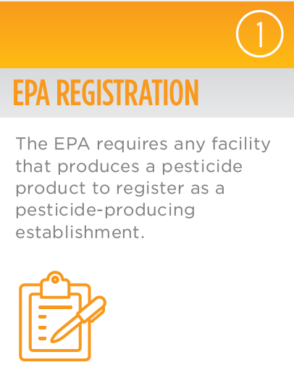
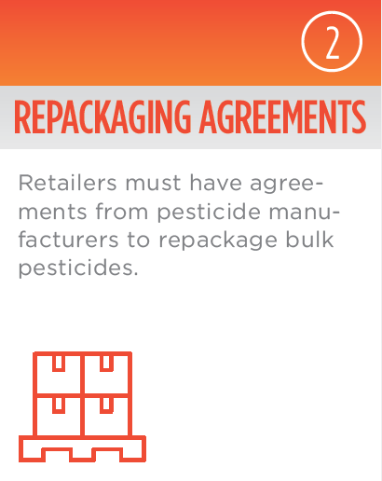
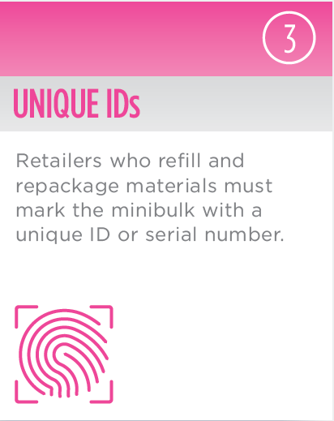
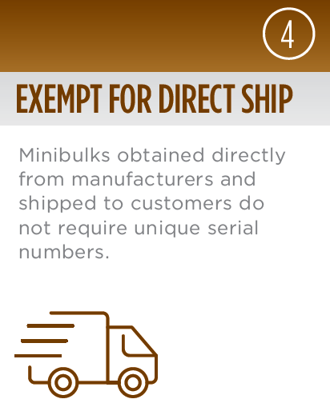
Requirements for Filling Minibulks (Retailers)
Notes:
Federal regulations spell out specific requirements that dealers must comply with when they take product from stationary bulk tanks to fill minibulks..
9 Requirements
Briefly review the first 4:
The facility must be an EPA Establishment.
There must be agreements in place between the manufacturer and the facility in order to repackage pesticides.
Repackaged pesticides must be marked with unique IDs (no prescribed method to assign these).
If no re-packaging is performed, the unique ID is not required. (i.e. if retailer is just holding entire package and contents for re-sale)

Slide 21
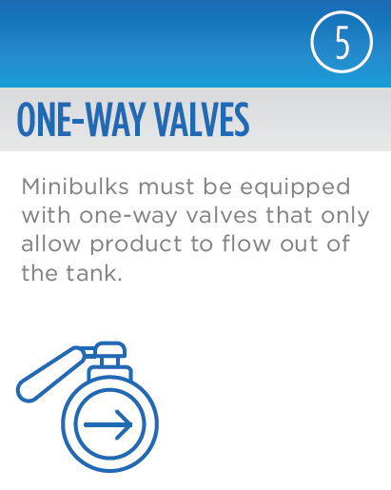

Slide 22
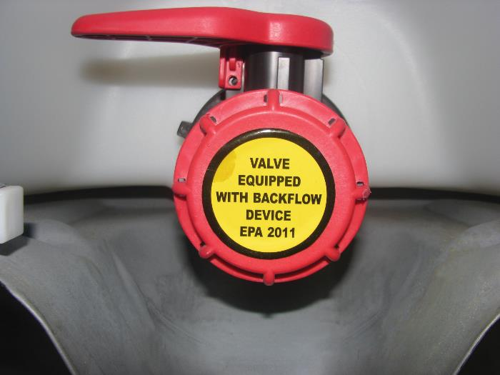
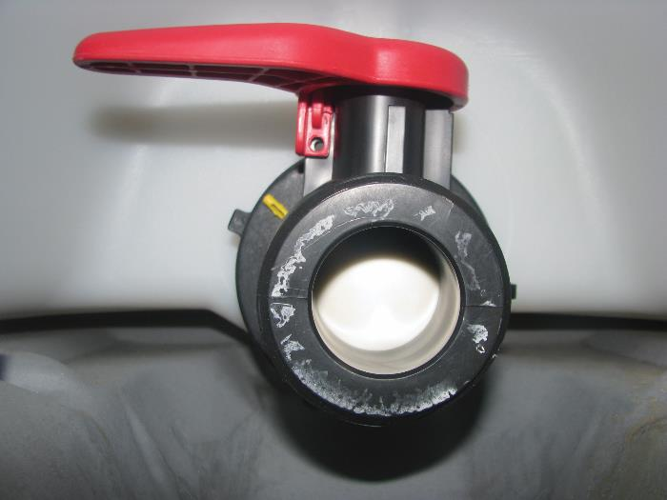
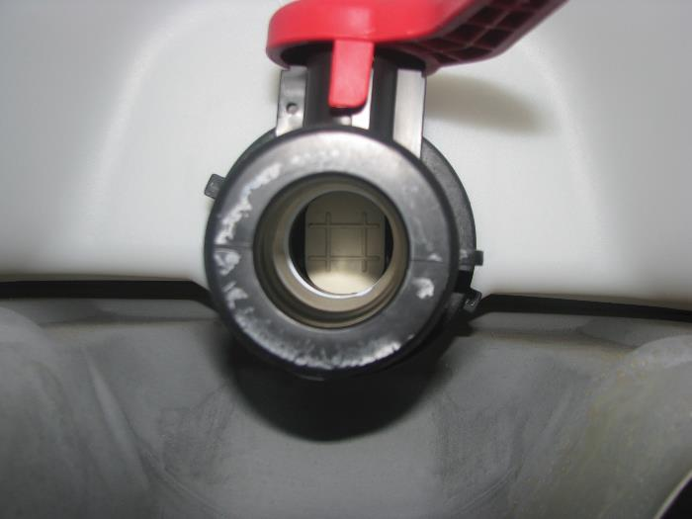
1
2
4
3
All valves must be one way valves
Notes:
Refillable minibulks must have one-way valves that only let the product flow one direction.
1 – example of one-way valve
2 – label removed; valve closed
3 – handle at half open; showing valve beginning to open
4 – fully open; chemical can flow out, but cannot flow back into tank due to mechanism shown= One Way Tank

Slide 23
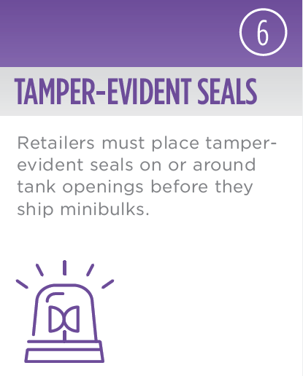

Slide 24
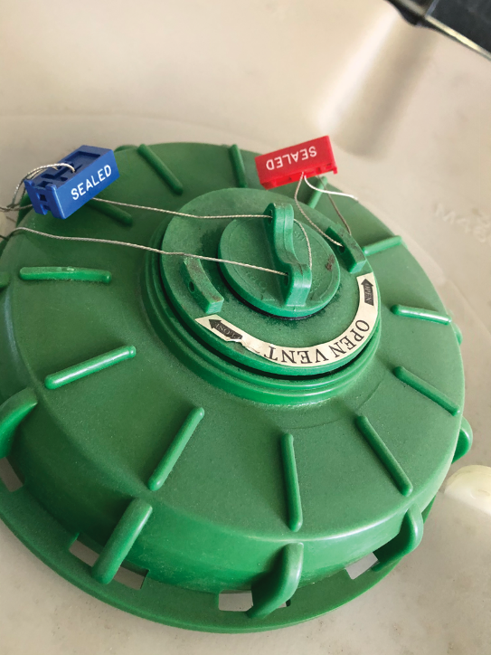
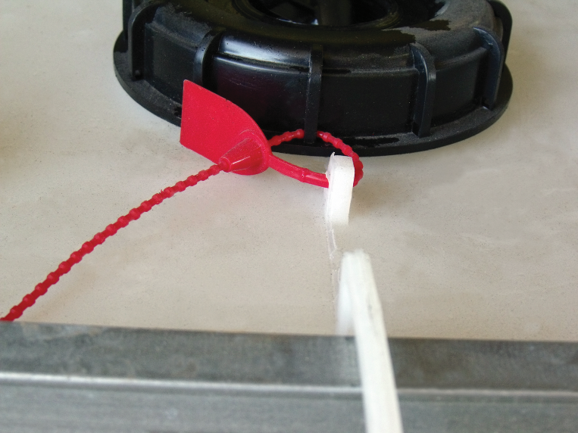
TAmper-evident Seals
Notes:
Retailers and manufacturers must place tamper-evident seals on or around openings
External seals provide visual clues when users return minibulks.
Seals protect product integrity. If seals are intact, the product has not been tampered with.
If seals are broken, retailers must follow specific cleaning instructions found in repackaging agreements before refilling — even if refilling the same product
Pictures: plastic or wire holds lid to tank to prevent lid from being removed and chemical added from top
If farmers return minibulks to dealers with seals, tags, or valves with damage, the farmer may
- be required to pay to have it cleaned
- need to purchase the minibulk
- not receive credit for remaining product

Slide 25
What should a retailer do if a minibulk has a broken seal?
Assume it has been contaminated and require cleaning per repackaging agreement
Notes:
When security devices have been breached, there is no guarantee of contents.
Farmers/retailers cannot assume material left in the minibulk is uncontaminated.
Retailers may refuse to take back product or give credit for remaining material if security seals or tags are tampered.
If a farmer needs to open the minibulk (e.g. to stir contents), call the retailer.
They can come out, do the work, and reseal the minibulk. This will save them work when returned.

Slide 26
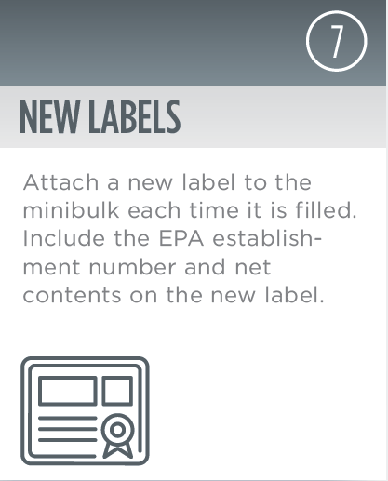

Slide 27
New Labels on Minibulks (Retailer/Filler)
Attach new labels at each filling
Include EPA Est. No. and net contents
Note: Net contents is the amount added to the minibulk
Notes:
The EPA Establishment No. on the minibulk is assigned by EPA to a specific facility. The Est. No. on a minibulk is always the number for the location where the container is filled. This holds true even if a facility fills a minibulk for a “sister” facility.
Example: Corteva → Retailer Tank Use Corteva’s EPA Est. No.
Retailer Tank → Farmer Use Retailer’s EPA Est. No.
Although not required, some dealers include the date the minibulk was refilled on each label

Slide 28
A farmer returns a 250-gallon minibulk with 25 gallons left. The retailer adds 225 gallons. What product amount would be written on the minibulk label?
Record 225 gallons for net contents.
Notes:
The net contents recorded on the label would be 225 gallons, not 250 gallons.
Most of the time, people will fill EMPTY minibulks.
Net contents is not the same as tank capacity.
Net contents may not equal total contents of a minibulk if product was added to a partially full minibulk.
Don’t leave an old label on the container – either paper over the old or remove the old and replace.

Slide 29
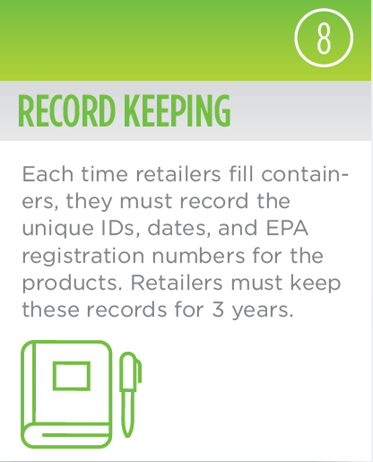

Slide 30
Record Keeping (Retailers/Fillers)
Each time you refill a minibulk, record
Unique ID/serial number
Date
EPA Reg. No.
Keep records 3 years
Note: RUPs require more detailed records
Notes:
Restricted Use Pesticide (RUP): keep more detailed records (RUP requires general records for 2 years, but minibulk refilling records must be kept 3 years)

Slide 31
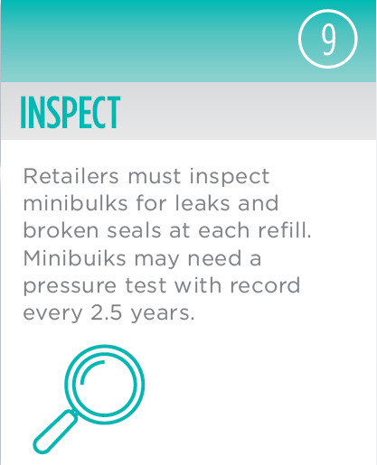

Slide 32
Inspection and Cleaning Requirements (Retailers/Fillers)
Are valves functioning?
Does the tank have spills, leaks, or cracks?
Is the pesticide label affixed?
Are tamper-evident seals intact?
Notes:
Determine if minibulk can be refilled by reviewing tank label
Most minibulks meant to be reused -- inspecting is perhaps the most important part of the refilling process
Proper inspections
Reveal faulty containers, leaking valves, tanks which need recertified (pressure-tested), or contamination issues
Failing to inspect before refilling can result in contamination issues, which may cause thousands of dollars in unintentional crop damage and ruined reputation
If tank labels do not match product to be put into them, or if any seal is cut or broken, retailers must clean the minibulks according to the instructions in the repack agreement. They must clean tanks over a wash pad where they can collect rinse.

Slide 33
What cleaning procedure must be followed when switching from one product to another?
Use the cleaning procedure for the last product in the tank.
Notes:
Use the cleaning procedure for the last product used in the tank to remove residue.
Then you may fill cleaned minibulk with any pesticide for which you have a repack agreement.
The cleaning procedure is found in the repackaging agreement.

Slide 34
Pressure testing
Purdue University is an equal access / equal opportunity institution.

Slide 35
Pressure Testing
Do retailers need to pressure test minibulk containers?
Notes:
EPA regulations defer the Dept of Transportation when it comes to testing minibulk integrity.
DOT regulations require some (not all) minibulks be pressure tested every 2.5 years.
Long-term, multi-use minibulks must be tested.
Single use, non-refillable tanks do NOT need pressure tested:
more commonly used for adjuvants
pesticides seldom packaged in one-way shuttles
confirm tanks are non-refillable (see label)

Slide 36
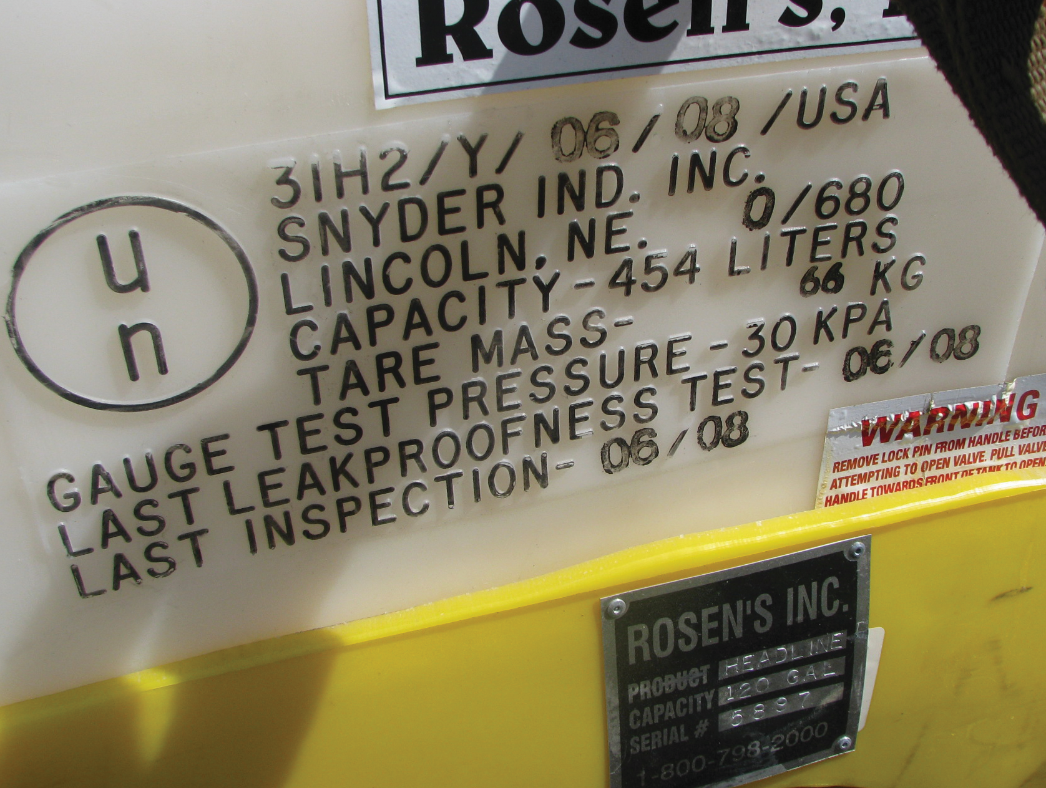
Does it need tested?
Check UN code:
X, Y, or Z?
Date
Notes:
Testing requirements are based on UN specification mark - an X, Y or Z on label means you should routinely test.
Refillable UN containers require pressure testing:
Test every 2 ½ years
Wear eye protection at minimum
Follow PPE on label
This label has a “Y” and was last inspected 06/08 – Therefore it should have been tested several times, which should have been noted permanently on the container.

Slide 37
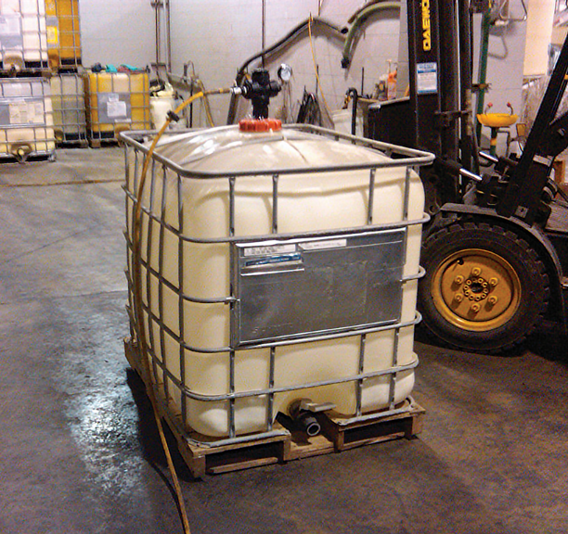
Pressure Testing Process
Close openings
Pressurize to 3 psi
Wait 5 minutes
If no signs of leaks or excessive bulging, the container passes the pressure test
Notes:
1. Make sure all openings (caps, one-way valves and vents) are completely closed.
2. Pressurize the container to 3 psi
Added pressure may cause container to slightly bulge out.
Do not apply too much pressure — that can permanently damage the container and/or injure the tester.
If a tank does not maintain pressure, there is a leak.
Use soapy water /glass cleaner, spray around lids, valves, and other areas to pinpoint leak’s source
The solution will bubble up, revealing the exact location of the leak
Repair
3. Wait 5 minutes to see if tank maintains pressure.

Slide 38
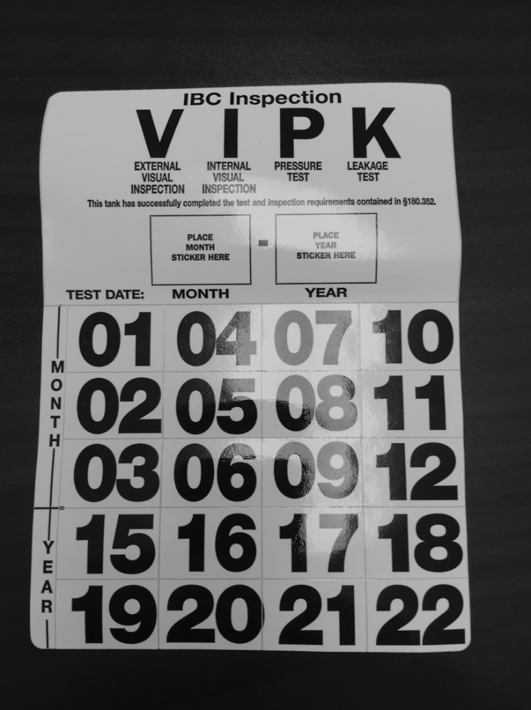
RECORDS: Pressure Testing
Permanently mark container
Date
Near UN logo
Record keeping
Your name
Testing site
Date
Container ID #
Pass/Fail
Procedure description
Notes:
Permanently mark the month and year of the inspection on the container near the UN marking.

Slide 39
RECORDS: Pressure Testing
What if it fails?
Permanently & prominently mark
“OUT OF SERVICE” or
“FAILED PRESSURE TEST”
Note date out of service in records
Destroy or recycle container
Notes:
Pesticide Stewardship Alliance lists where to recycle on their website: https://tpsalliance.org/

Slide 40
Farm-owned minibulks
Purdue University is an equal access / equal opportunity institution.

Slide 41
Farm-owned Minibulks
Farmers can transfer material for own use from retailer minibulk into own minibulk without EPA oversight
Notes:
No requirement for production reports, UN codes, pressure testing
But that doesn’t mean you shouldn’t do these things.
Audience question: What safety issue do you see in the picture? The filler is not wearing safety glasses (or at least not wearing them over his eyes).

Slide 42
PREVENT SPILLS
Inspect tanks thoroughly
Inspect valves and seals
Consider storage enhancements (pad or secondary storage)
Notes:
It is a good idea (but not required) for farmers to flow minibulk regulations just like ag retailers.
These are recommended practices for end users, but are not mandated by EPA.
INSPECT: If you don’t inspect, you will probably have a tank failure at some point
Insurance doesn’t normally cover spills without special coverage.

Slide 43
PREVENT CONTAMINATION
Dedicate each minibulk to single product
Properly clean between uses
Keep labels updated and maintain thorough records
Notes:
SINGLE PRODUCT: Keep each minibulk dedicated to a single product. Not cleaning properly between products can cause crop damage and injury, which insurance may not cover

Slide 44
KEEP RETAILER HAPPY
Keep tanks safe
Inspect tanks for tamper resistant seals and one-way valves
Clean tanks
Notes:
The retailer should inspect a farmer owned tank to ensure it meets required standards including cleanliness, one way valves and registrant approved design.

Slide 45
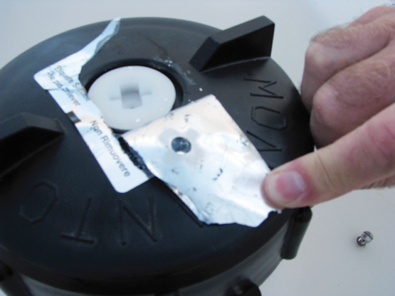
Farm-owned Minibulks
It is illegal for retailers to fill minibulks which don’t meet repackaging standards:
No one-way valve
No tamper evident seal
Not an approved container
Notes:
If you want a retailer to fill your minibulk, be sure your follow their standards.

Slide 46
summary
Purdue University is an equal access / equal opportunity institution.

Slide 47
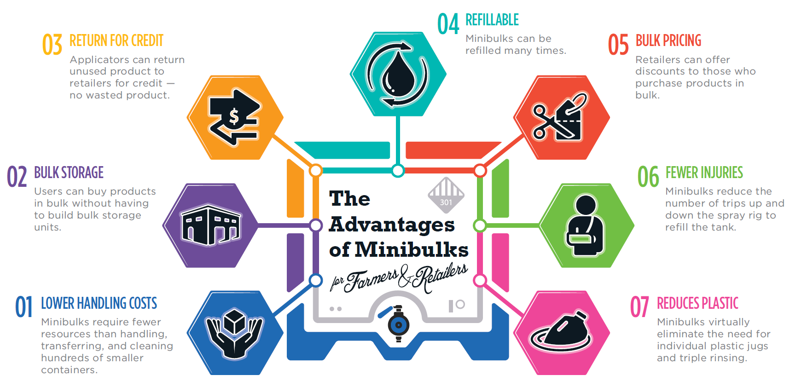
Why minibulks?
Notes:
Minibulks can be a cost-effective and efficient way to move pesticides from retailer to farm.
While there are many benefits, produces need to understand risks -- like spills and tank contamination.
When farmers and retailers work together, both benefit from using Minibulk systems.

Slide 48
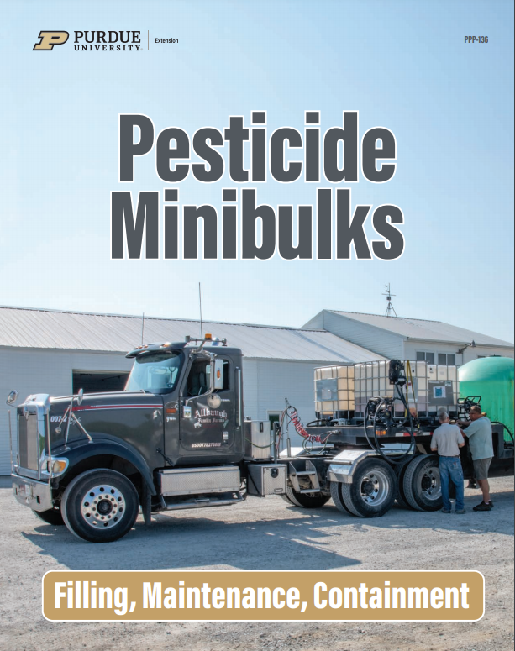
Much of this presentation's information came from Purdue publication PPP-136, which is available for free online!
https://ppp.purdue.edu/wp-content/uploads/2020/09/PPP-136.pdf

Slide 49
Questions?
Office of Indiana State Chemist
Joe Becovitz Telephone: 765-494-1589 E-mail: becovitz@purdue.edu
Purdue University is an equal access / equal opportunity institution.
Notes:
Educator: Pass on questions you are not confident in answering to Joe Becovitz at OISC

Slide 50
Credits
Information and uncited photos from PPP-136.
Presentation compiled by:
Ann Kline, Purdue Extension-Noble County, ANR Educator
Beth Vansickle, Purdue Extension-Madison County, ANR Educator
With input from Fred Whitford (Purdue Pesticide Programs) & Joe Becovitz (OISC)
Purdue University is an equal access / equal opportunity institution.

Slide 51
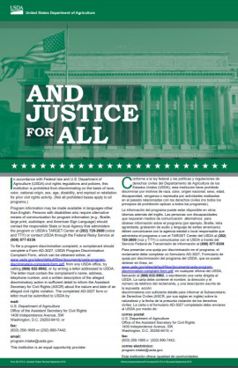
In accordance with Federal law and U.S. Department of Agriculture (USDA) civil rights regulations and policies, this institution is prohibited from discriminating on the basis of race, color, national origin, sex, religious creed, disability, age, political beliefs, or reprisal or retaliation for prior civil rights activity.
To file a program discrimination complaint, a complainant should complete a Form AD-3027, USDA Program Discrimination Complaint Form, which can be obtained online at www.usda.gov/sites/default/files/documents/usda programdiscrimination-complaint-form.pdf, from any USDA office, by calling (866) 632-9992, or by writing a letter addressed to USDA.
The letter must contain the complainant’s name, address, telephone number and a written description of the alleged discriminatory action in sufficient detail to inform the Assistant Secretary for Civil Rights (ASCR) about the nature and date of an alleged civil rights violation. The completed AD-3027 form or letter must be submitted to USDA by:
mail: U.S. Department of Agriculture, Office of the Assistant Secretary for Civil Rights, 1400 Independence Avenue, SW, Washington, D.C. 20250-9410; or
fax: (833) 256-1665 or (202) 690-7442;
email: program.intake@usda.gov.
This institution is an equal opportunity provider.

