Slide 1


Manure Handling on and Near Produce Farms

Slide 2
Topics
Why is this a concern?
Understanding manure biology
How do pathogens move
Recommendations:
On the farm
Transport
Staging
Application
Equipment Sanitation

Slide 3
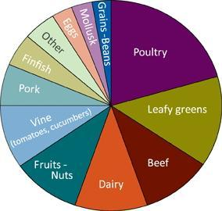
Why is This a Concern?
Every year about one in six Americans, or 48 million people get sick each year from something they eat
  128,000 hospitalizations
  3,000 deaths
Causes of illness in 1,565 single food commodity outbreaks, 2003–2008.
Source: US Centers for Disease Control. www.cdc.gov/foodborneburden

Slide 4
Recent Examples
Cantaloupes, August 2012 Cantaloupes, Fall 2011
24 states 28 states
261 Salmonella infections, 3 deaths 147 Listeria infections, 33 deaths
Raw produce, May-Aug., 2008 Spinach Aug 2007
43 states, D.C., Canada 8,000 cartons of fresh spinach
recalled.
1442 Salmonella infections, 286 hospitalized,
possible role in 2 deaths No illnesses
Fresh spinach, 2006
26 states
200 E. coli O157:H7 infections, 102 hospitalizations, 3 deaths
Notes:
Recent examples of illness traced to fresh fruits or vegetables. The number of states refers to number of states in which people got sick. Data are from the CDC.
The cantaloupes in 2012 were traced to an Indiana farm. The cantaloupes in 2011 were traced to a Colorado farm. Owners of the Colorado farm have plead guilty to federal criminal (misdemeanor) charges.

Slide 5
Manure Implicated in a Number of Outbreaks
1981 Cabbage: Listeria was traced to grower who applied manure from sheep herd with history of listeriosis.
2006 Spinach: E. coli 0157:H7 traced to farm leasing land from cattle ranch.
2006 Lettuce: E. coli 0157:H7 outbreak suspected to originate with manure seepage from neighboring dairy farm.
2011 Colorado: Listeria outbreak. Truck hauling culls to local feedlot implicated as possible vehicle for introducing pathogen.
Notes:
References:
http://www.cidrap.umn.edu/news-perspective/2008/02/report-suggests-wastewater-link-taco-johns-e-coli-outbreak

Slide 6
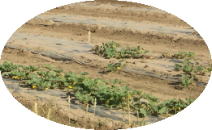
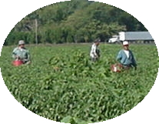
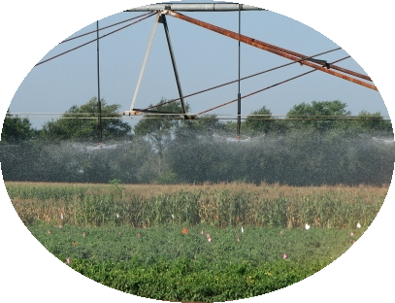
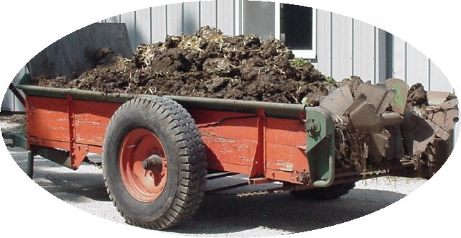
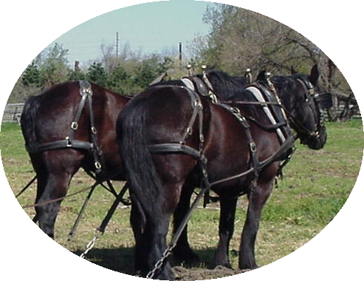
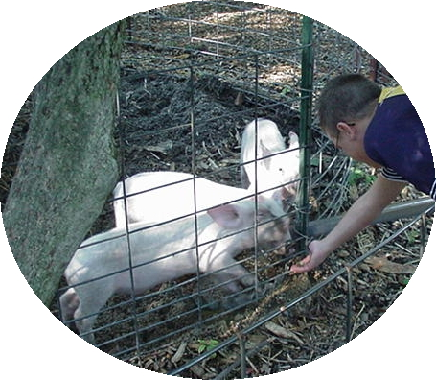
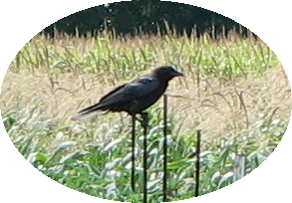
Where can Pathogens be Found?
Soil
People
Water
Manure
Livestock
Pets
Wildlife
Notes:
These are some sources of pathogens. You can see how easy it would be for contamination to occur on a farm.

Slide 7
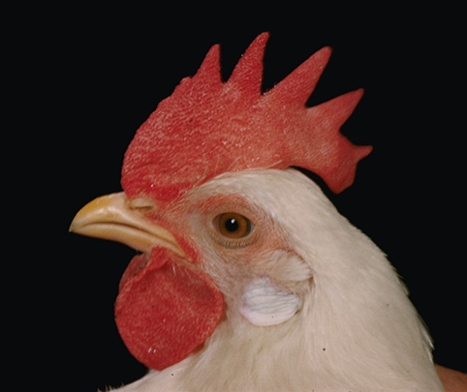
All Manure Can Carry Pathogens
Livestock
    cattle, swine, poultry, horse, & sheep
Dog and Cat
Bird
Rodent
Deer
Fly or other insect
Human
Cornell GAPS

Slide 8
Pathogens That Cause
Foodborne Illness
Bacteria – Single-celled organisms that live independently.
Viruses – Small particles that live and can only replicate in a host.
Parasites – Intestinal worms or microscopic protozoa that live in a host animal or human.
Bacteria in human and animal gut…
– Salmonella species
– E. coli O157:H7
– Shigella species
– Campylobacter jejuni
Notes:
Of the three types of microbes, viruses are the most common cause of food-borne illness (norovirus). However, bacteria are of great concern. Examples of each type of organism can be found as causes of food borne-illness. Remember that bacteria can grow on their own while viruses need a host. Salmonella and E. coli are most likely to be connected with produce, but others have been implicated as well. Shigella can only be transmitted from humans. There are 2600 different kinds of Salmonella but not all are one species. Viruses and Parasites are transmitted by contamination of human feces either directly or through contaminated water.
*

Slide 9
Good Agricultural Practices
GAPs Awareness and Training
GAPS are the conditions, growing practices, and harvest and postharvest practices recommended to produce safe and wholesome fruits and vegetables.
On-Farm Risk Assessment
Written Farm Food Safety Plan
Buyers demand that fruit and vegetable growers follow GAPs and pass an audit by an independent auditor.
Plan Implementation
Third Party Audit
$$$
Certification
Notes:
Main point: There are recommendations for produce farmers about how to reduce risks; recommendations include all aspects of production; vegetable and fruit growers have to invest time and money to address this problem or they can't sell to most wholesale buyers. As a member of the agricultural community YOU have a responsibility to help keep produce safe too.
Depending on farm size, cost of implementing GAPs and passing an audit may range from hundreds to tens of thousands of dollars annually. Audits alone range from a few hundred to thousands of dollars and must be done annually.

Slide 10
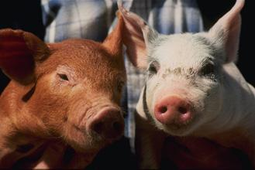
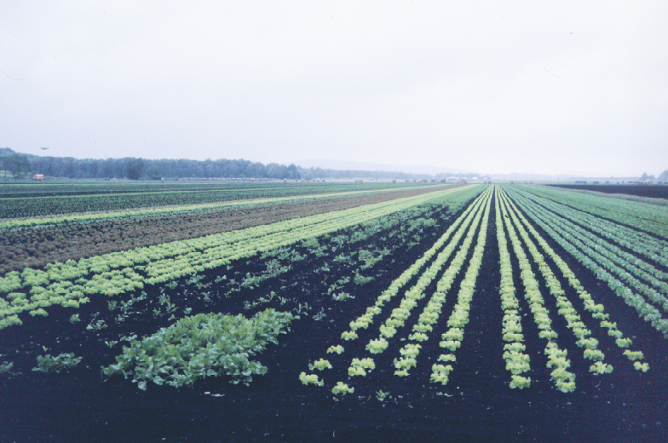
Manure = Fecal Matter = Microbes
Human or animal: DO EVERYTHING you can to keep manure off produce.
Preventing contamination is the goal.

Slide 11
How do pathogens get into produce?
Why can’t I just wash my produce?

Slide 12
How do Pathogens Get On/In the Produce?
From soil, water, animals
To roots, leaves, stems, fruit
  Surface
  Internal tissues
Notes:
The movement of pathogens into produce can happen indirectly by attachment to the produce surface (biofilms). Stomata and cuts allow sugars and nutrients to grow. Think of the stomata or cuts as an oasis that enables food for the pathogen to grow.
The attachment of these pathogens can be affected by pathogen strain and environmental cues such as plant and temperature and humidity.

Slide 13
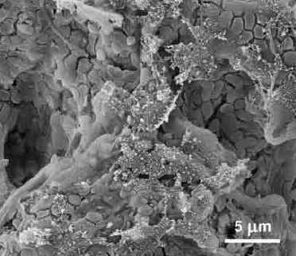
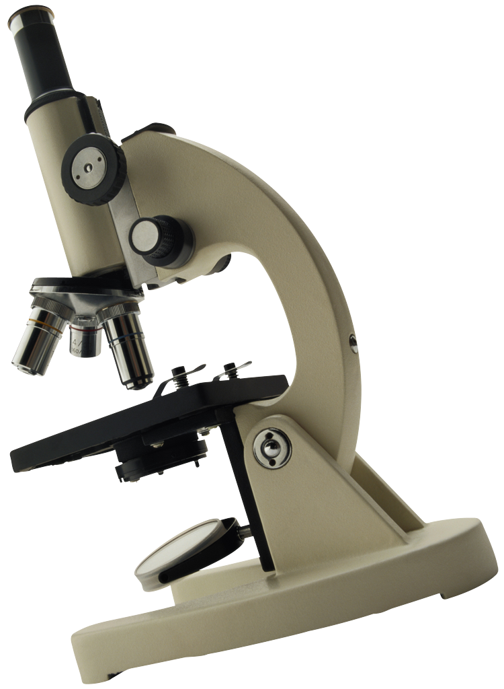
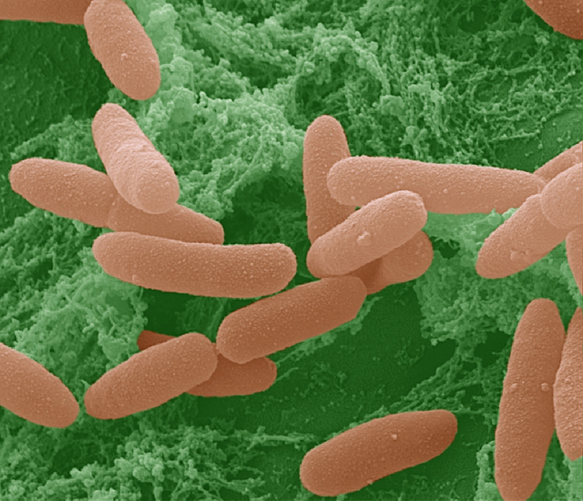
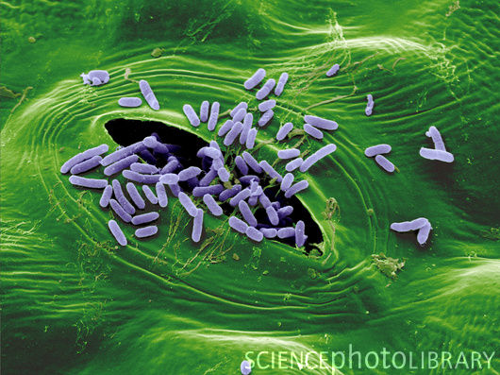
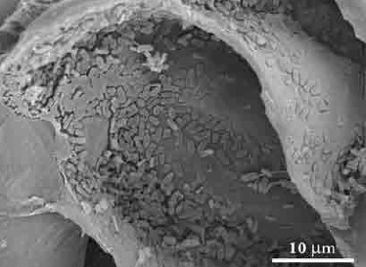
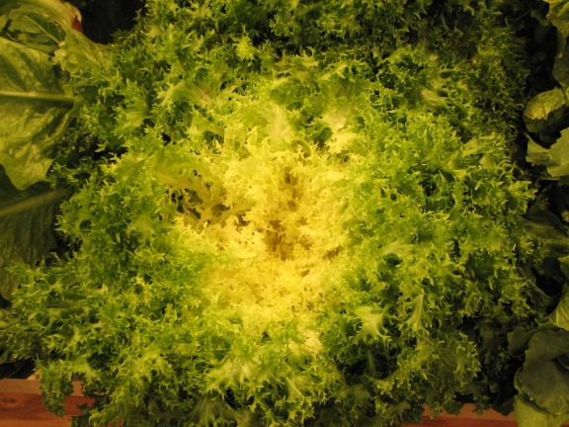
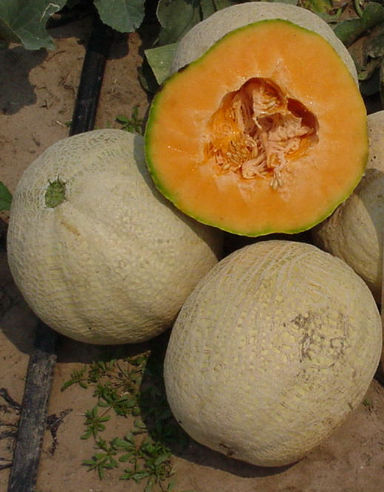
Pathogens get onto and into produce and can’t be washed off
E. coli on lettuce
Salmonella on muskmelon
Photo credits: E. Maynard, Peter Cooke, Stephen Ausmus, Scimat Science Photo Library, Institute of Food Technologists
Notes:
Image Number D2167-1
Colorized SEM (scanning electron micrograph) of pathogenic E. coli on a lettuce leaf. Image is shown at about 16,000 times normal size.
Photo by Peter Cooke, Colorization by Stephen Ausmus.
http://www.ars.usda.gov/is/graphics/photos/apr11/d2167-1.htm
http://www.sciencephoto.com/media/12688/enlarge
SEM of E. coli bacteria on Lettuce
B230/0292 Rights Managed
Credit: SCIMAT/SCIENCE PHOTO LIBRARY
Caption: Escherichia coli bacteria on a lettuce leaf congregate at the stomata (respiration openings in the leaves) Their presence may constitute a health hazard and cause severe food poisoning, particularly if the bacteria are toxigenic. They may get onto the vegetables if the water used for irrigation is contaminated with fecal material. Although thorough washing is recommended, electron microscopy shows that the bacteria enter the leaves through the stomata and would resist being removed. Similar bacterial contamination was also found with spinach and green onions. Enhanced SEM. Image width: 36.5 micrometers; magnification: 2740x if the image is printed 10 cm wide.

Slide 14
How Do Pathogens Move?
Movement varies depending on specific pathogen, but may include:
Wind-blown dust
Run-off
Wind-blown water
On equipment, people and clothes

Slide 15
Recommended Practices:
Stockpiling and Staging
Assess neighboring areas for orchards, greenhouses, vegetable fields
Cover pile, especially if near produce operations
Prevent run-off
Don’t stockpile or stage within 300 ft. of sinkhole, well head, irrigation pond, surface water, drainage inlets
Don’t stockpile or stage for extended periods on permeable soils
Consider a concrete pad for permeable soils
Notes:
Add definitions of stockpiling and staging to notes (not on slide).
For covering pile, note that staged manure does not have to be covered according to regulation unless it is sitting for more than 72 hours, but if produce is nearby it is best to cover right away.

Slide 16
Transporting Manure
During transport:
  Plan route to avoid vegetable fields
  Keep it covered
Wet manure:
  Non-leaking transport if possible (line dump bed with visqueen?)
  If container is leaking, try to avoid going by vegetable fields
Liquid manure:
  Transport in a tank
  Think about flow rate (bad leaks!)

Slide 17
Planning for Application
Identify application sites considered sensitive due to the presence of people (e.g. schools, outdoor recreation areas).
Know location of produce fields and future produce fields/greenhouses
The driftwatch website is available to applicators at driftwatch.org (note: not all farms participate in driftwatch).
Consider neighboring residences and farms when making setback and distance decisions.

Slide 18
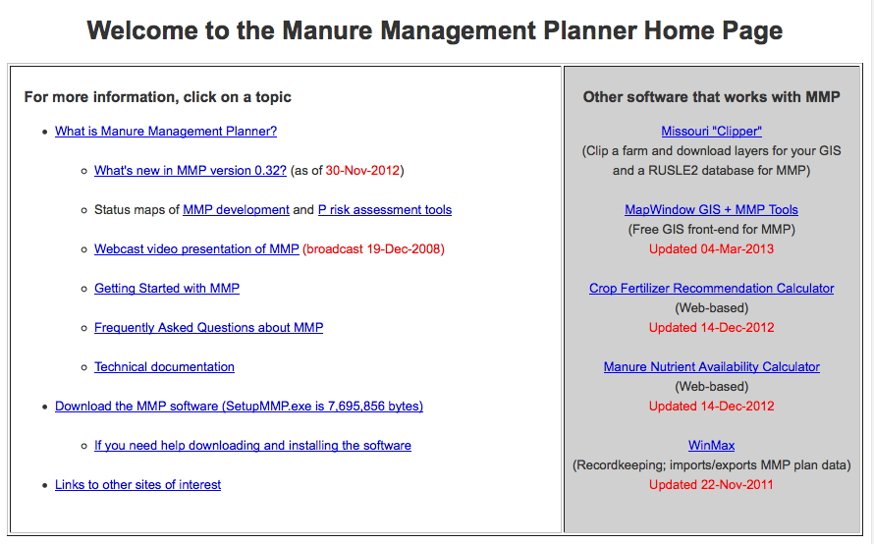
Indiana Manure Mgt. Plan http://www.purdue.edu/agsoftware/mmp/

Slide 19
Fertilizer Plan
Fertilizer Plan required by ALL growers.
  Required for both Manure (organic) and Inorganic Fertilizer applications
The Fertilizer Plan, at a minimum, is a written plan that ties the application of fertilizer to agronomic rates.
Must include how fertilizer rates are determined.
The purpose is that you have thought about rates to meet the crop’s needs.
Notes:
Plan required by everyone who applies fertilizer materials – inorganic/commercial and manure/organic. Certified and not certified.
Both Manure (Organic) and Inorganic Fertilizer [what you buy from your ag retailer or distributor. Liquid or solid fertilizer included as well as anhydrous ammonia)
Rule does not really specify what is in the plan except to mention how fertilizer rates are determined.
Think paragraphs, not plan.
Maybe manure sample, or standard replacement value of 1.2 pounds per bushel of corn removed, soil sampling, tri-state fertilizer recommendations, yield records
CFO is required to have manure analysis, non CFO does not. Recommend having analysis
A fertilizer plan is the grower’s defense against unpreventable acts of nature (storms, floods, etc)

Slide 20
Fertilizer Certification Rule:
Persons who apply or transport commercial fertilizer material for hire.
Persons who apply or transport manure, from the following:
  Indiana regulated confined feeding operations.
  Operations outside Indiana that would be confined feeding operations if they were located in Indiana.
Notes:
Quick review of who needs to be Certified, next 4 slides

Slide 21
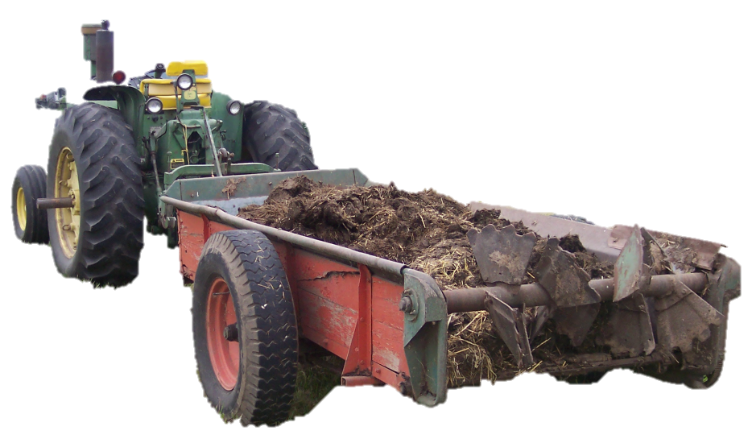
Who is exempt from standards?
Any person distributing or using less than 10 cubic yards or 4000 gallons of any type of fertilizer material* in a calendar year.
Notes:
Know it’s not much of an exemption
*This is the same exemption as with certification but now applies to Inorganic as well as Organic

Slide 22
Equipment
  Be aware of the potential for cross-contamination
Keep manure spreading equipment away from other equipment
  Give the honeywagon an isolated spot in the fencerow
Leave the chore boots with the animals and don't wear them into the produce patch
Change clothing after working with/around manure
Clean equipment properly
  Avoid spreading contamination with dirty wash water
  Sanitize before use in production or other produce operations
Each farm needs protocol for washing/rinsing spreading equipment. Wash in field? - gas powered pressure washer.
Don't forget the undercarriage and tires!!!
Notes:
Need to be aware of the potential for cross-contamination - use ellen's slide of compost turning??? Those things that pertain to folks who are on a livestock/veggie farm - put on a separate slide. Disinfection recommended when equipment will be returning to produce patch or being used for other produce-related items. Haul manure in truck and then boxes of produce - needs to undergo disinfecting process. Refer to biosecurity language in cat. 14 manual.

Slide 23
Survival of Pathogens in Manure
Pathogens have been reported to survive in manure for one year or longer.
No one knows precisely how long manure borne pathogens survive after application to fields.
Where it is not possible to maximize the time between application and harvest, raw manure should not be used in produce fields.
Notes:
If the use of manure cannot be managed to prevent contamination, or at least reduce the level of contamination risk to a negligible level, do not use manure on a food crop.
Pathogen survival dependent on
Type of pathogen
Rainfall
Soil moisture
Temperature
Soil type
Whether or not it is incorporated
Franz et al., 2005; Guan and Holley, 2003; Ingham et al, 2005; Natvig et al., 2002; Oliver et al., 2006; Saini et al., 2003; Scott et al., 2006

Slide 24
When should manure be applied?
If applying to a field where vegetables will be grown:
How far in advance
-Our recommendations: fall apply and incorporate (use cover crop) before ground freezes
-If no cover crop: apply to an agronomic crop the season (year) before vegetables
If GAPs (food safety) certification is involved, refer to specific audit being used (time interval required varies depending on audit)
Organic rules require incorporation 120 days before harvest of edible crop if soil contacts crop
Notes:
Add organic certification to notes. 120 days before vegetable harvest is a minimum, incorporation recommended. - very hard - must go on by Mar. 1 in Southern Indiana, difficult because may not apply to frozen ground. Best to recommend fall application and cover crop.

Slide 25
Fertilizer Materials
Application Records
Category 14 private applicators only keep records of manure (organic) applications
Category 14 commercial applicators keep records of inorganic fertilizer and manure (organic) applications
Records kept for 2 years
Commercial company can maintain records for their
customers
Notes:
Recordkeeping required only for Category 14 applicators must keep records
Compare RUP required records vs glyphosate applications
Good management to keep record of all, but only certified Cat 14 required.
If an investigation-- records will be requested.

Slide 26
Required Records (Indiana Fertilizer Rule)
Location:
Applicator+ Cert. no. | Date (m-d-yr) | Fertilizer Type | Nutrient value | Rate/acre | Application Method
Notes:
Information required. Additional information can be kept. No specific form.
Fertilizer type can include liquid, dry
Nutrient value is the N-P-K formula; X lbs P₂O₅/Ton
Application method is surface, injected, or incorporated
Can use PPP-18 or PPP-19 to meet recordkeeping

Slide 27
What about composting???

Slide 28
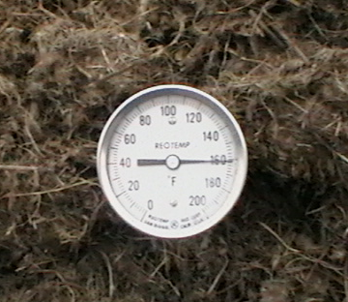
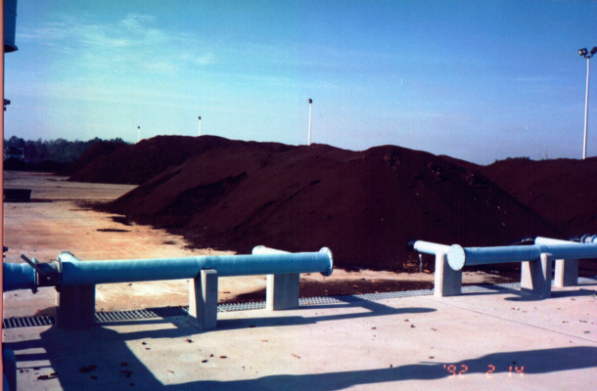
Manure Treatment Methods
Aging (passive)
  Doesn’t adequately reduce pathogens
Composting (active)
  Proper composting reduces pathogens
Other active treatments – also reduce pathogens
  Pasteurization
  Heat drying
  Aerobic and anaerobic digestion
  Alkali stabilization
http://msw.cecs.ucf.edu/Lesson7-composting.html
Notes:
‘Aged’ manure is not considered effectively ‘treated’ as far as human pathogens are concerned. The process is not well-controlled enough to expect that pathogens will be reduced.
Photo - thermometer, Ellen Phillips, University of Illinois Extension
Temperature – the difference between aging/ rotting and composting
Proper composting requires high temperatures(131-170F) for 3 days in an in-vessel or static aerated pile
OR
high temperatures (131-170F) for 15 days in a windrow system, with materials turned at least 5 times.
Pathogens are reduced in properly-done compost and it may be applied closer to the time of edible crop harvest.
Other active treatments also reduce pathogens and manure treated using these methods may be applied close to the time of edible crop harvest.
When used on produce, documentation of treatment methods (including compost temperatures) is required, and written record of application dates, rates, and produce harvest dates should be kept.
Compost Definition from the organic rule that specifies this:
“The product of a managed process through which microorganisms break down plant and animal materials into more available forms suitable for application to the soil.
Compost produced through a process that combines plant and animal materials
with an initial C:N ratio of between 25:1 and 40:1
Producers using an in-vessel or static aerated pile system
must maintain the composting materials at a temperature between 131⁰F and 170⁰F for 3 days.
Producers using a windrow system
must maintain the composting materials at a temperature between 131⁰ F and 170⁰ F for 15 days, during which time,
the materials must be turned a minimum of five times”

Slide 29
Questions?
Contributors
Liz Maynard, Extension Vegetable Specialist
Scott Monroe, Extension Educator ANR/ECD Daviess Co.
Cheri Janssen, Purdue Pesticide Programs
Additional Sources:
Ellen Phillips, University of Illinois Extension
National GAPs Program at Cornell University

