Slide 1
How to look up your PARP or CCH Credits
Bryan Overstreet - Purdue Extension Jasper County ANR

Slide 2
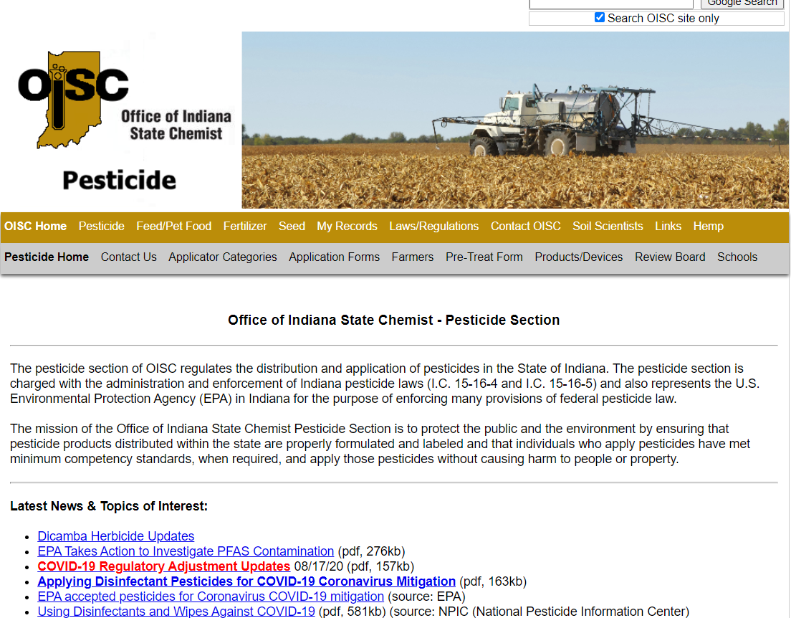
https://www.oisc.purdue.edu/pesticide/index.html

Slide 3
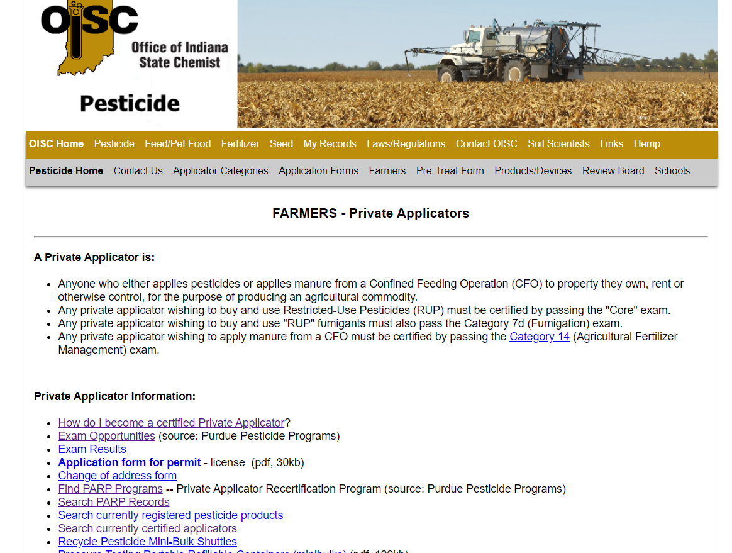
https://www.oisc.purdue.edu/pesticide/index.html

Slide 4
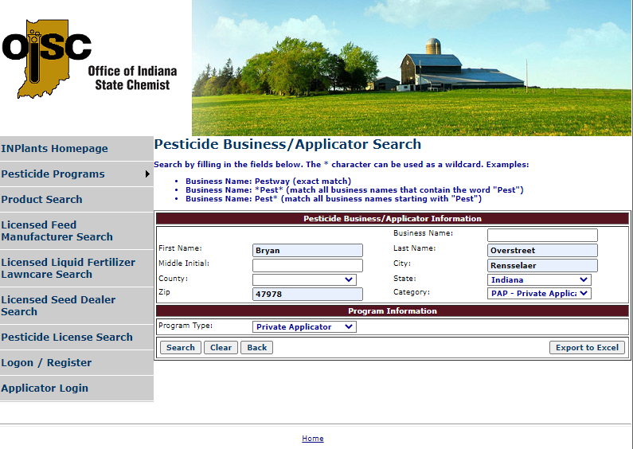
Searching for your credits
Put in your name and county and program type
Bulleted copy. Acumin Pro Reg 18 pt. Keep it short with bite-size chunks of information.
Bulleted copy. Acumin Pro Reg 18 pt. Keep it short with bite-size chunks of information.
Bulleted copy. Acumin Pro Reg 18 pt. Keep it short with bite-size chunks of information.
Bulleted copy. Acumin Pro Reg 18 pt. Keep it short with bite-size chunks of information.

Slide 5
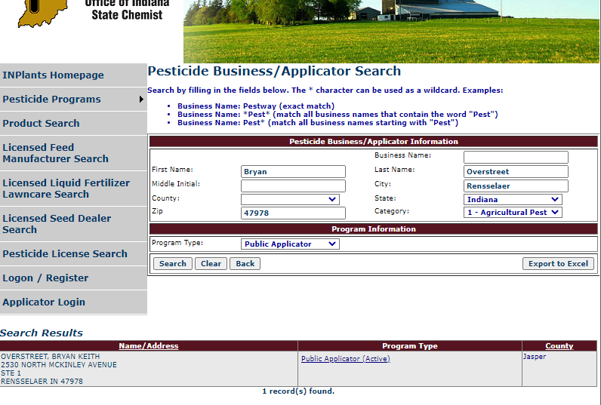
Searching for your credits
Bulleted copy. Acumin Pro Reg 18 pt. Keep it short with bite-size chunks of information.
Bulleted copy. Acumin Pro Reg 18 pt. Keep it short with bite-size chunks of information.
Bulleted copy. Acumin Pro Reg 18 pt. Keep it short with bite-size chunks of information.
Bulleted copy. Acumin Pro Reg 18 pt. Keep it short with bite-size chunks of information.

Slide 6
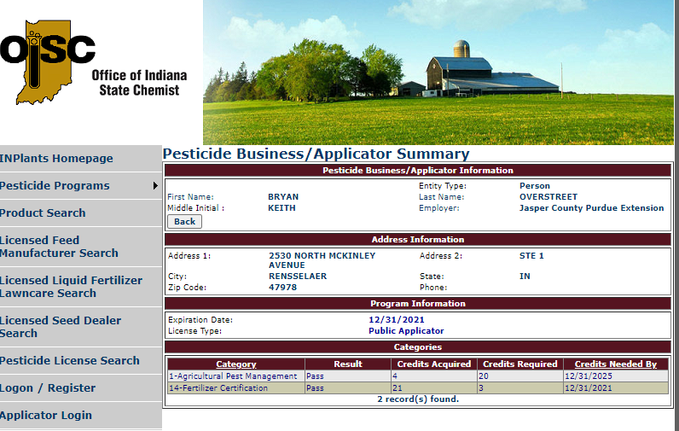
Searching for your credits
Bulleted copy. Acumin Pro Reg 18 pt. Keep it short with bite-size chunks of information.
Bulleted copy. Acumin Pro Reg 18 pt. Keep it short with bite-size chunks of information.
Bulleted copy. Acumin Pro Reg 18 pt. Keep it short with bite-size chunks of information.
Bulleted copy. Acumin Pro Reg 18 pt. Keep it short with bite-size chunks of information.

Slide 7
OR…

Slide 9
Purdue Pete, Boilermaker, West Lafayette, IN 765-222-1010

Slide 10
Purdue Pete, Boilermaker, West Lafayette, IN 765-222-1010
To print permit
“the card”

Slide 11
Thank You
Be sure to fill out the survey that will be sent to you later this morning to get your credits for this program.

