Slide 1
Comparison of Dicamba & 2,4-D Choline Off-Target Movement and Sensitivity to High-Value Specialty Crops Part II
Stephen L. Meyers & Bryan Young
Indiana CCA Conference- Virtual
December 16, 2020

Slide 2
Outline
This presentation will focus on 3 specialty crops of significance to Indiana producers:
Tomato, cucurbits, grape
Cropping distribution and information
Symptomology and crop residue tolerances

Slide 3
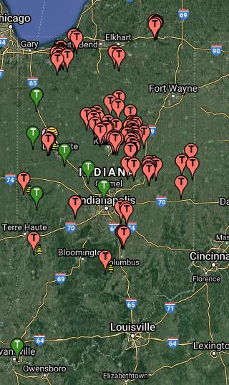
Tomato (Processing)
7,800 acres ($32 M)*
Primarily grown for processing (Redgold)
USDA-NASS 2018
*numbers seem low
driftwatch.org

Slide 4
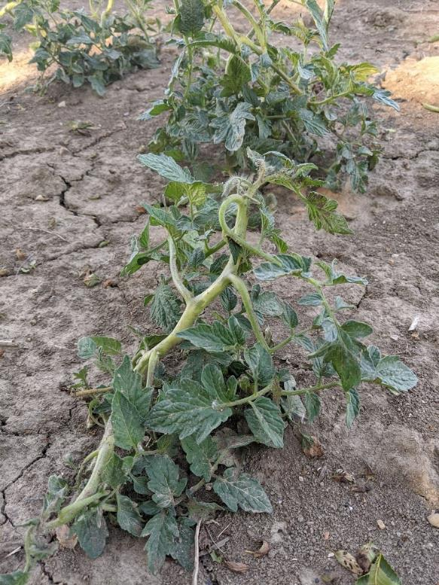
Tomato (Processing)
Injury: dicmba = 2,4-D (Dintelmann et al.)*
Yield loss: dicamba > 2,4-D (Jordan and Romanowski 1974)
Epinasty, cupping, strapping.
Flower drop and reduced fruit number.
*pepper injury far greater with dicamba than 2,4-D
driftwatch.org

Slide 5
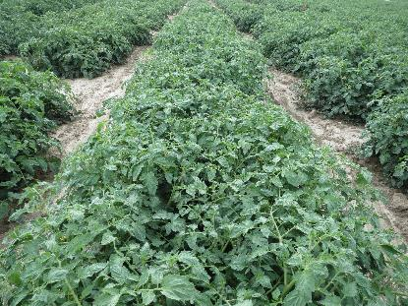
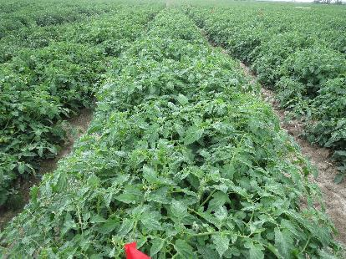
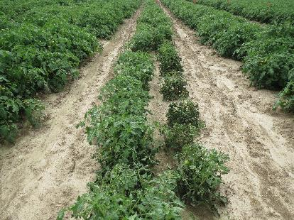
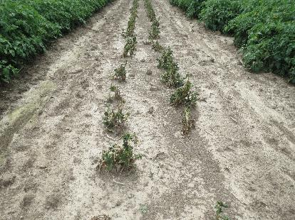
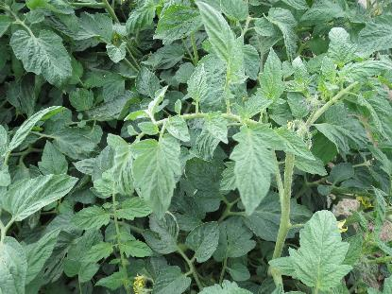
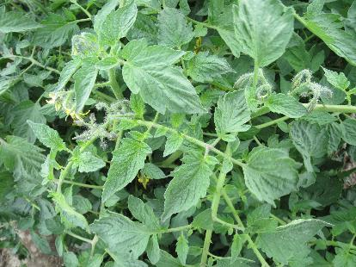
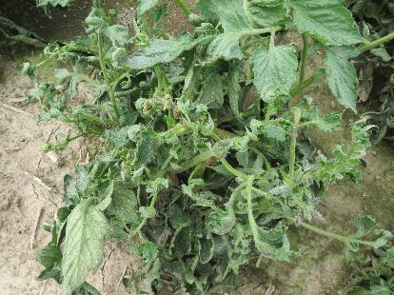
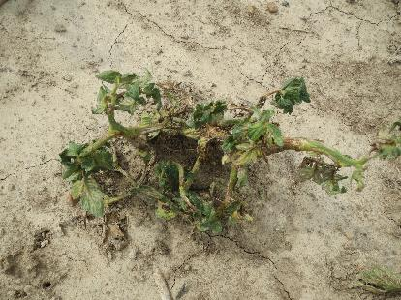
Dicmamba- 1 mo.
0 x 1/10x 1/3x 1x
driftwatch.org
Weller et al. (unpublished)

Slide 6
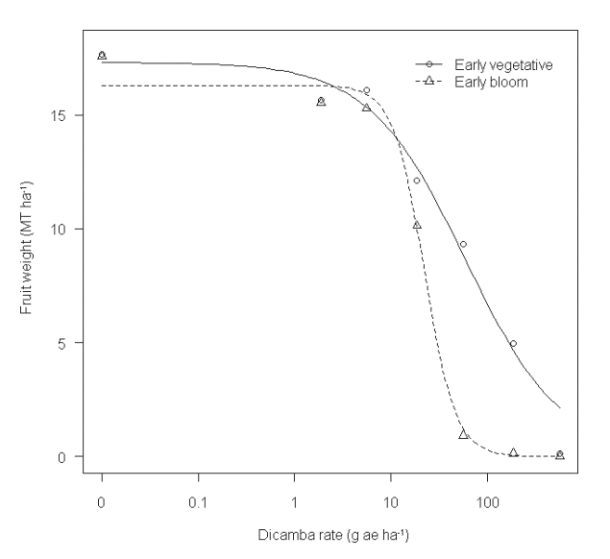
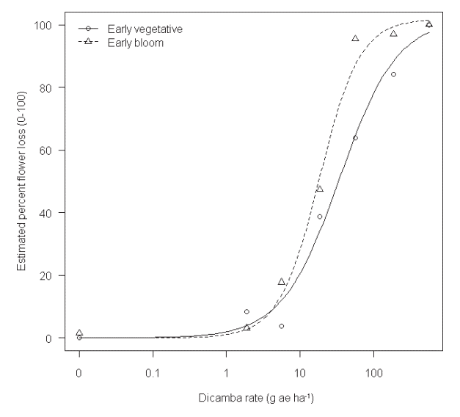
Tomato- Dicamba
Kruger et al. 2012

Slide 7
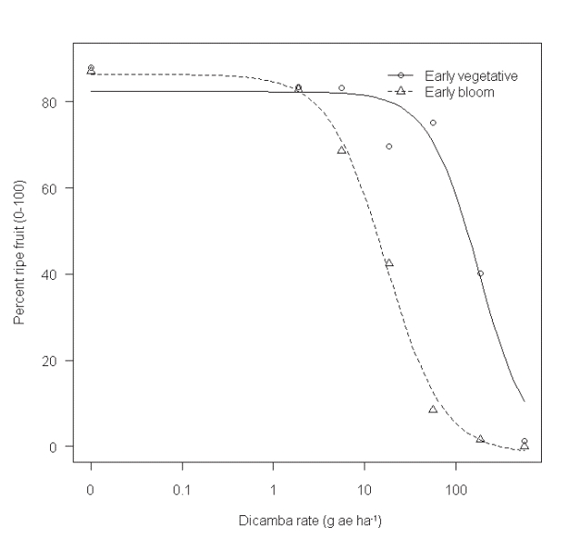
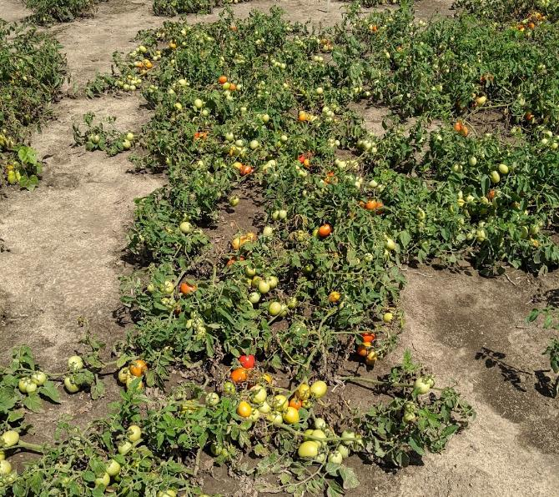
Tomato- Dicamba
Kruger et al. 2012

Slide 8
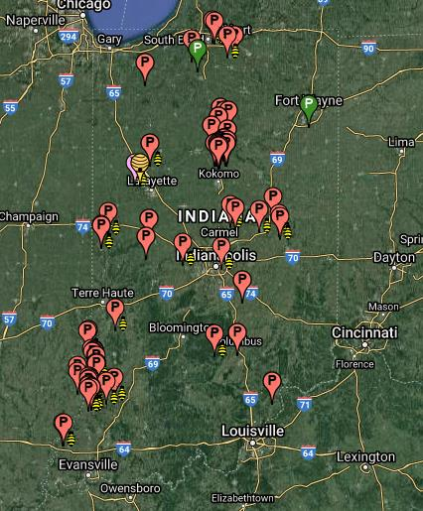
Pumpkins/Melons
Watermelon: 6,500 acres ($35 M)
Pumpkin: 5,200 acres ($17 M)
Cantaloupe: 1,800 acres ($8.6 M)
USDA-NASS 2019; 2020
driftwatch.org

Slide 9
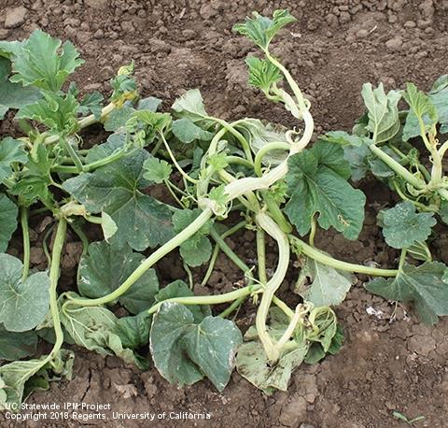
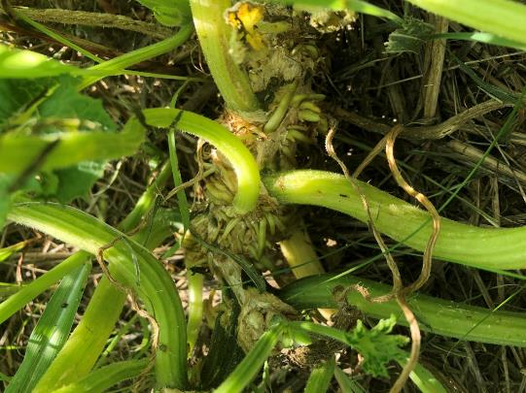
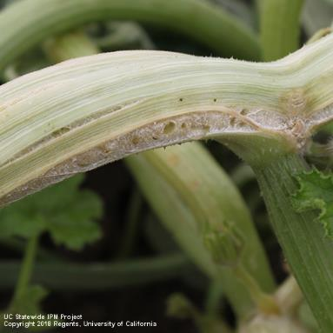
Pumpkin Symptomology
Dicamba and 2,4-D
Epinasty
Stem callus, cracking
Adventitious roots
Watermelon: dicamba > 2,4-D
Pumpkin & cantaloupe: dicamba = 2,4-D
D. Doohan
Dicamba and 2,4-D

Slide 10
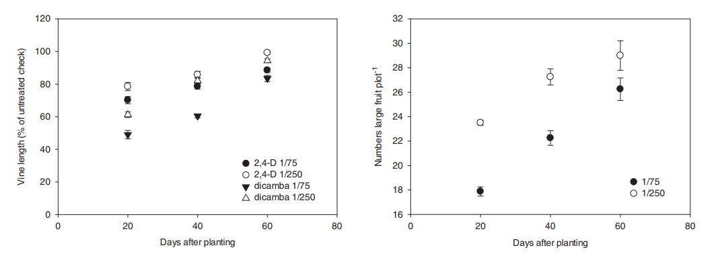
Watermelons Response
Culpeper et al. 2018

Slide 11
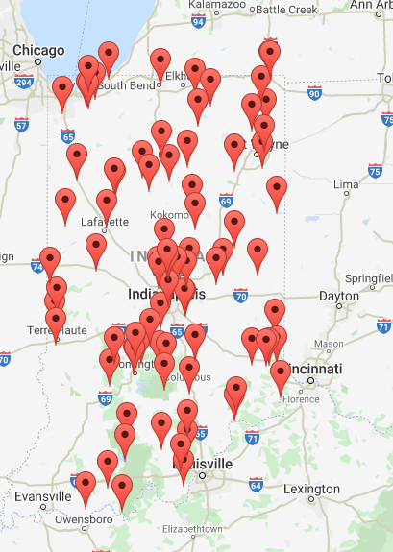
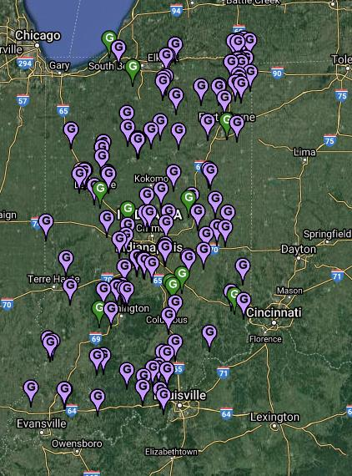
Grapes/Wineries
Grapes (2018):
600 acres (bearing)
$590,000 revenue
Wineries:
116 wineries
$603 M econ. impact
630,000 tourists
3,900 full-time jobs
indianawines.org
driftwatch.org

Slide 12
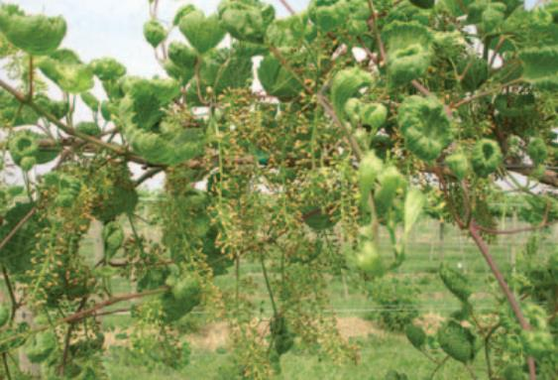
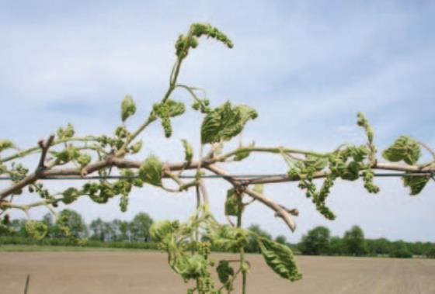
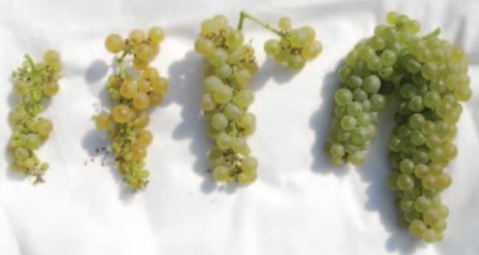
Grape Symptomology
Dicamba
Elongated growth
Upward leaf cupping
Fewer berries/cluster
B. Bordelon
B. Bordelon
Bordelon 2011
B. Bordelon

Slide 13
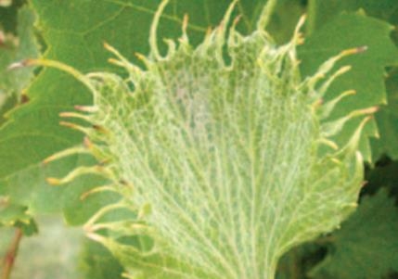
Grape Symptomology
2,4-D
Shoot tip death
Lateral shoot growth
Leaf strapping
Fewer berries/cluster
Sensitivity by varietal
V. vinifera > French hybrids > American grapes
B. Bordelon

Slide 14
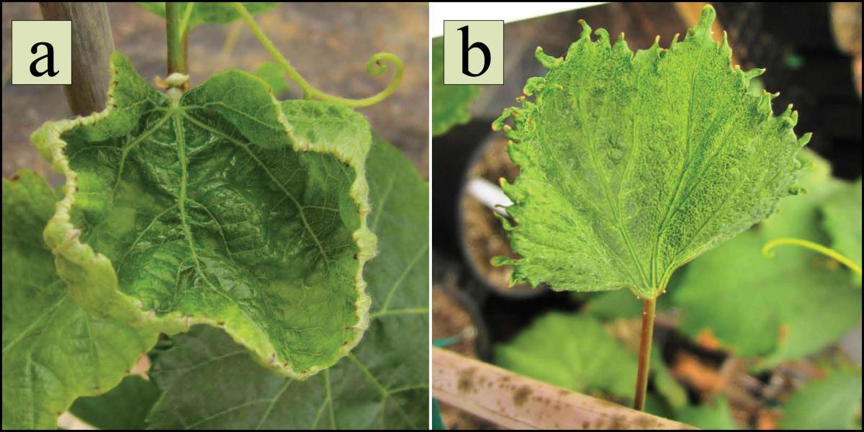
Grape Symptomology
Dicamba
2,4-D
D. Doohan

Slide 15
Pesticide Residue Limits
Herbicide and specific metabolites (ppm):
Crop | Dicamba* | 2,4-D
Tomato | None | 0.05
Cucurbits | None | 0.05
Pome and stone fruits | None | 0.05
Grape | None | 0.05
Berries | None | 0.20
*Only vegetable/fruit crops with dicamba tolerances: asparagus (4.0 ppm) and sweet corn (0.04 ppm).
driftwatch.org

Slide 16
§180.5 - Zero tolerances.
No amount of the pesticide chemical may remain on the raw agricultural commodity when it is offered for shipment. A zero tolerance may be established because, among other reasons:
(a) A safe level of the pesticide chemical in the diet of two different species of warm-blooded animals has not been reliably determined.
(b) The chemical is carcinogenic to or has other alarming physiological effects upon one or more of the species of the test animals used, when fed in the diet of such animals.
(c) The pesticide chemical is toxic, but is normally used at times when, or in such manner that, fruit, vegetables, or other raw agricultural commodities will not bear or contain it.
(d) All residue of the pesticide chemical is normally removed through good agricultural practice such as washing or brushing or through weathering or other changes in the chemical itself, prior to introduction of the raw agricultural commodity into interstate commerce.
driftwatch.org

Slide 17
§180.5 - Zero tolerances.
No amount of the pesticide chemical may remain on the raw agricultural commodity when it is offered for shipment. A zero tolerance may be established because, among other reasons:
(a) A safe level of the pesticide chemical in the diet of two different species of warm-blooded animals has not been reliably determined.
(b) The chemical is carcinogenic to or has other alarming physiological effects upon one or more of the species of the test animals used, when fed in the diet of such animals.
(c) The pesticide chemical is toxic, but is normally used at times when, or in such manner that, fruit, vegetables, or other raw agricultural commodities will not bear or contain it.
(d) All residue of the pesticide chemical is normally removed through good agricultural practice such as washing or brushing or through weathering or other changes in the chemical itself, prior to introduction of the raw agricultural commodity into interstate commerce.
driftwatch.org

Slide 18
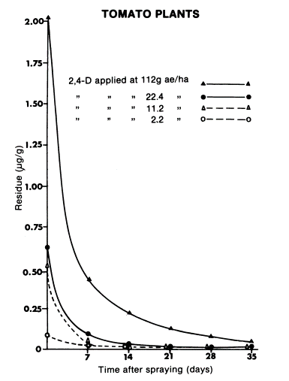
Pesticide Residues
In part, a function of time and rate.
2,4-D in tomato: 0.05 ppm
Previous work conducted on “all above-ground plant parts”.
We are currently repeating this work analyzing vegetative structures and fruit separately.
“raw agricultural commodity”
Sirons et al. 1982

Slide 19
Pesticide Residue Watermelon Fruit
Dicamba:
0.01 ppm when applied at 1/75x at 40 or 60 d after planting (DAP)
0.03 ppm at 1/75x at 40 or 60 DAP
0.01 ppm at 1/250x at 40 or 60 DAP
2,4-D:
1 of 2 years- none detectable
0.01 ppm when applied at 1/75x or 1/250x at 60 DAP
*Tolerances: dicamba: zero; 2,4-D: 0.05 ppm.
Culpeper et al. 2018
driftwatch.org

Slide 20
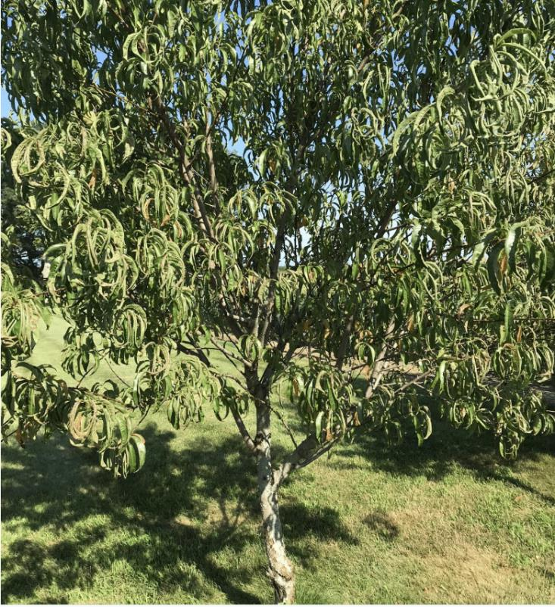
Other Notes:
Injury from dicamba and 2,4-D generally worse with glyphosate.
Not everything that curls/cups leaves is auxinic herbicide injury.
Look for more than a single symptom and rule out other potential causes.
Analyze distribution of symptoms.
Look at sensitive species in field edges.
M. Burk
driftwatch.org

Slide 21
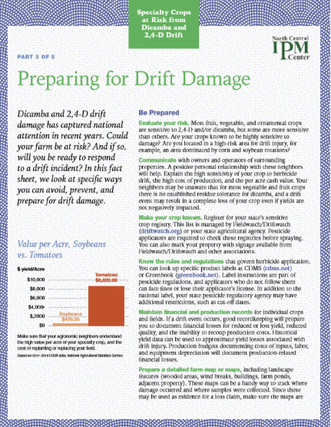
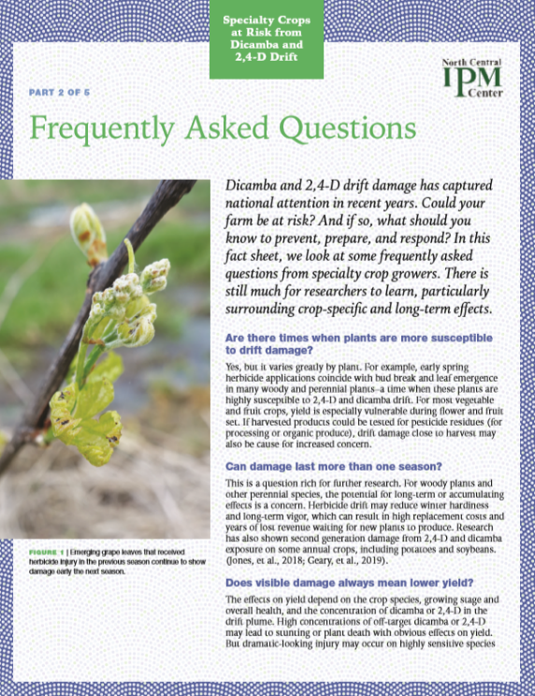
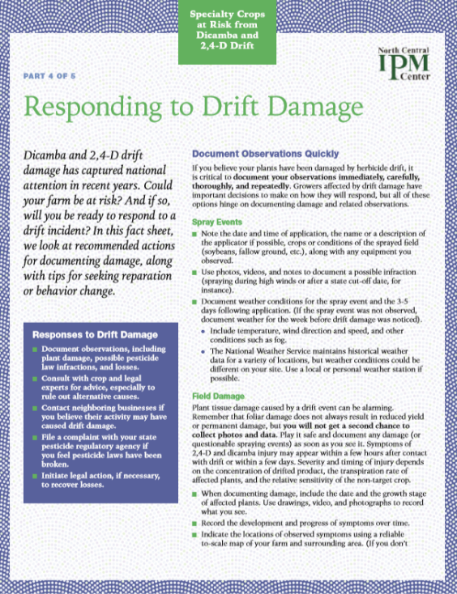
New Resources for Addressing Herbicide Drift
Notes:
Weed scientists in HLA and BTNY collaborated with colleagues at Ohio State and the North Central IPM Center to develop a series of online and in-print publications related to herbicide drift, with an emphasis on dicamba and 2,4-D.

