Slide 1
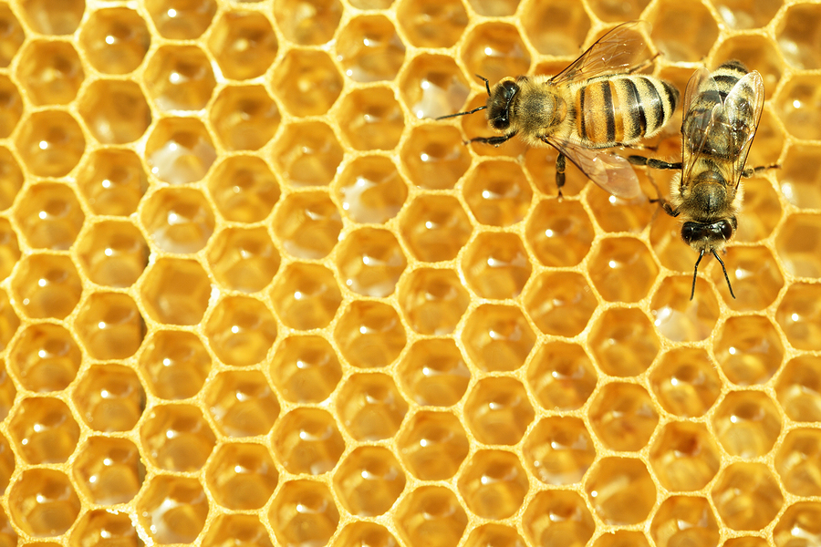
Bee
Aware!
Bee
Aware!
What You can do, as a Private Pesticide Applicator,
to Safeguard Bees from Pesticide Poisoning.
Photo Source: CrystalGraphics.com
Notes:
Presenter Notes: Please review the OISC Pollinator Protection Plan http://www.oisc.purdue.edu/pesticide/p3_activities.html
Specifically the Indiana Pollinator Protection Plan (P³) Summary http://www.oisc.purdue.edu/pesticide/pdf/p3_summary_aug2015.pdf- and
Indiana Pollinator Protection Plan http://www.oisc.purdue.edu/pesticide/pdf/indiana_pollinator_protection_plan_draft_5-31-15.pdf

Slide 2
This presentation will help you understand:
The importance and status of pollinators
How pesticide applicators can help protect pollinators
How pesticides can be used to control pests with minimal risks to pollinators
The potential effects of treating crops during the flowering period of the crop and adjacent blooming crops and plants

Slide 3
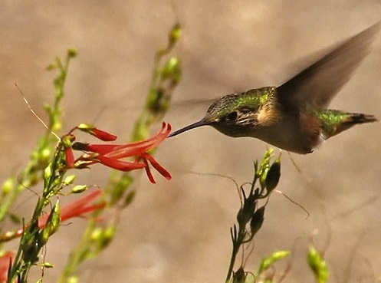
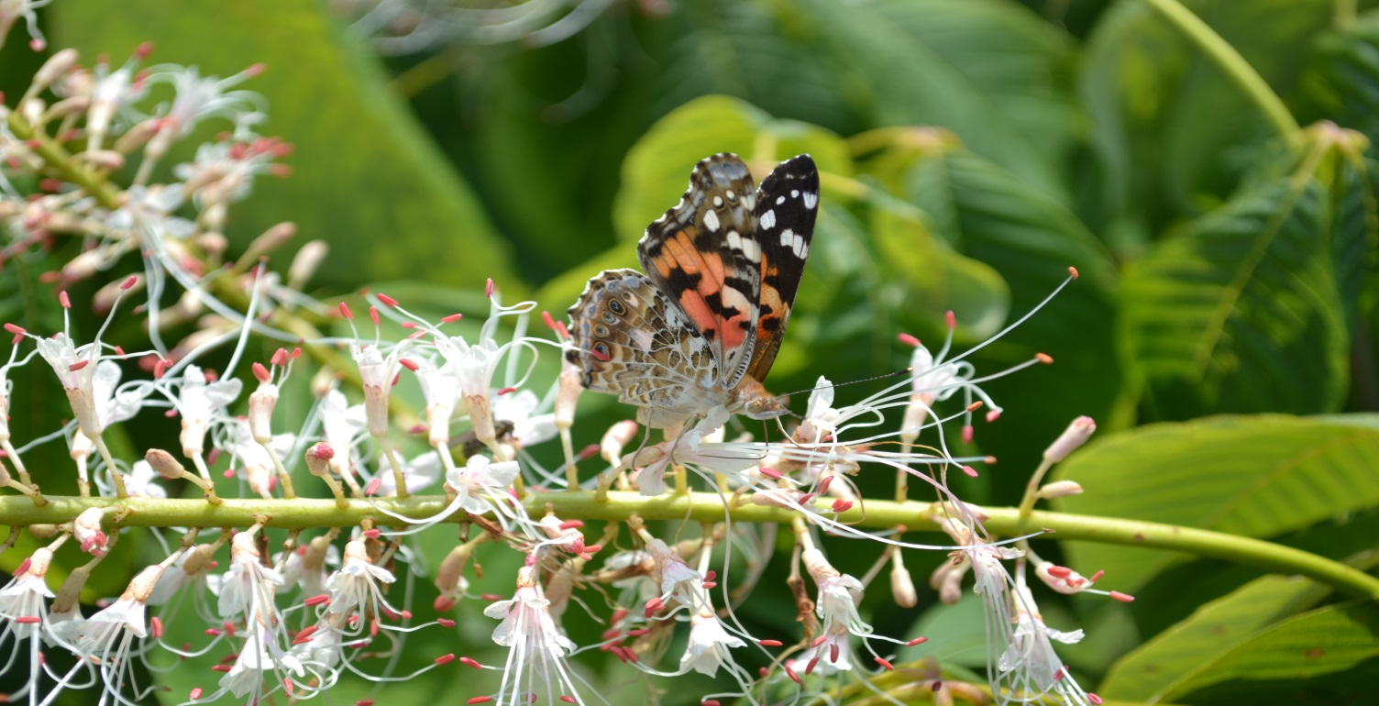
Why care about pollinators?
80 % of all flowering plants require animal pollinators
Wild lands and the environment – the value is incalculable
Tom Butzler,
Penn State Extension
Notes:
The value of pollinators to our environment is incalculable. Pollinators visit flowers in search of pollen and/or nectar, and in the process, the pollen grains often stick to their bodies and are carried from flower to flower. In this way, they facilitate the process we call pollination.

Slide 4
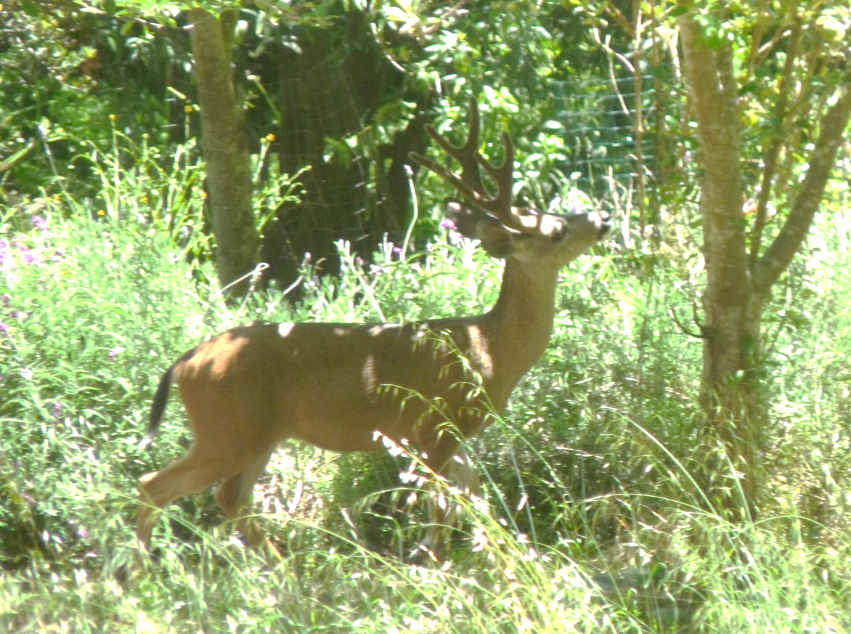
Why care about pollinators?
--Fruit and seed production needed for the survival of the majority of flowering plants in our environment.
Food for wildlife
Song birds
Wild turkeys
Sage grouse
Bear
Deer
Elk
Notes:
Without pollination, seed and fruit production in animal-pollinated plants can not be successful, not only for our food crops, but for wildlife diets, too.

Slide 5

Your breakfast without bees
Your breakfast
with bees
Scientific American April 2009
Value of crops in US that depend on pollination: >$18.9 billion
$217 billion worldwide
Source: Scientific American ‘09; M. Spivak, UMinn
Notes:
Case in point: your breakfast with and without bees. Humans depend on pollinators for our well being. An estimated 1 out of every 3 bites of food we eat each day result from the work of pollinators.

Slide 6
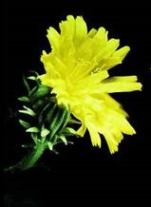
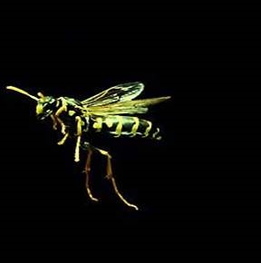
The Wild World of Pollinators
Insects are the most common and abundant
Honey bees
Bumble bees
Blueberry bees
…and also
Butterflies
Beetles
Flies
even, Wasps
When a pollinator is visiting a bloom in search of nectar (carbohydrate) and pollen (protein), it is called “foraging.”
Notes:
When a pollinator is visiting a bloom in search of
nectar (carbohydrate) and pollen (protein), it is called “foraging.”

Slide 7
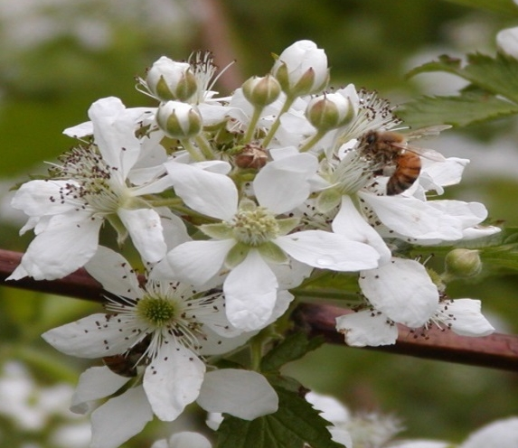
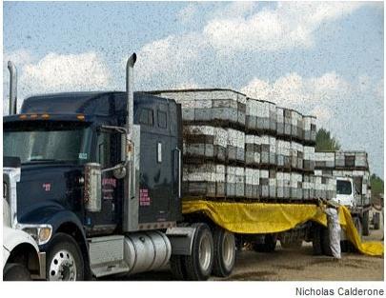
Champion Pollinator of Food Crops: The European Honey Bee
Honey bees are relied on to perform most of the commercial pollination.
Tom Butzler,
Penn State
A truckload of honey bee colonies is delivered for blueberry pollination in Maine
Notes:
Honey bees are the most important pollinator for food crops

Slide 8
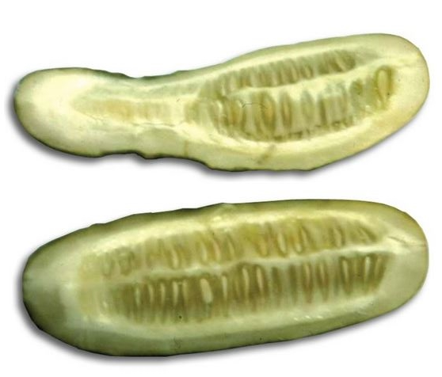
Why care about pollinators?
In Indiana
Apples
Blueberries
Cucumbers
Melons
Pumpkin
Strawberries
Peaches
Blackberries
Raspberries
Others
A partially pollinated cucumber (top) compared with a completely pollinated one (bottom). The seed did not form throughout the poorly cucumber and consequently the fruit did not grow around that portion.
Notes:
Crops grown in Indiana that are highly or somewhat dependent on honey bees for pollination. For some crops, like cucumbers, lack of honey bee pollination causes misshapen or underdeveloped fruit.

Slide 9
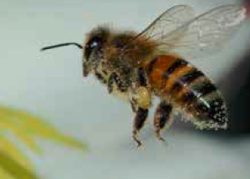
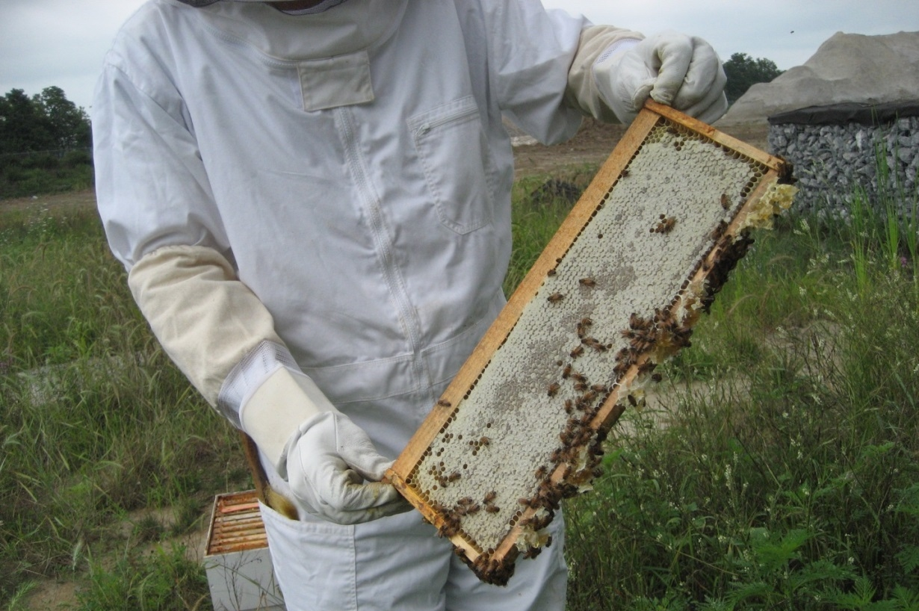
What is the current status of pollinators?
2020-2021 Honey Bee Overwintering Losses – 28% died over the winter (an unsustainable number)
-USDA /Bee Informed Survey
Notes:
Some pollinators, such as bees, are suffering losses both in population sizes and in species numbers. This is putting stress on our ability to produce food and ensure environmental stability.

Slide 10
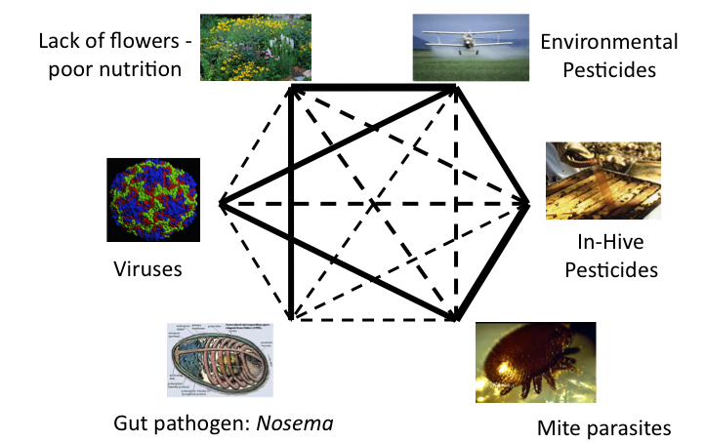
Causes of pollinator decline???
Several possible factors or a combination of them
Source: Marla Spivak, Univ. of MN
Notes:
It is believed that pollinator (especially, honey bee) declines can be caused by a combination of factors including predatory mites and parasites, pathogens, nutritional stress, and pesticides, though the exact combination and impact of each factor remains uncertain.
As you might imagine, pollinators can be highly sensitive to many pesticides, especially insecticides.

Slide 11
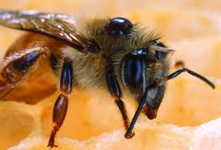
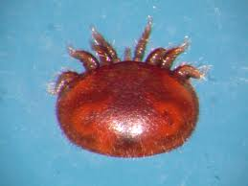
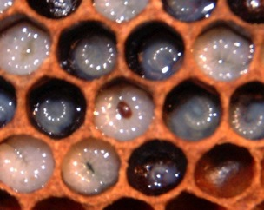
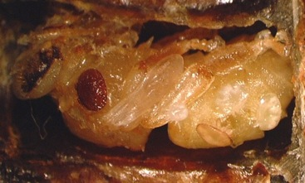
Varroa mite is the chief menace
Large mite sucks bee blood
Circulates bee viruses
Mite feeding on adult bee
Mite feeding on immature bees (brood)
Photo Source: M. Spivak, UMinn
Notes:
The Varroa mite is a large mite that behaves much like a tick. It sucks the blood of adult and immature bees. Immature bees are called brood. The mite is also capable of passing several viruses as it feeds.

Slide 12
Questions
Why is it important to protect pollinators?
  Humans are highly dependent on pollinators for crops
  Many plants need animal pollinators
  Pollinators are important for wildlife
  All of the above
Notes:
d) All of the above

Slide 13
Questions
Which of the following foods depend on animal pollination?
  Apples
  Blueberries
  Cucumbers
  Wheat
Notes:
a), b), and c)

Slide 14
Questions
In addition to honey bees, what other animals can pollinate flowers?
  Butterflies
  Birds
  Bats
  Flies
  Cattle
Notes:
All but cattle

Slide 15
Questions
What are the factors affecting pollinator health?
  Mites and parasites
  Nutrition and forage
  Pesticides
  A combination of these and/or other factors
Notes:
d. is correct

Slide 16
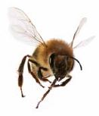
Pesticide applicators can help by reducing risks to honey bees and other pollinators
Understand How Pesticides Can Harm Bees
Recognize Pollinator Foraging Habits
Read the Label
Use IPM
Follow Best Management Practices
Notes:
As a pesticide applicator, it’s important that you understand how pesticides can harm bees, recognize the daily habits of bees, read the label to help select appropriate pesticide materials, and consider application methods and strategies (such as IPM and BMPs) to minimize exposure to bees.

Slide 17
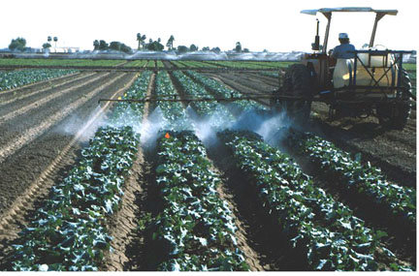
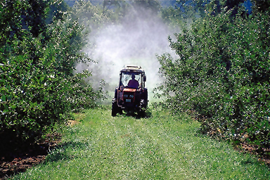
Did You Know?
Most pesticides are not toxic to honey bees and other pollinators.
As a general rule, insecticides are more toxic to pollinators than fungicides and herbicides.
  However, not all insecticides are toxic to pollinators.
UMinn

Slide 18
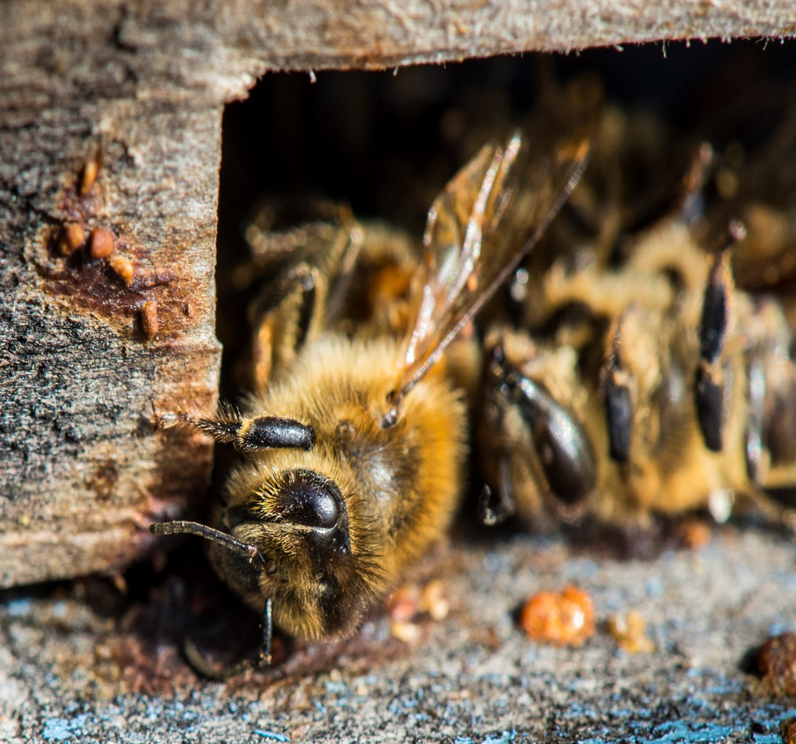
Pollinator poisoning can occur from:
Direct exposure during application
Residues picked up through foraging (pollen and nectar) and taken back to the hive
Residues from non-crop plants (ground cover, field edges, ditches, etc.)
iStockphoto.com
Notes:
Those pesticides that are toxic to bees can cause harm in one or more of the following ways: Direct Exposure; Residues picked up through foraging; and, Residues from non-crop plants. It is very important to understand that in addition to honey bees, there are hundreds of species of native bees that live in the ground or in stems. On some occasions, honey bee colonies can be moved to protect them (although that is not feasible for most beekeepers and in most situations), but the native bees remain and are more affected by bee-toxic pesticides because they are mostly solitary and get a direct dose.

Slide 19
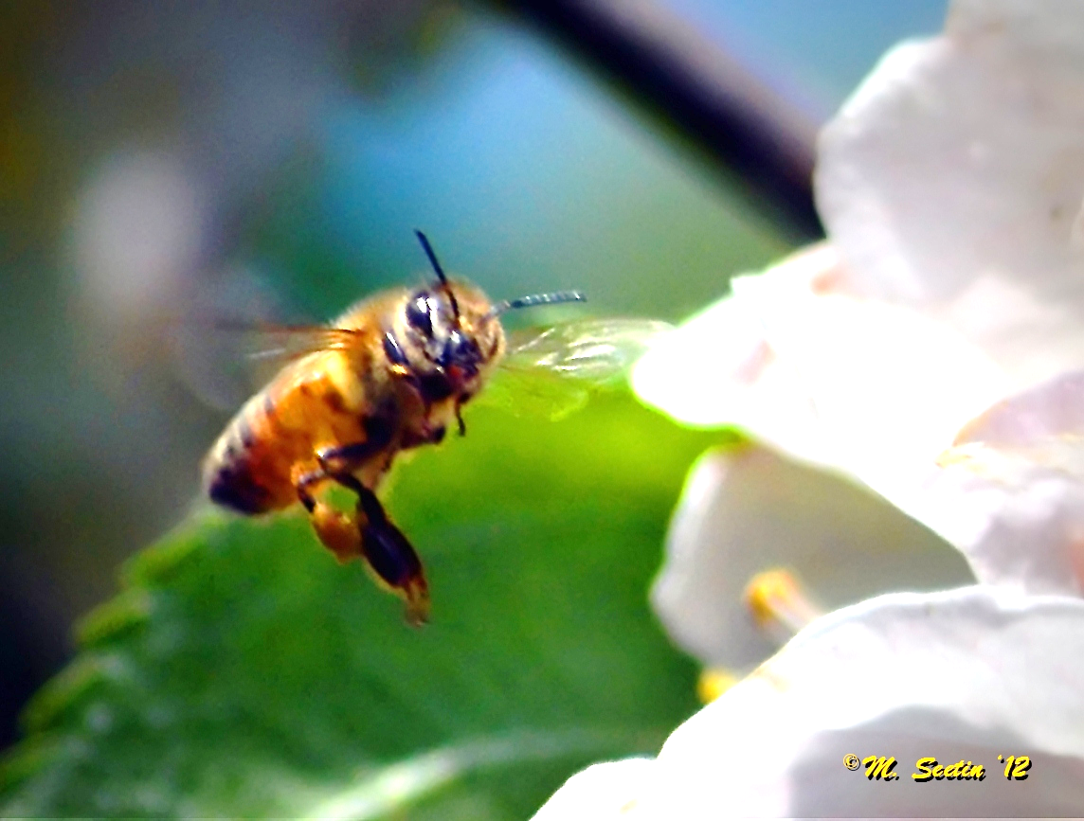
Recognize Residual toxicity
Some pesticides remain toxic to bees for some time after the application is made via contact with residues on the treated plant, including bloom.
This is residual toxicity.

Slide 20
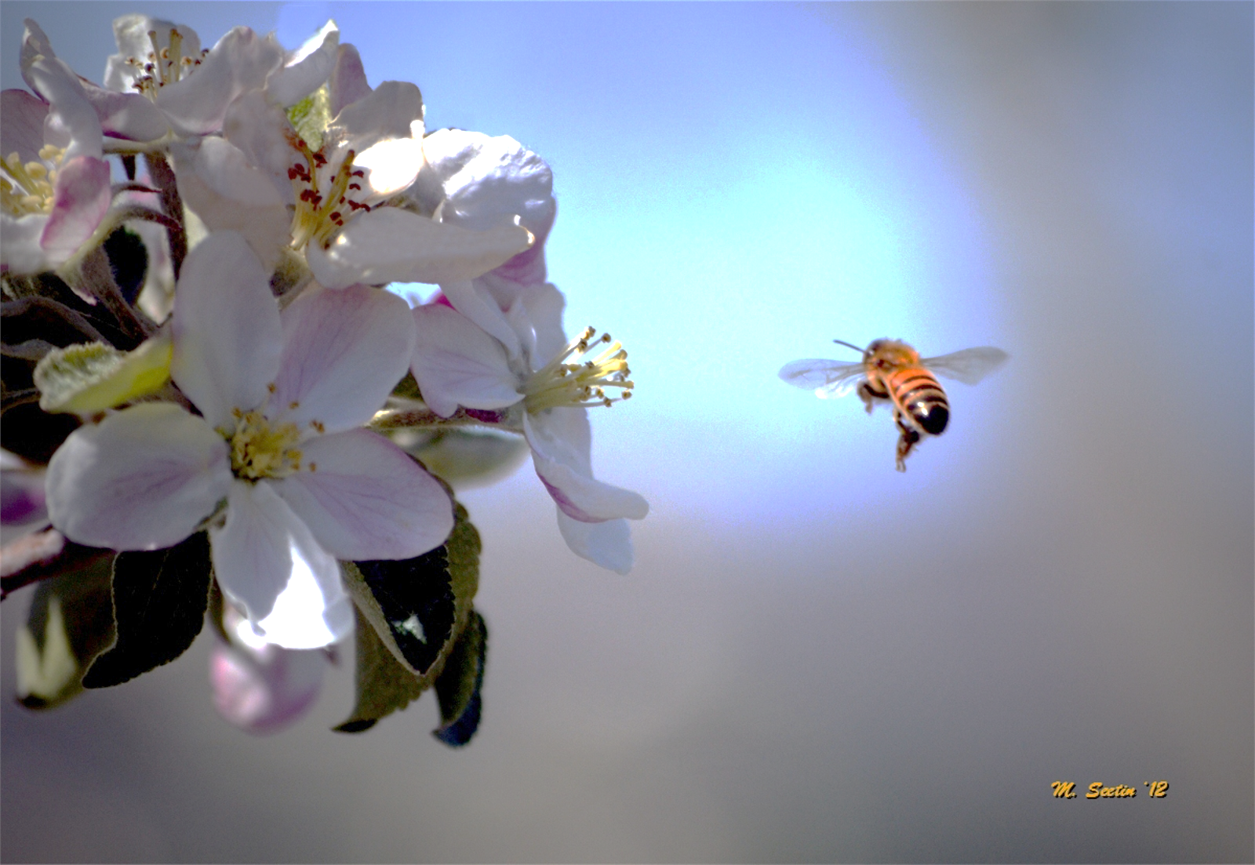
Extended Residual Toxicity (ERT)
Compounds that remain toxic to bees for an extended period of time following foliar applications are referred to as Extended Residual Toxicity or ERT.
ERT pesticides may not be applied to blooming crops or weeds.
Notes:
If products remain toxic for an extended period of time following foliar application the product is referred to as having an Extended Residual Toxicity or ERT. ERT pesticides may not be applied to blooming crops or weeds when pollinators are present or will be visiting soon after application.

Slide 21
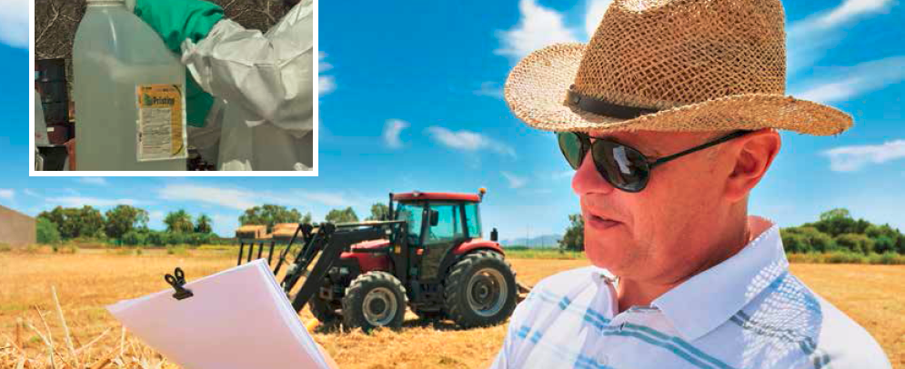
Pesticides with Extended Residual Toxicity
The families of pesticides most commonly associated with ERT include:
  Organophosphates (e.g., acephate, chlorpyrifos, malathion)
  Carbamates (e.g., carbaryl)
  Neonicotinoids (e.g., imidacloprid)
  Pyrethroids (e.g., deltamethrin and cyfluthrin)
Always read the label to determine
if a pesticide leaves residues
that are toxic to bees!

Slide 22
A Honey Bee’s (Daily) Life
Honey bees forage sun up to sun down unless it’s raining
# of foragers
Sun up
Sun down
Time of Day
Source: Marla Spivak, UMinn
Notes:
Most pollinator poisoning occurs when bee-toxic pesticides are applied to crops during bloom. This is a time when pollinators are most likely to be attracted to the crop while actively searching for pollen and nectar. A honey bee will take to flight when temperatures are 55 degrees or above. They are most active from late morning through mid afternoon.

Slide 23
Best time for pesticide application:
Dusk to Dawn
OK if no residue
Kills Bees
Best
OK if little
residue
# of foragers
Sun up
Sun down
Time of Day
Source: Marla Spivak, UMinn
Notes:
The worst time of day to apply bee-toxic pesticides, therefore, is from late morning through early afternoon. Some bee-toxic pesticides can be applied from dusk till dawn as long as little or no toxic residue is left behind.

Slide 24
Pesticides and bloom
When crops or ground cover are in bloom consider using pesticides that have a short activity period (i.e., non-ERT). Preferably apply them between late evening and early morning
The bottom line: DO NOT apply pesticides that have an ERT during bloom!

Slide 25
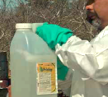
Read and understand the label
Pollinator Protection Statements on the label instruct you to:
Check the status of the application site for the presence of blooming plants and pollinators
Eliminate the exposure of bees and other insect pollinators when they are foraging on pollinator-attractive plants at the application site
Do this BEFORE you schedule an application
Notes:
Pollinator Protection Statements on the label instruct you to:
Check the status of the application site for the presence of blooming plants and pollinators
Eliminate the exposure of bees and other insect pollinators when they are foraging on pollinator attractive plants at the application site
Do this BEFORE you schedule an application

Slide 26
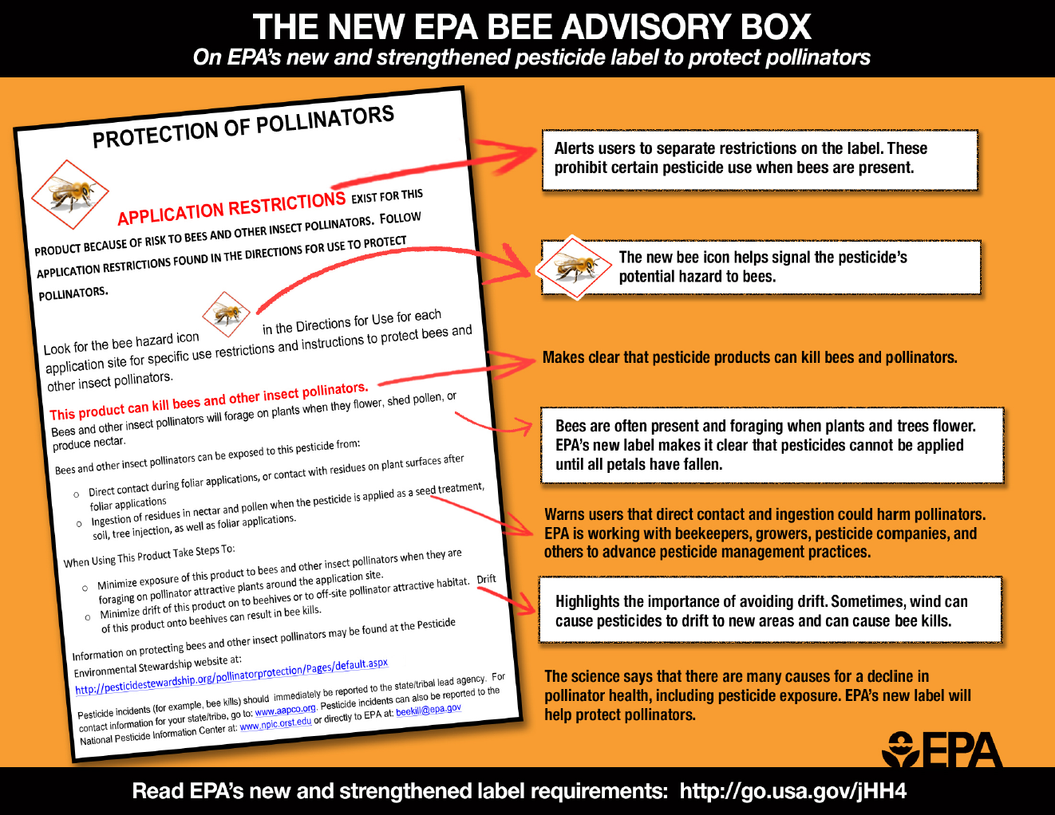
The “Bee Advisory Box”
Notes:
For several newer insecticides on the market, there is a “Bee Advisory Box” in the Environmental Hazards section of the label. On pesticides determined to be highly toxic to honey bees the label language may not be exactly like what is depicted, it will be similar and follow the same principles.

Slide 27
Pollinator protection statements should inform you of pesticide selection--and application timing--decisions
REMEMBER:
Take time, uninterrupted and undisturbed, to read and understand the label
Your actions must protect bees during application (and afterwards!).
Notes:
As the applicator, it is your responsibility to follow all statements and instructions on the label. Pollinator protection statements are called by a variety of names – “Bee Caution”, “Bee Hazard”, “Bee Warning” among others. These statements are based on the evaluated risk to honey bees. Don’t assume that all pollinator protection statements are the same. READ and FOLLOW label restrictions. Watch closely for label changes.

Slide 28
Indiana Pollinator Protection Plan
Growers and applicators should know if there are pollinators near pesticide application sites.
Growers and applicators should identify and contact nearby beekeepers prior to application
Growers and applicators should follow Best Management Practices (BMPs) to promote pollinator protection and health
Notes:
Is the plan enforceable by any state agency?
The state plan is a blue print for action to enhance opportunities for pollinator health, and management of exposure to pesticides through better communication and education. Both current and proposed labeling by U.S.EPA on pesticides are and will be enforceable to some degree. Pesticide drift and exposure cases that effect honeybees will continue to be evaluated and investigated when reported to the OISC.

Slide 29
Key questions to consider
What is the growth cycle of the crop?
When will the crop be in bloom?
What are the predicted dates that pests will need to be treated?
What else is blooming in or near the field?
  Cover crops
  Weeds
  Fencerow vegetation
  Adjacent crops or orchards
What pollinator activity is nearby?
Can (non-crop) blossoms be removed by mowing or other methods before applying bee-toxic pesticides?
Notes:
With this information in mind, there are a number of key questions to consider when using pesticides in or near crops that are attractive to bees.

Slide 30
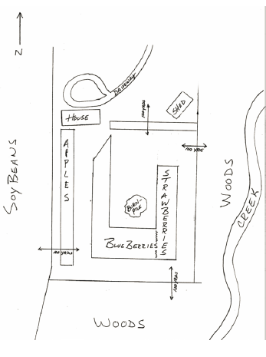
Know the landscape
Observe the surroundings
Observe fields and adjacent areas
Notes:
Be familiar with your fields and the surrounding areas so you will know which areas may have potential pollinator activity. Note what other plants (weeds, plants in hedgerows, in drainage ditches, etc.) are present and may be blooming.

Slide 31
Develop an IPM Plan
Use a variety of tools beyond chemical controls only
Use pesticides only when needed
Determine the need for treatment through pest scouting or monitoring
When using pesticides, prevent drift!
Notes:
Develop an Integrated Pest Management plan and consider other methods of pest prevention or control. Be sure you have a pest problem before applying pesticides through scouting or monitoring for the presence of pests in damaging numbers. Use pesticides wisely and prevent drift.

Slide 32
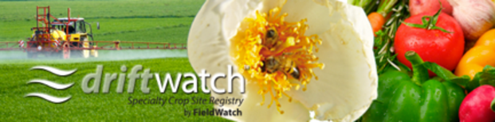

Cooperate and Communicate with Beekeepers
Locate beekeepers in the area and open dialogue before problems
Beekeepers and applicators are strongly encouraged to utilize Driftwatch crop registry to located managed bee colonies
Image source: Coalition for Urban/Rural Environmental Stewardship
Notes:
To protect pollinators, communication is key. The underlying cause of most bee poisoning incidents is a lack of information or awareness, rather than intent to do harm. Most pest management programs can be modified so that little or no be poisoning occurs, without undue cost or inconvenience to the grower. Both beekeepers and pesticide applicators benefit from forming working relationships and familiarizing themselves with each other’s management practices. Good communication will help you avoid problems from occurring.
While participation in Driftwatch through the beehive location registry is voluntary for both beekeepers and pesticide applicators, utilization of this valuable communication tool is critical to success in minimizing potential pesticide exposures to pollinators.

Slide 33
Questions
What has the EPA recently changed with regard to pesticide labels that will help protect pollinators?
  a) The color
  b) Pollinator protection language
  c) Added a bee hazard icon
Notes:
B and C

Slide 34
Questions
What does it mean to have foraging bees on the intended application site?
  You can apply any pesticide when you like
  You can apply non ERT pesticides from dusk until dawn
  You should avoid applying pesticides
Notes:
b) You can apply non ERT pesticides from dusk til dawn

Slide 35
Questions
When are pollinator poisonings most likely to occur?
  Whenever pesticides are used
  Whenever pesticides are sprayed from the air
  When pesticides are applied to crops during the bloom period
Notes:
c. When pesticides are applied to crops during the bloom period

Slide 36
Questions
What additional information might be useful to you when deciding what, where, and when to spray? (indicate all that apply)
  Location of the field
  What was in the field last year
  What is flowering in, around, and downwind of the target field
  Are there any sensitive areas (bee yards, natural areas, etc.) downwind of the target field?
Notes:
A, C, and D

Slide 37
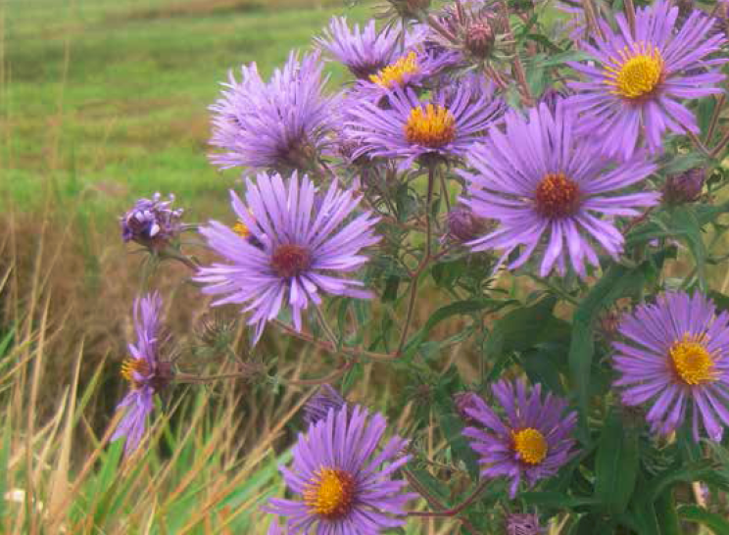
Credit
Resources
This presentation was developed for the Private Applicator Recertification Program, 2015-2017.
By Bill Skelton, Haywood County Cooperative
Extension and Wayne Buhler, NC State Univ.
Indiana Pollinator Protection Plan (P3) Activities, Office of Indiana State Chemist
Pollinators and Pesticide Stewardship. Penn State Pesticide Education Program. extension.psu.edu/pesticide-education
Protecting Pollinators, A Training Module for Certified Pesticide Applicators.
North American Pollinator Protection Campaign.
Photos and Text were extracted from a presentation entitled,
Bees: Protecting our Pollinators.
Marla Spivak, PhD, University of Minnesota.

